Slide 1
Temporally Dense
Ray Tracing
Pontus Andersson, 2019-07-08
with Jim Nilsson, Marco Salvi, Josef Spjut, and Tomas Akenine-Möller
NVIDIA
Notes:
I would like to talk to you about Temporally Dense Ray Tracing. Let us start off with some motivation for the work...

Slide 2
Motivation
Higher frame rates results in
Improved accuracy and target tracking in games
Motion blur reduction
Less perceived aliasing and noise
60 Hz
120 Hz
240 Hz
Notes:
We found out about multiple positive effects of rendering at high frame rates (e.g., 240 FPS).
In competetive video games, for example, we have seen improved accuracy and target tracking.
Due to the higher frame rates, the latency is also reduced, meaning that you can see the enemy before he sees you,
which can be really beneficial.
Additionally, we have seen a reduction in motion blur.
Something we think is really cool is the fact that you perceive less aliasing and noise at these higher frame rates.
Here is an example of that:
We took a tilted quad, rendered it with 1 spp and jittered it with the 4x MSAA pattern. This gave us four different images,
which we showed in succession at different speeds. We took photographs of the quad to emulate what the eye sees.
At 60 Hz, you see crawlies along the edges. At higher frame rates, however, the human visual system starts integrating
the four images, and what we get is an antialiased effect, and can no longer see any crawlies.

Slide 3
An Algorithm for Faster Rendering
Goal: ~4x speedup at iso-quality
1920x1080 on an NVIDIA RTX 2080 Ti:
290 FPS (581k tri, 3 lights)
310 FPS (1M tri, 15 lights)
260 FPS (192k tri, 3 lights)
Notes:
So, our aim is to go from 60 to 240 FPS, without losing quality (or even improving it, if possible).
Here are a few sample images of ours, which were originally rendered with our method at resolution 1920x1080 on an NVIDIA RTX 2080 Ti,
where we used Whitted Ray Tracing, and one shadow ray per light source.
We see that we are able to reach roughly 300 FPS in somewhat complex scenes.
Other bottlenecks become more apparent, however. In the robot scene on the right, where we have a moving object, the bottleneck is the CPU rather than the GPU.
It is worth noting that looking at our images one by one, or even at 60 / 120 FPS, does not do them justice. To see the effects of our algorithm,
the images need to be shown in succession at 240 FPS, on a 240 Hz monitor.
Now, before we explain the algorithm, let us go over some terminology we will be using.

Slide 4
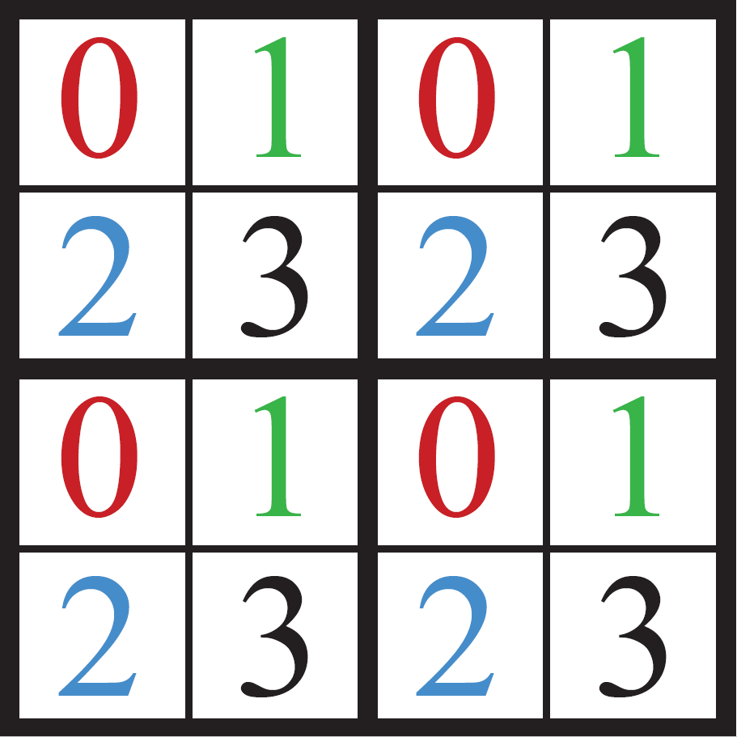
An Algorithm for Faster Rendering
Terminology
Full frame: The full resolution output frame
Tile: 2 × 2 pixels
Subframe: Collection of pixels with the same ordering number

Slide 5
An Algorithm for Faster Rendering
Terminology
Full frame: The full resolution output frame
Tile: 2 × 2 pixels
Subframe: Collection of pixels with the same ordering number
Notes:
To the right is the full frame resolution output frame. We want to show 240 of these per second.

Slide 6
An Algorithm for Faster Rendering
Terminology
Full frame: The full resolution output frame
Tile: 2 × 2 pixels
Subframe: Collection of pixels with the same ordering number
Notes:
We divide the full frame into tiles of 2x2 pixels.
This could be any constellation of pixels (e.g., 3x3), but we chose to use 2x2.
Each tile has a pixel ordering, 0-3.

Slide 7
An Algorithm for Faster Rendering
Terminology
Full frame: The full resolution output frame
Tile: 2 × 2 pixels
Subframe: Collection of pixels with the same ordering number
Notes:
The collection of all pixels with the same ordering number is called a subframe.

Slide 8
An Algorithm for Faster Rendering
Our Approach – First Step (not new)
Raytrace the pixels of one subframe per iteration
→ ¼ samples per pixel in the full frame
Pixels in the latest subframe are new, the others are old
Notes:
The first step of our approach is to raytrace the pixels of a subframe.

Slide 9
An Algorithm for Faster Rendering
Our Approach – First Step (not new)
Raytrace the pixels of one subframe per iteration
→ ¼ samples per pixel in the full frame
Pixels in the latest subframe are new, the others are old
Notes:
These ”new” pixels are then put into the full frame.

Slide 10
An Algorithm for Faster Rendering
Our Approach – First Step (not new)
Raytrace the pixels of one subframe per iteration
→ ¼ samples per pixel in the full frame
Pixels in the latest subframe are new, the others are old
Notes:
The remaining, ”old” pixels are copied from the previous frame.

Slide 11
An Algorithm for Faster Rendering
Our Approach – First Step (not new)
Raytrace the pixels of one subframe per iteration
→ ¼ samples per pixel in the full frame
Pixels in the latest subframe are new, the others are old
Notes:
After raytracing the subframe containing only pixels marked with ”0”, we raytrace the subframe with pixels marked with ”1”, and copy them to the full frame.

Slide 12
An Algorithm for Faster Rendering
Our Approach – First Step (not new)
Raytrace the pixels of one subframe per iteration
→ ¼ samples per pixel in the full frame
Pixels in the latest subframe are new, the others are old
Notes:
Again, the three old pixels are copied from the previous frame.

Slide 13
An Algorithm for Faster Rendering
Our Approach – First Step (not new)
Raytrace the pixels of one subframe per iteration
→ ¼ samples per pixel in the full frame
Pixels in the latest subframe are new, the others are old
Notes:
... And we continue like that until we have generated samples for each pixel in the tile.

Slide 14
An Algorithm for Faster Rendering
Our Approach – First Step (not new)
Raytrace the pixels of one subframe per iteration
→ ¼ samples per pixel in the full frame
Pixels in the latest subframe are new, the others are old
Notes:
... And then repeat.

Slide 15
An Algorithm for Faster Rendering
Our Approach – First Step (not new)
¼ samples per pixel per frame
Works fine when no movement
Disturbing during motion, even at 240 FPS
Notes:
The results with this initial approach are not great. While it does work fine when there’s no movement,
one can see grainy artifacts during motion, which are disturbing even at 240 FPS.
In this example, the movement is horizontal.
Let us see if we can improve on this.

Slide 16
Improving the Perceptual Experience
Our Approach
Process all pixels in the final frame
Consider static/dynamic pixels separately
If static: average
If dynamic:
Copy new pixels from subframe to full frame
Reproject and clamp old pixels, similar to TAA without exponential average
Notes:
We will now process all pixels in the final frame.
We consider pixels with static and dynamic content separately.
Static pixels are averaged.
For the dynamic pixels, we deal with new and old pixels differently.
New pixels are recently raytraced, and thus contain up-to-date information. We copy them directly to the final frame,
in the same fashion as previously.
Old pixels are reprojected and clamped, similar to TAA, but without the exponential average. We remove the exponential
average as it resulted in rather significant ghosting.
The clamping used in TAA is usually done by taking samples from a neighborhood around the pixel that should be clamped,
and using them to create a color box to which the pixel is clamped. However, there are multiple possible neighborhoods to choose from.

Slide 17
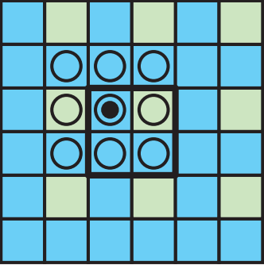
Improving the Perceptual Experience
Dynamic, Old Pixels – Clamp Footprint
Reproject and clamp old pixels
Old pixels are blue, new pixels are green
Current pixel marked with bullet, pixels used in footprint marked with circles
Three alternatives:
Immediate neighbors
Notes:
Consider the full frame to the right. New pixels are marked green, while old pixels are marked blue.
We want to clamp one of the old pixels. In particular, the one marked with a bullet.
The pixels we use to create the color box are marked with circles.
Here is one possible choice of neighborhood. All pixels are close in space, but many are old.

Slide 18
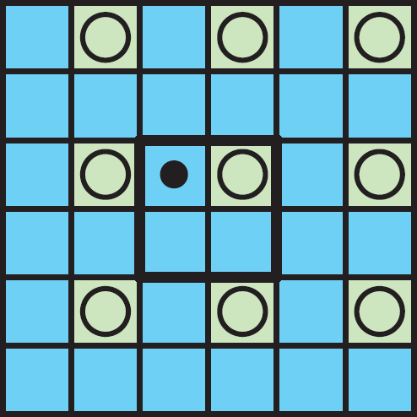
Improving the Perceptual Experience
Dynamic, Old Pixels – Clamp Footprint
Reproject and clamp old pixels
Old pixels are blue, new pixels are green
Current pixel marked with bullet, pixels used in footprint marked with circles
Three alternatives:
Immediate neighbors
3x3 area in newest subframe
Notes:
Another way to do it would be to use the closest, new pixels. These are rather far apart in space, though.

Slide 19
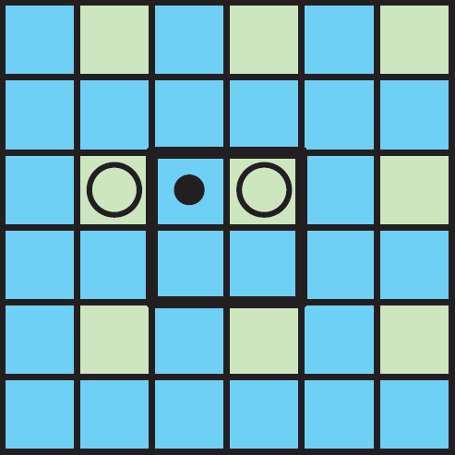
Improving the Perceptual Experience
Dynamic, Old Pixels – Clamp Footprint
Reproject and clamp old pixels
Old pixels are blue, new pixels are green
Current pixel marked with bullet, pixels used in footprint marked with circles
Three alternatives:
Immediate neighbors
3x3 area in newest subframe
Ours: immediate and new neighbors
Notes:
A third alternative, which is the one we use, is to only use the immediate and new neighbors.

Slide 20
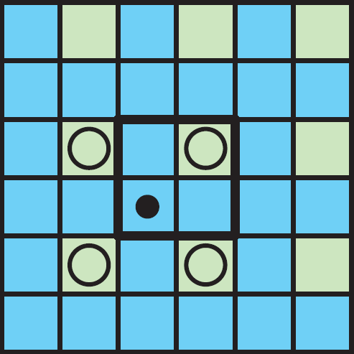
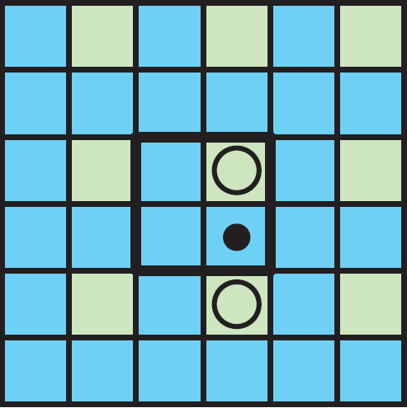
Improving the Perceptual Experience
Dynamic, Old Pixels – Clamp Footprint
Notes:
With our method, we sometimes use two and sometimes four samples to create our color box,
depending on which pixel is being clamped, and which adjacent pixels are new.

Slide 21
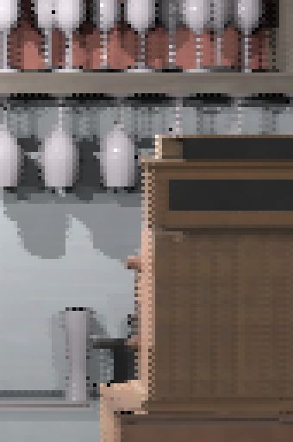
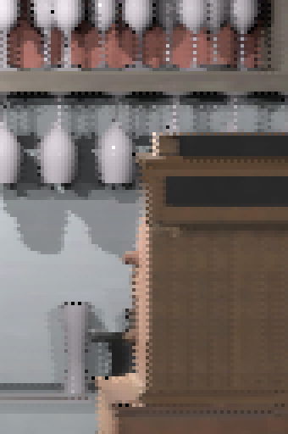
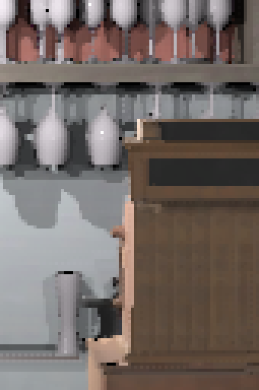
Improving the Perceptual Experience
Dynamic, Old Pixels – Clamp Footprint
Immediate neighbors
3x3 area in newest subframe
Ours
Notes:
Here are frames generated with the three footprint alternatives. We see how the two on the left, which use more samples in
their footprints, result in frames with a lot more fringes. Again, note that the results will not look the same at 240 FPS, but some of the arificats will still be noticeable.
With our method, the fringes are reduced, but, with the reduction in fringes, we started seeing more aliasing in the form of flickering. Next, we will present a way to combat this.

Slide 22
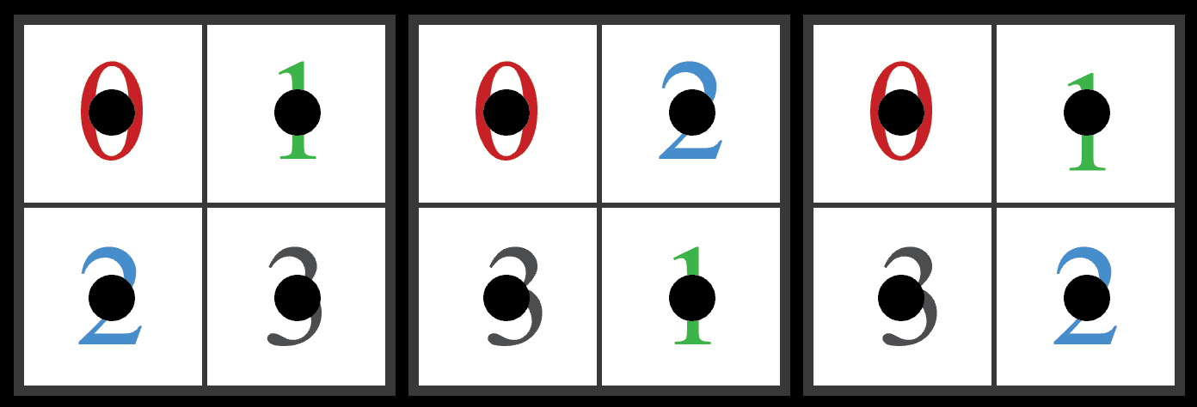
Adaptive Pixel Ordering Selection
Pixel Ordering Makes all the Difference!
4! = 24 possible pixel orderings
Three basic shapes:
Hourglass
Bowtie
Square (no benefit)
Our most interesting result!
Hourglass
Bowtie
Square
Notes:
Remember the pixel ordering within each tile? We found that this ordering matters greatly in reducing the flickering.
Looking more closely at it, we see that, with a 2x2 tile, there are 24 different, possible orderings.
We can reduce them to three basic shapes, which we call the hourglass, the bowtie and the square.
Looking at the far left tile, for example, we see that if we first trace the pixel marked with a ”0”, then the one with a ”1”, and so on,
the hourglass pattern arises.
Similarly, we get the bowtie and the square.
While the hourglass and bowtie both showed interesting results, the square didn’t really provide any benefit over the other two, so we chose to focus on those.
The discovery that the pixel ordering made a large difference is probably our most interesting finding!

Slide 23
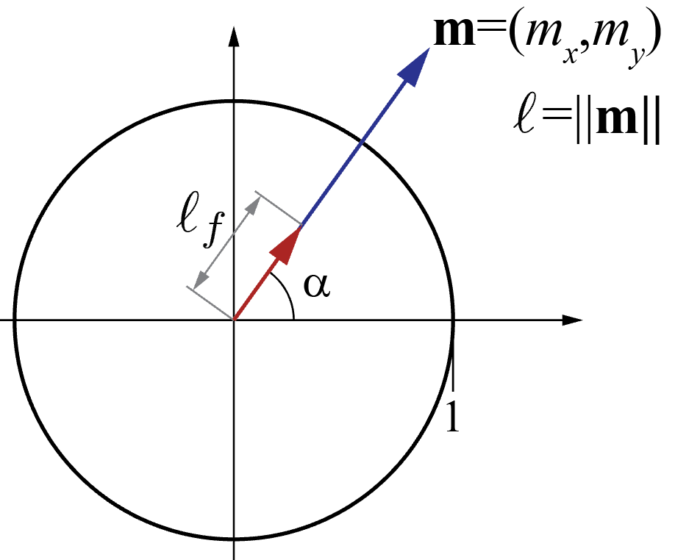
Adaptive Pixel Ordering Selection
Our Approach
Decision is a function of motion and pixel neighborhood contents
We narrow it down to pixel motion:
direction 𝛼 and
length’s fraction part ℓ_{f}
Horizontal motion (𝛼 = 0): Vertical motion (𝛼 = π/2):
Notes:
With that knowledge, the question becomes: How do we choose between the hourglass and the bowtie?
We believe the decision to be a function of motion and pixel neighborhood contents, such as edges.
However, we narrow the decision down to pixel motion. In particular,
we use the motion direction, and the fractional part of the motion vector’s length.
Our tests suggested that the fractional part was preferable over the full length, which was why we used it.
We started investigating horizontal motion. Here, we found that it worked well to use the hourglass pattern when the
fractional part of the motion vector’s length was between one quarter and three quarters, and the bowtie otherwise.
For vertical motion, we simply flipped the decision.

Slide 24
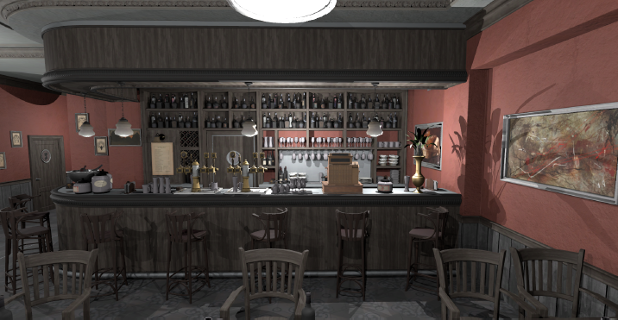
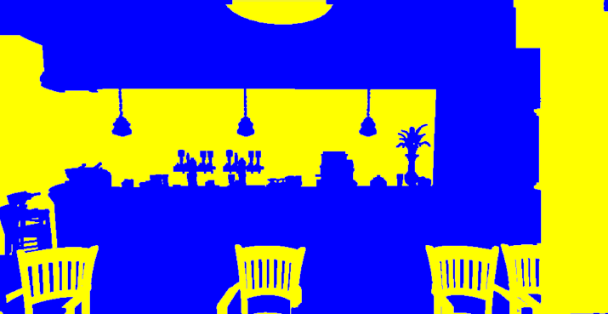
Adaptive Pixel Ordering Selection
Pixel Ordering Makes all the Difference!
Horizontal motion (𝛼 = 0):
Pixel ordering decision –
yellow = hourglass,
blue = bowtie
Notes:
Here is an example where we have horizontal camera motion in a static scene.
On the right, we show the tiles of the scene in which we choose to use the hourglass pattern (yellow) and the bowtie pattern (blue),
given the decision function we just set up.
Had we, for example, only used the hourglass pattern here, things on the bar counter would flicker, but not the glasses on the shelves in the back.
On the other hand, if we had only used the bowtie pattern, we would instead see flickering on the glasses in the back, but not on the bar counter.
With our decision function, we choose the correct pattern in both cases, and thus avoid significant flicker.

Slide 25
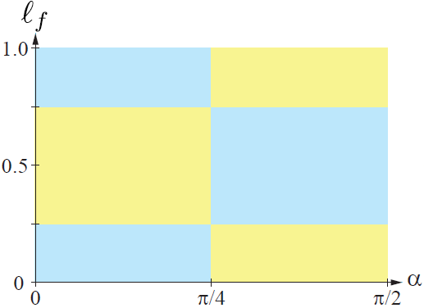
Adaptive Pixel Ordering Selection
Our Approach
How about 𝛼 𝜖 (0, π/2)?
Transition between the two extremes
yellow = hourglass, blue = bowtie
Notes:
Now, let’s consider all the motion directions that are not strictly horizontal nor vertical.
On the right, we have the decision function’s graph with the motion direction on the x-axis, and the fractional part of the motion vector’s length on the y-axis.
Yellow indicates that we choose the hourglass pattern, while blue indicates that we choose the bowtie pattern, given the motion direction and the
fractional part of the motion vector’s length.
So far, with the horizontal (alpha = 0) and vertical (alpha = pi/2) decision functions we proposed earlier, we have set the boundary conditions of our full decision function.
We now need to fill in the remainder of the function.
This can be done in infinitely many ways. We will look at four alternatives.

Slide 26
Adaptive Pixel Ordering Selection
Our Approach
How about 𝛼 𝜖 (0, π/2)?
Transition between the two extremes
Dominant motion direction
yellow = hourglass, blue = bowtie
Notes:
The first alternative is to switch between the two based on the dominant motion direction, i.e., we use the horizontal decision function until the direction is pi/4,
At which point we have more vertical than horizontal motion, and therefore use the vertical decision function instead.
Note that this satisfies the boundary conditions.

Slide 27
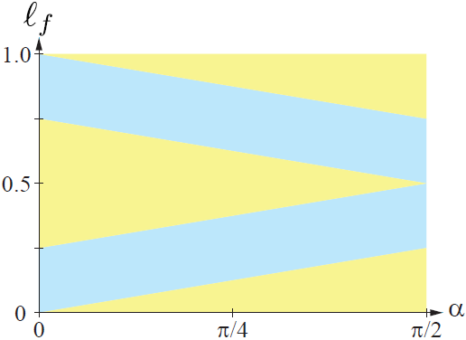
Adaptive Pixel Ordering Selection
Our Approach
How about 𝛼 𝜖 (0, π/2)?
Transition between the two extremes
Dominant motion direction
Continuous transition #1
yellow = hourglass, blue = bowtie
Notes:
Another way to do it would be to have a more continuous transition, like this one.

Slide 28
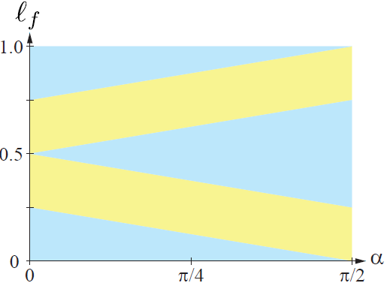
Adaptive Pixel Ordering Selection
Our Approach
How about 𝛼 𝜖 (0, π/2)?
Transition between the two extremes
Dominant motion direction
Continuous transition #1
Continuous transition #2
yellow = hourglass, blue = bowtie
Notes:
... Or this one.
We noticed that these both performed well at different parts in the range of directions between 0 and pi / 2.
Close to pi / 4, however, neither worked very well, and neither did the dominant motion solution. We still saw a lot of flickering for those motions.
Our idea to combat this was to randomize the pattern choice for those direction, thus reducing the structure of the image.
This introduced some grainy artifacts, but also reduced the perceived flickering, and improved the perceptual experience overall.

Slide 29
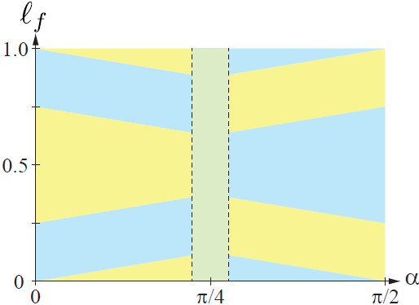
Adaptive Pixel Ordering Selection
Our Approach
How about 𝛼 𝜖 (0, π/2)?
Transition between the two extremes
Dominant motion direction
Continuous transition #1
Continuous transition #2
Ours: Combo of #1 & #2, w/ random Why random? Removes structure
yellow = hourglass, blue = bowtie
green = random
Notes:
In summary, the final decision function we used was the one shown on the right here,
where green implies that we choose randomly between the hourglass and the bowtie pattern.
There is a lot of possible future work to be done on this selection.
It would, for example, be interesting to see how well a neural network would be able to choose between the patterns.
Additionally, the results could possibly be improved upon with other constellations of tiles, e.g., 3x3 or 4x4 pixels.

Slide 30
Results
General
Similar or better than 1 spp @ 60 FPS
User study: 94% of subjects preferred our technique over 1 spp @ 60 FPS
TAA @ 60 FPS smoother, but substantially more blurry
Notes:
However, with the algorithm we proposed, we were able to produce results which, at 240 FPS, looked similar to, or better, than full frame renderings at 60 FPS.
This was confirmed with a user study, in which 35 subjects participated. 94% of the subjects thought our results looked more similar to
a ground truth sequence of high spp renderings, shown at 240 FPS, than the 1 spp image sequence, shown at 60 FPS, did.
We also looked at TAA at 60 FPS, and compared it to our results. The TAA results were smoother, but also substantially more blurry. Which one is preferable is a matter of taste!
We would love to show you more results now, but we can’t! However...

Slide 31
Results
Experience our Results
Live demo during the poster session
Experience the magic at:
240hz.org
Notes:
... We have brought a 240 Hz monitor here, and will set it up to show you a demo during the poster session tomorrow.
Should you wish to experience the magic yourself, and have access to a 240 Hz monitor, please visit our website: 240hz.org.
Thank you!

Slide 33
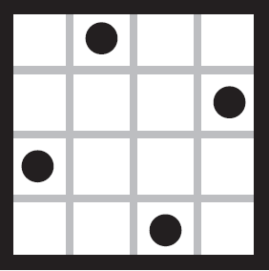
BACKUP: Improving the Perceptual Experience
Our Approach – Static Pixels
Moving window average while static
4x SSAA
Static/Dynamic decision done per pixel

