Slide 1
Dynamic Many-Light Sampling for Real-Time Ray Tracing
Pierre Moreau ^{1,2}, Matt Pharr ¹ and Petrik Clarberg ¹ ¹ NVIDIA, ² Lund University

Slide 2
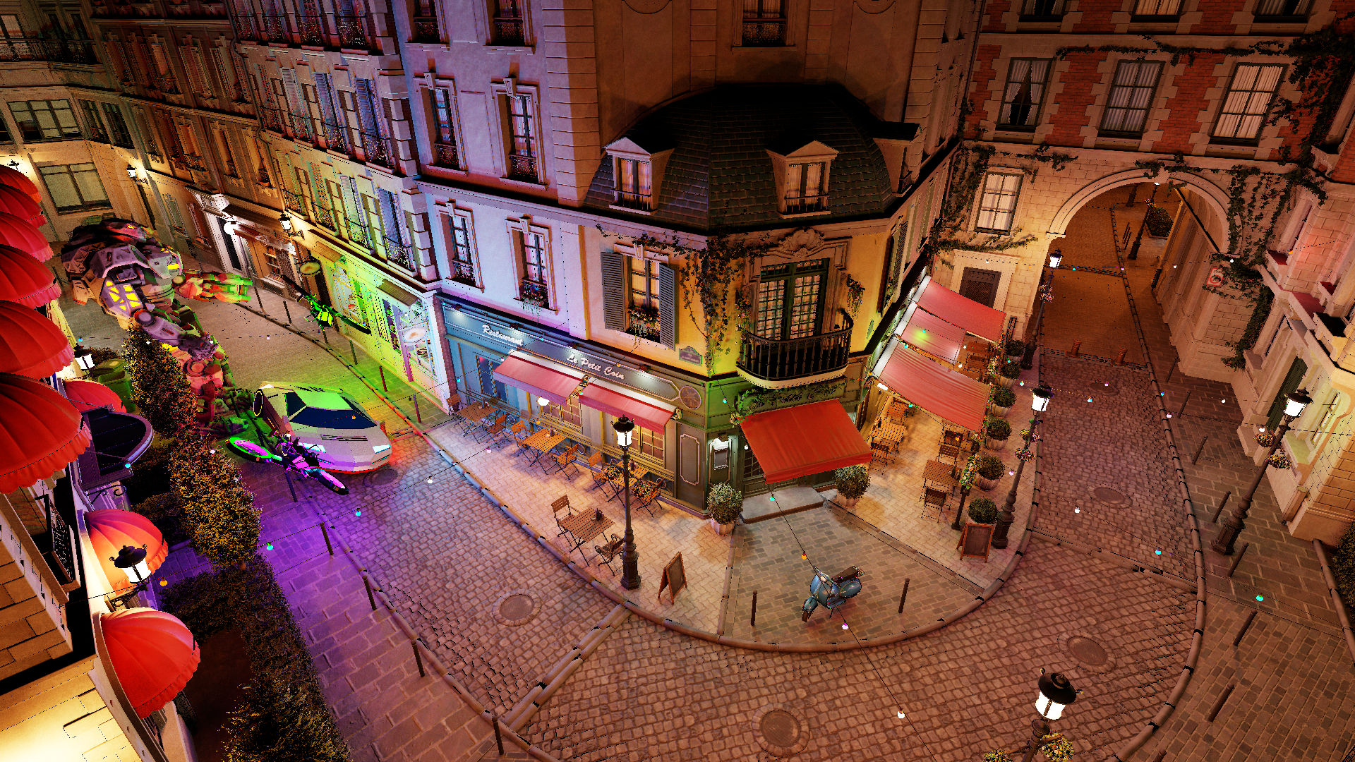
Still from the Bistro Exterior animation
Only direct illumination

Slide 3
Reference Animation in Bistro Exterior

Slide 4
Previous Work: Overview
 | Approximate Methods | Unbiased Methods
Consistent | ✗ | ✓
Area lights | ✗ | ✓
Light leakage-free | ✗ | ✓
Cheap | ✓ | ✗
Notes:
Example of approximate methods: VPLs, setting a region of influence per light & computing which pixels are affected
Example of unbiased methods: importance sampling
Linearly Transformed Cosines by Heitz et al. can be used with an approximate method to cheaply compute area lights contribution, however visibility evaluation remains.

Slide 5
Light Importance Sampling
Vévoda2016, ContyEstévez2018
Dynamic PDFs per cluster or shading point
Adapts to dynamic scenes
Log scaling with number of light sources, from light hierarchy
Supports mesh, point and analytic lights
Notes:
Recent work made light importance sampling more dynamic, scalable, and interesting for real-time applications (see our Ray Tracing Gems article: Importance Sampling of Many Lights on the GPU)

Slide 6
Contributions
Organise light sources in multiple BVHs, arranged in a 2-level hierarchy
Top-level light BVH: cheap, good for large motions
Refitting light BVHs on GPU: efficient, good for small motion
Notes:
For refit operation:
* Maintain the topology
* Recompute each AABB against the latest content
* Recompute each orientation cone
* Recompute the emitted flux

Slide 7
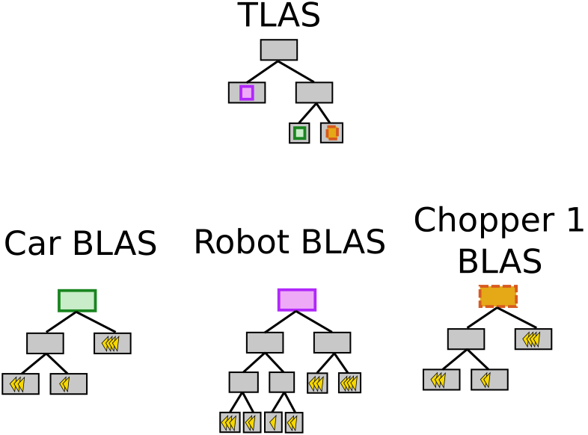
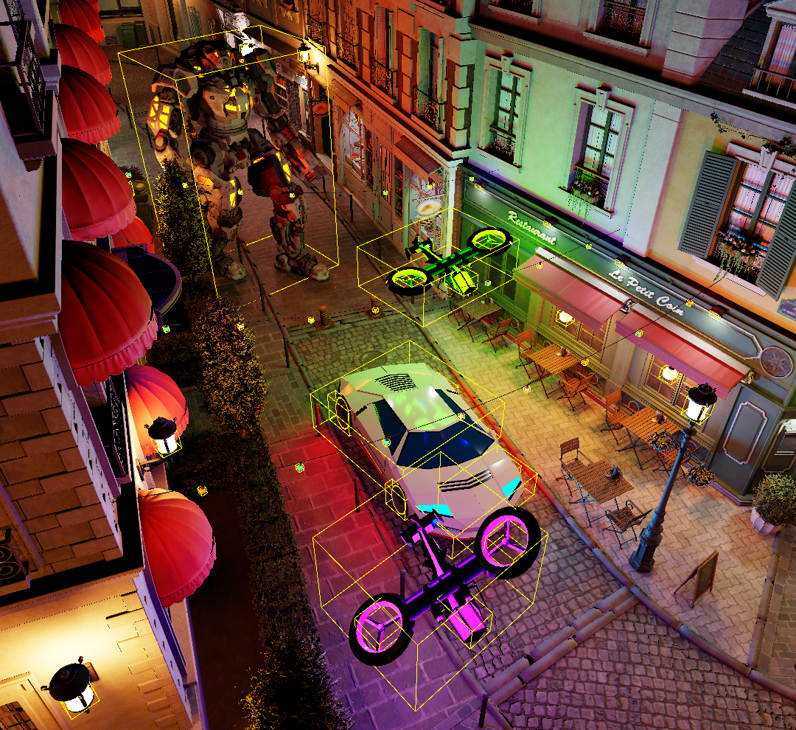
2-Level Light BVH
TLAS: top-level acceleration structure BLAS: bottom-level acceleration structure
Notes:
1 emissive mesh -> 1 BLAS

Slide 8
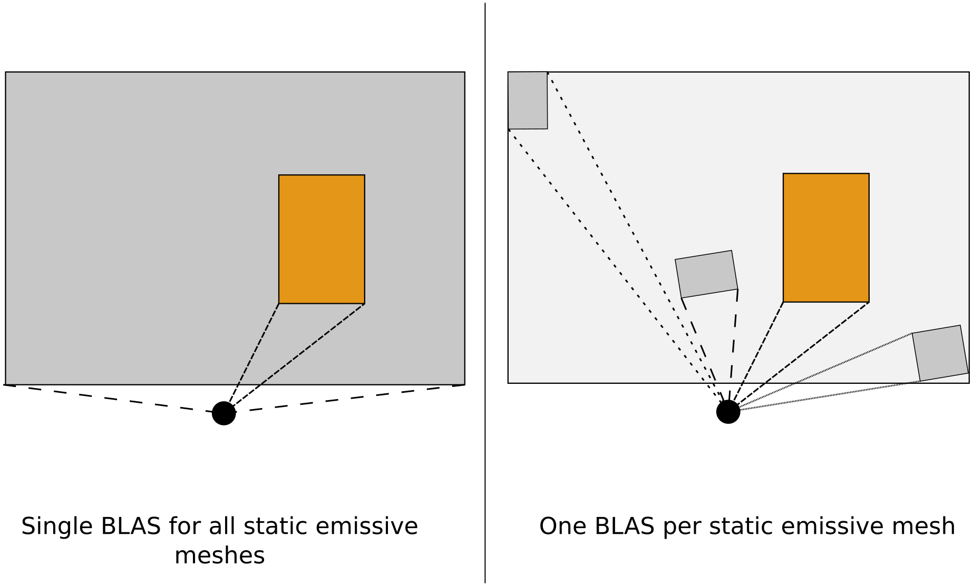
2-Level Light BVH
No single BLAS for static emissive meshes
Static BLAS
Dynamic BLAS
Static BLASes
Dynamic BLAS
Shading point
Shading point
Notes:
Geometry vs light 2-level BVH:
|-> For static primitives, single BLAS recommended for geometry BVH:
- Better perf for geometry BVH, no difference for light BVH
- Worse sampling in BLAS for light BVH
- Smaller TLAS for both

Slide 9
2-level light BVH updates
Each frame
BLAS Refit
Refit every BLAS that needs it
Refit the TLAS before use
Update all leaf nodes
Update all internal nodes at depth: tree_heigh – 1
Iteratively update remaining internal nodes, bottom to top
Notes:
Limited large movements in BLAS -> always refit
Large movements in TLAS possible but rebuild is cheap -> always rebuild
Refitting the BLASes and TLAS could be run asynchronously, while the G-buffer is being built for example.

Slide 10
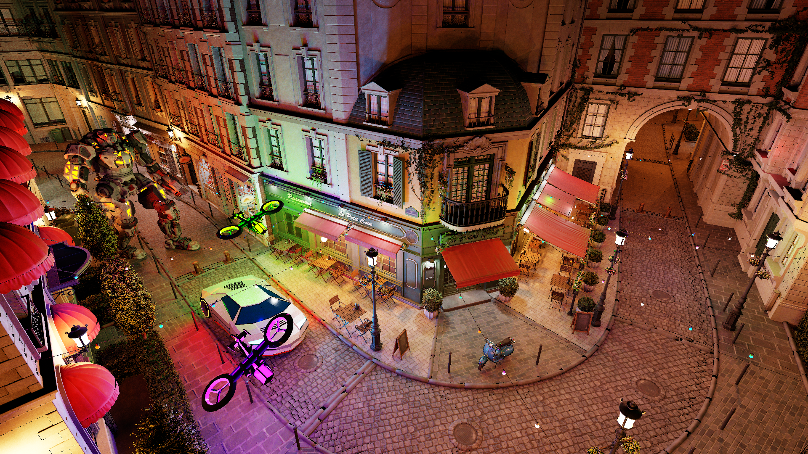
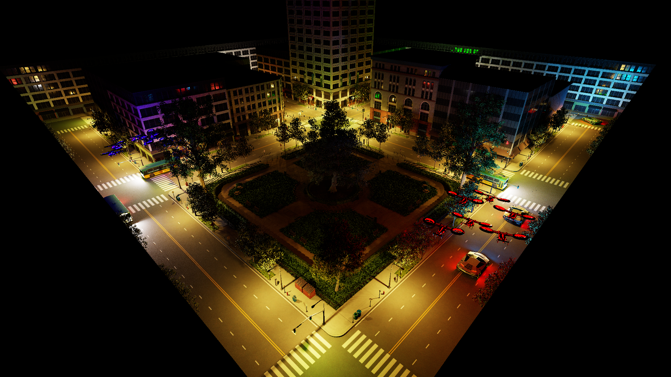
Results
Scenes information
 | Bistro Exterior | Emerald Square
Static emissive triangles | 20k | 19k
Dynamic emissive triangles | 6k | 66k
Total triangles | 3m | 10m

Slide 11
N-Level BVH Comparison
Sampling results after large amount of light movement
1-level BVH, 4 spp
Refitted every frame
2-level BVH, 4 spp
Every frame, TLAS rebuilt and BLASes refitted
Reference

Slide 12
Quality And Performance Results
Time [ms]
Time [ms]

Slide 13
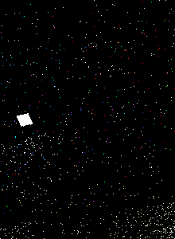
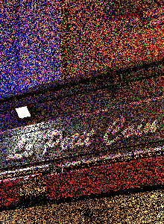
Filtered Results
Comparison with Uniform Sampling
Uniform sampling
1 spp
Uniform with SVGF
1 spp, 5 accum. frames
2-level BVH
1 spp
2-level with SVGF
1 spp, 5 accum. frames
Reference

Slide 14
Summary
Contributions
Light sources: multiple BVHs, 2-level hierarchy
Refitting light BVHs: efficient, small motions
Top-level light BVH: cheap, large motions
Future Work
Detect: rebuild >>> refit
Use light visibility information
Reuse previous frame(s) light samples
Take-Away
Light BVH benefits from geometry BVH improvements
2-level light BVH: quality of 1-level rebuild & speed of 1-level refit
Source code will be part of Falcor 4.0, to be released around October 2019
https://github.com/NVIDIAGameWorks/Falcor

Slide 16
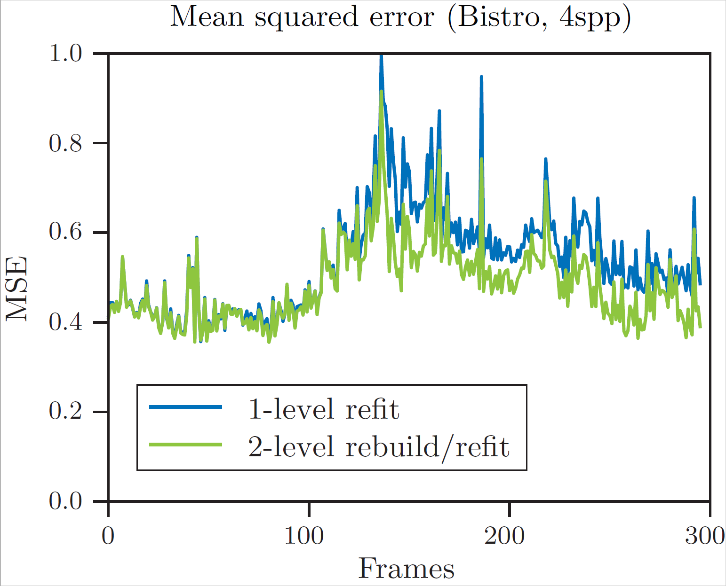
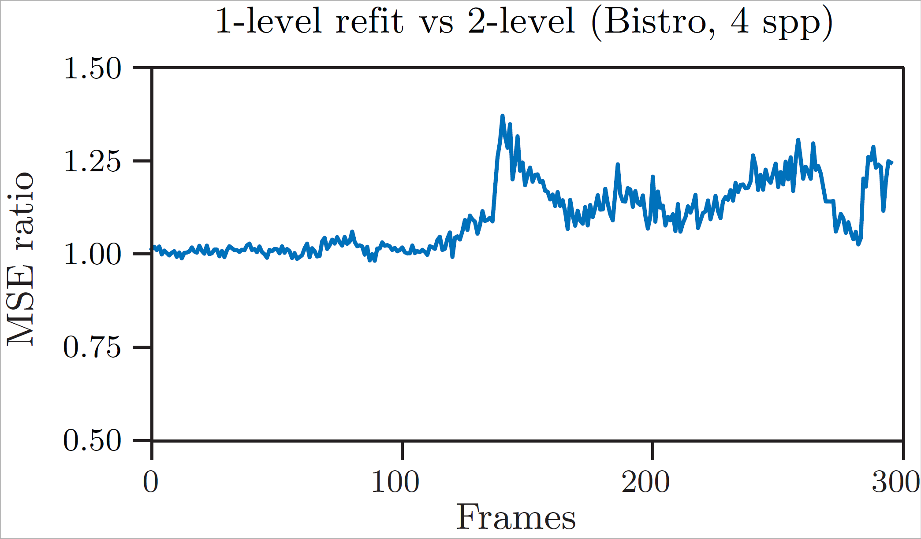
N-Level BVH comparison Over Time

Slide 17
Results
Uniform vs 1-level (rebuilt) at equal time
Uniform: 20 spp, 39.7 ms
DFBO: 6 spp, 41.8 ms
Reference

Slide 18
Results in Bistro Exterior
 | Uniform | One-level (rebuild) | One-Level (refit) | Two-level (rebuild/refit)
BVH update time (ms) | 0 | ~90 | 0.17 | 0.85/0.18
Sampling time (ms) | 0.34 | 2.3 | 2.4 | 2.6
Total time (ms) | 6.2 | 101 | 10.8 | 12.0
MSE | 16.5 | 1.56 | 1.95 | 1.65
MC efficiency ε | 0.0097 | 0.0064 | 0.048 | 0.050
Ε w.r.t. uniform | 1x | 0.66x | 4.9x | 5.2x

Slide 19
Results in Emerald Square
 | Uniform | One-level (rebuild) | One-Level (refit) | Two-level (rebuild/refit)
BVH update time (ms) | 0 | ~300 | 0.22 | 0.89/0.35
Sampling time (ms) | 0.32 | 2.0 | 2.0 | 2.2
Total time (ms) | 7.7 | 311 | 11.3 | 12.6
MSE | 20 | 0.58 | 0.67 | 0.61
MC efficiency ε | 0.0065 | 0.0055 | 0.132 | 0.130
Ε w.r.t. uniform | 1x | 0.85x | 20.3x | 20.1x

Slide 20
Filtered Results
In motion closeup
Notes:
Top-left shows a region where we get a close result to the reference, including the red-ish tint emitted by the robot.
Most shadows are missing (see bottom-left and top-right); might come from SVGF blurring those out, or from the input (we only have 4spp per frame to sample 25k emissive triangles!).
Light ghosting visible in bottom right.

