Slide 1
An Analysis of Region Clustered BVH Volume Rendering on GPU
David Ganter¹ and Michael Manzke²
School of Computer Science and Statistics
Trinity College Dublin
Ireland
¹ganterd@scss.tcd.ie
²manzkem@scss.tcd.ie

Slide 2
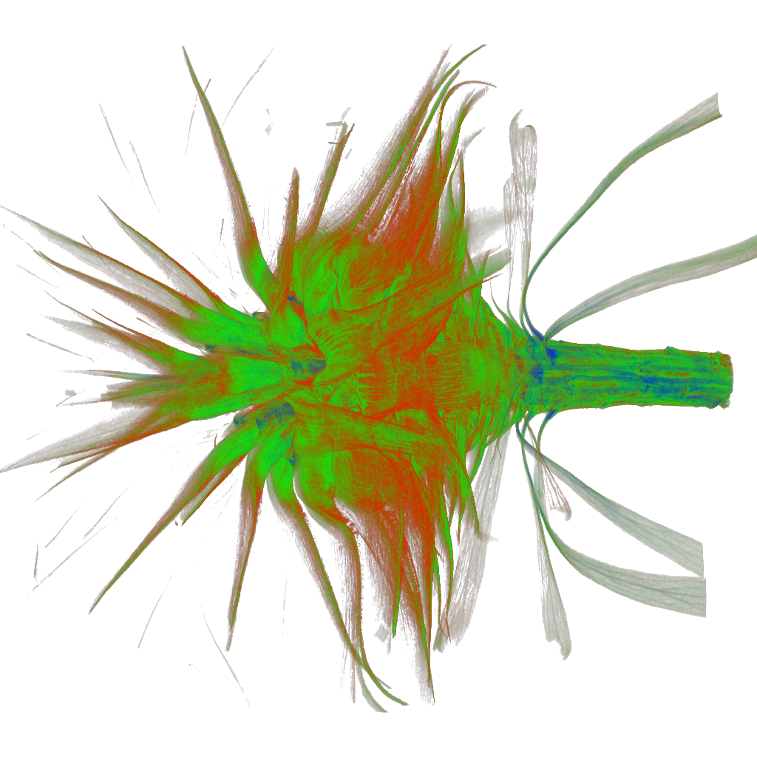
Direct Volume Rendering Applications
Medical
3D MRI Scans
Scientific
Acquired Data
Simulations

Slide 3
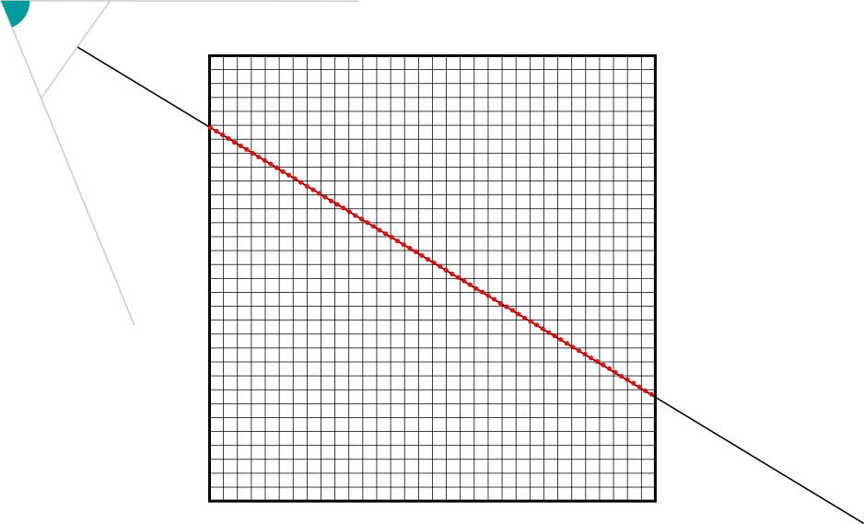
Direct Volume Rendering Background
In this work we consider 'volumes' to be regular 3D grids of discrete scalar data volume elements (voxel)
Volume is resampled by ray at regular intervals
Scalar value is translated to colour and opacity by a transfer function
In our case this is a 1D Look-up-table
Ray can be traversed front-to-back or back-to-front using either under or over compositing operator

Slide 4
Direct Volume Rendering Optimisations
Early Ray Termination (ERT)
Once an opacity threshold is reached, stop sampling ray
Empty Space Skipping (ESS)
Regions of the volume that don’t translate to any opacity don’t need to be sampled

Slide 5
Direct Volume Rendering Empty Space Skipping (ESS)
In Essence
Divide volume into regions of the same size
If any voxels in region have opacity greater than zero, region is considered active
If region is inactive, the ray can skip over the empty space to avoid sampling non-contributing data

Slide 6
Background GPU Based ESS
Octrees are popular
Regions – or bricks – make up octree leaves
Inner nodes marked as active/inactive based on leaves
Ray traverses from top down
Inner nodes can be skipped
But:
Fine-grained regions = deeper octrees = potentially more expensive traversal
Especially with sparse or thin strands of voxels

Slide 7
Background Sparseleap (Hadwiger et al 2018)
Uses octree to generate “occupancy geometry” on CPU when TF updates
Geometry is rasterized on GPU in front-to-back order
Gives a list of per-ray entry-exit events
Events can be merged on the fly if criteria are met
Ray traversal now just uses entry-exit event list
But:
Occupancy geometry is still tied to octree subdivision bounds
Occupancy geometry needs to be rasterised when camera moves

Slide 8
Background Bounding Volume Hierarchies
Can represent sparse or thin strands of data with less nodes
Less nodes can equate to less traversal for ESS
Traditionally suited to continuous space data like polys (i.e. not on a regular grid like voxels)
Have not been traditionally used in GPU DVR, partly due to build times, partly to traversal logic

Slide 9
Background BVH in Direct Volume Rendering
CPU
Knoll et al. 2011 (and subsequent work)
Used BVH on CPU for full-resolution direct volume rendering
GPU
?

Slide 10
Background NVidia OptiX & RTX
OptiX
Ray-tracing API
RTX RTCore
New hardware for Ray-BVH logic
Why not re-evaluate BVHs as a standard for GPU-based ESS for Direct Volume Rendering?

Slide 11
Approach Assumptions
Like Sparseleap:
Just focussing on ESS portion of DVR
Underlying sampling is abstracted
Uses paged region/brick pool
Sampling brick size is not necessarily same as ESS region size
Might be optimised for disk IO or cache
Notes:
Unclustered results

Slide 12
Approach
Divide volume into regions, storing min/max voxel values
When TF updates, regions are quickly tested in parallel.
Now we have an array of active/inactive regions (can be stored as bit-string)
Spatial bounds of active regions are given to OptiX as AABBs
Tell OptiX to ray-trace

Slide 13
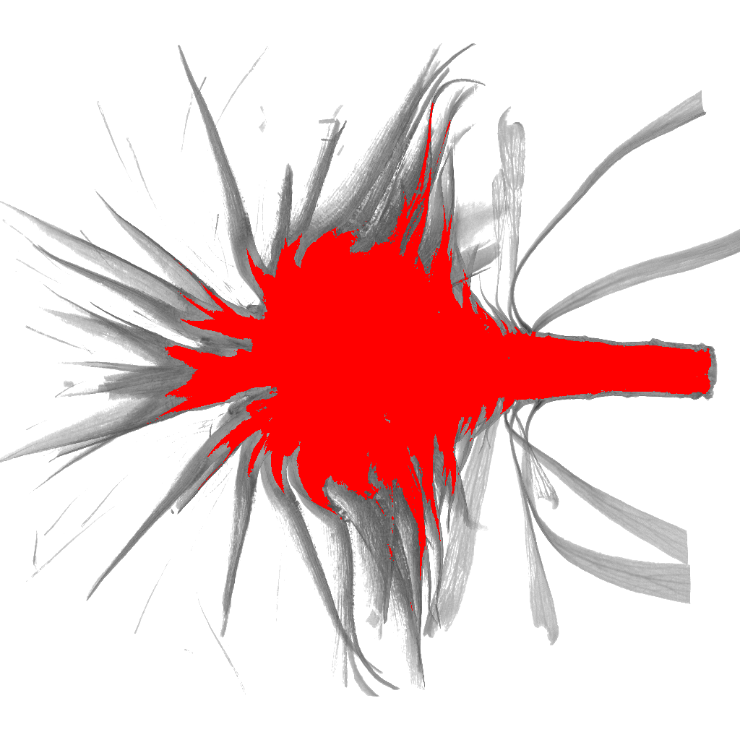
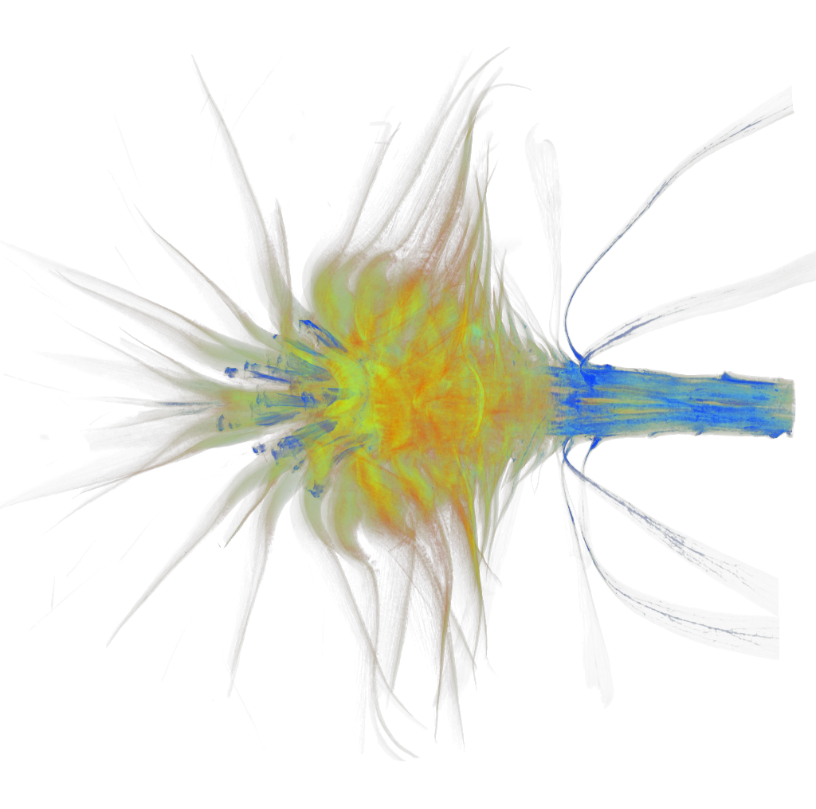
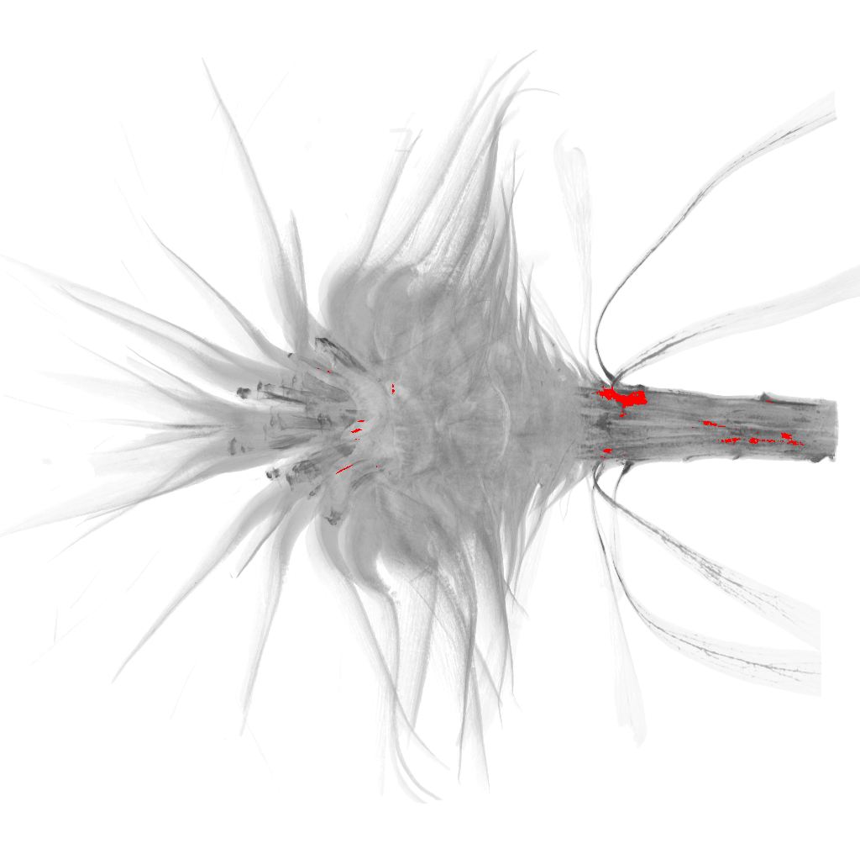
Experiment Data

Slide 14
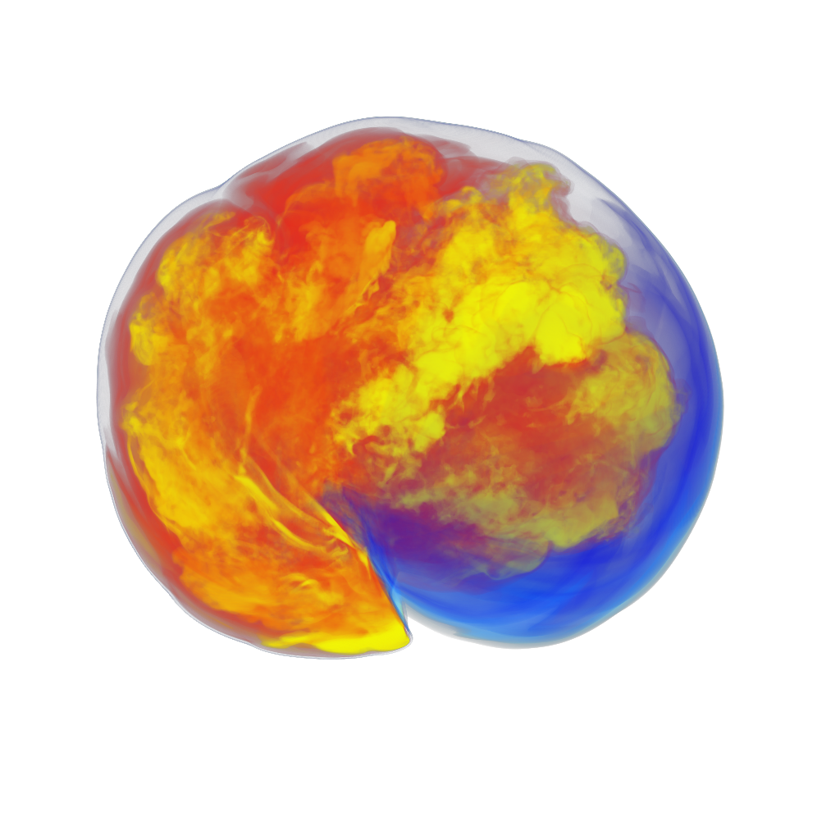
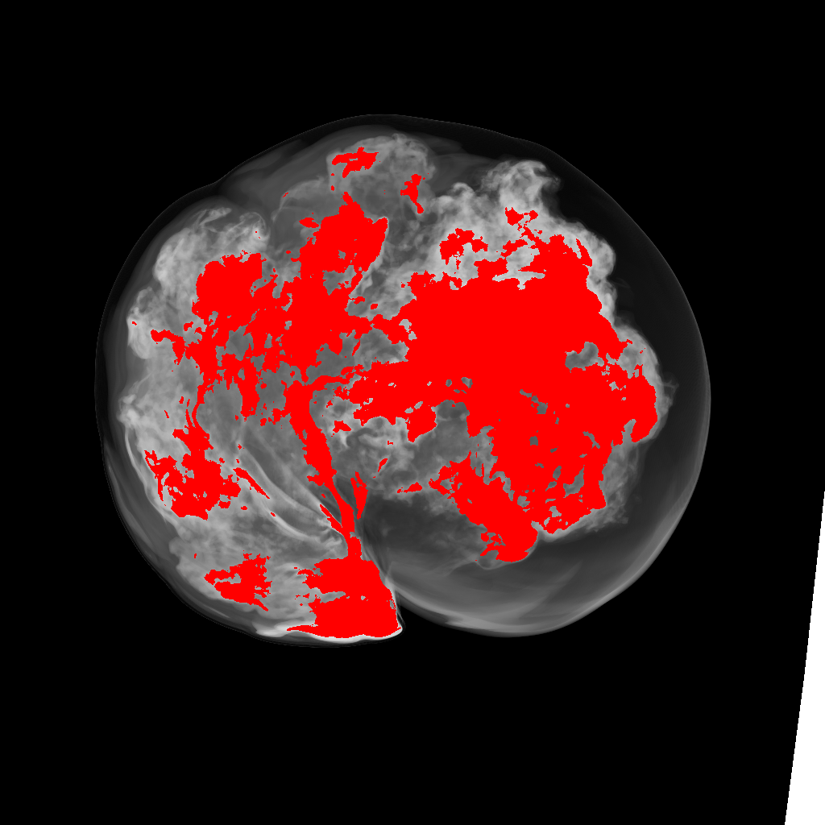
Experiment Data

Slide 15
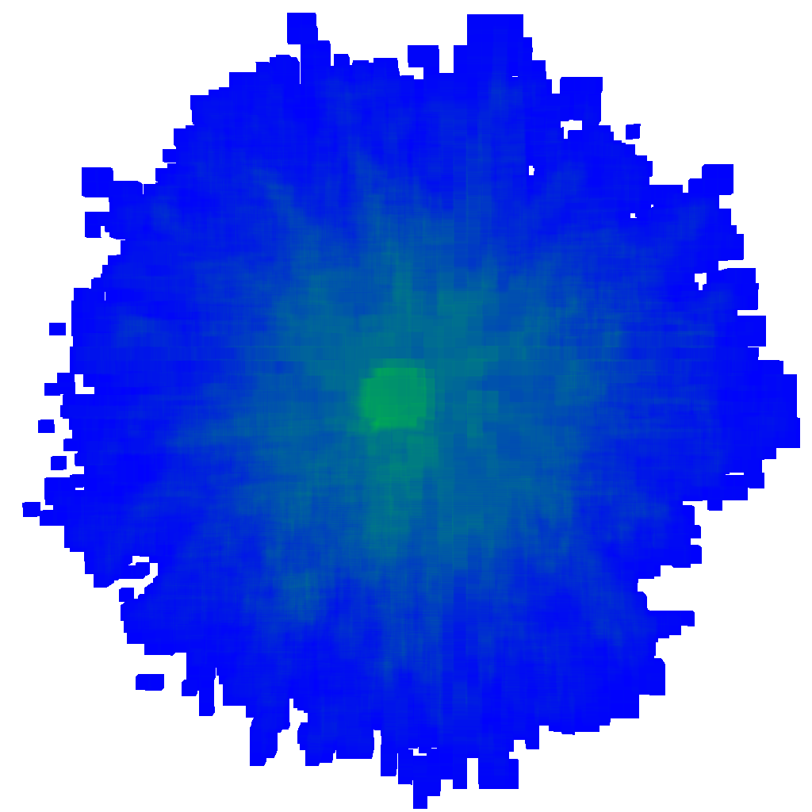
Observation Depth Complexity

Slide 16
Observation Depth Complexity

Slide 17
Clustering Approach
Many contiguous groups of active regions
Many regions share borders, needlessly subdividing the space in the BVH
We cluster cube-shabed groups of active regions (2x2x2, 3x3x3, 4x4x4 regions, etc)
Prefer to cluster the largest regions first
How can we do this efficiently on CPU before giving AABBs to OptiX?

Slide 18
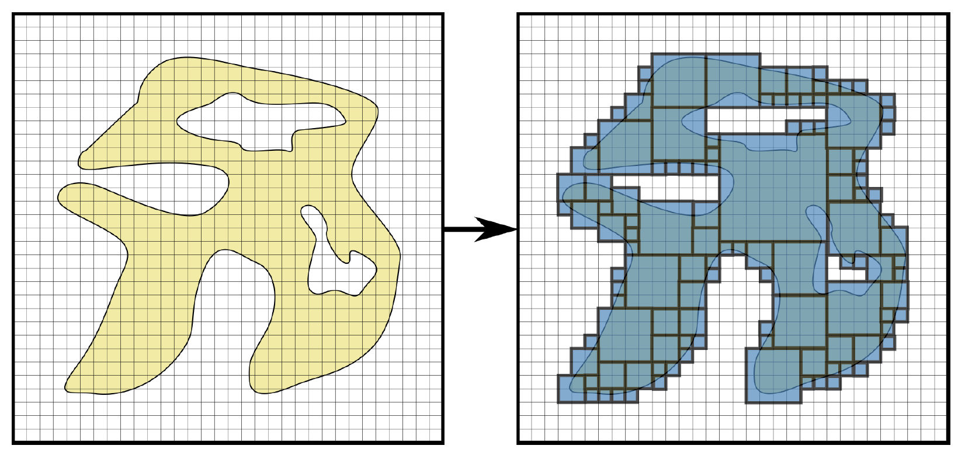
Clustering Approach 3D Summed Area Table (3DSAT)
Sweep across the active regions array searching for groups of completely active regions
If considered as a 3D array of active/inactive flags (0/1) we create a 3D summed area table, adding 1 to the sum for every active region.
Example: a cluster of 3x3x3 active regions will have a summed-area of 27
3DSAT allows us to query how many active regions in an area with 8 lookups.
Keep another bit-string that represents currently clustered regions (regions that have already been added to a cluster)
Sweep in descending order of cluster size (64³, 63³, 62³, etc)

Slide 19
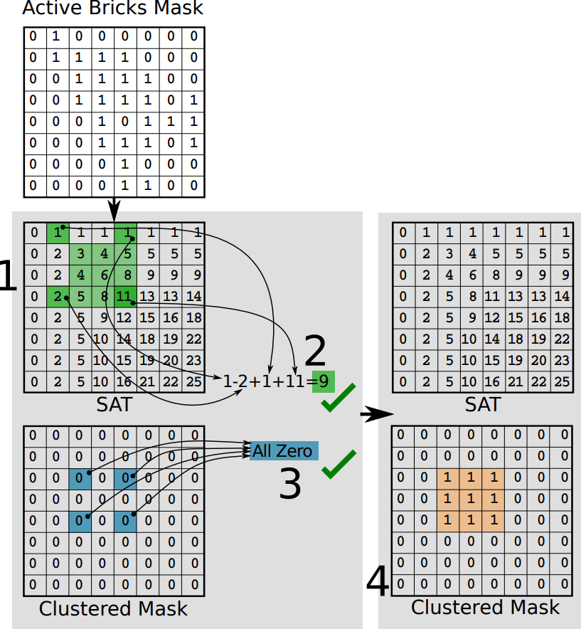
Clustering Approach 3D Summed Area Table (3DSAT)
-

Slide 20
Clustering Approach Depth Complexity

Slide 21
Clustering Approach Depth Complexity

Slide 22
Approach
Divide volume into regions, storing min/max voxel values
When TF updates, regions are quickly tested in parallel.
Now we have an array of active/inactive regions (can be stored as bit-string)
Clustering
Spatial bounds of active regions are given to OptiX as AABBs
Tell OptiX to ray-trace

Slide 23
Experiment System
CPU
Intel Xeon E5-1620 v2
GPU
Nvidia RTX2080

Slide 24
Results Clustering vs No Clustering

Slide 25
Results Sparseleap vs OptiX Cluster

Slide 26
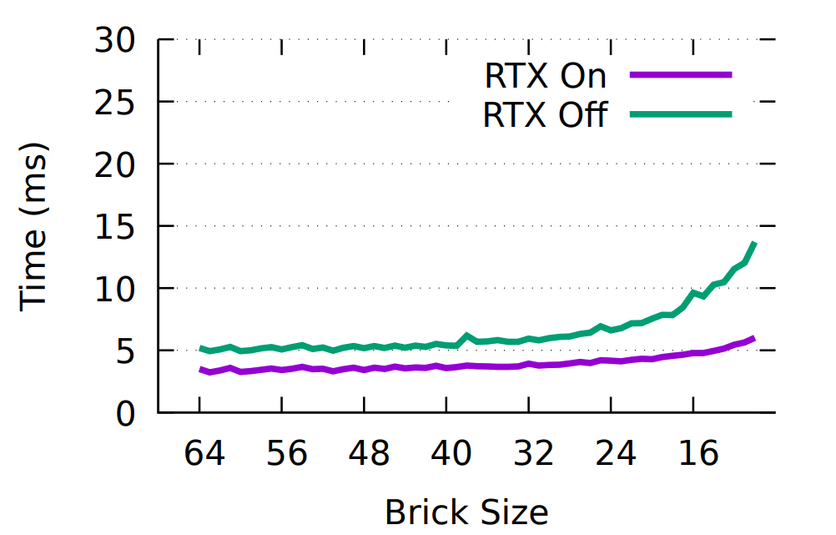
Results RTX On vs RTX Off (Stubbed Sampling)

Slide 27
Result Data

Slide 28
Conclusion
We have shown that BVHs are a viable candidate for GPU direct volume rendering
We observe that new ray-tracing hardware can benefit GPU direct volume rendering performance
We show that BVH build times should not be considered a hindering factor
We give one approach to reduce BVH complexity

Slide 29
Possible Future Work
Use a clustering heuristic that allows <100% active groups of regions to be clustered
Cluster non-cubed shapes (2x2x8, 1x4x16, etc)
Investigate with more volumes
Translate work to Time-Varying or Steaming Volume Data

Slide 30
Any Questions?
github.com/ganterd/optixdvr

