Slide 1
HMLFC: Hierarchical Motion-Compensated Light Field Compression for Interactive Rendering
Srihari Pratapa¹ & Dinesh Manocha²
University of North Carolina at Chapel Hill¹
University of Maryland at College Park²
High Performance Graphics, July 2019

Slide 2
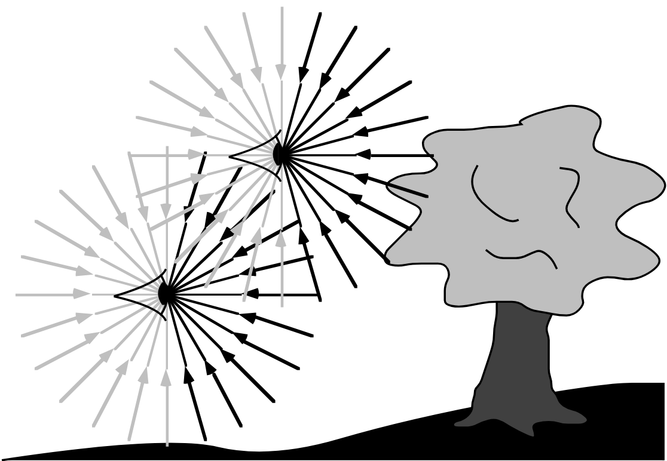
Light Fields (LF)
Capture the scene by storing all the light rays
Render the scene using the light rays
Photo-realistic rendering of the scene
[Adelson et al. 1991]

Slide 3
Light Fields (LF)
Highly complex scenes
Light rays are sampled using camera images
Render new views by filtering sampled light rays
[Joan Charmant 2015]

Slide 4
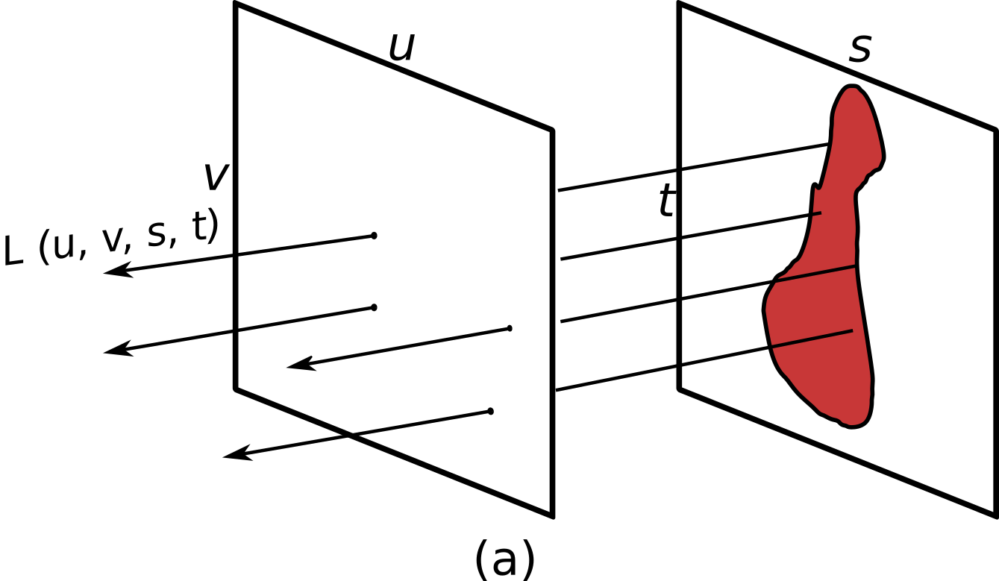
Light Fields: Representation
Several ways to represent the idea are proposed [McMillan et al. 1995] [Shum et al. 2004]
Intensity of light rays stay constant
4D representations: $L= P\left(u, v, s, t\right)$ [Gortler et al. 1996, Levoy et al. 1996]
Two planes: $\left(u, v\right) \& (s, t)$

Slide 5
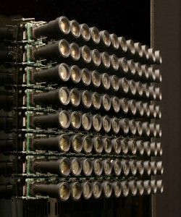
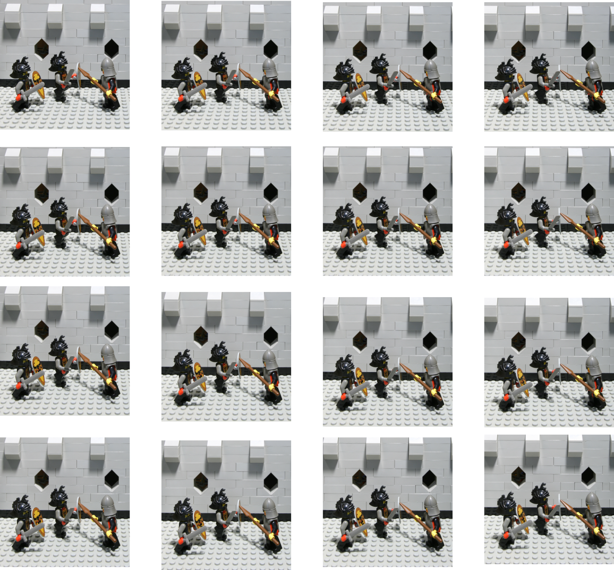
Light Fields: Capturing
Light rays are captured using large array of camera images
Stanford Camera Rig

Slide 6
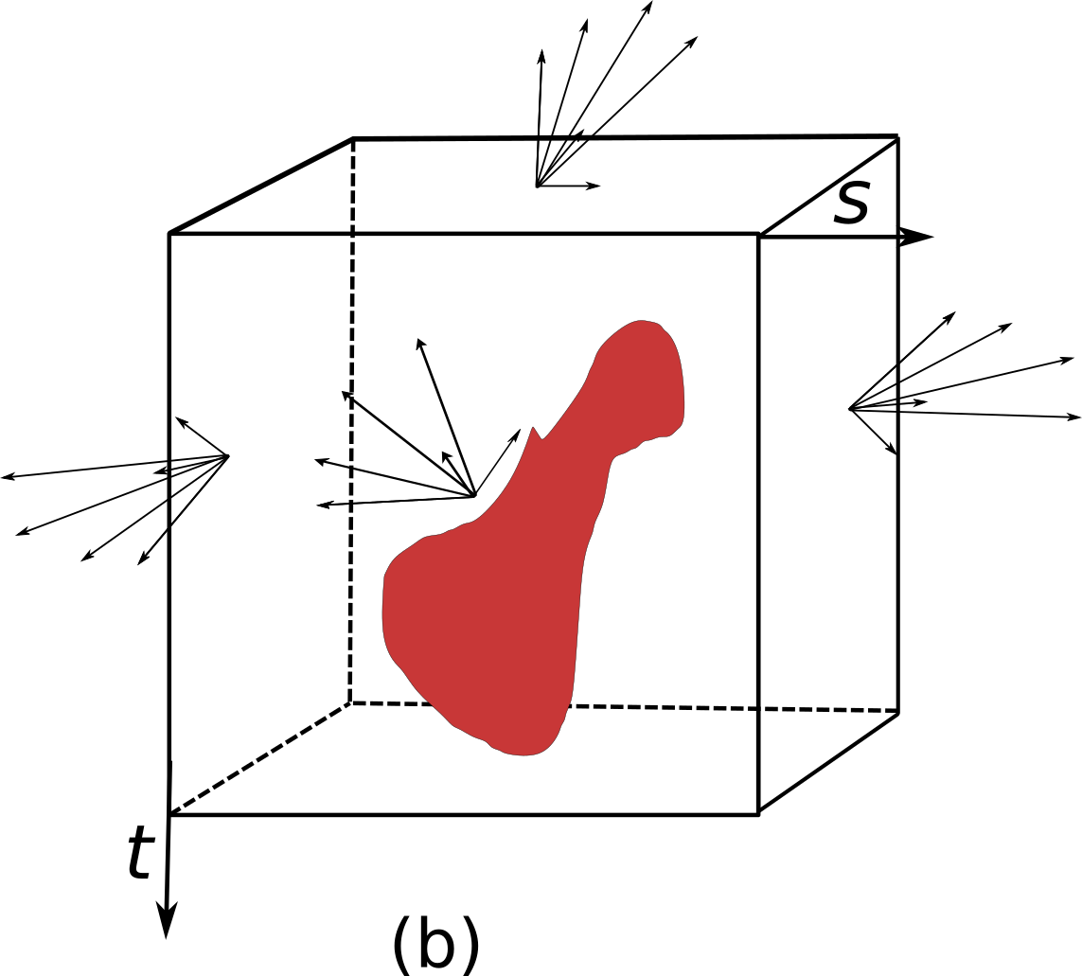
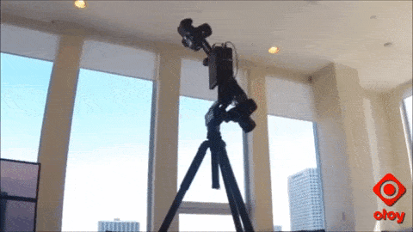
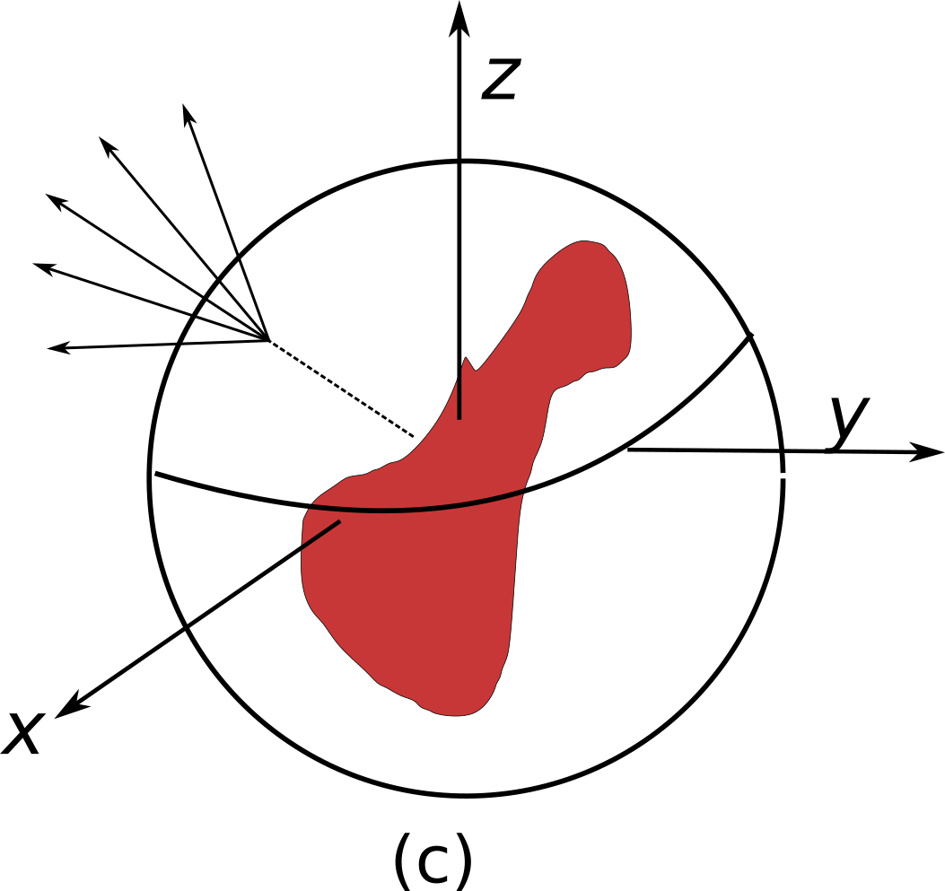
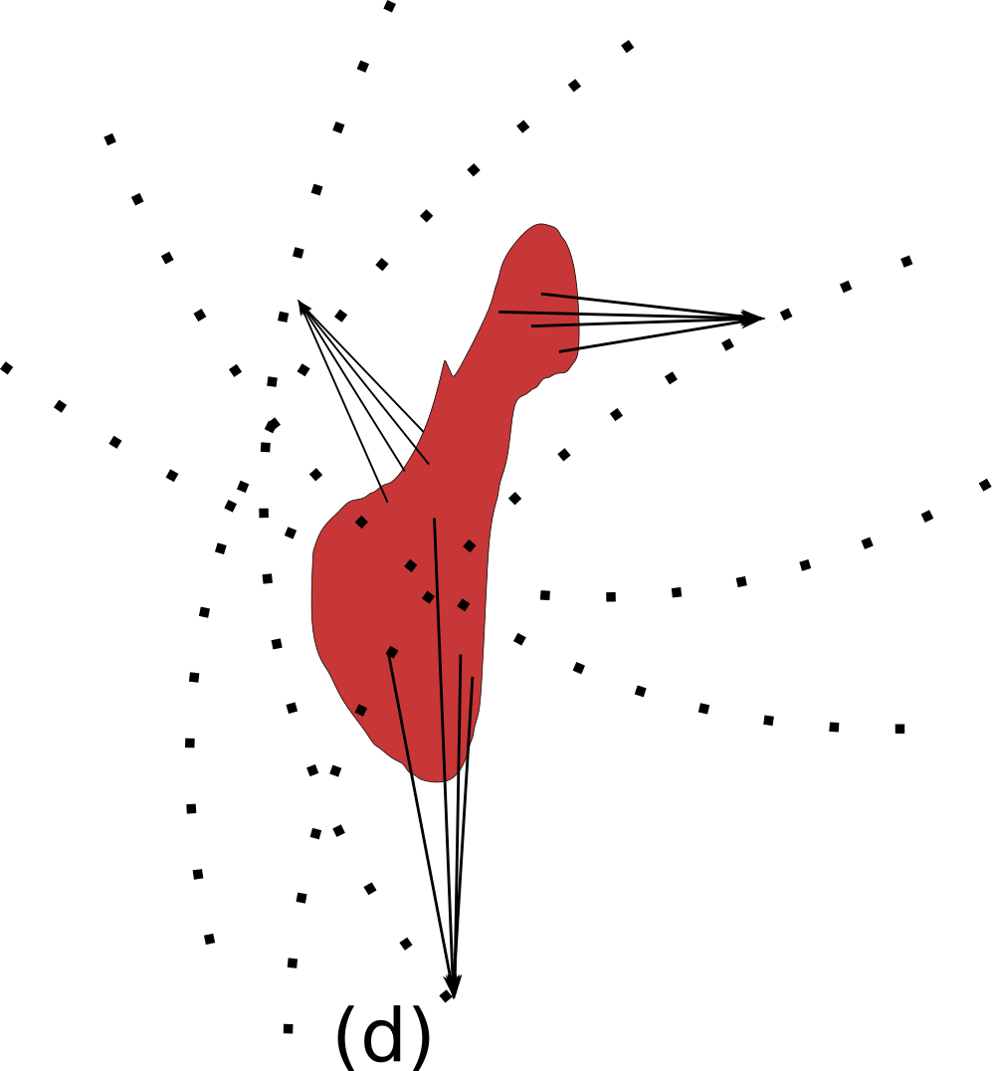
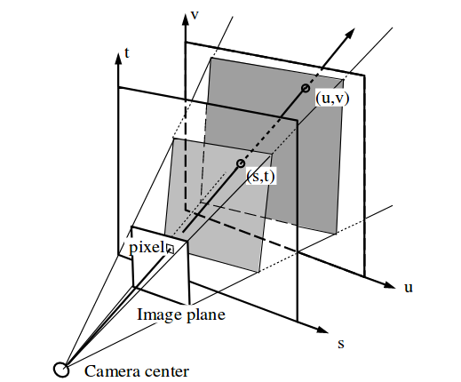
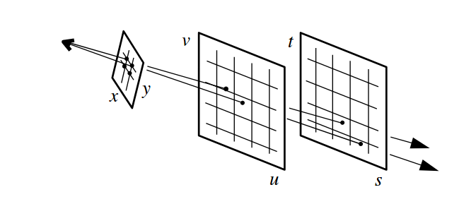
Challenges
Parameterizing the scene
Capturing the scene using images
Representations of the images
Compression of the captured images
Rendering from the sampled images

Slide 7
Challenges
Parameterizing the scene
Capturing the scene using images
Representations of the images
Compression of the captured data
Rendering the scene back

Slide 8
Data – Rendering Quality
High image sampling rate (1K – 10K images) [chai et al. 2000]
High resolution of image samples (1K, 2K)
Data sizes range from 300MB- 100 GB [ Levoy et al. 2000 , Lin et al. 2000 ]
Major bottle neck in terms of storage, transmission, and real-time rendering

Slide 9
Data – Real-time Rendering
Parallel processing is required for real-time rendering
New views are generated using filtering from the captured images
Fast parallel access to the pixel values
Image samples should be present in video memory
Ray Tracing
Levoy et al. 96

Slide 10
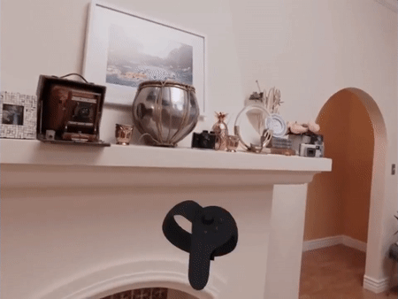
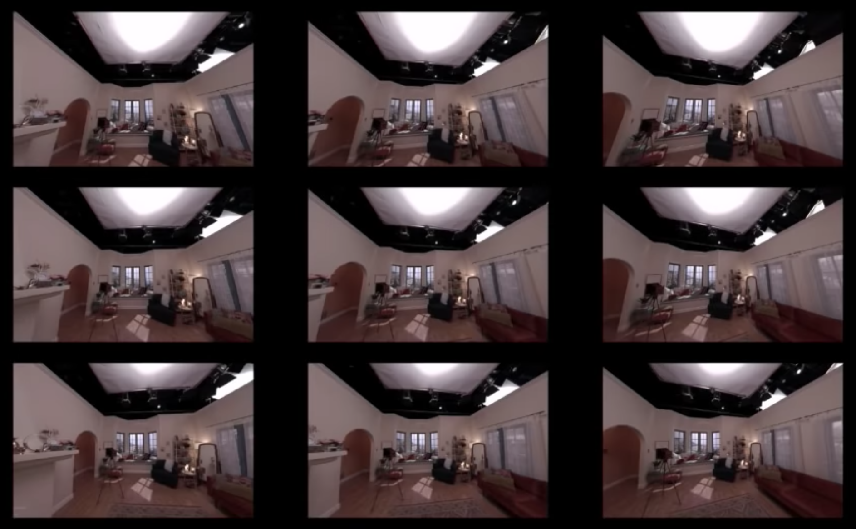
Rendering
Rendering a new view requires only small set of pixels from image samples
Captured Images
Rendered views

Slide 11
Compression: Requirements
Storing uncompressed data is expensive
Random Access – Decode only the required set of pixels
Fast low-latency decoding capability
Video memory & memory bandwidth are scarce on mobile devices

Slide 12
Organization
Introduction
Background
Our Approach – HMLFC
HMLFC Implementation
Results
Limitations & Future Work

Slide 13
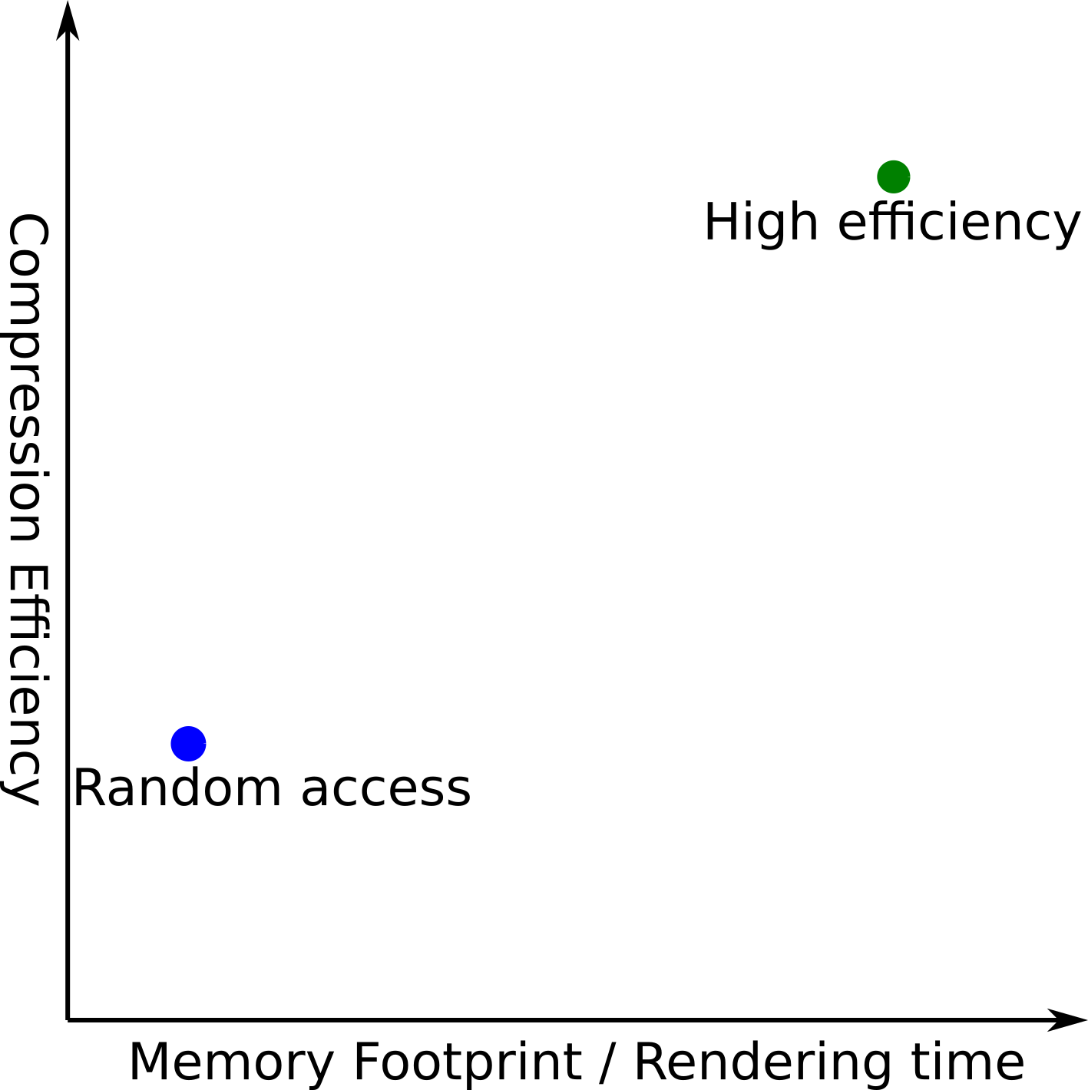
Background: LF Compression
High efficiency compression schemes
Modified MPEG and JPEG schemes
Girod et al. [2003] Magnor et al. [2000] Chen et al. [2018] Liu et al. [2016] Perra et al. [2016] : ∼ 100 – 500X
Schemes that enable random access
Vector quantization [Levoy et al. 1996] : ∼ 40X
Wavelet based hierarchy [Peter et al. 2001] : ∼ 20-40X
MRF with Just-in-time [Zhang & Li 2000] : ∼ 80X
RLFC [Pratapa & Manocha 2019] : ∼ 20 – 200X

Slide 14
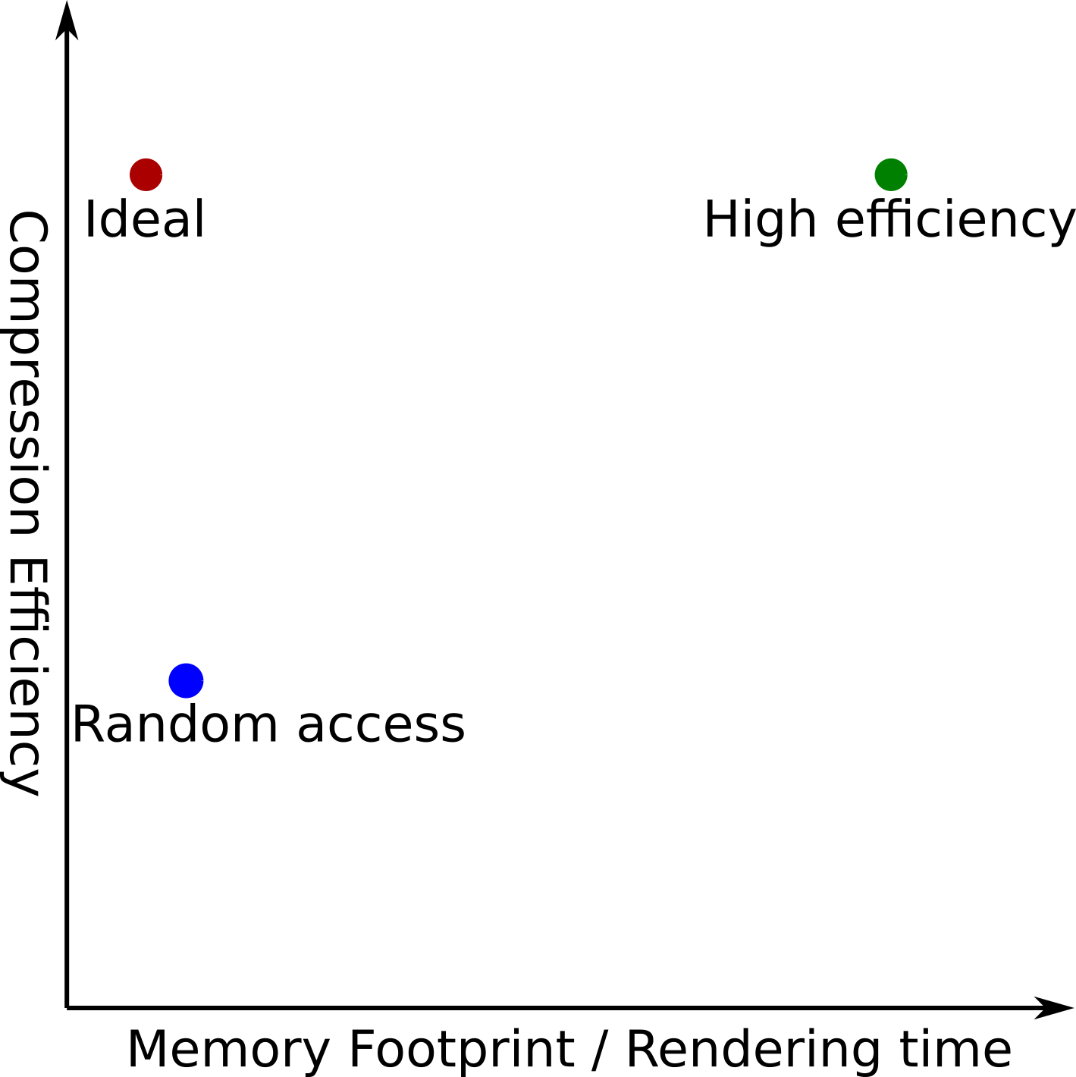
LF Compression: Ideal Requirements
High efficiency compression schemes
Random Access
Ideal compression scheme
High compression efficiency
Low memory footprint

Slide 15
LF Compression: Motion vs. Hierarchy
Motion compensation compression schemes
Girod et al. [2003]; Magnor et al. [2000]; Chen et al. [2018]; Liu et al. [2016]; Perra et al. [2016] : ∼ 100 – 500X
MRF with Just-in-time [Zhang & Li 2000]: ∼80X
Hierarchical compression schemes
Wavelet based hierarchy [Peter et al. 2001] : ∼ 20 – 40X
RLFC [Pratapa & Manocha 2019] : ∼ 20 – 200X
Hierarchical coding of light fields [Magnor & Girod 1999] : ∼ 40 – 100X

Slide 16
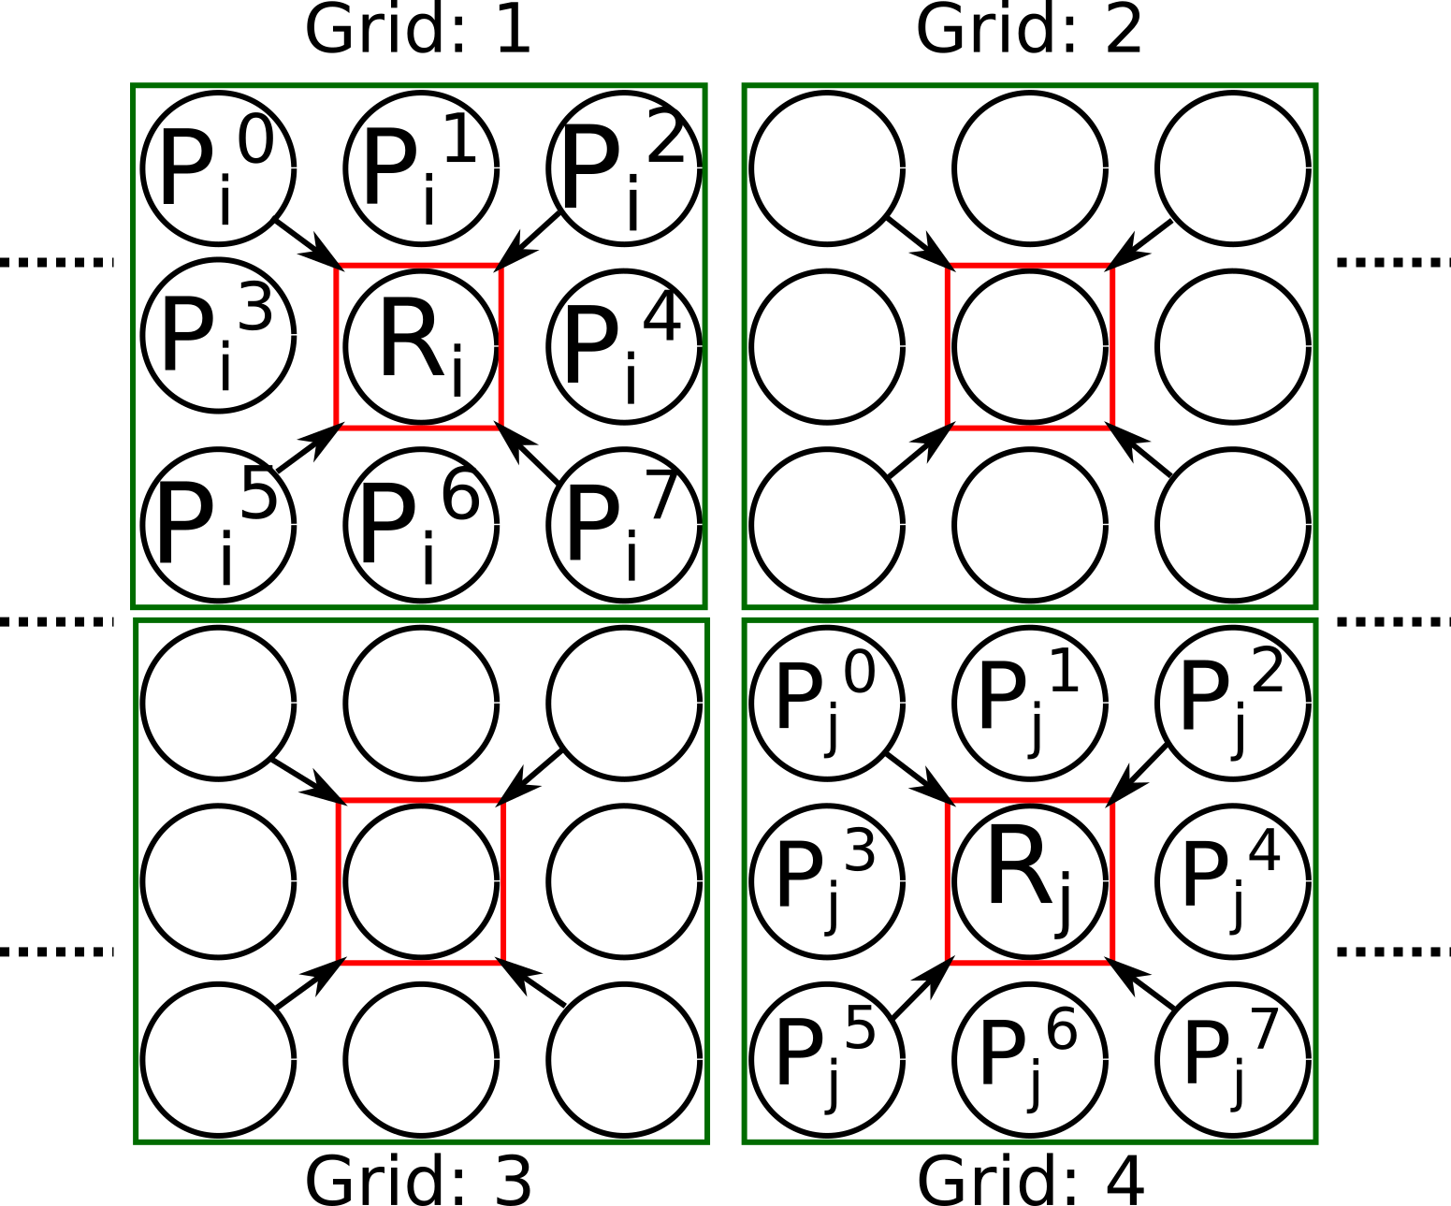
Overview: Motion Compensation
Redundancy in grids:
R_{i} <--> {P_{i}⁰, P_{i}¹, …. , P_{i}⁷ }
Redundancy between grids?
Redundancy between (R_{i} <--> R_{j} )
Redundancy between (R_{j} <--> P_{i}^{k} )
: Light Field Image
R_{i} : Reference Images
{P_{i}⁰, P_{i}¹, …. , P_{i}⁷ } : Predictive Images

Slide 17
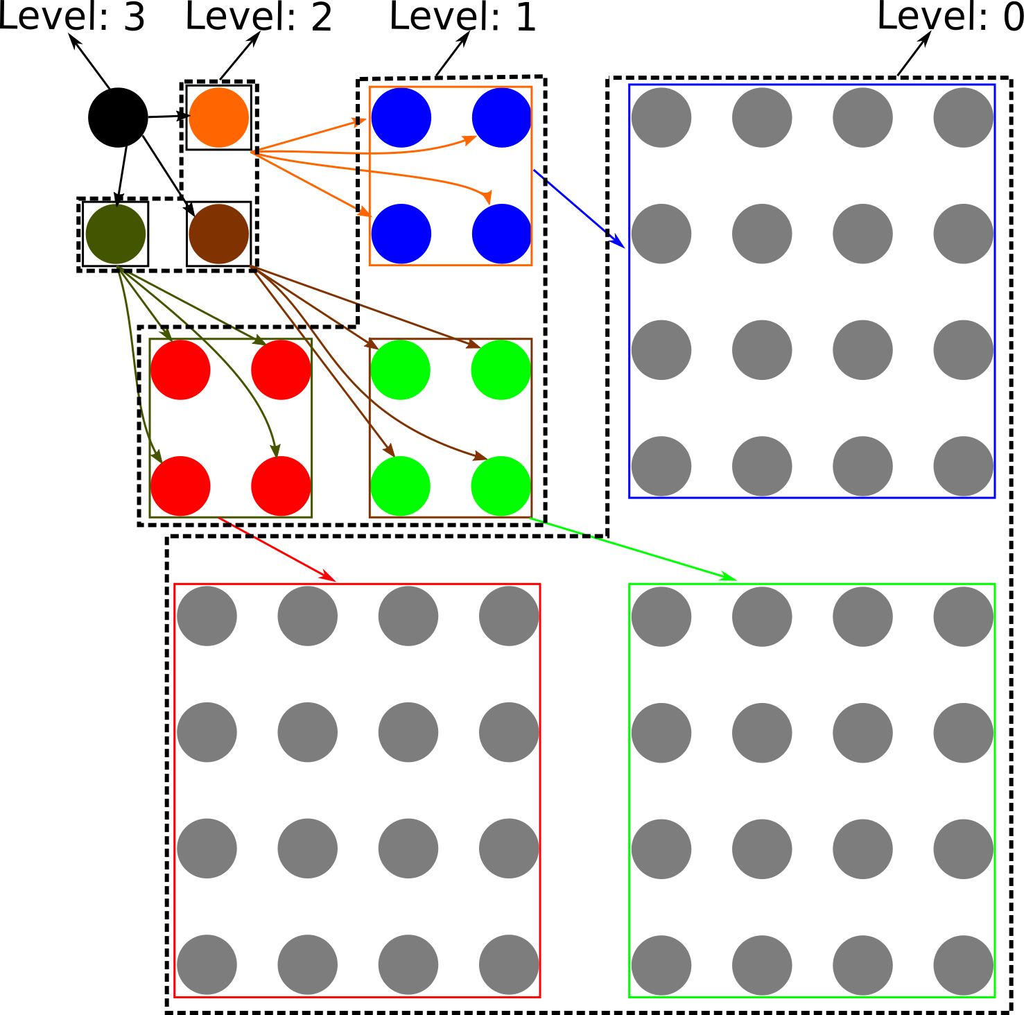
Overview: Hierarchical Schemes
The entire LFI are transformed using image processing and manipulations
Captures redundancies across all the LFI
Redundancy captured is limited

Slide 18
LF Compression: Categories
Motion compensation
Hierarchical compression
Exhaustive search for redundancy using motion vectors Efficiently exploit the local coherence among LFI Select reference images from LFI & predict the rest using motion vectors | Image transformations and manipulation to separate redundancies Exploit the global coherence among LFI Build a hierarchy of new parent & child images using the transformations

Slide 19
Organization
Introduction
Background
Our Approach – HMLFC
HMLFC Implementation
Results
Limitations & Future Work

Slide 20
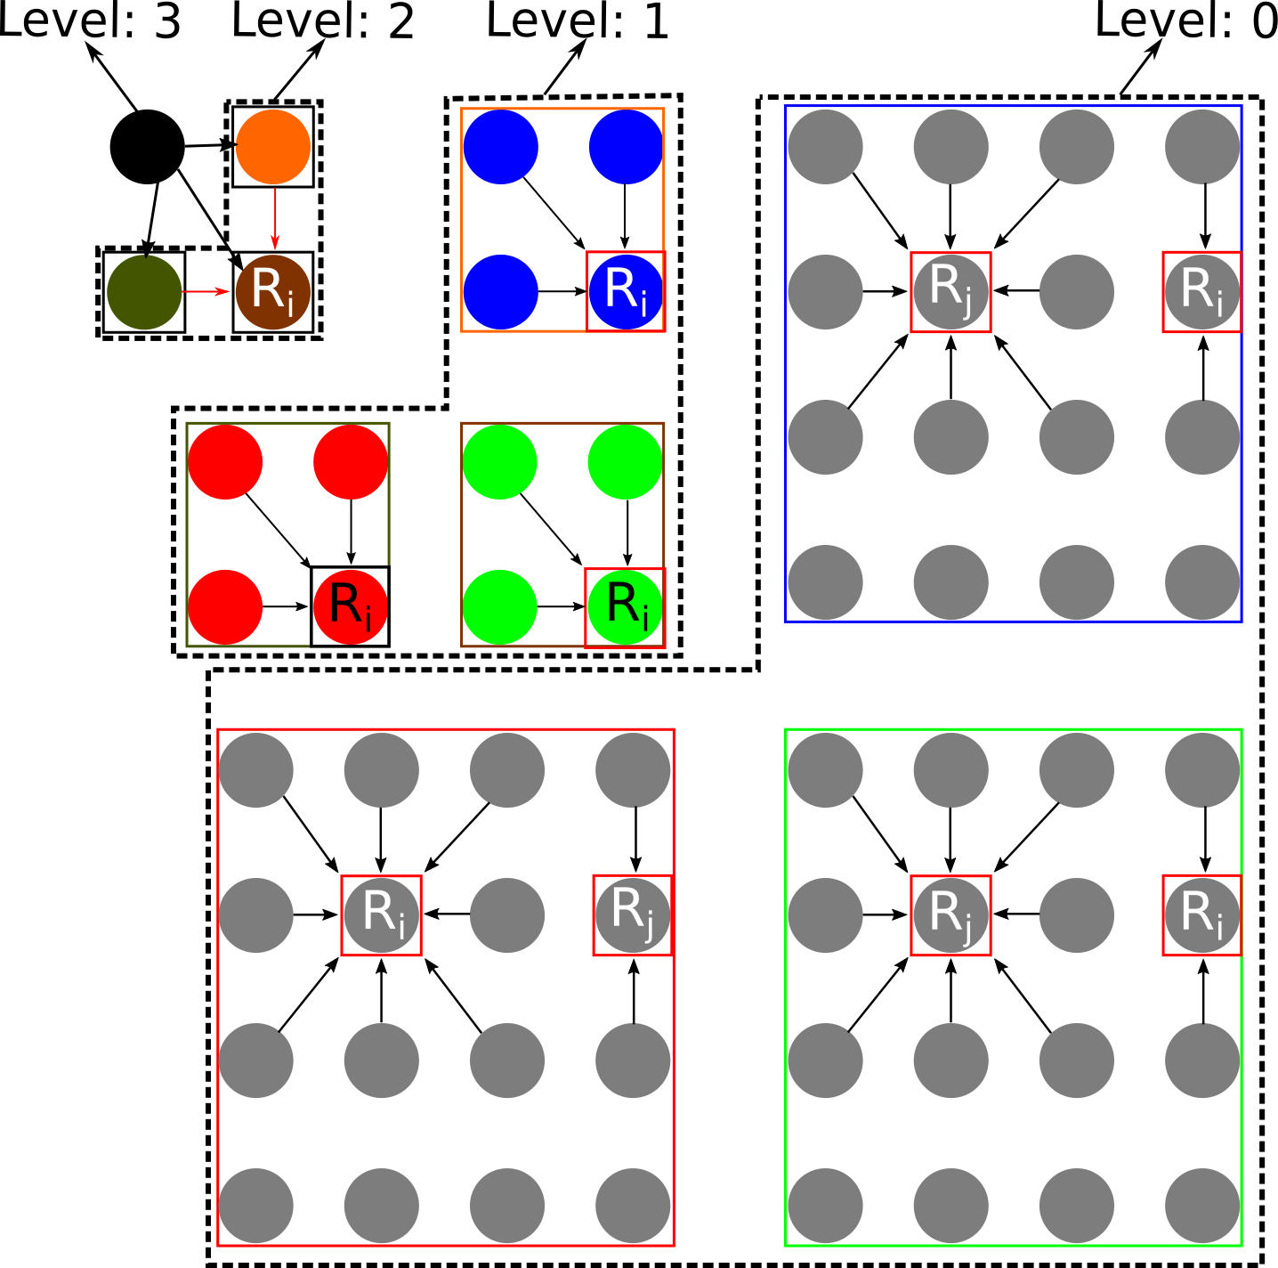
Key Idea: Hybrid Approach
R_{i} : Reference Images
{P_{i}⁰, P_{i}¹, …. , P_{i}⁷ } : Predictive Images
Apply motion compensation at all levels

Slide 21
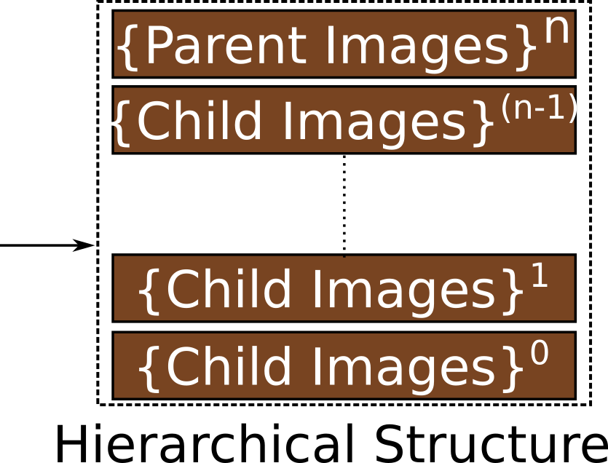
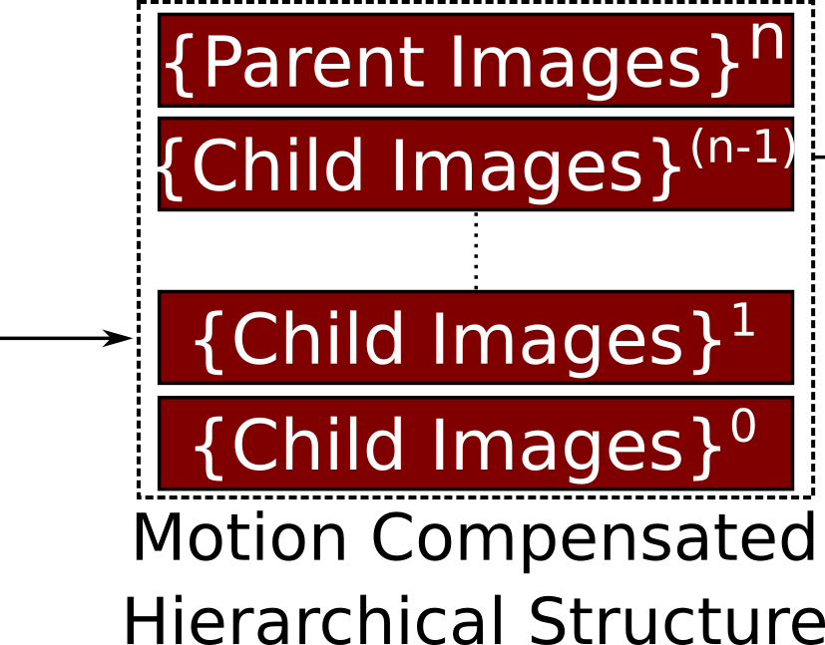
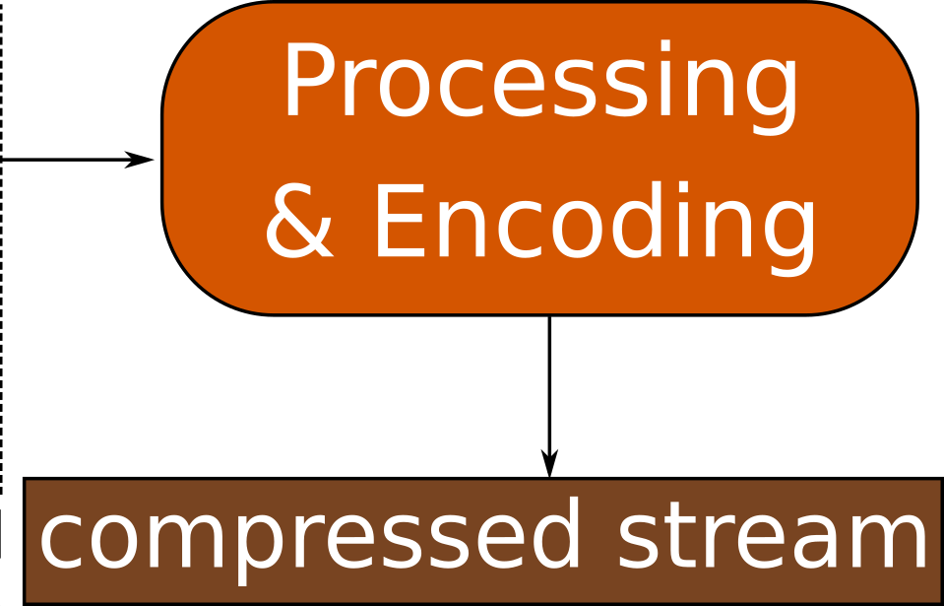
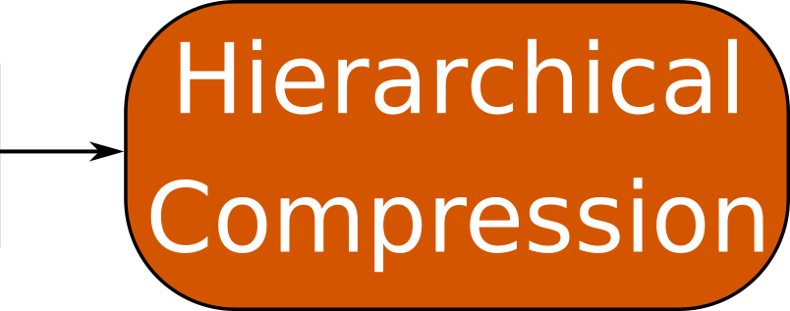
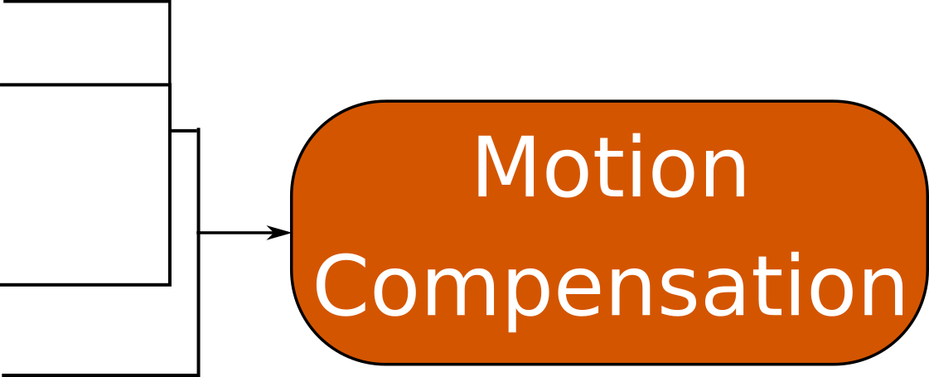
HMLFC : Hierarchical Motion-compensated Light Field Compression
Motion compensation schemes and hierarchical schemes capture different kind of redundancies
Optimize the compression by merging different redundancies in both approaches

Slide 22
HMLFC: Main Challenges
The structure of the hierarchy should remain the same
New motion compensation method for transformed images
Over-heads should be minimal

Slide 23
Organization
Introduction
Background
Our Approach – HMLFC
HMLFC Implementation
Results
Limitations & Future Work

Slide 24
HMLFC Implementation on RLFC
RLFC [Pratapa & Manocha 2019] as the hierarchical scheme
RKV: Representative Key Views
Redundancies across the LF
SRV: Sparse Residual Views
Specific details of the LF
Encoding the RKV & SRV

Slide 25
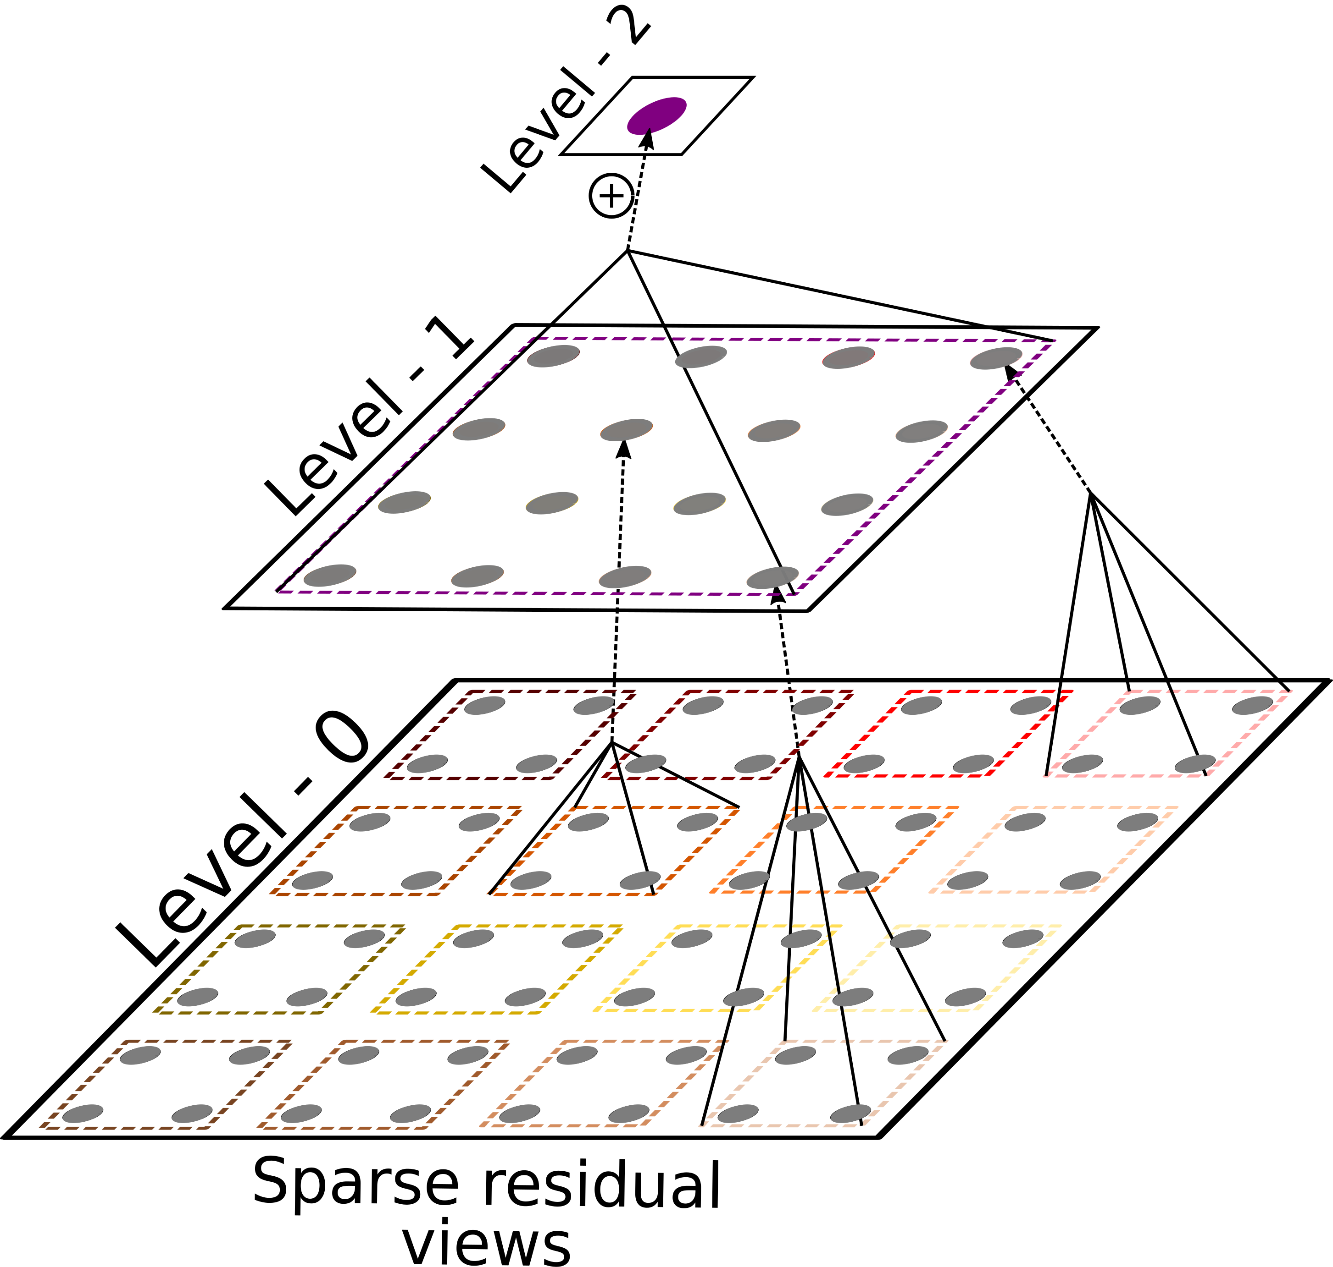
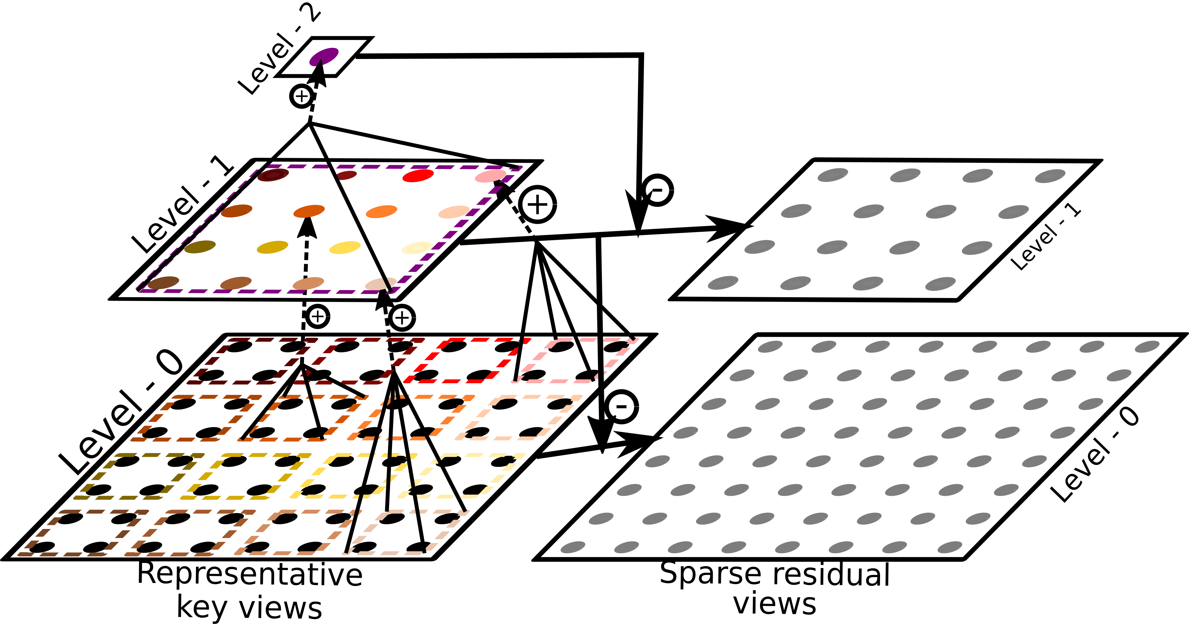
RLFC Overview
RKV²
SRV¹
SRV⁰
Light Field Images
RKV: Representative Key Views
SRV: Sparse Residual Views

Slide 26
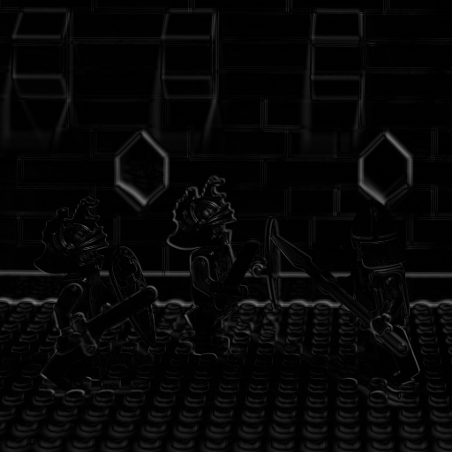
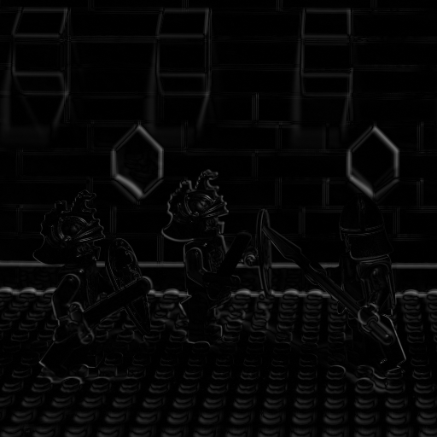
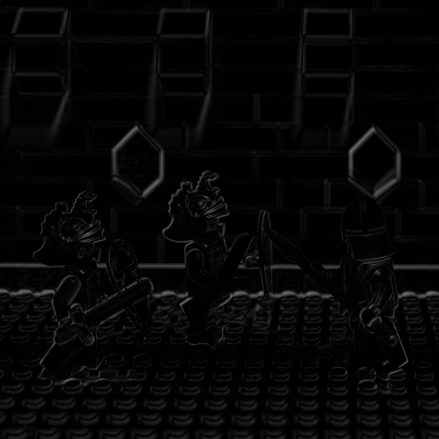
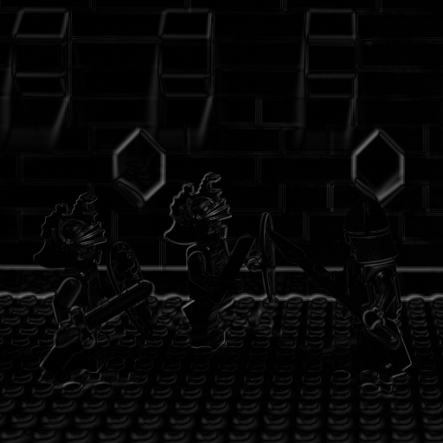
RLFC Overview
RKV image: Level - 2
SRV images: Level - 1
SRV images: Level - 0

Slide 27
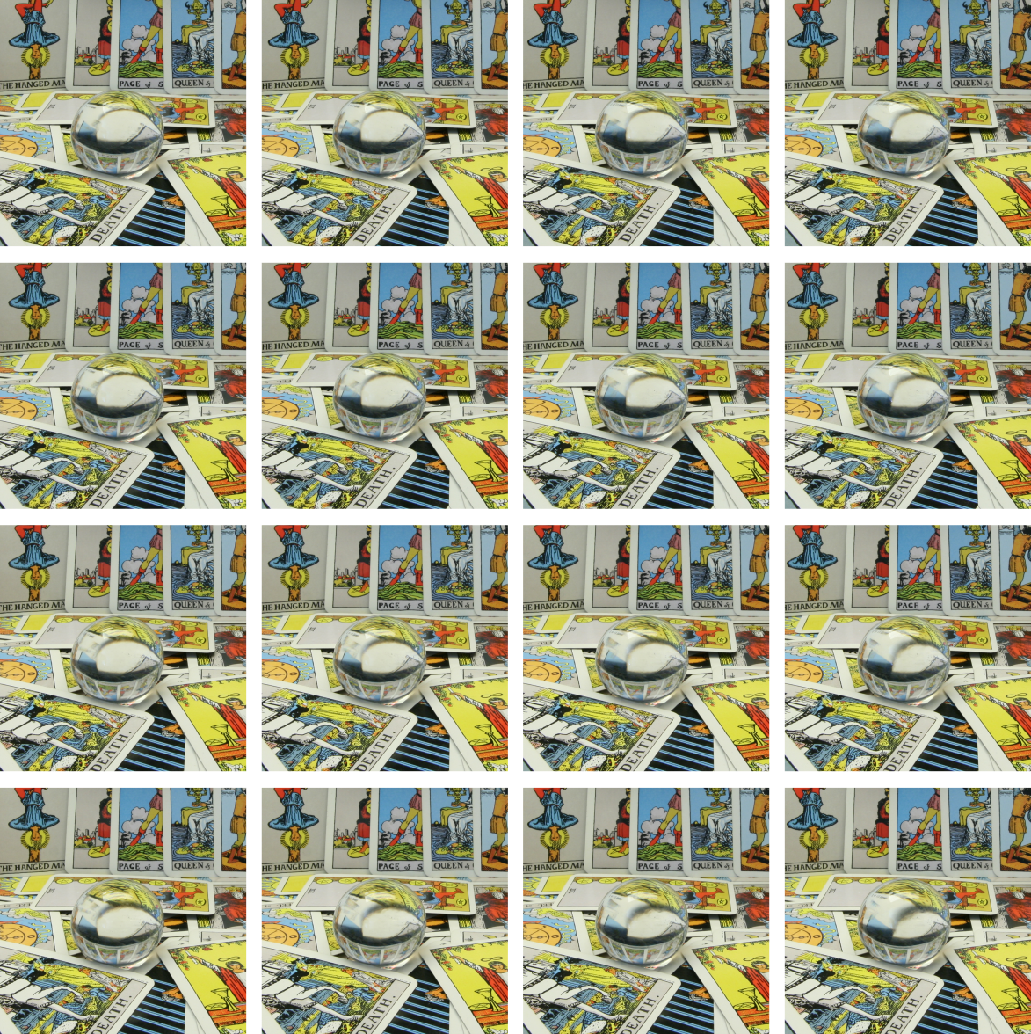
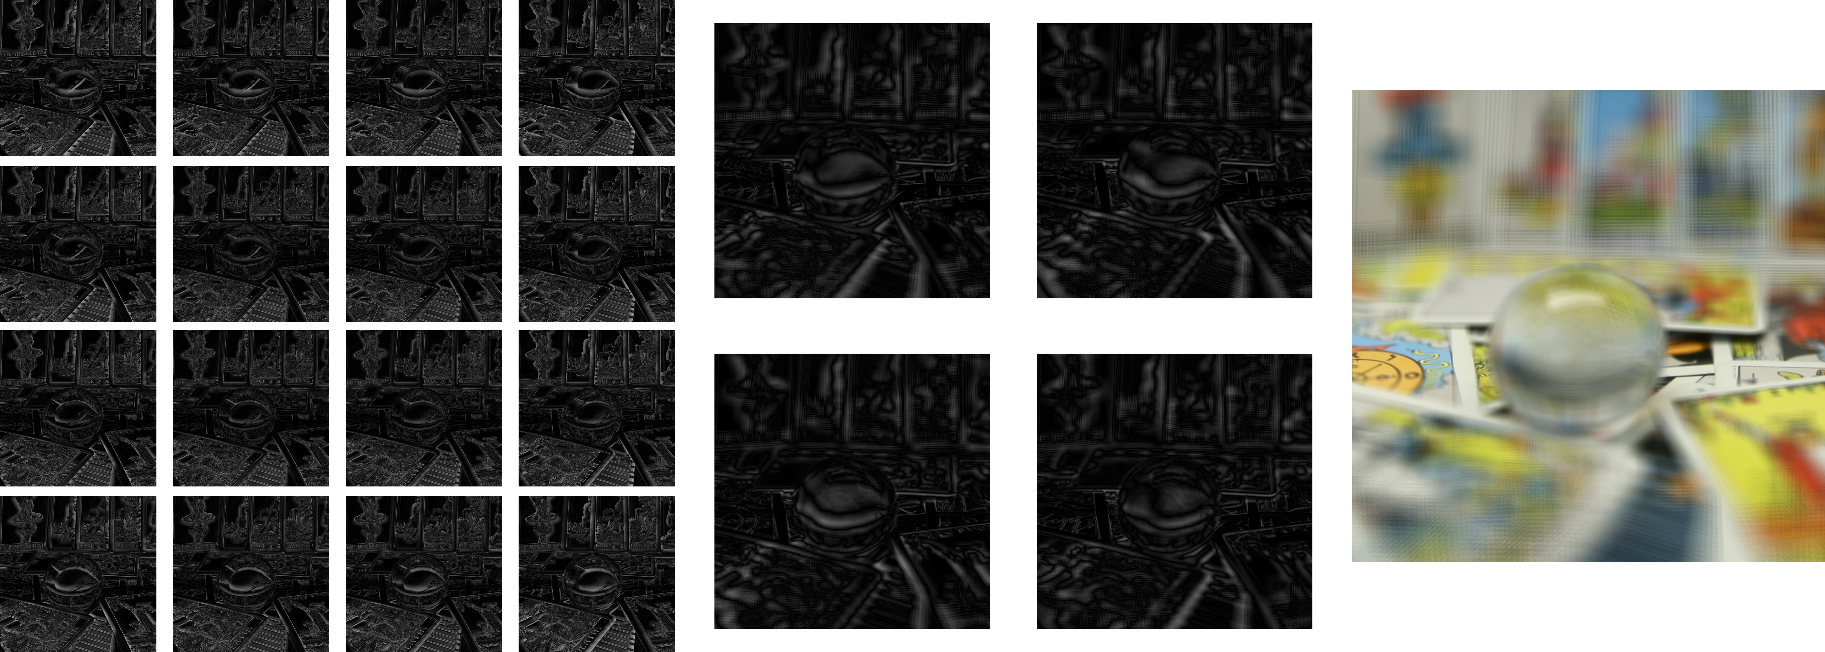
RLFC Overview
RKV image: Level - 2
SRV images: Level - 1
SRV images: Level - 0

Slide 28
Hybrid approach for RLFC
Compute the RLFC hierarchy
Apply motion compensation to all the level of hierarchy

Slide 29
HMLFC: Extending RLFC with Motion Vectors
Lot of redundancy between SRV images
Block based motion compensation
Small blocks in predictive image are motion compensated
Search in a given window in a reference image
Find the best matching block
Reference image
Predictive image

Slide 30
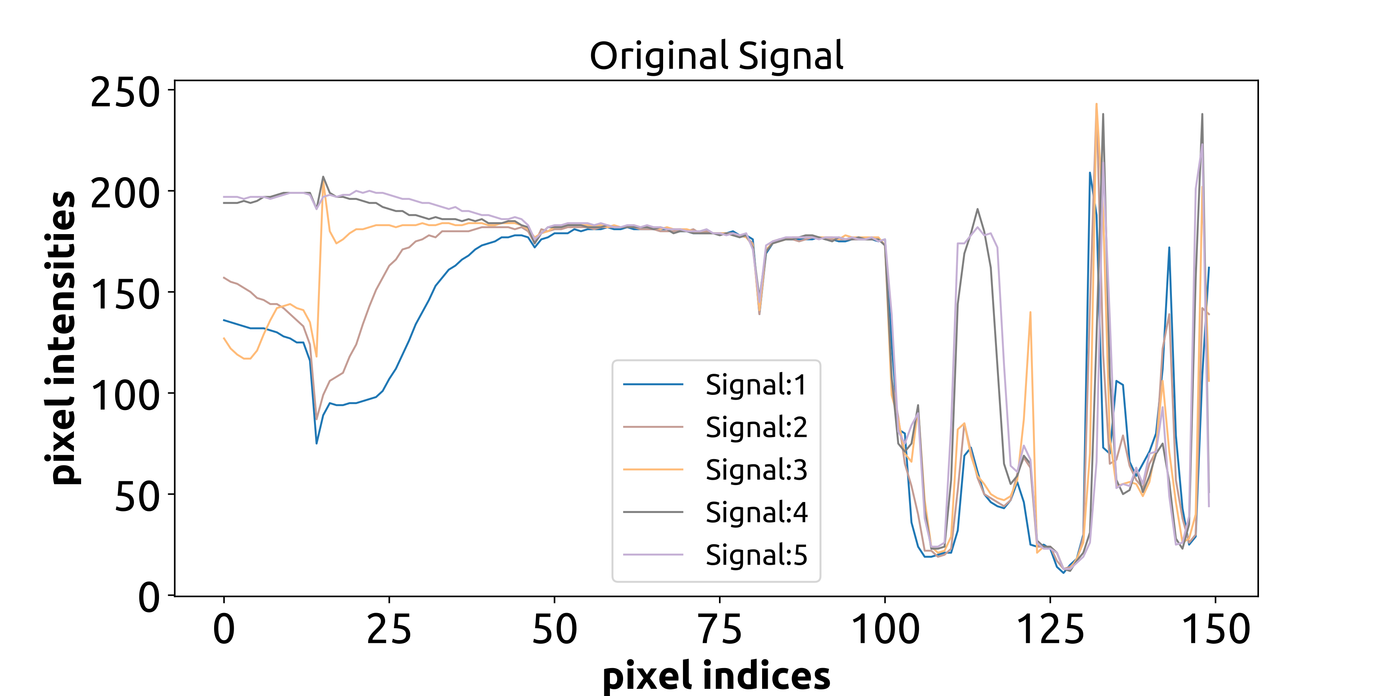
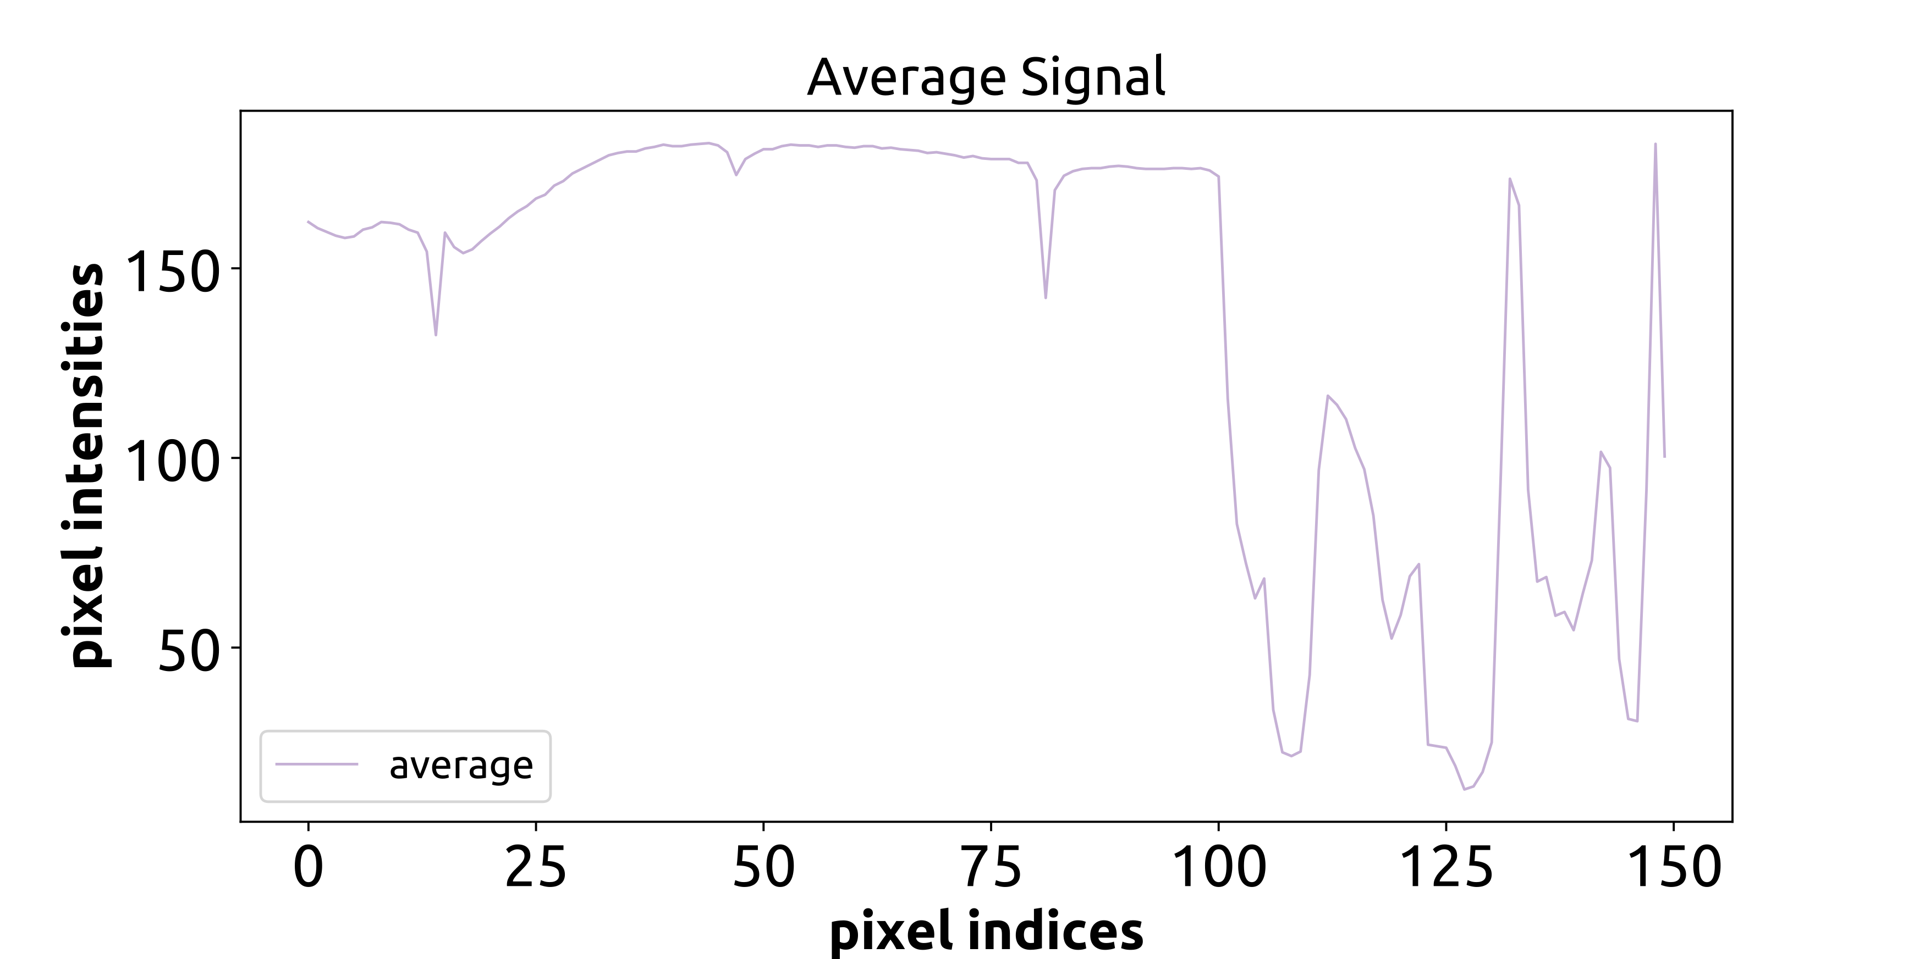
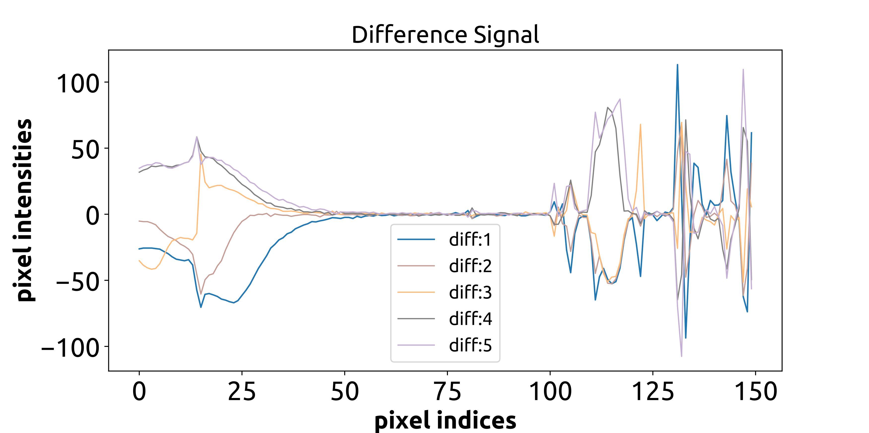
Phase-shifted Motion Prediction
Series of shifted 2D – signals
$∆ =Pred−Ref$
$\left(m_{x}, m_{y}\right)$
$∆ =Pred+ Ref$
$\left(m_{x}, m_{y}\right)$

Slide 31
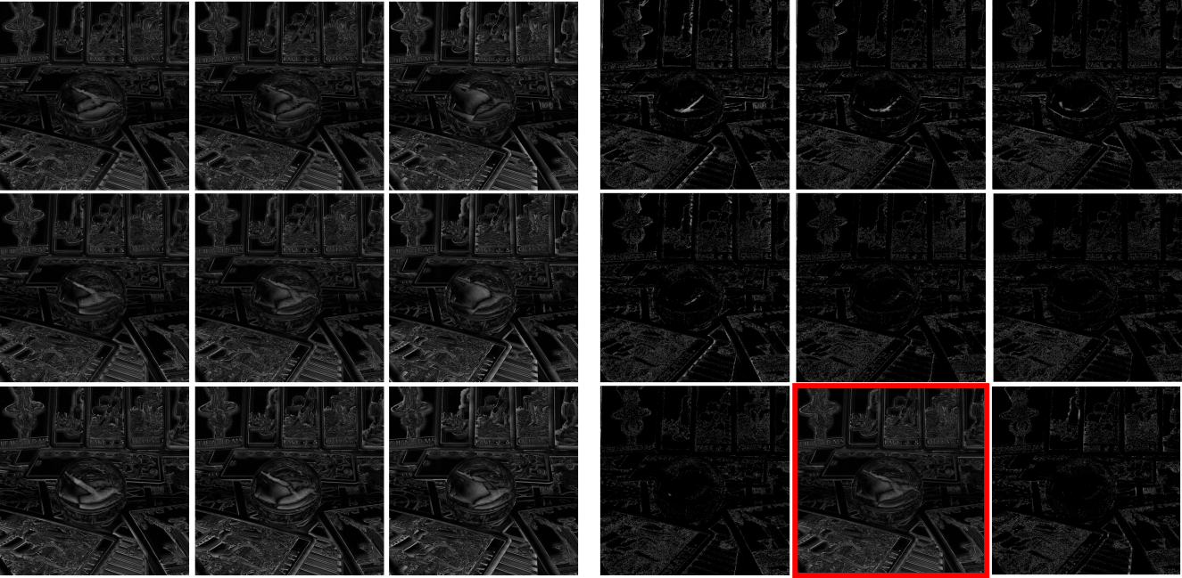
HMLFC: SRV Images
The data in the motion compensated SRV images is significantly less than original SRV images
Reference frame is marked in red
Original SRV images
Motion compensated SRV images

Slide 32
Organization
Introduction
Background
Our Approach – HMLFC
HMLFC Implementation
Results
Limitations & Future Work

Slide 33
Results: Data Sets
Data sets – Stanford new LF archive

Slide 34
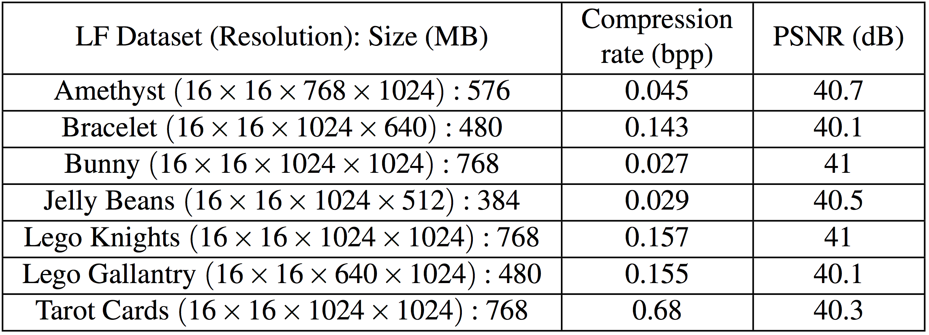
Results: Compression rate/Quality
fdfd
Compression ratio: ∼ 30 – 800X
Analysis on the Stanford LF archive

Slide 35
HMLFC: Comparison
Similar compression quality
Improvement factor: ∼ 2 – 5X
Data set | RLFC (bpp) | HMLFC (bpp) | Improvement factor
Bunny | 0.145 | 0.073 | 1.9X
Amethyst | 0.137 | 0.045 | 3X
Bracelet | 0.52 | 0.143 | 3.6X
Jelly Beans | 0.172 | 0.029 | 5.5X
Lego Knights | 0.62 | 0.157 | 4X
Tarot Cards | 2.20 | 0.68 | 3.2X

Slide 36
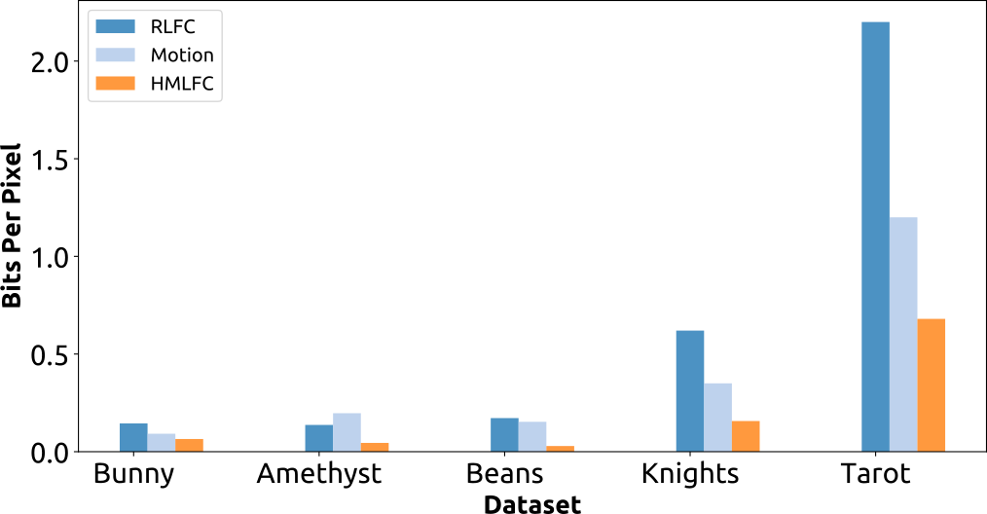
HMLFC: Comparsion
Lower is better
HMLFC does better than both RLFC and motion-compensation

Slide 37
HMLFC: Visual Quality
Visual quality in comparison with RLFC
Similar quality of compression (PSNR)
Visual quality same as RLFC

Slide 38
Results: Rendering Speeds
Generate new views using LF renderer with GPU decoder
Hardware used: NVIDIA GTX – 960 (2GB) and Intel Xeon (2.4GHz)
Image resolution (512 X 512)
Avg. frames per second: ∼200 fps
Image resolution (1024 X 1024)
Avg. frames per second: ∼110 fps

Slide 39
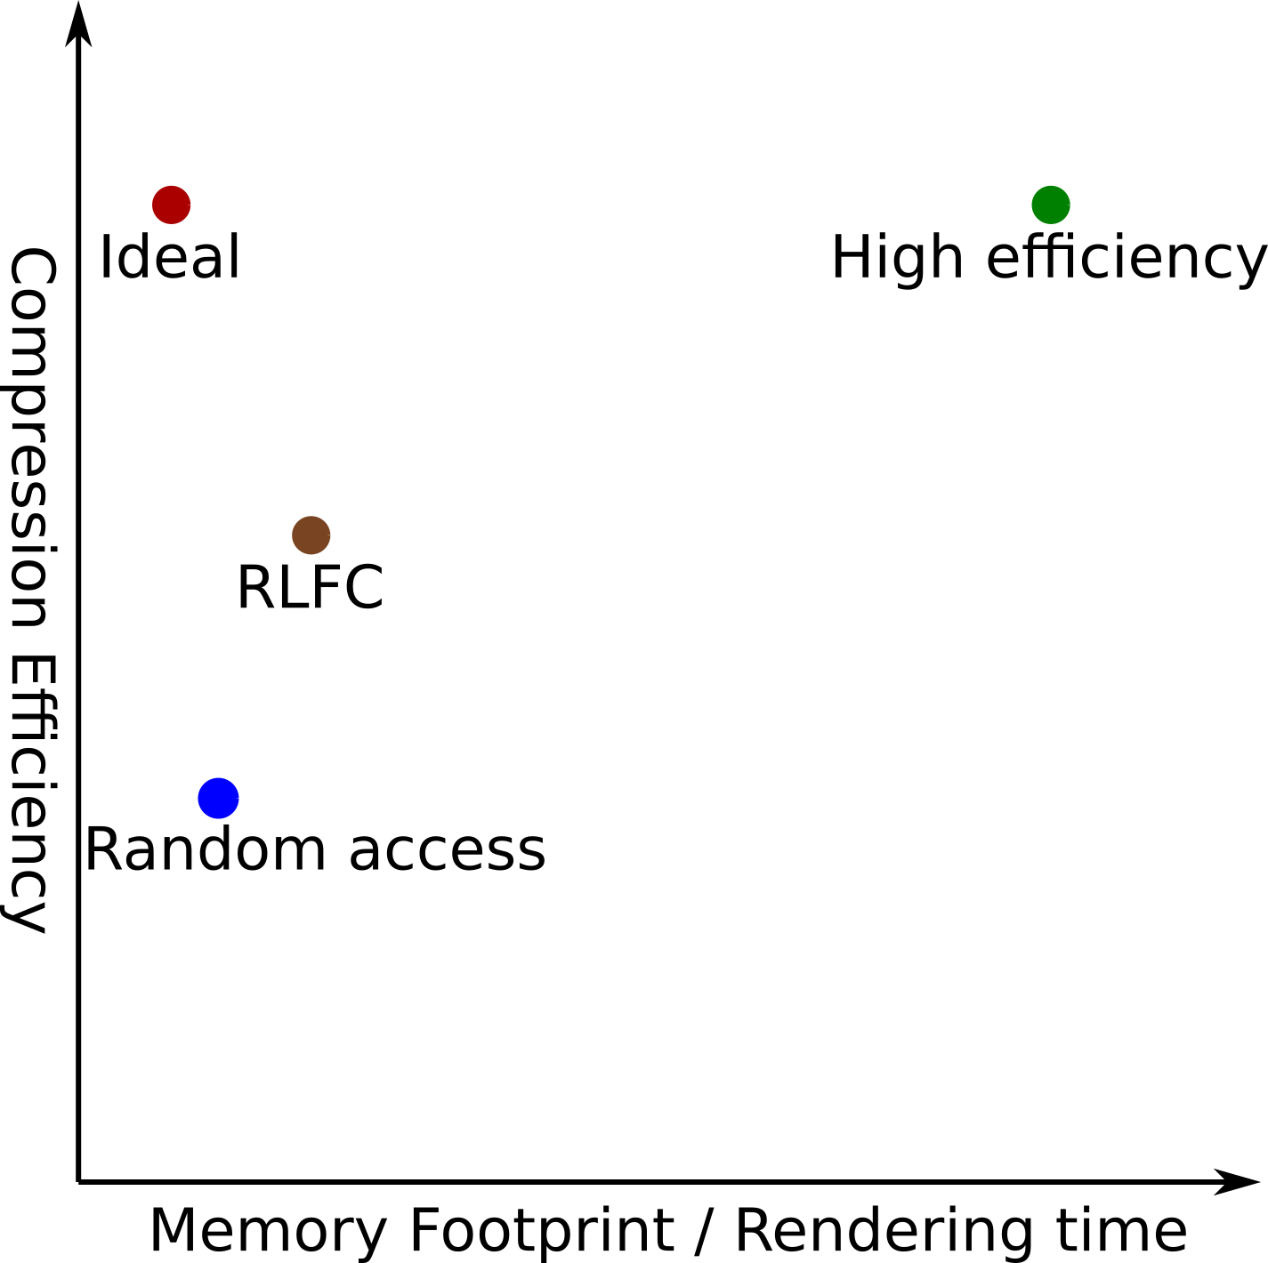
HMLFC: Conclusion
HMLFC: Hierarchical Motion-Comepensated Light Field Compression
RLFC as the underlying hierarchical scheme
Phase-shifted motion compensation to all the levels of the hierarchy
Factor of 2-5X improvement in compression rates for the same quality
HMLFC

Slide 40
Organization
Introduction
Background
Our Approach – HMLFC
Results
Limitations & Future Work

Slide 41
HMLFC: Limitations
Benefits are limited to finding a suitable motion-compensation method
No fine grain control over the encoding parameters
Unoptimized GPU decoder in terms of memory operations

Slide 42
HMLFC: Future Work
Extend to other LF parameterizations (spherical & unstructured)
Use sub-pixel motion compensation to search for a matching block
Extend the current ideas for light field videos
Integrate our method in a end-to-end LF rendering system

Slide 43
Acknowledgements
The research was supported in part by Intel
Reviewers for great feedback

Slide 44
Thank you!
Questions?

Slide 45
BACK-UP SLIDES

Slide 46
Light Fields: Parameterizations
2 Planes
Cube: 6 planes
[Levoy et al. 1996]
[Gortler et al. 1996]
UnStructured
Spherical
[Ihm et al. 1997]
[Davis et al. 2011]
Notes:
Apart from the 2 plane parameterization we have seen. Several other parameterizations have been proposed as well.

Slide 47
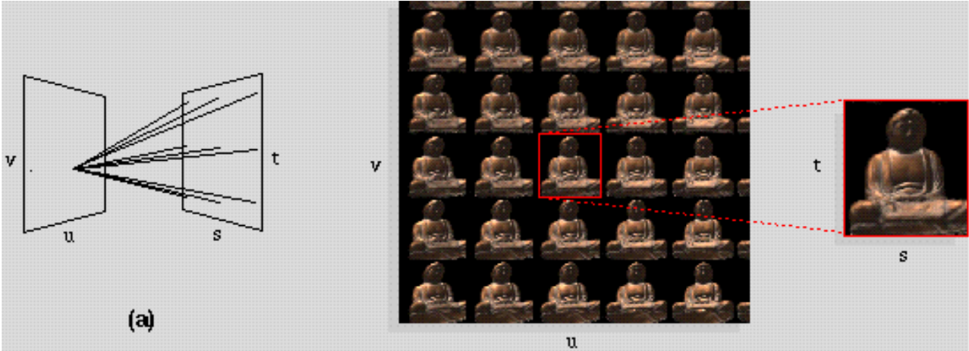
Sampling of the Light Rays
Sample by taking 2D photographs
Levoy et al. 96
Notes:
This is the confusing in many different respects

Slide 48
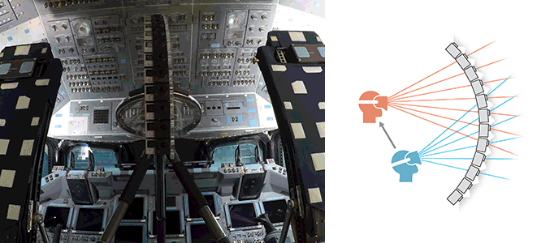
Light Fields: Revival
Recent developments in capturing & displays
Google – Welcome to Light Fields[Overbeck et al. 18]
Spherical LF representation (360⁰ FOV)
Image samples captured: 8K; Image resolution: 1K; Data size ∼8GB
“VR is still a novelty, but Google’s light-field technology could make it serious art”- MIT Technology review
Notes:
1. Most of the work in LF is done one or two decades. There are several advances in the computational photography which made capturing easier. With recent excitement with VR the photo-realistic content possible with light fields increases the sense of immersion by a significant factor.
2. In the most recent work by overbeck an end-to-end system for capturing and rendering spherical panoramic LF in VR is presented. They use a huge rotating rig as shown in the figure

Slide 49
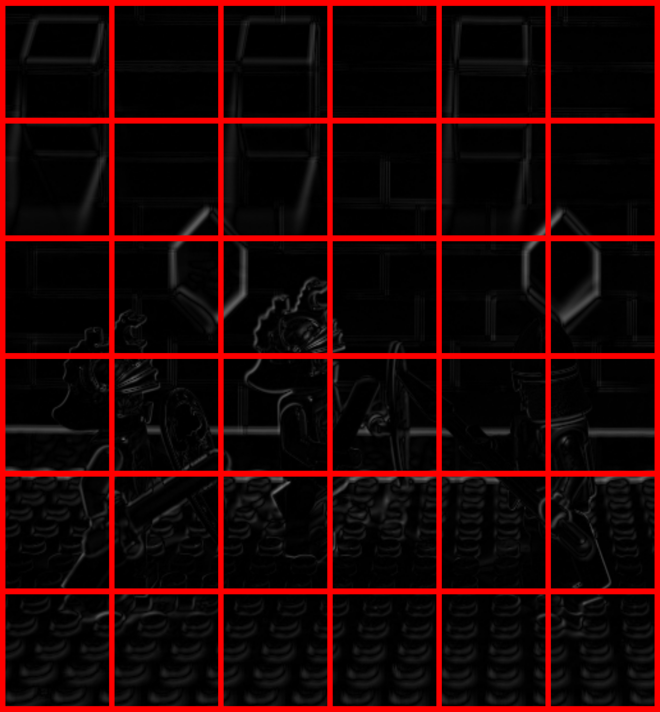
Encoding SRV
Sparse high frequency images
Discard insignificant blocks
Bounded Integer Sequence Encoding (BISE)
Encodes integer values using BISE from ASTC [Nystad et al. 12]

Slide 50
Encoding RKV
Properties are similar to standard color images
Compress using JPEG2000

Slide 51
HMLFC : Hierarchical Motion-compensated Light Field Compression
Improve the compression by combining the orthogonal dependencies
A hybrid approach to combine both the approaches

Slide 52
HMLFC: Decoding properties
The hierarchical structure of RLFC remains the same in HMLFC
Tree traversal decoding to decode the motion compensated blocks
One additional motion re-compensation step to compute original block
Decoding properties – Random access, parallel access are preserved

Slide 53
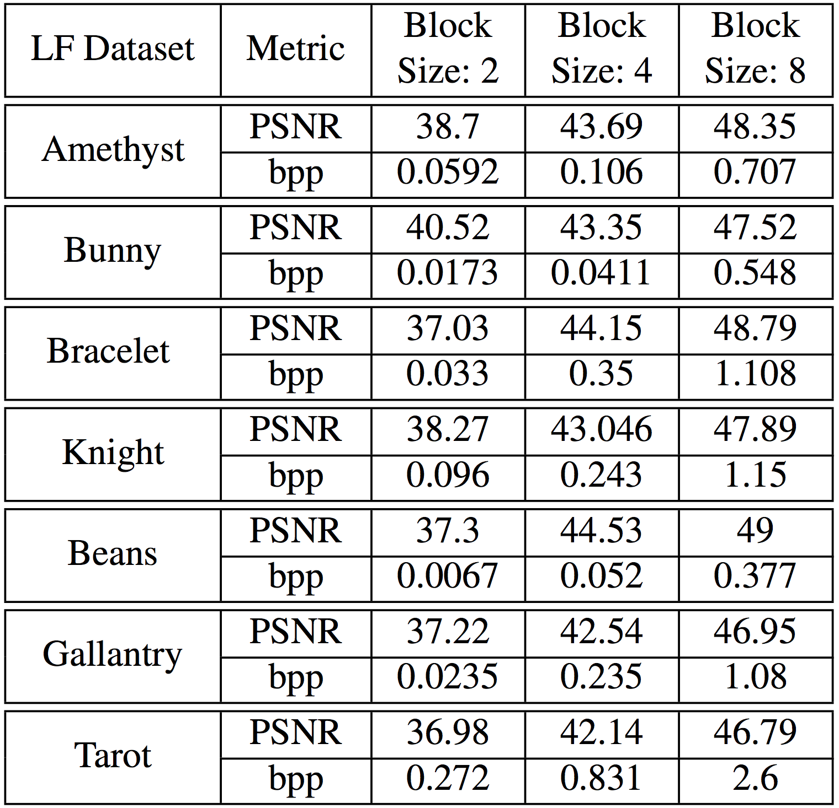
HMLFC: Rate Distortion
Variation with block size

Slide 54
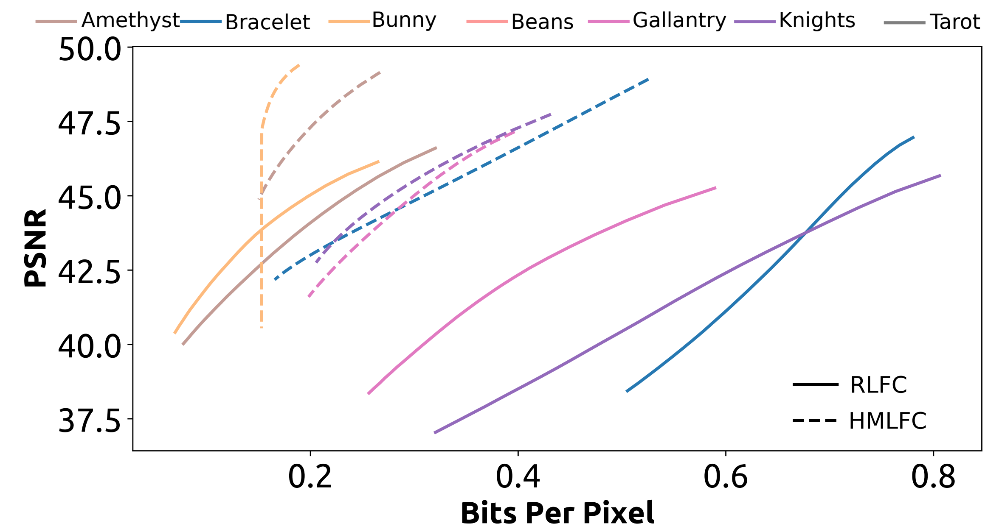
HMLFC: Rate Distortion
Variation with block thresholding

Slide 55
HMLFC: Decoding times
YCoCg-r color space [Malvar et al. 2008]
Block size 8X8
Channel | RLFC (microseconds) | HMLFC (microseconds)
Y - Channel | 2.61 | 3.32
Co - Channel | 1.62 | 2.86
Cg - Channel | 1.42 | 2.21
NVIDIA GTX – 960 (2GB) and Intel Xeon (2.4GHz)

