Slide 1
Managing ultra-high complexity in real-time:
some hints and ingredients
HPG, July 2019
Fabrice NEYRET
CNRS / INRIA / Grenoble University, France
CNRS / INRIA / Grenoble University, France
Notes:
[ ~1h, with 5 small video chunks (not included) ]

Slide 2
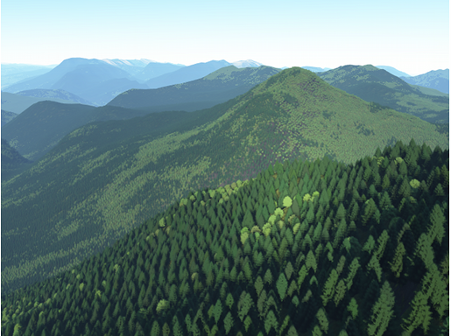
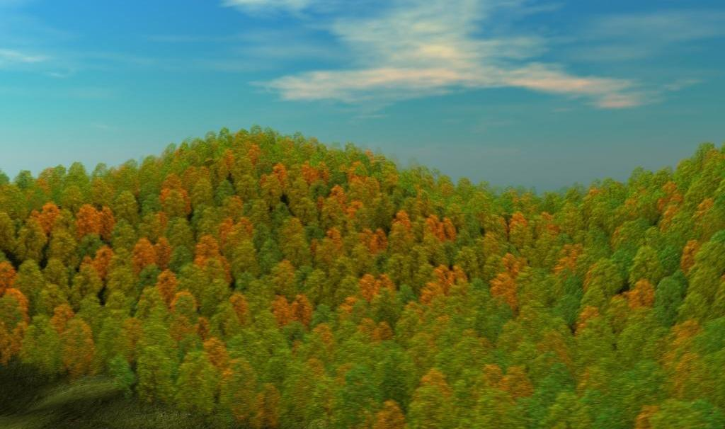
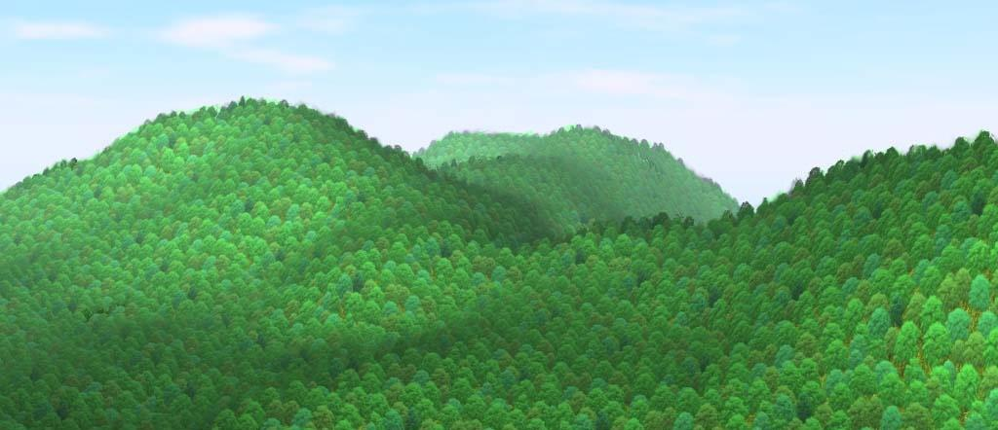
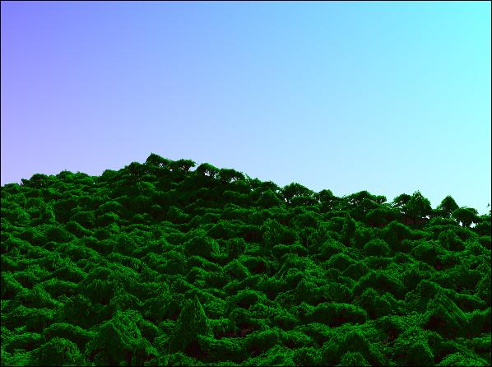
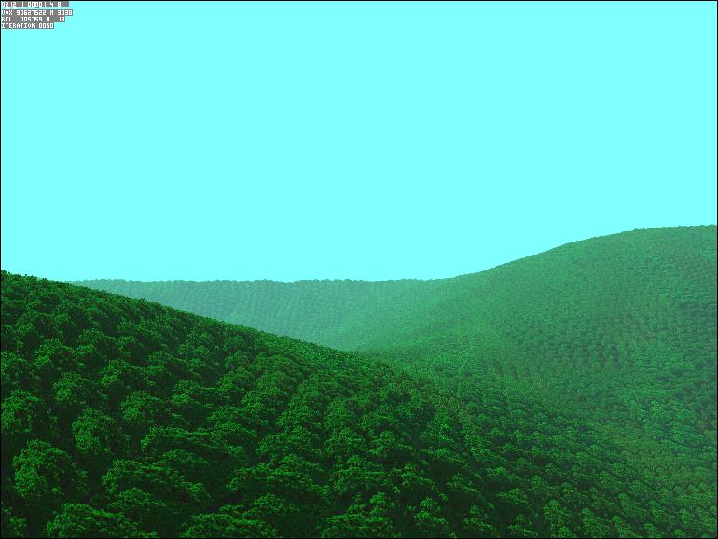
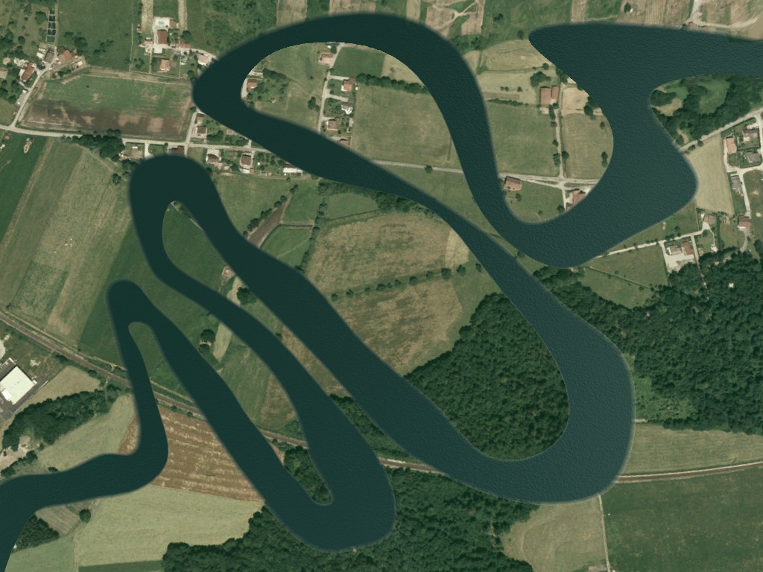
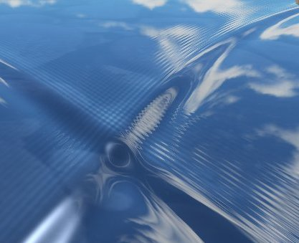
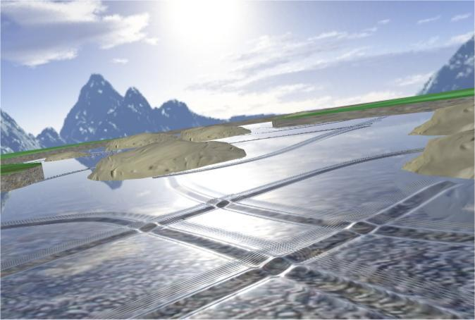
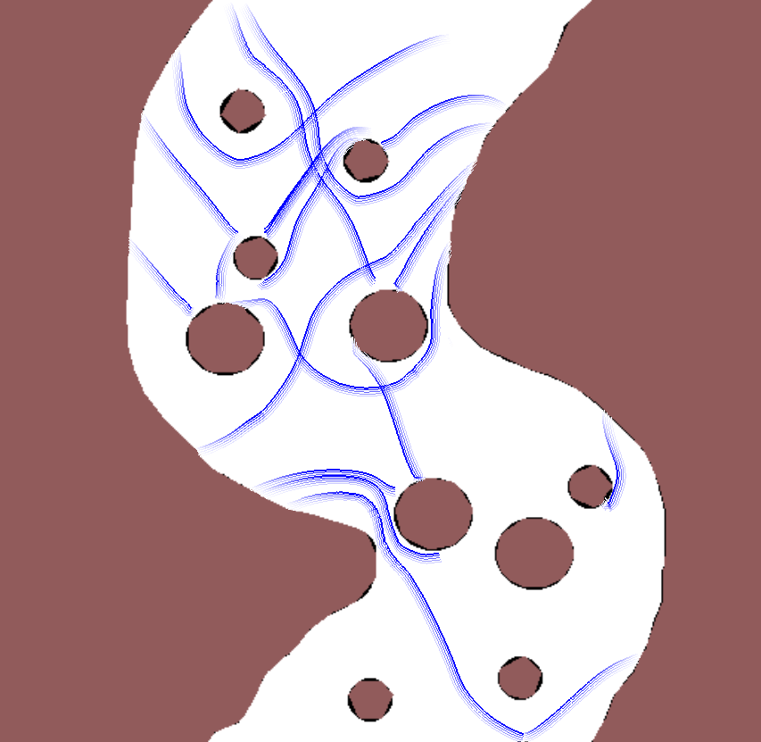
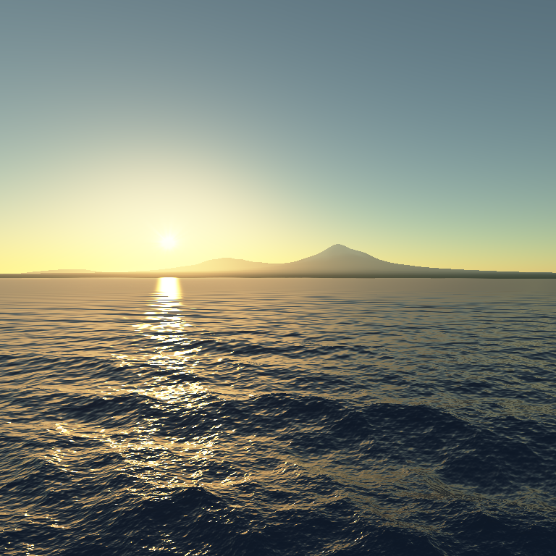
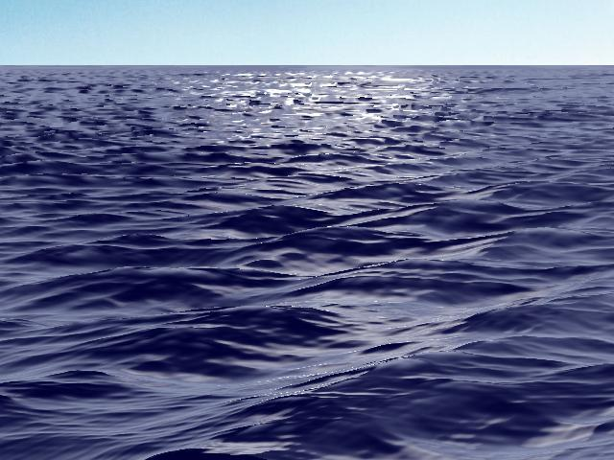
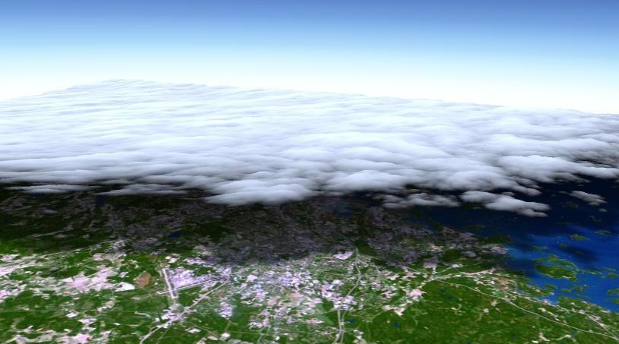
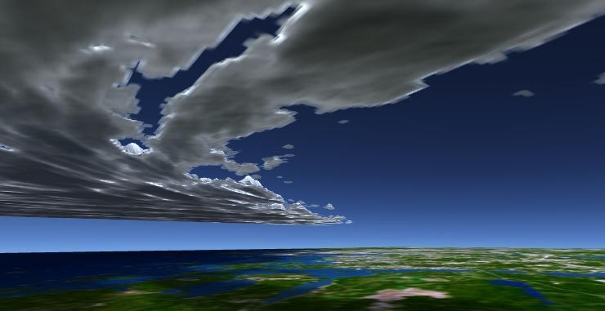
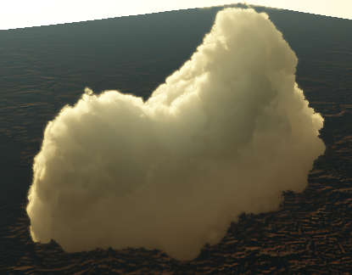
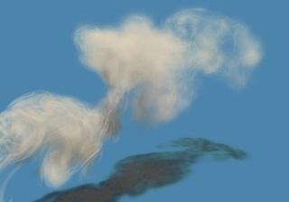
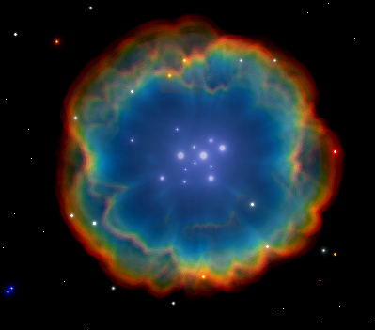
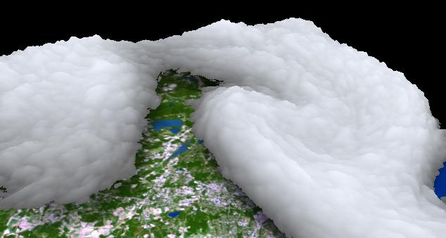
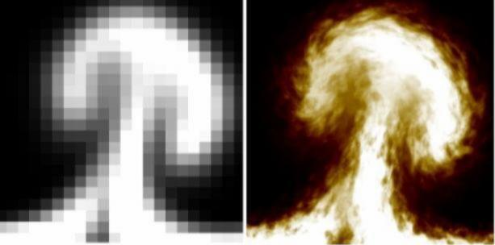
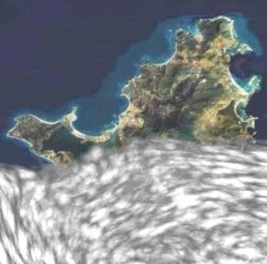
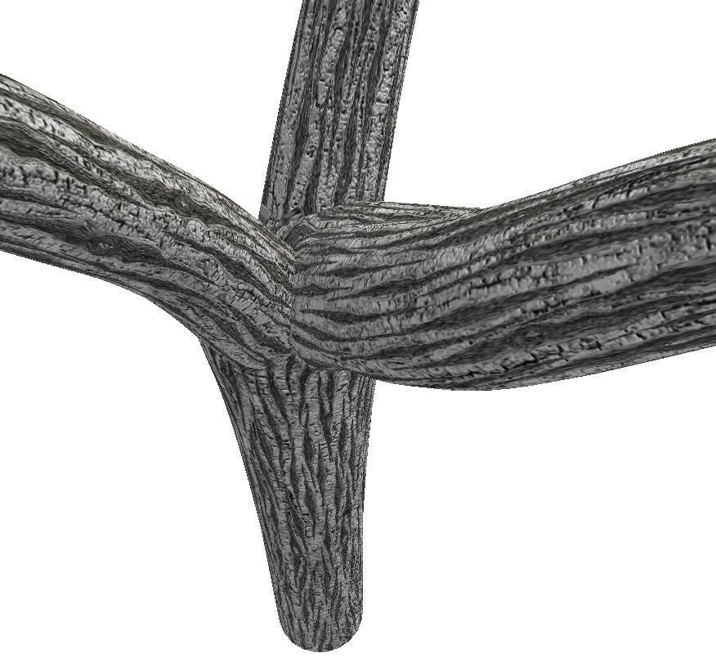
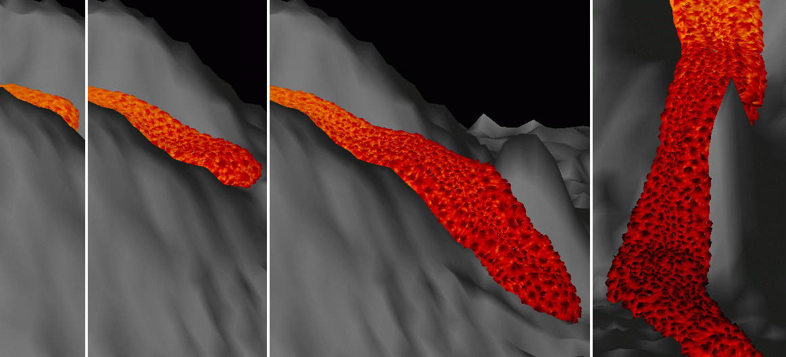
Pheno:
Forests:
Rivers:
Ocean:
Clouds:
Smoke:
Astro-imagery:
Advected textures, Flow Noise:
Bark, lava:
Notes:
… from my experience at tackling the modelization of natural scenes. ( Only the red dots where not real-time… at the time).

Slide 3
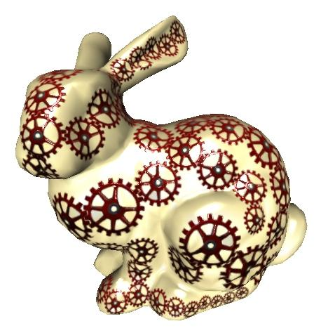
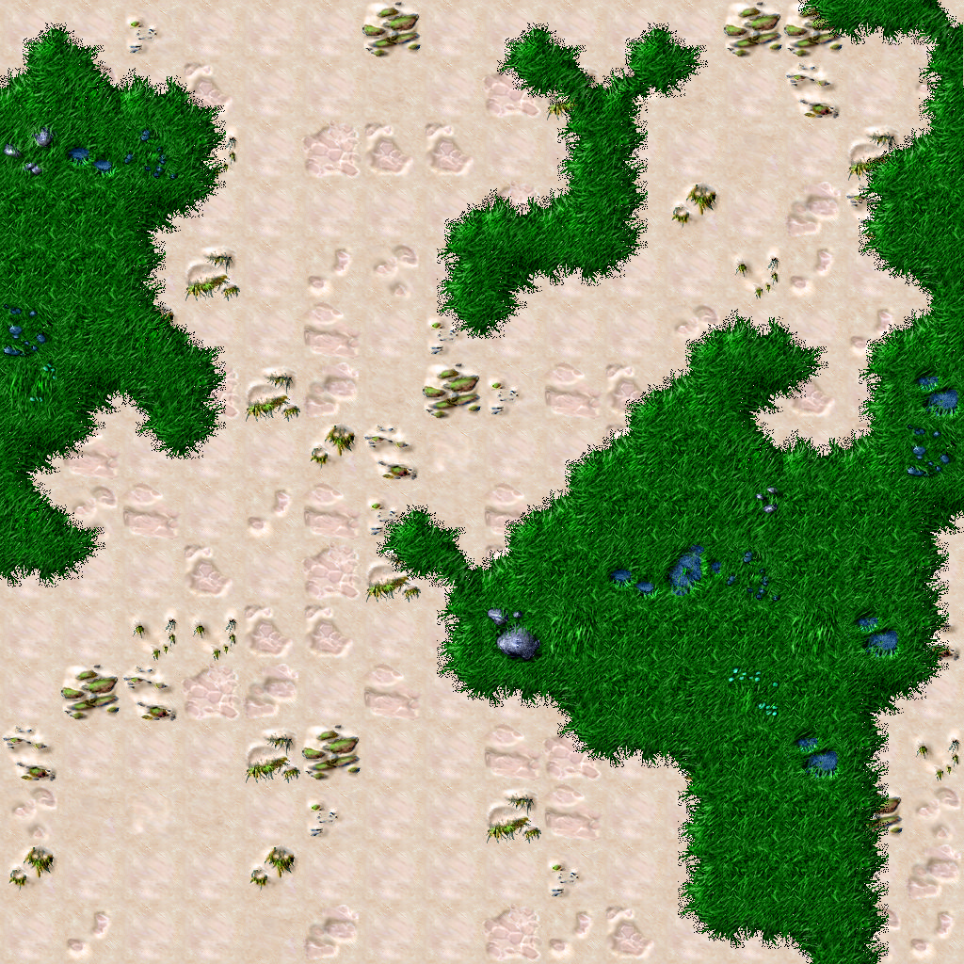
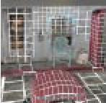
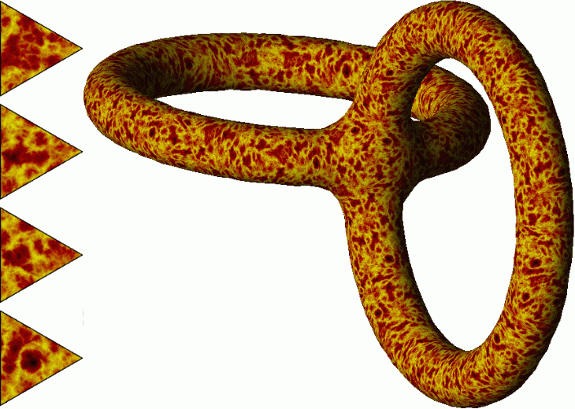
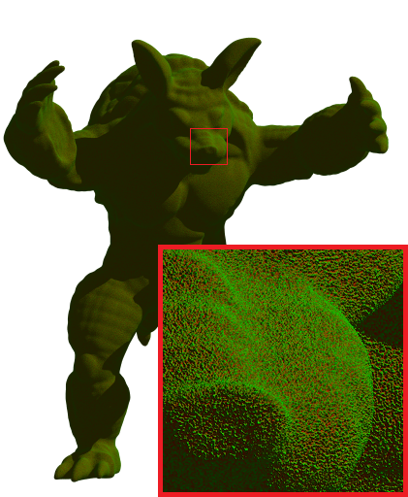
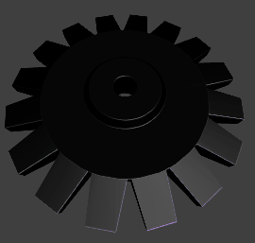
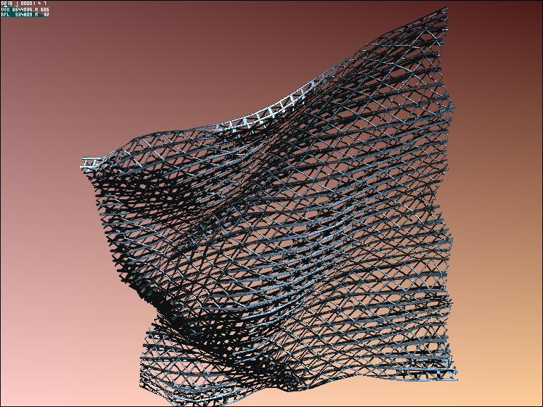
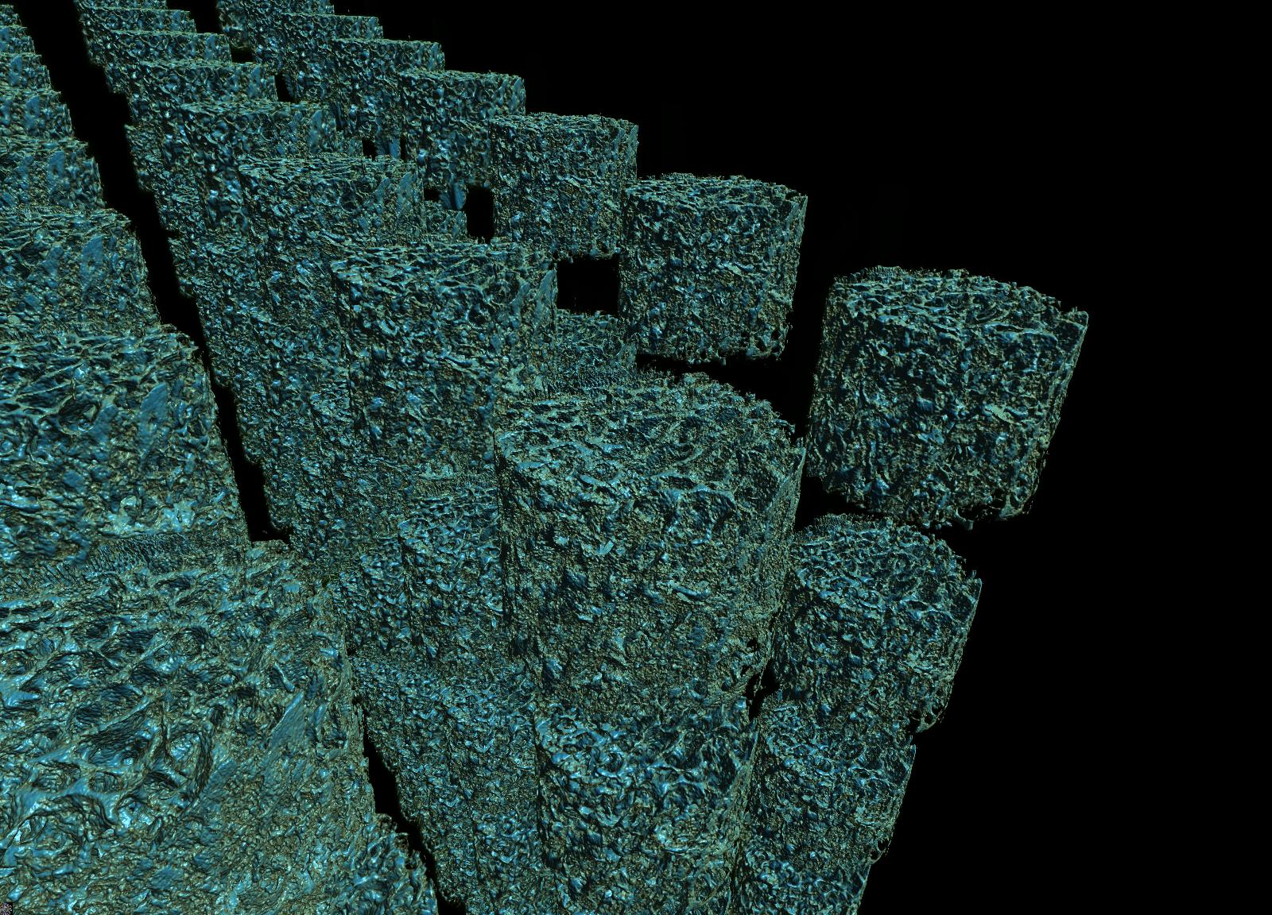
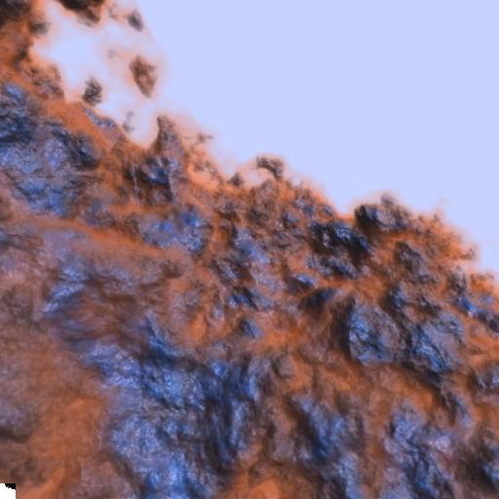
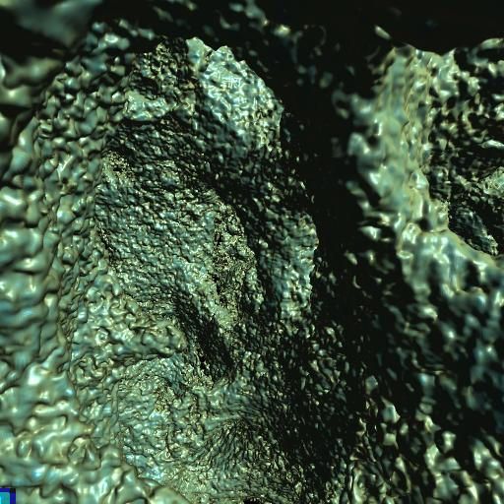
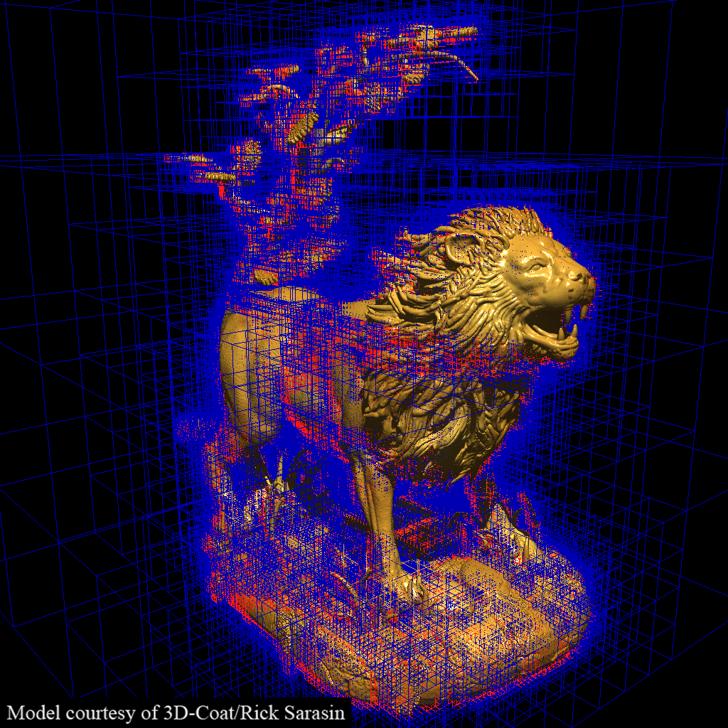
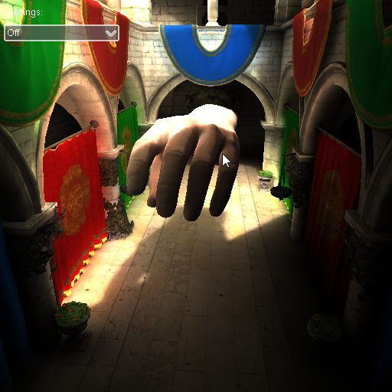
Representations:
Textural world:
Appearance filtering:
SVO:
smart voxels:
Notes:
… and on some more general-purpose representations of complex content I was involved with.

Slide 4
Reproducing the Natural Complexity
Reproducing the Natural Complexity
( photo )

Slide 5
Reproducing the Natural Complexity
ultra-detailed + ultra large
Reproducing the Natural Complexity

Slide 6
Reproducing the Natural Complexity
ultra-detailed + ultra large
shape + animation + rendering
Reproducing the Natural Complexity

Slide 7
Reproducing the Natural Complexity
ultra-detailed + ultra large
shape + animation + rendering
seamless + realistical
Reproducing the Natural Complexity

Slide 8
Reproducing the Natural Complexity
ultra-detailed + ultra large
shape + animation + rendering
realistical
in real-time
Reproducing the Natural Complexity

Slide 9
Reproducing the Natural Complexity
ultra-detailed + ultra large
shape + animation + rendering
realistical
in real-time
controlable
Reproducing the Natural Complexity
Notes:
In games & production scenes are generally designed by artists, to serve a scenario.
Then, automatic black box tools are not cool: designers want some handles.

Slide 10
Reproducing the Natural Complexity
ultra-detailed + ultra large
shape + animation + rendering
realistical
in real-time
controlable
NB: gaming more challenging than prod : we don’t know where/what player will do
( and 1 / million^{th} of time budget )
Reproducing the Natural Complexity

Slide 11
So, what can we do ? → some generalities
Avoid wasting : often, realize el. useless after processed: v. frustum, hidden...
→ requires to structure data
Notes:
Will seem like Captain Obvious remarks, but not so easy to follow.

Slide 12
So, what can we do ? → some generalities
Avoid wasting : often, realize el. useless after processed: v. frustum, hidden...
→ requires to structure data
Use available knowledge :
a priori knowledge on content
assumptions and requirements on context
be consistent ( quality = worst parts, not best )
Notes:
Our contents are generally not semi-transparent glinty white noise floating in the air: we know something ( → regularizing, that can thus be exploited ).
For gaming and effects, our context is not ultra-precision with lives at stake. Just no shocking artifacts and good plausibility.
As scientists or dev we often love focussing on one pet aspect, then we forget that quality = some other weakest part. Also, a complex analytical model is just as good as the availability of parameters for it (or easily tweakable ones).

Slide 13
So, what can we do ? → some generalities
Avoid wasting : often, realize el. useless after processed: v. frustum, hidden...
→ requires to structure data
Use available knowledge :
a priori knowledge on content
assumptions and requirements on context
be consistent ( quality = worst parts, not best )
Use relevant scale : smallest image element = pixels
Notes:
Don’t forget that the true final product is the image, not the 3D world itself.

Slide 14
So, what can we do ? → some generalities
Avoid wasting : often, realize el. useless after processed: v. frustum, hidden...
→ requires to structure data
Use available knowledge :
a priori knowledge on content
assumptions and requirements on context
be consistent ( quality = worst parts, not best )
Use relevant scale : smallest image element = pixels
→ Minimalism : do/store only what you need. ideally 1 sample / pix.
→ requires adapted representation

Slide 15
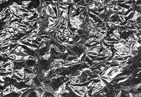
So, what can we do ? → some generalities
Avoid wasting : often, realize el. useless after processed: v. frustum, hidden...
→ requires to structure data
Use available knowledge :
a priori knowledge on content
assumptions and requirements on context
be consistent ( quality = worst parts, not best )
Use relevant scale : smallest image element = pixels
→ Minimalism : do/store only what you need. ideally 1 sample / pix.
→ requires adapted representation
Notes:
...adapted representation: Since if we cull the small details of a crumpled aluminium foil, we still want it to look rough, not mirror-like. → Culled information must be reinjected somewhere else.

Slide 16
Minimalism: guides
“Cost morality” : less info ⇒ should cost less, not more e.g.: soft shadows, depth of field…
Notes:
One could expect that optimal cost should relate to visual complexity. Blurry image contains less information (i.e., has lower Kolmogorov complexity). But usually, soft shadows or depth-of-field cost a lot more than sharp images. → potential for gain.

Slide 17
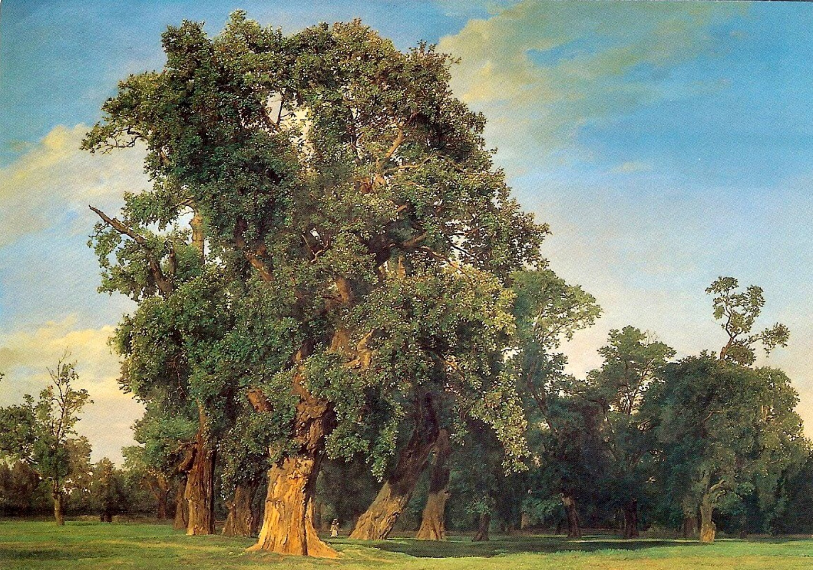
Minimalism: guides
“Cost morality” : less info ⇒ should cost less, not more e.g.: soft shadows, depth of field…
“What a painter would do” :
Notes:
Help forgetting a bit what we know, to focus on what we see.
Painter see blotches of dark and light, then paint so. Not all leaves are there (and strokes are probably not leaves), etc. ( Of course in CG it’s more complicated since we want to wander around the scene. )

Slide 18
Modelization / Choosing a representation
Why MIPmap works so well* ? ( 1 sample / pix )
backproj(pixel) on surface
mapping : direct access to data
texture pixel grid → direct access to neighborhood
texture pixel grid → easy LOD hierarchy → precomputed filtering

Slide 19
Modelization / Choosing a representation
→ General scheme for 1 sample / pix:
differential cone tracing through 3D scene. ( NB: DoF & soft shadow also cones. + tracing ray differentials ).
requires representing appearance at this scale & filtering detailed appearance down to this scale

Slide 20
Modelization / Choosing a representation
Content proxy + appearance model: some ingredients
mesh, voxels, surfels, transp slices, textures, Zmaps, bump maps, NDF, flakes…

Slide 21
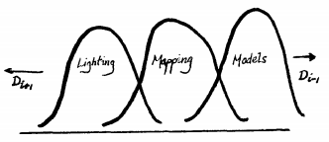
Modelization / Choosing a representation
Content proxy + appearance model: some ingredients
mesh, voxels, surfels, transp slices, textures, Zmaps, bump maps, NDF, flakes…
[ Kajiya85 ] hierarchy of details: geom / bump texture / brdf,phase func “anisotropic reflection models”
ex: [KK89] “render. fur with 3D text.” : voxels + phase func + textural world
Notes:
[Kajiya85] organized the ideas about how to connect representations.

Slide 22
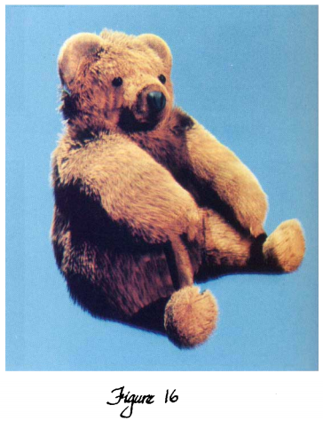
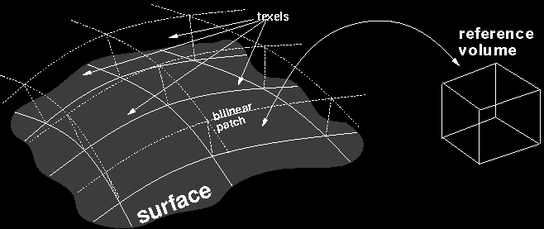
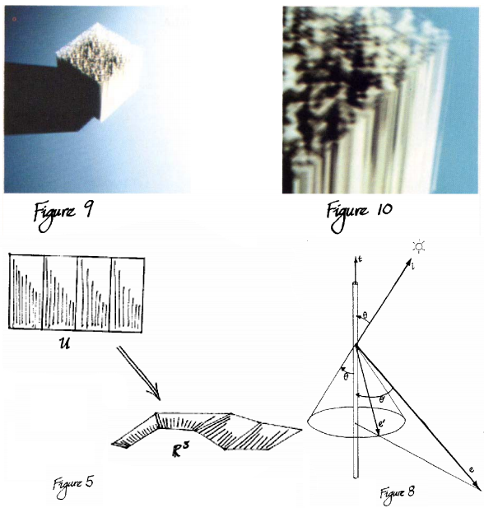
Volumetric Textures
“Rendering fur with three dimensional textures” Kajiya & Kay [ Sig’89 ]
geometry
“texture”
- volume = impressionism illusion
- hierarchy of models [Kaj85]
geom → texture → phase function
- mapping shapes onto shapes
( shape as a 3D material )
phase func
pdf

Slide 23
Modelization / Choosing a representation
Content proxy + appearance model: some ingredients
mesh, voxels, surfels, transp slices, textures, Zmaps, bump maps, NDF, flakes…
[ Kajiya85 ] hierarchy of details: geom / bump texture / brdf,phase func “anisotropic reflection models”
ex: [KK89] “render. fur with 3D text.” : voxels + phase func + textural world

Slide 24
Modelization / Choosing a representation
Content proxy + appearance model: some ingredients
mesh, voxels, surfels, transp slices, textures, Zmaps, bump maps, NDF, flakes…
[ Kajiya85 ] hierarchy of details: geom / bump texture / brdf,phase func “anisotropic reflection models”
ex: [KK89] “render. fur with 3D text.” : voxels + phase func + textural world
expr. vs tables. Datatype: raster(grid) / vector / polynomial... Parameterization.
We want dynamic LOD →
hierarchical is important (closed repr.)
seamless: transitions btw LOD (and repr.)
filter appearance, not raw data
Notes:
In fact [KK89] is not that a good example: hierarchy is static, not dynamic LOD (fix voxel size). we will come to this later.

Slide 25
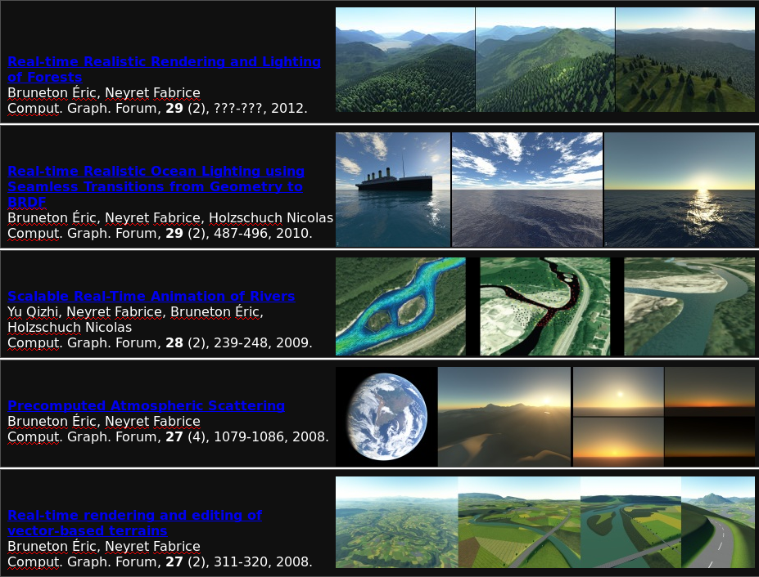
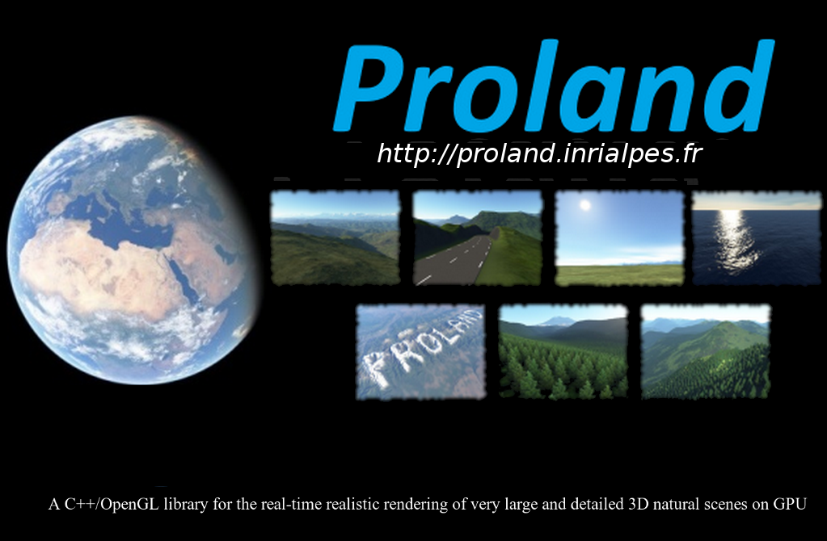
PROLAND, with Eric Bruneton
- whole Earth, all scales
- seamless, realistic
- animated
http://proland.inria.fr
www
video
demo

Slide 26
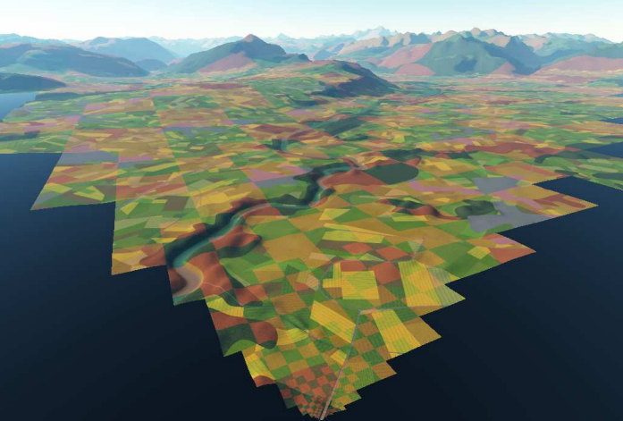
PROLAND, with Eric Bruneton
- whole Earth, all scales
- seamless, realistic
- animated
...only at useful pos & resol: quad-trees + out of core
http://proland.inria.fr
www
video
demo
Notes:
We store only what needed, only at resolution needed.
( Produced on demand, and kept in a cache ).

Slide 27
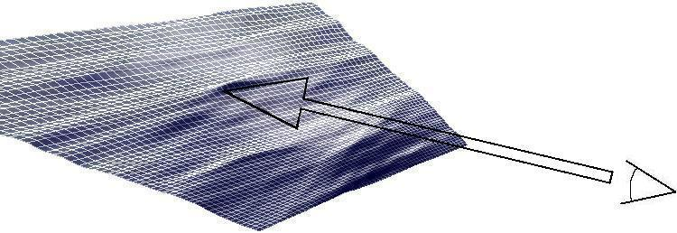
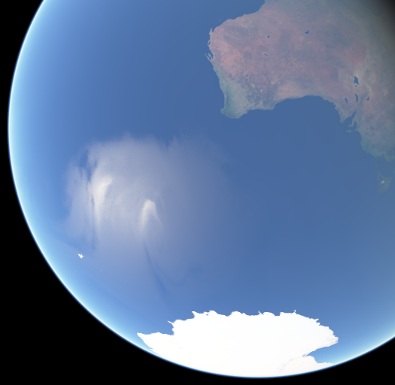
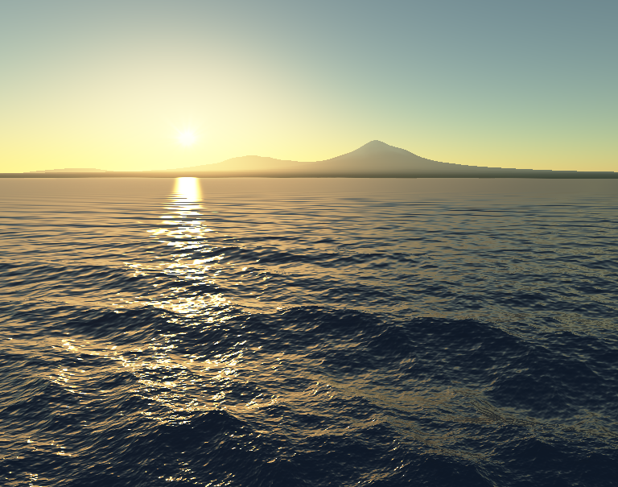
Real-time all-scales ocean, with Eric Bruneton [ EG’10 / SCA’02 ]
simulate all waves
...only at useful pos & resol
waves eqn: Σ trochoïds + oceanographic spectrum A(k)
dispersion eqn
amplitude spectrum (PM)
video
ocean
video
ocean
pdf
Notes:
Our model of all-scales (animated) ocean offers a direct illustration of [Kajiya85] hierarchy principle.
Since waves shape are organized by wavelengths, it is easy to determined which can be resolved in the current pixel.

Slide 28
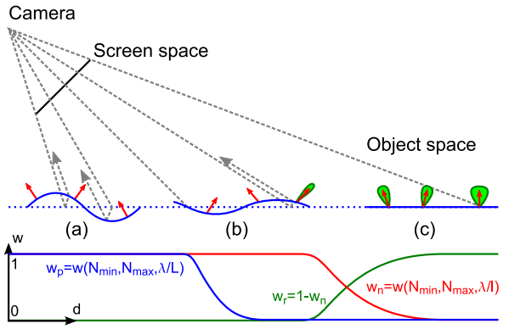
Real-time all-scales ocean, with Eric Bruneton [ EG’10 / SCA’02 ]
simulate all waves
...only at useful pos & resol
waves eqn: Σ trochoïds + oceanographic spectrum A(k)
dispersion eqn
Appearance filtering: shape→<N>→BRDF
amplitude spectrum (PM)
video
ocean
video
ocean
pdf
Notes:
… the smaller ones close to the limit are represented only as normals (bump map), and the even smaller progressively enrich a BRDF. → At the horizon there is no longer any wave geometry but the sunset highlight keeps correct via the corresponding surface roughness. → If we zoom out up to satellite view, the effect of local winds on waves still appears in the highlight pattern.

Slide 29
Endless forest, with Eric Bruneton [ EG’12 ]
in Proland ( ⇒ all scales, real-time, seamless LOD ) realism: sun+sky , trees silverlining & transparency,
all-scales correlations ( hot spot ) + shadowing ( ambient occlusion )
photos:
our:
video demo
video full
Notes:
[video. might replace the slides.]

Slide 30
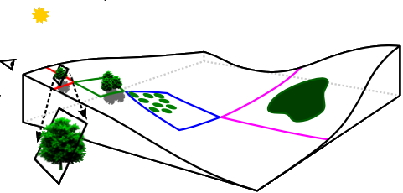
Endless forest, with Eric Bruneton [ EG’12 ]
- several tree species
- Poisson-disk distribs
- gaussian params
- large scale: param maps
3 representations: near, mid, far
forest dyn texture tree / ground
forest dyn shader
individuals with parallax
and detailed shading
pdf
Notes:
[ we can directly use the video instead of these slides ]

Slide 31
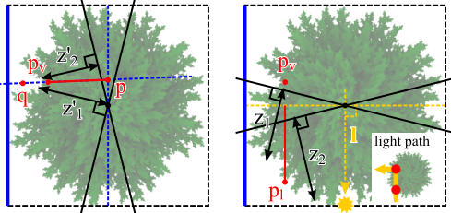
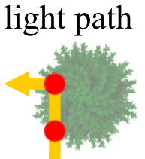
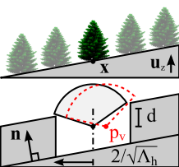
Endless forest, with Eric Bruneton [ EG’12 ]
- several tree species
- Poisson-disk distribs
- gaussian params
- large scale: param maps
3 representations: near, mid, far
forest dyn texture tree / ground
forest dyn shader
Near: ~Zmap IBR
individuals with parallax
and detailed shading
Zv,Zl → extinction
pdf
Notes:
Foreground: we can’t afford detailed tree geometry. → We use precomputed billboards facing camera, mapping to precomputed view-dep Z-images. With a few iterations we get seamless virtual 3D shape. Considering the Z-map in the light direction, we can estimate the light transport inside the tree.

Slide 32
Endless forest, with Eric Bruneton [ EG’12 ]
- several tree species
- Poisson-disk distribs
- gaussian params
- large scale: param maps
3 representations: near, mid, far
forest dyn texture tree / ground
forest dyn shader
Near: ~Zmap IBR
individuals with parallax
and detailed shading
Mid & far: masks*shaders ( ~ “Fake Fur Rendering” [Sig97] )
Zv,Zl → extinction
pdf

Slide 33
→ Deep a priori-knowledge allows deep LOD
What about more generic content ?

Slide 34
Volumetric Textures
“Rendering fur with three dimensional textures” Kajiya & Kay [ Sig’89 ]
- only for hairs - not hierarchical / not filterable
- stochastic ray-tracing
→ static hierar. of details: not for dyn. LOD
→ PhD topic ! :-)
Notes:
The representation is not hierarchical since voxels are fix size: a bunch of hairs has no reason to act like a cylinder phase function, we have no way to aggregate them. → this force to sample data at a fixed resolution ( possibly << pixel ). NB: note that the volume was not explicitly stored: it is just an extruded slice.

Slide 35
Volumetric Textures: generic, LOD my PhD [ 94,95,96, TVCG’98 ]
tiling volumetric layer
Volume:
- multiscale (MIPmap)
- compress void (SVO)
→ octree of voxels
Voxel data: - “generic” reflectance - viewdep opacity -
pdfs
+ videos
NDF of ellipsoid
impressionism illusion :
( → SGGX, GGX )
video
torus
video forest
video
flag
video
lawn
Notes:
How to turn the [KK89] idea into a general-purpose LOD representation ? Octree for hierarchical (used like MIPmap) + efficient void compression (since explicit storage is now used).
Most crucial point = phase function. Representation must be compact (since 1 per voxel), generic enough, allow interpolation & filtering. I used NDF of ellipsoid since it can represent the key cases of flat surface, isotropic volume (i.e. sphere), cylinder, + intermediates ( → good for filtering), with only 5 coefficients to store.
NB: nowadays we would call the ellipsoid a microflake. SGGX reuses the idea with better normalization and aggregation formula. Its authors remarked that the GGX surface BRDF also relates to an ellipsoid NDF, which will ease transition between surfaces and volumes.

Slide 36
Volumetric Textures: generic, LOD my PhD [ 94,95,96, TVCG’98 ]
tiling volumetric layer
Volume:
- multiscale (MIPmap)
- compress void (SVO)
→ octree of voxels
Voxel data: - “generic” reflectance - viewdep opacity -
pdfs
+ videos
NDF of ellipsoid
impressionism illusion :
( → SGGX, GGX )
video
torus
video forest
video
flag
video
lawn
Differential cone tracing ( 3D MIP-mapping ) 1 ray per pixel. Is prefiltering shape appearance !
Notes:
Works well on a variety of shapes. Rendered using only one ray per pixel: the differential cone tracing uses the appropriate MIP-map level, thus no aliasing. → we really (pre)filtered the data appearance-wise !

Slide 37
Volumetric Textures: real-time ( Z-buff ):
with A Meyer [ 98 ], Ph Decaudin [ 04,09 ]
Volume as textured transparent slices → now real-time ! ( no phase function. Only RGBA filtering )
Tiled pattern on volumetric layer:
As free objects:
Notes:
My PhD thesis was off-line ray-tracing. Let now see what we can do in real time. Old school volumes in OpenGL = stacking alpha-textured slices ( as a volumetric layer upon surface or in BBoxes ). → Convey good impression of complexity with a small number of slices, and give nice antialiasing. But slicing LOD must be managed manually, and there is a lot of overdraw (and no voids compression).

Slide 38
GigaVoxels, with Cyril Crassin [ I3D’09 ]
http://gigavoxels.inria.fr
GPU cone-tracing full volumetric scene
www
Youtube
C.Crassin
Notes:
… But now that we have programmable shaders, we can implement volume ray-marching on the GPU. We can then rely on 3D MIPmap, and rays can stop once opaque.

Slide 39
GigaVoxels, with Cyril Crassin [ I3D’09 ]
http://gigavoxels.inria.fr
GPU cone-tracing full volumetric scene
Volume:
- multiscale
- compress void (SVO)
→ octree of bricks + out of core
- ( hardcoded gradient phase function )
→ ”volumetric PROLAND”
Differential cone tracing 1 ray per pixel.
www
Youtube
C.Crassin
Notes:
Still, the GPU memory is (very) limited while the detailed scene can contain arbitrary large data.
→ we rely on the same scheme than Proland, transposed to volumes: We use an octree in place of the quadtree, voxels bricks instead of texture quads, and we produce the necessary bricks at necessary resolution only once needed (and then kept in a cache).

Slide 40
GigaVoxels, with Cyril Crassin [ I3D’09 ]
http://gigavoxels.inria.fr
GPU cone-tracing full volumetric scene
Volume:
- multiscale
- compress void (SVO)
→ octree of bricks + out of core
Differential cone tracing 1 ray per pixel.
www
Youtube
C.Crassin
Notes:
How can we be sure memory will be enough to render a frame ? First, note that despite “volume” is often understood as “gaseous phenomena”, our goal is to represent “ordinary scenes” (e.g. the average bunny) with voxels [ NB: naming ‘SVO’ instead of ‘volumes’ help disambiguating this to reviewers ;-) ]. If everything is semi-transparent noise, then we must store and traverse everything in the frustum: it won’t fit + it can’t be fast. If we assume an ordinary scene is made of opaque clusters (possibly with fuzzy borders) laying in transparent medium, then the camera sees either details on foreground (then the rays stop) or large coarse data on the background (after fast traversal of the void), giving a pretty constant maximum number of visible bricks per frame.

Slide 41
GigaVoxels, with Cyril Crassin [ I3D’09 ]
http://gigavoxels.inria.fr
GPU cone-tracing full volumetric scene
Volume:
- multiscale
- compress void (SVO)
→ octree of bricks + out of core
-
Differential cone tracing 1 ray per pixel.
DoF and soft shadow = blurry ⇒ faster !
www
Youtube
C.Crassin
Notes:
Note that with depth of field effect, the blurry regions fetch coarse data and marching them uses larger steps, so these images are indeed faster to render than sharp ones !
[video]

Slide 42
GI-Voxels, with Cyril Crassin [ CGF’11 ]
+ reflectance + multiple scattering
Differential cone tracing 1 ray per pixel.
pdf
video GI voxels
Notes:
Now we have quite reached back the setup of my off-line PhD model [ without the stored phase function, though ].
→ How to go further and compute multiple scattering on materials ? ( e.g., the glossy reflection on the floor ).

Slide 43
GI-Voxels, with Cyril Crassin [ CGF’11 ]
Differential cone tracing 1 ray per pixel.
+ reflectance + multiple scattering
pdf
video GI voxels
Notes:
For a mirror reflection on a surface, we can just bounce the incoming cone in the Snell-Descarte direction (possibly with added ray-differential aperture), and continue integrating the scene along the ray. → For a rough specular, we have just to enlarge the cone. But for precise materials, one wants to rely on some given angular weighting profile. → we can subdivide the cone and use different weight for each, and trade efficiency for precision with the level of subdivision. Similarly for the diffuse, a 2pi steradian cone would be impractical, but we can efficiently integrate all directions with a few cones. ( NB: in a first pass, we project light from the sources and store the energy in the voxels ).

Slide 44
GI-Voxels, with Cyril Crassin [ CGF’11 ]
Differential cone tracing 1 ray per pixel.
+ reflectance + multiple scattering
Voxel data: ( smart voxels ) - viewdep opacity ( 6 dir ) - col, reflectance ( lobes ) & light ( 6 dir )
- no reflectance LOD
pdf
video GI voxels
Notes:
Still, with opaque objects like this architectural data there is an issue: If the voxel contains a wall, opacity should be 100% if the wall is facing the viewer or weak if seen from the side. Also, the wall could be blue on one side and red on the other side. Or even lit on one side and not on the other side. → Opacity, attributes and energy must be view-dependent. In this first application, we used 6 directions. [video]
So, contrarily to gaseous volumes, general purpose requires smart voxels.

Slide 45
Smarter voxels: correlation, with G. Loubet [ EG’18 ]
silhouette issue
Silhouette
uncorrelated
renderer: Mitsuba
Notes:
If we want to push accuracy, there is more to consider for smart voxels:
A “density” voxel value corresponds to uniform uncorrelated content. But on silhouettes, all the real content is packed on one side. If we represent this content as a single uniform voxel, we will overestimate opacity.

Slide 46
Smarter voxels: correlation, with G. Loubet [ EG’18 ]
silhouette issue
self-shadowing issue
Silhouette
uncorrelated
pdf
( renderer: Mitsuba )
Notes:
Similarly if the content is not homogeneous and isotropic (like the hairs on the right), we can sometime see deep inside some unlit regions. Uniformizing the pixel content would prevent this, thus getting over-bright material.
Cf image (with usual voxels on left, shadows get too opaque and matter too bright at coarse LODs). We proposed an extended microflakes model encoding some of the intra-voxel correlation with few extra parameters (cf image, right).

Slide 47
Mixing mesh and volumes
Because source data is often mesh
Animated meshes
Because host render engine is often mesh based
For efficiency ( walls... )
and precision ( walls... )
Notes:
Host render engine:
Because to be used by people, we can’t tell them “trash your system and use mine” ;-) . Better to have a way to integrate in existing workflows.
Walls:
Voxels are efficient to encode complex content, but for a large flat wall on foreground using just one big polygon is always more efficient. Also, we have seen that the opacity must be view-dependent. If the encoding of view-dependency is approximate, we might have light leaks between adjacent wall voxels.

Slide 48
Mixing mesh and Volumes, with C. Crassin, G. Loubet
Z-buffer + GI-Voxel in fragment shader
CC [ CGF’11 ]
dynamic voxelization
video GI voxels
Notes:
[ video also illustrates dynamic voxelisation of animated meshes ].
I did not tell you everything about the GI-voxels example. Indeed, what you see is ordinary Z-buffer rendering of a polygonal mesh ;-) . Only once in the fragment shader, we switch to the volumetric world (possibly at low resolution).

Slide 49
Mixing mesh and Volumes, with C. Crassin, G. Loubet
Z-buffer + GI-Voxel in fragment shader
CC [ CGF’11 ]
dynamic voxelization
geom LOD + appearance filtering continuous transition ( progressive aggregation ) : mesh + brdf (GGX) + col → voxels + phase-func (SGGX) + col GL [ EG’17 ]
pdf
video
( renderer: Mitsuba )
Notes:
Atotally different mix context: extending geometric LOD to volumes.
Here, we revisited the traditional geometric LODs, but appearance-wise, including BRDF.
When the local content to be aggregated can no longer be represented by geometry, we locally switch to voxels + flakes. As mentioned earlier, if we represent BRDF with GGX and flakes with SGGX, the transition is easy.

Slide 50
LOD → Filtering shape into shading:
That’s it for volumes.
What can we do for surfaces ?
→ heightfield

Slide 51
Appearance filtering of heightfields
with Eric Heitz [ HPG’12,I3D’13, SIGA’13 ]
- Small scale relief + visibility
→ all is view-dep and light-dep !
video + pdf
Notes:
When a pixel footprint covers a patch of heightfield, we would like to directly rely on his (pixel-)average appearance. Problem: it depends on what is visible from eye, and from light. E.g. if the top of the heightfield is green and the bottom is red, on average the material looks yellow, but on silhouettes we only see the green top of bumps. Similarly at grazing light angle, only the green tops are lit. So the apparent chrominance varies. [video]

Slide 52
Appearance filtering of heightfields
with Eric Heitz [ HPG’12,I3D’13, SIGA’13 ]
- Small scale relief + visibility
→ all is view-dep and light-dep !
- Correlations everywhere !
→ light and colors → + content correlation
→ normals → missing in all bumps
→ visibility → microfacet models
→ occlusion
...
video + pdf
Notes:
And what is true for color is true for everything else: shadows, normals, highlights… There are potential correlations everywhere !
Still, we want a way to directly access the average appearance in a pixel footprint (without brute-force integration).

Slide 53
Appearance filtering of heightfields
with Eric Heitz [ HPG’12,I3D’13, SIGA’13 ]
content correlation
ex: color-height,
color-orientation
⇒ pixel integral not separable ( or : why MIPmapping is so wrong )
color masking BRDF shadowing
video + pdf
Notes:
To understand the problem more formally, let see what MIPmapping does so wrong:
the true pixel appearance is the pixel-integral of incoming light x color x BRDF(N) x visibility from eye and light. MIPmap assumes that everything but the color can factor out of the integral. This is wrong when there are correlation in the content (giving the constant-red bunny instead of the chrominance-varying). The very definition of correlation is sum(products) != product(sums), i.e., non-separability.

Slide 54
Appearance filtering of heightfields
with Eric Heitz [ HPG’12,I3D’13, SIGA’13 ]
BTW, even color(texture) is an issue
→ also all f(noise): LUT, clamp, abs...
since
average(LUT(text.)) # LUT(average(text.))
LUT ( 0.5 )
Notes:
Indeed, this kind of problem occurs all the time, even in much simpler situations. E.g., when a color look-up (or any non-linear transform) is applied to a grey-level texture (or any field). The naïve idea would be to apply the LUT to the pixel-average of the field. At the horizon the pixel-average of the field might be 0.5, but there is no reason that the value stored at mid-LUT corresponds to the average color. LUT(sum) != sum(LUT). Averaging operator doesn’t commute.
So what can we do if we want to avoid brute-force integration ?

Slide 55
Appearance filtering of heightfields
with Eric Heitz [ HPG’12,I3D’13, SIGA’13 ]
BTW, even color(texture) is an issue
→ also all f(noise): LUT, clamp, abs...
since
average(LUT(text.)) # LUT(average(text.))
LUT ( 0.5 )
→ Idea: use stat distrib
1: average = < LUT, histogram >
Notes:
One thing that is exact is that integrating on the field is equivalent to integrating on its histogram ( this is just the variable change f(x)dx → df ).

Slide 56
Appearance filtering of heightfields
with Eric Heitz [ HPG’12,I3D’13, SIGA’13 ]
BTW, even color(texture) is an issue
→ also all f(noise): LUT, clamp, abs...
since
average(LUT(text.)) # LUT(average(text.))
LUT ( 0.5 )
→ Idea: use stat distrib
1: average = < LUT, histogram >
2: histogram ~ gaussian
3: simply precompute iLUT(v,σ)
NB: applies to any distrib
e.g., heights ...
Notes:
Note that this work with any field. E.g., a heightfield.

Slide 57
Appearance filtering of heightfields
with Eric Heitz [ HPG’12,I3D’13, SIGA’13 ]
heightfield content correlation ex: color-height,
pb: apparent heights distribution
is view-dep and light-dep
color-shape correlation ⇒ view+light correlation
Notes:
...So now we can come back to the problem of filtering the appearance of a heightfield with color correlated to height. Problem: the color is also modulated by visibility from camera and light.

Slide 58
Appearance filtering of heightfields
with Eric Heitz [ HPG’12,I3D’13, SIGA’13 ]
heightfield content correlation ex: color-height , color-orientation
pb: apparent heights distribution
is view-dep and light-dep
color-shape correlation ⇒ view+light correlation
→
4: effect = lobe offset
→ easy !
5: NB: for diffuse surface,
effect of envmap = irradiance_map(N)
→ cf colormap(slope)
Notes:
With the hypothesis of Gaussian histogram of slopes, we show that the effect of visibility is just to bias the statistic of apparent & lit heights. So we can now fetch the correct pre-filtered color.
[video]

Slide 59
Appearance filtering of heightfields
with Eric Heitz et.al [ HPG’12,I3D’13, SIGA’13 ]
heightfield → BRDF (microfacets)
Notes:
Now, what about filtering the BRDF itself over the heightfield in the pixel footprint ?
For this is at the hearth of the [Kajiya85] hierarchy principle: converting geometry to BRDF at distance.

Slide 60
Appearance filtering of heightfields
with Eric Heitz et.al [ HPG’12,I3D’13, SIGA’13 ]
heightfield → BRDF (microfacets)
microfacets BRDF: Beckmann NDF ← f ( slope variance )
Notes:
Illustrated with the specular term: in microfacet BRDF model (as well as many other models), the NDF roughness appears as a slope variance parameter.

Slide 61
Appearance filtering of heightfields
with Eric Heitz et.al [ HPG’12,I3D’13, SIGA’13 ]
heightfield → BRDF (microfacets)
microfacets BRDF: Beckmann NDF ← f ( full slope stat. ) → tilted anisotropic lobe
Notes:
This easily generalizes by swapping with the full statistic: tilt by average slope and apply anisotropic covariance matrix.
Now, how to get these slopes statistics efficiently ?

Slide 62
Appearance filtering of heightfields
with Eric Heitz et.al [ HPG’12,I3D’13, SIGA’13 ]
heightfield → BRDF (microfacets)
LEAN maps → eval slope statistics MIPmap = moments → cov matrix
slopes
slopes ²
→ m1, m2, ∑
microfacets BRDF: Beckmann NDF ← f ( full slope stat. ) → tilted anisotropic lobe- point light + IBL
Notes:
By reusing a cool idea from the “Lean map” paper [Olano10]:
We have a map with the heightfield. if you store the slopes (dh/dx and dh/dy) in another map, MIPmapping directly provides the local average within the current pixel footprint.
And if you also store the square of the slopes, and the diagonal product, MIPmap directly provides the second moment for you.
So you can obtain the covariance matrix (and the full intra-pixel statistics) basically for free, and inject them in the BRDF model. [video]

Slide 63
Appearance filtering of heightfields
with Eric Heitz et.al [ HPG’12,I3D’13, SIGA’13 ]
heightfield → BRDF (microfacets)
LEAN maps → eval slope statistics MIPmap = moments → cov matrix
slopes
slopes ²
Effect of geometric distortion on appearance:
video T-rex
microfacets BRDF: Beckmann NDF → tilted anisotropic lobe
video prop
pdf
Notes:
Note that this statistic is still a representation of the same nature than geometry:
if you stretch the heightfield, the slopes change accordingly and so does the covariant matrix, changing the roughness accordingly. Geometric transforms propagate to the BRDF.

Slide 64
Managing ultra-high complexity:
so many other important stuffs...

Slide 65
Realistic clouds in real time, with Antoine Bouthors [ EGNP’06, I3D’08 ]
pdf
pdf
Youtube

Slide 66
Realistic clouds in real time, with Antoine Bouthors [ EGNP’06, I3D’08 ]
simulating all light paths: hard pb.
→ goal: real time !
reflectance:
Mie :-s
absorption: 0
pdf
pdf
Youtube
Notes:
There is basically no absorption so we need to consider very high orders of scattering, or some cloud parts will be way too dark.
Besides, the Mie phase function is a nightmare, e.g. with its very high Bessel oscillations (and this is a log-plot).
But this is a typical case where we can be blinded by what we know.

Slide 67
Realistic clouds in real time, with Antoine Bouthors [ EGNP’06, I3D’08 ]
simulating all light paths: hard pb.
→ goal: real time !
1: ∫ Droplet Size Distrib
→ cancels Bessel oscillations
reflectance:
Mie :-s
DSD
2: nscatter > 1
→ - peak (50% E) ~= no hit
- high freq useless
- no colored back-scatter
absorption: 0
pdf
pdf
Youtube
Notes:
In nature droplets are not all the same size, they come in a distribution (e.g. log-normal). The location of Bessel oscillations shifts with the droplet radius, and when you integrate on the radius distribution they vanish.
The resulting phase function is less nasty, but still: cf backscatter peak, rainbow colored arc, second fogbow, and 50% of the energy within the 5° forward direction (and a reminder it’s a log-plot).
It’s tempting to approximate this narrow forward by a Dirac, but the silverlining on cloud silhouette is entirely due to the glossiness, so we can’t suppress it. In fact, we can keep it for 1 or 2-scatters paths only, but for higher orders, convolving the phase function by a narrow lobe or a Dirac is just the same, so here we can do the approximation.
But what means having a Dirac representing 50% of the energy in the forward direction ? It means just forget the Dirac, and divide the probability of scattering by 2. So we end up with this quite more gentle phase function, with very little approximation.

Slide 68
Realistic clouds in real time, with Antoine Bouthors [ EGNP’06, I3D’08 ]
simulating all light paths: hard pb.
→ real time !
3: macro-material
(L,V,Vpos,thick.)5D
➔collector(pos,σ)3D
ψ(i,o)
~ ”Most Probable Path”
10⁷ simu
fit
pdf
pdf
Youtube
Notes:
Now, about the light transport itself. What we would like is look at a cloud pixel and directly obtain the connection with the cloud surface collecting the entering light. So we want to characterise a sort of subsurface scattering in cloud material, in the spirit of “Most Probable Path” paper [Premoze03] : in a slab, if the eye is at a given height and direction and light at a given angle, where does the incoming light come from. MPP paper characterized a “banana” beam shape and considered it’s curved axis as the MPP.
We run a virtual experiment to characterize the full Gaussian collector, in the idea to tabulate collector(view&light setup).

Slide 69
Realistic clouds in real time, with Antoine Bouthors [ EGNP’06, I3D’08 ]
simulating all light paths: hard pb.
→ real time !
3: separate scattering orders
→ shift Most Probable Path
and scale of transport
3: macro-material
(L,V,Vpos,thick.)5D
➔collector(pos,σ)3D
ψ(i,o)
10⁷ simu
fit
pdf
pdf
Youtube
Notes:
We did more: Antoine had the idea of grouping paths by order of scattering. This revealed a very specific behavior, with the collector shifting in location and size as the scattering order increases. This gives us our “subsurface” precomputed cloud material model.

Slide 70
Realistic clouds in real time, with Antoine Bouthors [ EGNP’06, I3D’08 ]
simulating all light paths: hard pb.
→ real time !
3: separate scattering orders
→ shift Most Probable Path
and scale of transport
3: macro-material
(L,V,Vpos,thick.)5D
➔collector(pos,σ)3D
4: solve i=collect(o) for cloud shape
ψ(i,o)
10⁷ simu
fit
5: ground cloud radiosity, sky illu
pdf
pdf
Youtube
Notes:
Of course clouds are not slabs. From the output cloud pixel, for each group of scattering order, we find the associate collector with a few iterations.

Slide 71
Animated details
Notes:
A problem I didn’t addressed yet: details are sometime animated, which adds to the difficulty.

Slide 72
Fluids as vortex filaments, with Alexis Angelidis [ SCA’05,06 ]
photos
Notes:
E.g., clouds and smoke are rich in details, but their shape results from movement. Ideally they should result from some fluid simulation, a costly process, especially at high 3D resolution. Moreover we usually do simulations in “aquarium” regions with boundaries, while landscapes are large and open spaces. So what could we do ?

Slide 73
Fluids as vortex filaments, with Alexis Angelidis [ SCA’05,06 ]
- "soul" of fluid motion - compact, highres, controlable… - closer to std CG workflow
photos
Notes:
The fact is, it you take the curl of a velocity field to visualize its vorticity, you see 2 things: in this dual space, the value is zero almost everywhere, which is very convenient for boundless domains. And the content is coherently organized as filaments, which we can thus represent as vector curves. These vorticity filaments are really the soul of convective and turbulent fluids. And this is very compact to manage and store, quite intuitive to the artist, so that if he doesn’t like a part of the simulation he can edit or keyframe the curve.

Slide 74
Fluids as vortex filaments, with Alexis Angelidis [ SCA’05,06 ]
- "soul" of fluid motion - compact, highres, controlable… - closer to std CG workflow
photos
Lagrangian curves
Notes:
Indeed we can simulate Navier-Stokes equation directly in vorticity space, this is even simpler (mass conservation is built-in). And we can do it directly on our lineic particles, the vorticity filaments, which is a lot more accurate (no numerical dissipation). Then we can get the induced velocity at any location by the inverse of curl, i.e. the Biot&Savart law. For visualisation, we just drop passive markers wherever needed.

Slide 75
Fluids as vortex filaments, with Alexis Angelidis [ SCA’05,06 ]
- "soul" of fluid motion - compact, highres, controlable… - closer to std CG workflow
photos
Lagrangian curves
pdf
+ video
+ vortex noise
+ particles = ellipsoid
Notes:
So, 2 ideas here:
Sometime a problem is much simpler (or a representation is more convenient) in some dual space.
Sometime using vector representation instead of raster (or the reverse: e.g: voxels, from meshes) can help.

Slide 76
Rivers & vector features, with NP,QY,EB,... [ SCA’01,EG’09,...]
(photos)
grid⇒ high res or aliasing
Notes:
Another example: on a river surface, ripples are millimetric in size (capillary waves). But they catch Sun highlights very well, and are thus visible up to very far away. Simulating and storing the heightmap at this resolution would be cumbersome. And we even need a resolution quite higher than the wavelength to avoid geometric aliasing.

Slide 77
Rivers & vector features, with NP,QY,EB,... [ SCA’01,EG’09,...]
(photos)
grid⇒ high res or aliasing
align mesh with features, or meshless
Notes:
To save computation and storage, at least we can try to sample coherently with ripples direction. Or even, to mesh only where ripples are expected. Or to rely on some meshless approach directly in the fragment shader.

Slide 78
Rivers & vector features, with NP,QY,EB,... [ SCA’01,EG’09,...]
(photos)
grid⇒ high res or aliasing
align mesh with features, or meshless
analytic flow
Notes:
Note that in many situations, we can totally avoid numerical flow simulation at all, and rely on analytic computation on the fly. It’s what we did for Proland rivers.

Slide 79
Fluids amplification: flownoise & advected texture with K.Perlin, Q.Yu, … [ SigSketch’01, SCA’03, Sig’07, TVCG’11 ]
1: given: coarse flow simu details: use texture
2: advect texture & preserve aspect
volume
height-field
Notes:
As often in graphics, the artist might want to rely on a coarse base flow animation, and add the details through some texture. Here the texture would be advected with the flow, but it needs to be regenerated to keep its aspect (I was involved with several published methods solving that).

Slide 80
Fluids amplification: flownoise & advected texture with K.Perlin, Q.Yu, … [ SigSketch’01, SCA’03, Sig’07, TVCG’11 ]
1: given: coarse flow simu details: use texture
2: advect texture & preserve aspect
3: flownoise: swirling Perlin noise
volume
pdf
video
height-field
Notes:
But advecting is not sufficient: the artist likely wants the texture itself to be “fluidy”, i.e. turbulent and swirling.
For this I relied on a small idea we published with Ken Perlin: a swirling version of Perlin noise, just by rotating the random gradients, and this at each fractal scale.

Slide 81
Fluids amplification: flownoise & advected texture with K.Perlin, Q.Yu, … [ SigSketch’01, SCA’03, Sig’07, TVCG’11 ]
1: given: coarse flow simu details: use texture
2: advect texture & preserve aspect
3: flownoise: swirling Perlin noise
volume
pdf
video
4: amplifying fluid: subscale turbulence
height-field
pdf + video
pdf + video
Notes:
To connect this to some physics behavior, I related on a characteristics of turbulence, the Kolmogorov cascade telling how vorticity is transported to smaller and smaller scales along a power law. The incoming energy can be measured in the coarse simulation, then we just pick up the rotation rates at needed scales and plug them in the flownoise model.

Slide 82
Life in texture space, with S.Lefebvre, … [ SIG’99, I3D’03,I3D’05,RR’06, GPU Gems2 ]
High res data on demand low geometry cost
Simu in mix space
Notes:
[no time !] When complexity lies on a surface (or in vicinity), we can use geometry as a proxy, and settle the representation in texture space. We can even process simulations in texture space (possibly with some feedback with the 3D world).

Slide 83
Galaxy Project, with RSA Cosmos & Paris-Meudon Observatory
- Real time walk-through
- ~ Hubble quality - spectral
GigaVoxels++ & proceduralism
- Real time walk-through
- ~ Hubble quality - spectral
GigaVoxels++ & proceduralism
simulating
video SkyExplorer
www
Notes:
[no time !]

Slide 84
Conclusion
There is hope for ultra-high complexity in real-time :-)
Notes:
I know I was speed, but the idea was to show it could already be done in various examples (some already old ☺ ), and to open the doors and windows about possibilities and ingredients.

Slide 85
Conclusion
There is hope for ultra-high complexity in real-time :-)
Future: “converging” RT tools on GPU are cool, but don’t lose our soul:
Gaming is more challenging than prod: ( 1 / million^{th} of time budget… ) → we must keep being smart !

Slide 86
Conclusion
There is hope for ultra-high complexity in real-time :-)
Future: “converging” RT tools on GPU are cool, but don’t lose our soul:
Gaming is more challenging than prod: ( 1 / million^{th} of time budget… ) → we must keep being smart !
So:
don’t get too picky with raw path tracing as light transport
don’t get too picky with “no, it’s biased” argument
keep our shader expressiveness
( materials, proceduralism, alt. representations )
or LOD will be forbidden ( then either perf or quality or complexity won’t be ok )

Slide 87
Conclusion
There is hope for ultra-high complexity in real-time :-)
Future: “converging” RT tools on GPU are cool, but don’t lose our soul:
Gaming is more challenging than prod: ( 1 / million^{th} of time budget… ) → we must keep being smart !
So:
don’t get too picky with raw path tracing as light transport
don’t get too picky with “no, it’s biased” argument
keep our shader expressiveness
( materials, proceduralism, alt. representations )
or LOD will be forbidden ( then either perf or quality or complexity won’t be ok )
PS: all presented tools are usable in prod too ;-)

Slide 88
Questions ?

Slide 89
heap
( extra discussion material )
Notes:
[ not mentioned in the talk ] Potential useful high level content from previous talks.

Slide 90
A few things I learned

Slide 91
Representations
Many tools on store !
raster (e.g., Photoshop) = grid
vs vector (e.g. Illustrator) = shape
grids: image texture. Voxels. Eulerian simu. BRDF table. SH.
vectors: GL,ps,laser. Mesh. Lagrangian simu, filaments. Lobes.
- indeed, more continuous: amount of info:
compressed data, base decomp., compr.sensing, fit, procedural, analytic
size matter:
- 4D table is cheap if interpolated low-res
- fitting or SH is not cheap if 798 coefs + trancend. math op
- opposed pro- and con- :
- no universal one: choose the appropriate
→ can be mixed :
- can change with scale or interaction length (local / long dist)
- each box can use different one:
shape, colors, shadowing & light transport, anim (space def)

Slide 92
Representations
Ones from Physics & maths:
Eulerian vs Lagrangian
Space vs Fourier
Velocity vs vorticity
Point-mechanics vs Finite elements / SPH
Color spaces
Point mechanics / statistic mechanics / fluids / waves / spectrums
energy lines
Photons / waves / rays / energy
( don’t forget validity domain & hypothesis )

Slide 93
Representations
Where to start:
- where is largest potential for improvement ?
ie, what worse part in the look / workflow ?
- best improvement reachable for each bit of extra budget ?
think “differentials everywhere” : pixel=circle, occluder=slab, ray=spline.
= 1st order Taylor approx
better = F(P)+PX.grad(P), X in neighborhood. → integrate(f(Fb(P,X),X))
- what constraints ? preferences ?
time budget ? storage budget ? precision budget ? hard or sloppy ?
Have quality estim
→ faith → weighting, transition to backup to canonical approach
Reminder: quality = worst box, not best
so long “perfect equation” if no accurate parameter available
→ forgot nothing ? Shannon-Nyquist ok ? Large Numbers ok ?

Slide 94
Differential everywhere !
= continuous integral everywhere
Points are not physical objects
differentials are. dS, dl, dω, cones… = local integral
differential domain ⇒ value=distrib.
→ Distributions everywhere !
Any scalar → distribution ( colors, mask … )
Any vector → distribution ( velocity, pos, ... )
- minimal is a lot better than nothing
- can be cheap to have & store: Gaussian stddev, lobe width
- can be cheap to use
make well-posed many ill-posed problems
e.g., aliasing and filtering issues
is a kind of LOD ( subgrid model )

Slide 95
LOD everywhere !
Reminder: metrics = pixel color
→ LOD is not “anything simpler”
LOD ~= pre-integration over the pixel
i.e., preparation of the colorfield pixel integral giving
→ compact magic atom renderable with 1 sample
Some LOD examples:
- CG: roughness. brdf, glossiness. surface.
NDF,MIPmap,texture. impostors,particles.
Physics:
- pseudoforces: buoyancy, coupling, ….
- pseudo objects: rays & optic geometry. Surfaces & solids
- emerging numbers: Temp, Pressure…. even Velocity…
( probably even space & time )

Slide 96
LOD everywhere !
LOD ~= pre-integration over the pixel
i.e., preparation of the colorfield pixel integral giving
Not so easy:
- non-linearity → average(f(x)) is not f(average(x)). same for interpolation
- correlations, non-separability → ∫fg is not ∫f ∫g
- a cascade of wrongness & clandestine hypothesis: MIPmapping
→ Reformulate:
- other physics or math handle
- distributions. Stat momentums.
- reparameterize: log, sqrt, ^2, 1/x, equivalent set (e.e., polar)
- change space: uv → uvw, or no uv

Slide 97
LOD everywhere !
hierarchical:
- scalewise divide and conquer
- don’t forget upstream and downstream:
frequencies in data ? frequencies once rendered ?
different scales might be totally different problems:
- different purpose (scenario)
- different perception (river-way / flow / details)
- different knowledge
→ different controls
→ Choose best representation

Slide 98
Undeveloped ( so many slides, so little time... )
Philosophical key questions
- What is an LOD ? (metrics: screen, pixels)
- What is a volume ? a surface ?
- What is a normal ? a transparency ?
- What is a sample ? a texture ?
Sampled scales along graphics pipeline → aliasing & bias
maths (integration calculus, signal processing)
texture render geom anim
geometry/material/brdf fetch pixel/intersect vertex/polygon vertex/voxel
sample span footprint/kernel kernel(Srate,DoF) surf(kernel) mesh/vol(kernel), dt
multiscaling subgrid LODfetch(aniso) fragment(Abuff) brdf subgrid, motion blur
interpolation mag,min mag,min mag,LOD subdiv,decim mag, more blur
aliasing/oversmoothing Moire,noise jaggies,noise peak,jaggies flick,pop,backturn
(col,spec,shadow) (shape,sillh,shadows,+render)
poor: (beside aliasing) color change shading change silh,small feat. ghosting,polymove
filtering (pre-integration)
‘filtering’ means: lod+aniso mutisampling micropolygon sampled blur
Shannon-Nyquist obeing: no/poor filter sampling anything displ(mdl/rend) t-sampling anything
op after filter having screen hifreq

Slide 99
Qu’est-ce que la recherche en synthèse d’images ?
About “physical models” (in CG tongue)
« ‘physical approach’, ‘exact’, ‘rigorous’»
There is no such thing like «exact» in physics
«Physical» ≠ local (equa-diff)
Local eqn vs macroscopic, «rigorous vs empirical»: subjective !
mecaQ → molecules → stat phys → thermodyn → → NS → hydraulics/waves/atmo(oceano)sc
mecaQ → EM field → Huygens → geom optic → → RT/radios/visibility
Hypothesis, conditions, limits of validity
ex, continuous fluids: notion of P,T, V, parcel (emergence)
Border conditions, parameters one half of the problem is not or poorly known !
continuous eqn → numerical engineering: resol issues
subgrid models: on-going research
sub-res → errors qualitatives and quantitatives [SAA00]
Tool, inspiration. But don’t sacralize. Context is important !
D’où viennent les participants ?
( dans industrie, labos, soumissions )
Contour flou: assemblée de disciplines
Plusieurs angles pour un problème
Focus: application ultime
D’où viennent les problèmes / l’inspiration ?
( industrie, «science pure», autres sciences)
BAD SCIENCE: Vrai ? Attention aux prétextes !
BAD SCIENCE: Attention aux «solutions without a problem»
GOOD SCIENCE: Poser un problème (pour étude, article)
Relation aux autres sciences (prend, donne, boucles)

Slide 100
What does users want ?
Graphist:
Super-spectator
Scenario
Expressive tools: not black box !
Usable
Controlable
Intuitive & predictables parameters
Generative space rich / useful enough
Feedback ( → fast is useful even for SFX )
For on scene, on shot. → All tools are on shell + full manual

Slide 101
Studying real world
Physics eqn vs the real Nature
Structured vs ‘blurry’, known vs dirt & fluctuations Artificial symmetries,regularities,rigidities change the phenomenon ( buckling, natural convection, silhouette brdf )
Clandestine hypothesis ( Evil !)
LC: borders, such a mysterious thing ! (meso-shape, param value) e.g. “river bed”, “bark”
Useless details vs uncontrolled emerging phenomena
Simu: result change with resol [PDI-LF02]
A.Fournier: start from real images, end with real images (inspiration, validation)
Observe. picture. film. touch. draw. Repeat.
Learn how to see. Find the ‘meaning’ (the ‘structure’. of things & eye)
Pb of subjective validation

Slide 102
Reproducing the Natural Complexity
Reproducing the Natural Complexity
Quality real-time rendering / animation is sometime reachable
- Choose the right representation
- Be smart rather than brute force
- Don’t get blinded by what you know
→ look through the window, Nature is right there ! :-)

Slide 103
Alternate representations
Scales: (≠ meaning, perception, goal, data, simu) → coupling different models
Formes, surfaces: subjectives notions !
How to representer the world ?
What we know / what we see (shape, relief…)
Minimalist, impressionnist approaches separate shape/relief, normals, shading Adaptive: hierarchy of modeles [Kaj85]
Repr. of shapes: meshs, surfels, voxels… Properties ≠ : structuration, cost, filtering…
Decoupling (geom / texture space / light space / ...)

Slide 104
Phenomenological simulation
Large & detailed: physical simu out of reach. + [PDI-LF02]
Some a priori knowledge usually exists !
values ranges, modes, dominant pheno…
at least: what the purpose is, what the scene is
Emerging effects: instabil., waves, folds, equilibrium…
Equations: indirect, phys++. While predictable
Closer too meaning, macroscopic, intuition, user language
Direct repr of emerging phenomenons Macroscopic phys ( phenomenological / empirical / analytical )
Availablemodels / analytical / direct obs. / obs. ref simu
Macroscopic primitive
XVIIIth - XXth treasures
revisit, make yours, invent, generalize…
uneasy, sparsely explored…but results might pay.

Slide 105
Settling a problem
Purpose (what are we aiming at ? why ?)
goal: finalist (appli) vs constructive (fondam. tools)
Formalize data/knowledge
Formalize hypothesis (reasonned), Goals (list of requirements), Criterions
Proposal
What already exist ? what to draw on, what’s inadapted and why ?
Your way (explicit and justified choices) goals →sub-goals →details (c/ code review!)
Validation, + & -, perfs, limitations, comparaisons

Slide 106
Texture filtering ( interp & MIP-map)
Clandestines hypothesis:
Linearity 1: N, courb., visibility, shadows, const params. pb: micro-géométrie ! Filtrage ultime !
Linearity 2: fragment = lin(texture) , i.e.: text = RGBA
pb: textures banalisées (Z,N,…) !
Continuity: neglect borders, holes, atlases, tiling
pb: indirections !
Filtrage de géométrie:
Polygones pas antialiasés
+ en + petits
Pas filtrables en amont
→ repr alt, transition de modèle

Slide 107
Texture filtering ( interp &
Clandestines hypothesis:
Linearity 1: N, courb., visibility, shadows, const params.
pb: micro-geometry ! Ultimate filtering !
Linearity 2: fragment = lin(texture) , i.e.: text = RGBA
pb: textures for anything (Z,N,…) !
Continuity: neglect borders, holes, atlases, tiling
pb: indirections !
Geometry filtering:
Polygons not antialiased
Get smaller and smaller
Not pre-filterable
→ repr alt, model transition [Kaj85]

