Slide 1
Research Impact Retrospective: MLAA from 2009 to 2017
Alex Reshetov, NVIDIA
Jorge Jimenez, Activision
Notes:
MLAA paper was presented at the inaugural HPG, last time Siggraph was on East Coast.
I have some unique perspective, since I knew about this algorithm before August 2009.

Slide 2
the original title
MLAA Introspective: from 2009 to 2017
Alex Reshetov, NVIDIA
Jorge Jimenez, Activision
Notes:
This was my original proposal for the title of this talk, and Peter-Pike recommended changing it to Retrospective.
And this is, basically, the story of MLAA: I suggested something and other people made it better.

Slide 3
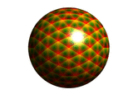
Alexander Reshetov
Intel Labs
Notes:
This is the master slide for the original presentation showing the algorithm as-is.
I had also included this rotating sphere, which has nothing to do with neither the algorithm, nor HPG, nor Intel.
It was a byproduct of some botched research on normals and I just didn’t want to waste it completely.

Slide 4
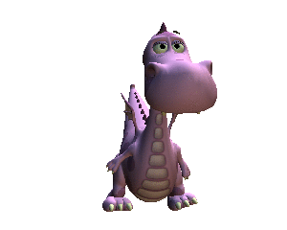
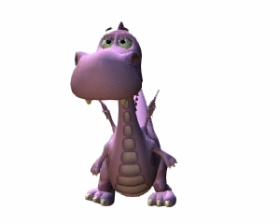
What we’re talking about
this one is antialiased _
^ this one is not
(if you can read it, you can see it)
Notes:
We will be talking about image antialiasing using only image data.

Slide 5
If you were in N.O. in 2009 you would learn…
What sfumato is
Notes:
If you attended to original presentation, you would learn what sfumato is

Slide 6
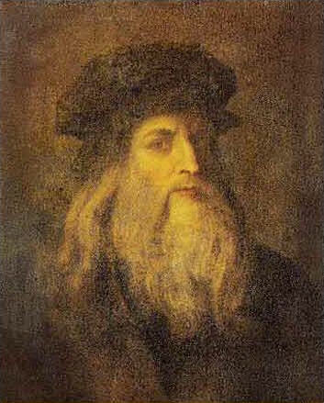
If you were in N.O. in 2009 you would learn…
What sfumato is
sfumato: painting technique “without lines or borders, in the manner of smoke or beyond the focus plane”
Leonardo da Vinci – Inventor of Antialiasing

Slide 7
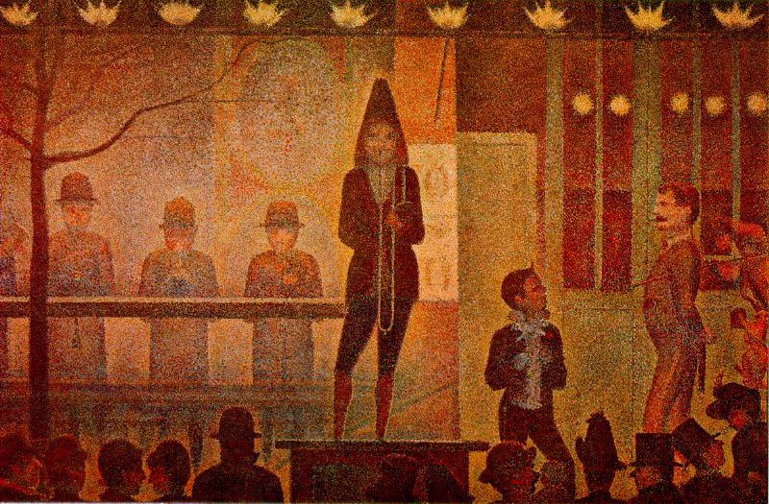
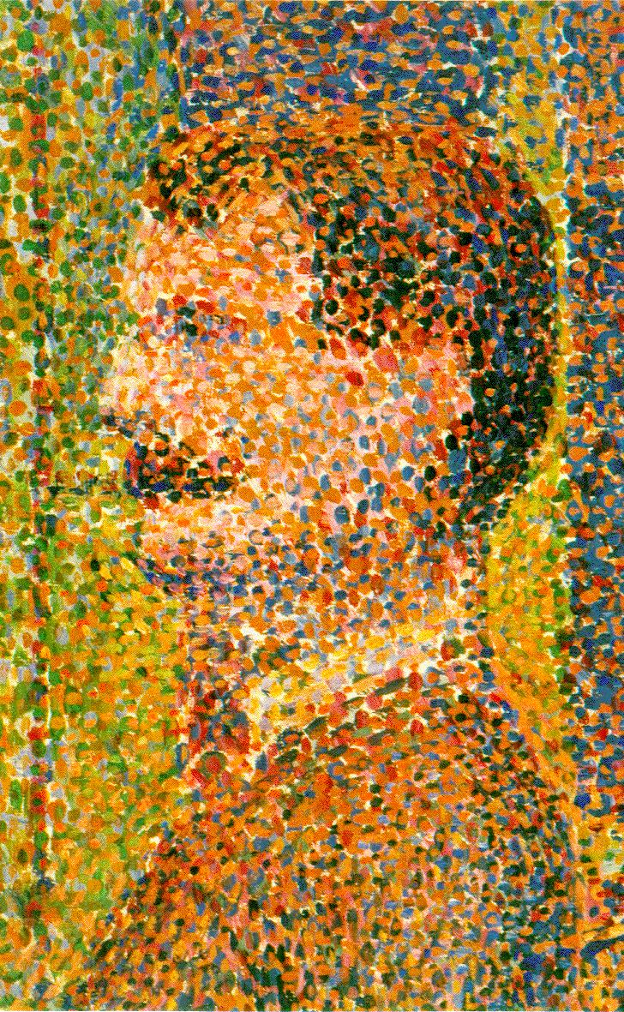
If you were in N.O. in 2009 you would learn…
What sfumato is
How Georges-Pierre Seurat worked on his paintings (pointillism)
Notes:
And the painting technique of Georges Seurat.

Slide 8
If you were in N.O. in 2009 you would learn…
What sfumato is
How Georges-Pierre Seurat worked on his paintings (pointillism)
We would discuss Black Square of Kazimir Malevich
Notes:
We would discuss Black Square of Kazimir Malevich

Slide 9
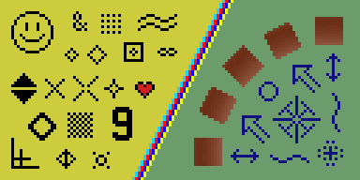
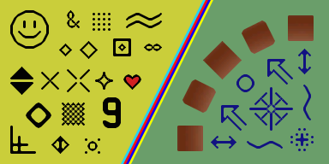
If you were in N.O. in 2009 you would learn…
What sfumato is
How Georges-Pierre Seurat worked on his paintings (pointillism)
We would discuss Black Square of Kazimir Malevich
and early Pixel Art
Notes:
and early Pixel Art.

Slide 10
If you were in N.O. in 2009 you would learn…
What sfumato is
How Georges-Pierre Seurat worked on his paintings (pointillism)
We would discuss Black Square of Kazimir Malevich
and early Pixel Art
畫意能達萬言
Notes:
You also would learn what it means in Chinese.

Slide 11
However…
You would learn nothing about deferred shading
In fact, this term was never mentioned in neither
The MLAA paper
The ‘09 presentation
But 1 out of 4 reviewers guessed it right
Notes:
However, you would learn nothing about deferred shading.
And, in fact, it was never mentioned in neither MLAA paper, nor the presentation though
One of the reviewers guessed it right.

Slide 12
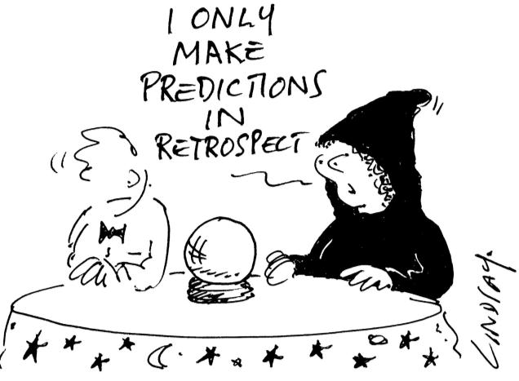
Notes:
This makes it quite interesting to think what had happened. And, of course, it is much easier to look back.

Slide 13
“The Americans have need of the telephone, but we do not. We have plenty of messenger boys” Sir William Preece, Chief Engineer, British Post Office, 1878
“There is not the slightest indication that nuclear energy will ever be obtainable. It would mean that the atom would have to be shattered at will” Albert Einstein, 1932
“There is no reason for any individual to have a computer in his home” Ken Olson, president, chairman and founder of Digital Equipment Corporation (DEC), in a talk given to a 1977 World Future Society
“In short, never use BVH” Gordon Stoll, Siggraph 2005 Course on Real-Time Ray Tracing
Notes:
This is the list of some technological predictions that didn’t quite come true.

Slide 14
Would it be nice though…
…If we could predict outcome of our research (is significance/risk == const?)
Eventually, DL will take care of it, but now,
using MLAA as an example, I will
describe ‘under the hood’ details of the project,
speculate what makes research successful,
and what ‘success’ actually means
Jorge will talk about the advanced features and the current status of MLAA (is it dead yet?)
Notes:
It would be so nice though to be able to predict what would happen with a particular research direction.
Eventually, Deep Learning will take care of it and everything else, but now,
I would like to use MLAA to speculate what makes research successful and describe some under the hood details.
And Jorge will talk about the current status of MLAA and antialiasing in general.

Slide 15
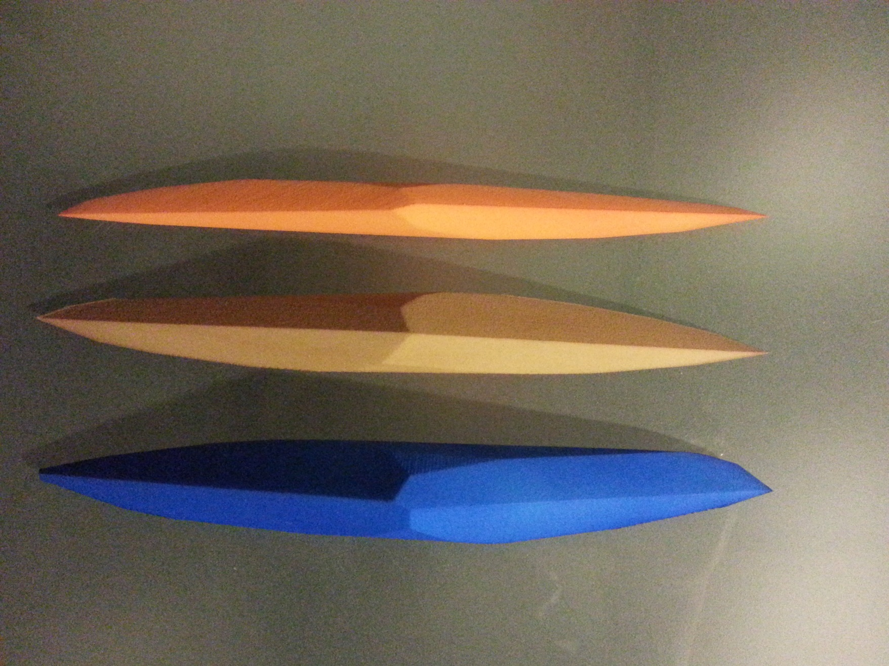
In fact, I’ll talk about 2 research projects
Morphological antialiasing
A
unistable
polyhedron with 14 faces
Wasn’t developed with a clear goal in mind
An explicit goal to improve the previous best
(I started working first on soft shadows by
result (18)
diffusion)
Many variations
Many variations
Criteria of success was murky
Couldn’t be more clear
No limitations at all; valid in any corner
Many limitations
of the Universe
Wasn’t very happy with the result
Happy as a clam at high tide
Have a limited lifespan
Will remain in Wikipedia till year 3000
Widely adopted by game developers
Has absolutely no practical value
src
code released
src
code released
Notes:
In fact, I will talk about two projects, since one case is just a guess, but 2 is already statistics.
First one is MLAA, and the second project is a search for polyhedron that is stable only on one face and has small number of faces.
These are 3D printed examples of the found bodies and this is the video showing that there is only one face for which this thing is stable.
I.e. if placed on any other face, it will rotate until ending on the only stable face.
I had never attended any American school, and I never participated in this show-and-tell activities.
So this is my opportunity to experience it for the first time.
This is one of such bodies. This one, I think with 17 faces, as it can be printed in a bigger size.
So, as you could guess, this project was undertaken with a very explicit goal in mind.
On the other hand, MLAA was neither antialiasing nor morphological for a long time, as I started it trying to have soft shadows by diffusion.
It was not working, the diffused images were coming ugly, and I started thinking what was the problem. The problem was, of course, that computer-generated images are prone to aliasing unless specifically taken care of, while aliasing by itself never happens in nature.
Both projects had experienced many variations, though net result was quite different: one has many limitations, while another is correct in any place in the Universe.
Accordingly, I was happy with one result, and not so happy with the another.
Due to all its limitations, MLAA has a limited lifespan, while the polyhedron thing will still be in Wikipedia in a year 3000.
Yet, one project was widely adopted by game developers, while another has absolutely no practical value and will never have.
What unites these 2 projects, and was rather important in their fate, is that source code was made available for both of them

Slide 16
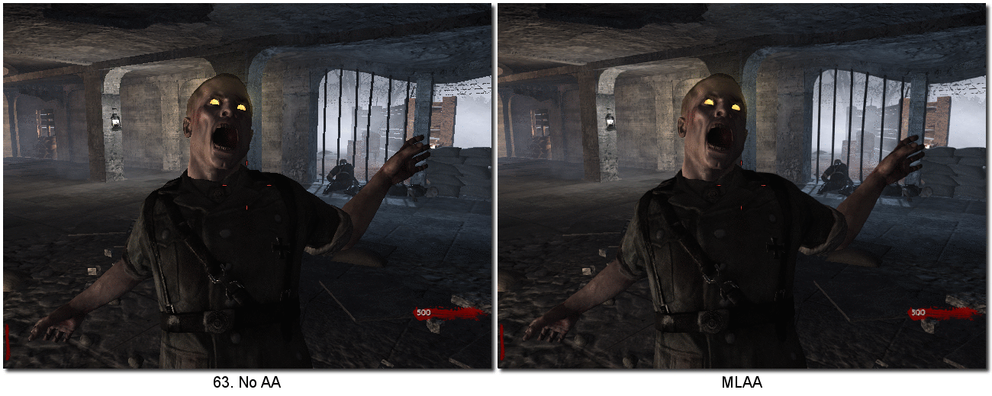
IMHO, this what makes success more likely ¹
∃ need for something
Usually it is not crystal clear, this is why it is “research”
Universal approach
Breadth beats depth
Real-world tests (GOD mode in COD)
Exposure to CG community
Long live HPG!
Code availability
2 days to evaluate research papers
Name
¹ (for the research project)
Notes:
Thinking about all this, this is what in my opinion makes the project successful.
There should be a need for something, whether developers realize it or not. Problem of course, is that if it is clearly understood what the issue is and how to fix it, it is not a research, it is an engineering.
The more universal the solution, the more chances it will be used. To achieve this, it makes a lot of sense to test the proposed methods on real examples. For MLAA, I was testing it a lot using Call of Duty game, that came free with one of the graphics cards we bought. Daniel Pohl also told me how to activate God mode in the game and it was pretty handy, as it allowed me to do all experiments without a risk of being killed.
Interestingly enough, MLAA code, which was made available together with the paper, wasn’t ready for any deployment. It was the CPU version, there were no restrictions on filter size, and I never tried to make the code more readable. However, it was enough to validate the concept for whatever assets game developers were working on.
Among intangible things, I think a name is important as well. In case of MLAA, it kind of invites believability, referring to fundamental concepts.
It wasn’t the first one I came with. I tried to remember all other names I was thinking about and nothing came to mind, since morphological characterization is so entrenched. So, in a way, I duped myself as well.
And this is how I proposed to spell it at ‘09 conference.

Slide 17
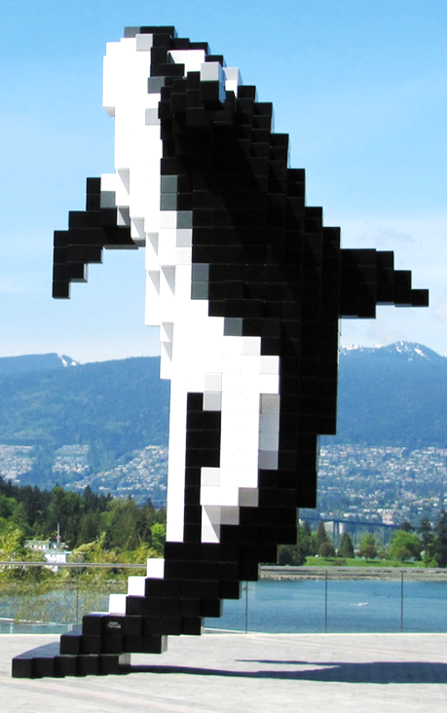
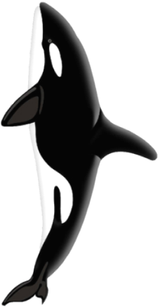
Segue to Jorge’s talk: MLAA details
image enhancement technique
(screen-space post-processing)
Notes:
As a segue to Jorge’s talk, let me briefly outline main MLAA concepts.

Slide 18
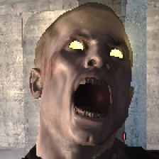
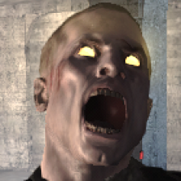
Somehow find silhouettes in images
(and hope that it will correspond to real objects)
Blend (aka filter) colors around the silhouettes
Notes:
And there 2 such concepts: first, find silhouettes in the image, and, second, filter colors around the found silhouettes.

Slide 19
Find axis-aligned lines separating pixels with different colors
Notes:
To find silhouettes, we first separate pixels with different colors.

Slide 20
Reconstruct silhouette lines connecting pixels adjacent to both horizontal and vertical separation lines while…
Notes:
Silhouettes then will connect pixels adjacent to both horizontal and vertical separation lines.

Slide 21
Z-shape
U-shape
resolving ambiguity in favor of the longer silhouettes
and taking into account the resulting shapes
Notes:
Possible ambiguity in resolved in favor of longer silhouettes.
And we also take into account the resulting shapes. For this u-shape on the right, for example, it will make sense to create 2 silhouette lines.

Slide 22
For each pixel intersected by the silhouette lines, its color is blended with the color of the pixel on the opposite side of the separation line with weights proportional to the trapezoid areas
Notes:
Once silhouettes are found, we change color of all the pixels intersected by such lines, using trapezoid areas as blending weights.

Slide 23
Pros and cons
pros
Reconstructs the simplest possible edges (lex parsimoniae)
Independent from the rest of graphics pipeline
cons
It is not physically based
Edges are hallucinated
Nyquist issues (in spatial and temporal domain)
Threshold-based behavior
Processing @ image border
Notes:
In essence, it allows to reconstruct the simplest possible silhouettes, in spirit of Occam’s razor. And, of course, it is orthogonal to the rest of 3D graphics pipeline, as MLAA is an image-based algorithm.
Since the algorithm is not physically based, it is prone to all kinds of artifacts, especially in a temporal domain.

Slide 24
Conclusion: slide from the ‘09 talk
Single sample to find AA
Multiple samples to find AA
Silhouette approximation/
analytical
SSAA:
gold standard
Sen and Cammarano’03/04:
shadow silhouette maps ⇨ improved hard shadows
Increasing quality
MSAA/CSAA:
coverage ⇨ color blending
Bala et al’03:
projected silhouettes ⇨ constraint color interpolation
Jin et al’09:
various discontinuities ⇨
more rays
beams, cones, pencils, bounds, covers, pyramidal rays
Whitted’80:
color variation ⇨ more rays
MLAA
Increasing amount of information
Notes:
Let me conclude with this slide from ‘09 talk. Apparently, idea was to show that, in principle, MLAA could increase quality without using additional information.
What I realize now, is that it shows trials and tribulations of the algorithm itself.
Thank you.

Slide 25
Linked slides (do not remove)

Slide 26
“The Americans have need of the telephone, but we do not. We have plenty of messenger boys” Sir William Preece, Chief Engineer, British Post Office, 1878
“There is not the slightest indication that nuclear energy will ever be obtainable. It would mean that the atom would have to be shattered at will” Albert Einstein, 1932
“There is no reason for any individual to have a computer in his home” Ken Olson, president, chairman and founder of Digital Equipment Corporation (DEC), in a talk given to a 1977 World Future Society
“In short, never use BVH” Gordon Stoll, Siggraph 2005 Course on Real-Time Ray Tracing
Notes:
http://list25.com/25-famous-predictions-that-were-proven-to-be-horribly-wrong
https://pdfs.semanticscholar.org/cb3d/2e6fa321369e53cba85ca6092a4b4a83bd96.pdf

Slide 27
Call of Duty as a testbed (came free with graphics card)

Slide 28
Extra slides

Slide 30
In fact, I’ll talk about 2 research projects
Morphological antialiasing | A unistable polyhedron with 14 faces
Wasn’t developed with a clear goal in mind (I started working first on soft shadows by diffusion) | An explicit goal to improve the previous best result (18)
Many variations | Many variations
Criteria of success was murky | Couldn’t be more clear
Many limitations | No limitations at all; valid in any corner of the Universe
Wasn’t very happy with the result | Happy as a clam at high tide
Have a limited lifespan | Will remain in Wikipedia till 3000
Widely adopted by game developers | Has absolutely no practical value
src code released | src code released

Slide 31
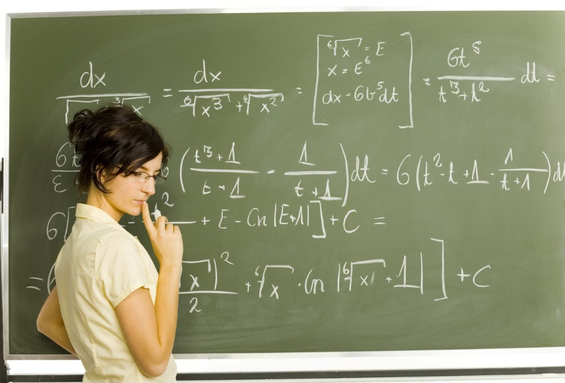
MLAA in a one sentence
(1) detect all pixels that are different from neighbors to (2) approximate silhouettes and then (3) blend colors around these silhouettes
Steps 1 and 2 allow innovation and differentiation
If we know more, we could get better results
subpixel discontinuity data
original 3D data
previous frames
domain knowledge

Slide 32
http://www.geniusstuff.com/blogs/10-accidental-inventions10.htm

Slide 33
2:00 | Introduction | Diego Gutierrez
2:05 | A Directionally Adaptive Edge Anti-Aliasing Filter | Jason Yang
2:20 | Morphological Anti-Aliasing (MLAA) | Alexander Reshetov
2:35 | Jimenez's MLAA & SMAA (Subpixel Morphological Anti-Aliasing) | Jorge Jimenez
2:50 | Hybrid CPU/GPU MLAA on the Xbox-360 | Pete Demoreuille
3:05 | MLAA on the PS3 | Cedric Perthuis Tobias Berghoff
3:35 | The Saboteur Anti-Aliasing (SPUAA) | Henry Yu
3:50 | Break
4:00 | Subpixel Reconstruction Antialiasing (SRAA) | Morgan McGuire
4:15 | FXAA 3.11 in 15 Slides | Timothy Lottes
4:30 | Distance-to-edge Anti-Aliasing (DEAA) | Hugh Malan
4:45 | Geometry Buffer Antialiasing (GBAA) | Emil Persson
4:55 | Directionally Localized Anti-Aliasing (DLAA) | Dmitry Andreev
5:10 | Anti-Aliasing Methods in CryENGINE 3 | Tiago Sousa
5:25 | Wrap-up and Discussion / Q & A
5:30 | Close
ACM SIGGRAPH 2011 Course
Filtering Approaches for Real-Time Anti-Aliasing

