Slide 1
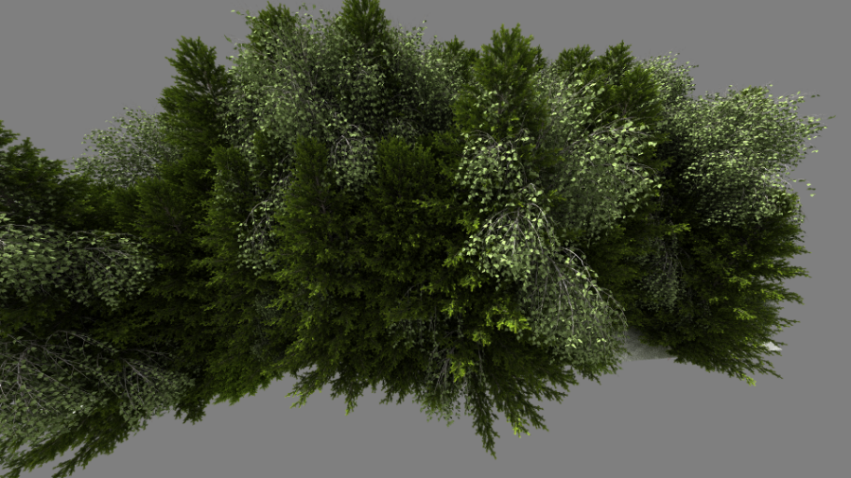
Improved Two-Level BVHs using Partial Re-Braiding
Carsten Benthin, Sven Woop, Ingo Wald, Attila Áfra
HPG 2017

Slide 2
Recap
Two-level BVH
Multiple object BVHs
Single top-level BVH

Slide 3
Recap
Two-level BVH
Multiple object BVHs
Single top-level BVH

Slide 4
Motivation
The “Library Incident”

Slide 5
Motivation
The “Library Incident”

Slide 6
Motivation
The “Library Incident”
Objects based on material ➔ large overlap of object bounds!
Ray traverses many objects

Slide 7
How to improve two-level BVHs with large spatial overlap?
Fix object grouping
Often grouping can‘t be changed easily
Cannot avoid object overlap in general
Build a single, flat BVH
Slow build performance
Issues with partial updates (dynamic scenes)
Instancing

Slide 8
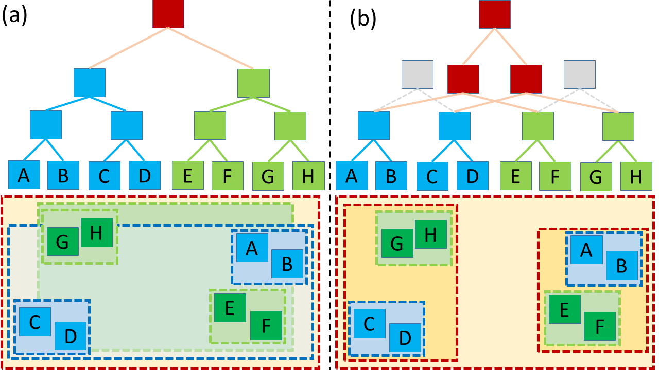
General Idea
Open up object BVHs to find subtrees with less overlap
Rebuild top-level BVH over these subtrees
Let new top-level BVH reach „deep“ into object BVHs

Slide 9
But…
Which object should be opened?
When should we stop the opening?
How and when do we build the new top-level BVH?
How do we efficiently parallelize the opening and top-level build phase?

Slide 10
Our Approach
Maintain a list of subtree nodes (initialize with object BVH root nodes)
In each top-level BVH builder step:
First check if node opening should be done for current node list
If yes, iterate over list and mark nodes which meet opening criteria
Open marked nodes by replacing them with their children
Apply SAH-based binning step to partition list into two sub-lists
Continue recursively with the two sub-lists

Slide 11
Our Approach
open subtree root node
SAH-based binning for partitioning into two lists

Slide 12
Node Opening Criteria
Node opening criteria
Compare node‘s AABB to AABB over entire list
Pick dimension d where extent is largest
Open node if its extent (in d) is > 10% than list extend
will be opened
will be opened

Slide 13
Opening Phase Termination
Stop subtree node opening for given list if
All subtree nodes in list belong to the same initial object
There‘s no overlap between nodes (only tested for short lists)
No more memory is available to store children of opened nodes

Slide 14
Memory Handling
Node opening lets list grow quickly
Allocating system memory during top-level build is too costly
Use pre-allocated memory block for holding list data
Memory block has „extra“ space for new entries
Similar to spatial split BVH builders [Ganestam 2016, Fuetterling 2016]
Distribute „extra“ space heuristically during recursion
List
Extra Space
Left
Right

Slide 15
Parallelization
Recusively spawn tasks when processing left and right sub-lists
Parallize opening, binning, partition phases for lists with many entries
Need to exploit nested parallelism
TBB ➔ very good scalability in #threads

Slide 16
Results
Integrated our approach into Embree
Path tracing for comparing rendering performance
Dual-socket Intel Xeon E5-2699 v3 (36 cores total) with 64 GB of memory

Slide 17
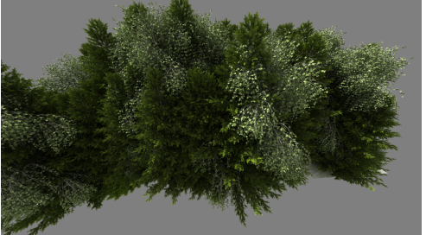
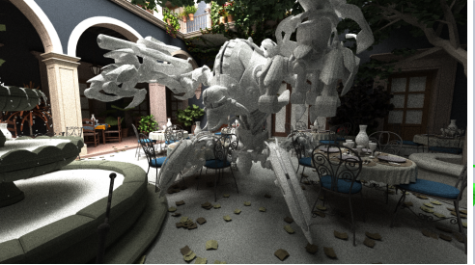
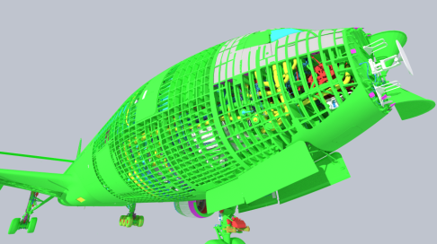
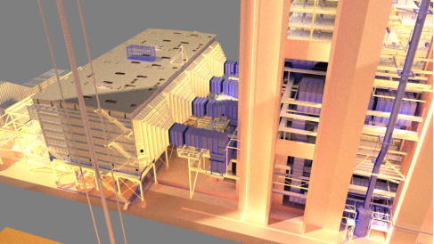
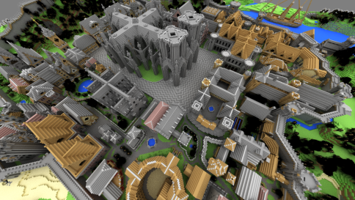
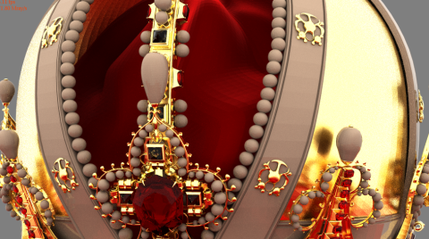
Rendering Performance
objects | 8 | 253 | 720,849 | 56 | 84 | 850
instances | 12,000 | - | - | - | - | -
triangles | 522M | 10.5M | 330M | 12.3M | 6.7M | 4.8M

Slide 18
Rendering Performance
objects | 8 | 253 | 720,849 | 56 | 84 | 850
instances | 12,000 | - | - | - | - | -
triangles | 522M | 10.5M | 330M | 12.3M | 6.7M | 4.8M
out of memory

Slide 19
BVH Build Performance
objects | 8 | 253 | 720,849 | 56 | 84 | 850
instances | 12,000 | - | - | - | - | -
triangles | 522M | 10.5M | 330M | 12.3M | 6.7M | 4.8M

Slide 20
Dynamic Scenes

Slide 21
Conclusion & Future Work
Partial Re-Braiding significantly reduces spatial overlap in two-level BVHs
Improves overall BVH quality ➔higher rendering performance
Adds just little overhead to top-level BVH builder (always on)
Good fit for partial updates in dynamic/static scenes
Integrated into Embree 2.16
In the future focus on
Better opening heuristics, leaf opening and improved overlap detection
Combine with ideas from [Hendrich 2017]

Slide 22
Questions…
https://embree.github.io
Demo at Intel SIGGRAPH Booth

Slide 23
Legal Disclaimers
INFORMATION IN THIS DOCUMENT IS PROVIDED IN CONNECTION WITH INTEL PRODUCTS. NO LICENSE, EXPRESS OR IMPLIED, BY ESTOPPEL OR OTHERWISE, TO ANY INTELLECTUAL PROPERTY RIGHTS IS GRANTED BY THIS DOCUMENT. EXCEPT AS PROVIDED IN INTEL'S TERMS AND CONDITIONS OF SALE FOR SUCH PRODUCTS, INTEL ASSUMES NO LIABILITY WHATSOEVER AND INTEL DISCLAIMS ANY EXPRESS OR IMPLIED WARRANTY, RELATING TO SALE AND/OR USE OF INTEL PRODUCTS INCLUDING LIABILITY OR WARRANTIES RELATING TO FITNESS FOR A PARTICULAR PURPOSE, MERCHANTABILITY, OR INFRINGEMENT OF ANY PATENT, COPYRIGHT OR OTHER INTELLECTUAL PROPERTY RIGHT. A "Mission Critical Application" is any application in which failure of the Intel Product could result, directly or indirectly, in personal injury or death. SHOULD YOU PURCHASE OR USE INTEL'S PRODUCTS FOR ANY SUCH MISSION CRITICAL APPLICATION, YOU SHALL INDEMNIFY AND HOLD INTEL AND ITS SUBSIDIARIES, SUBCONTRACTORS AND AFFILIATES, AND THE DIRECTORS, OFFICERS, AND EMPLOYEES OF EACH, HARMLESS AGAINST ALL CLAIMS COSTS, DAMAGES, AND EXPENSES AND REASONABLE ATTORNEYS' FEES ARISING OUT OF, DIRECTLY OR INDIRECTLY, ANY CLAIM OF PRODUCT LIABILITY, PERSONAL INJURY, OR DEATH ARISING IN ANY WAY OUT OF SUCH MISSION CRITICAL APPLICATION, WHETHER OR NOT INTEL OR ITS SUBCONTRACTOR WAS NEGLIGENT IN THE DESIGN, MANUFACTURE, OR WARNING OF THE INTEL PRODUCT OR ANY OF ITS PARTS. Intel may make changes to specifications and product descriptions at any time, without notice. Designers must not rely on the absence or characteristics of any features or instructions marked "reserved" or "undefined". Intel reserves these for future definition and shall have no responsibility whatsoever for conflicts or incompatibilities arising from future changes to them. The information here is subject to change without notice. Do not finalize a design with this information. The products described in this document may contain design defects or errors known as errata which may cause the product to deviate from published specifications. Current characterized errata are available on request. Contact your local Intel sales office or your distributor to obtain the latest specifications and before placing your product order. Copies of documents which have an order number and are referenced in this document, or other Intel literature, may be obtained by calling 1-800-548-4725, or go to: http://www.intel.com/design/literature.htm Software and workloads used in performance tests may have been optimized for performance only on Intel microprocessors. Performance tests, such as SYSmark and MobileMark, are measured using specific computer systems, components, software, operations and functions. Any change to any of those factors may cause the results to vary. You should consult other information and performance tests to assist you in fully evaluating your contemplated purchases, including the performance of that product when combined with other products.
Intel does not control or audit the design or implementation of third party benchmarks or Web sites referenced in this document. Intel encourages all of its customers to visit the referenced Web sites or others where similar performance benchmarks are reported and confirm whether the referenced benchmarks are accurate and reflect performance of systems available for purchase.
Relative performance is calculated by assigning a baseline value of 1.0 to one benchmark result, and then dividing the actual benchmark result for the baseline platform into each of the specific benchmark results of each of the other platforms, and assigning them a relative performance number that correlates with the performance improvements reported.
SPEC, SPECint, SPECfp, SPECrate. SPECpower, SPECjAppServer, SPECjbb, SPECjvm, SPECWeb, SPECompM, SPECompL, SPEC MPI, SPECjEnterprise* are trademarks of the Standard Performance Evaluation Corporation. See http://www.spec.org for more information. TPC-C, TPC-H, TPC-E are trademarks of the Transaction Processing Council. See http://www.tpc.org for more information.
Hyper-Threading Technology requires a computer system with a processor supporting HT Technology and an HT Technology-enabled chipset, BIOS and operating system. Performance will vary depending on the specific hardware and software you use. For more information including details on which processors support HT Technology, see here
Intel® Turbo Boost Technology requires a Platform with a processor with Intel Turbo Boost Technology capability. Intel Turbo Boost Technology performance varies depending on hardware, software and overall system configuration. Check with your platform manufacturer on whether your system delivers Intel Turbo Boost Technology. For more information, see http://www.intel.com/technology/turboboost
No computer system can provide absolute security. Requires an enabled Intel® processor and software optimized for use of the technology. Consult your system manufacturer and/or software vendor for more information.
Intel processor numbers are not a measure of performance. Processor numbers differentiate features within each processor family, not across different processor families: Go to: Learn About Intel® Processor Numbers
Intel product plans in this presentation do not constitute Intel plan of record product roadmaps. Please contact your Intel representative to obtain Intel’s current plan of record product roadmaps.
Copyright © 2014 Intel Corporation. All rights reserved. Intel, the Intel logo, Xeon and Intel Core are trademarks or registered trademarks of Intel Corporation or its subsidiaries in the United States and other countries. All dates and products specified are for planning purposes only and are subject to change without notice
*Other names and brands may be claimed as the property of others.

Slide 24
Risk Factors
The above statements and any others in this document that refer to plans and expectations for the third quarter, the year and the future are forward-looking statements that involve a number of risks and uncertainties. Words such as “anticipates,” “expects,” “intends,” “plans,” “believes,” “seeks,” “estimates,” “may,” “will,” “should” and their variations identify forward-looking statements. Statements that refer to or are based on projections, uncertain events or assumptions also identify forward-looking statements. Many factors could affect Intel’s actual results, and variances from Intel’s current expectations regarding such factors could cause actual results to differ materially from those expressed in these forward-looking statements. Intel presently considers the following to be the important factors that could cause actual results to differ materially from the company’s expectations. Demand could be different from Intel's expectations due to factors including changes in business and economic conditions; customer acceptance of Intel’s and competitors’ products; supply constraints and other disruptions affecting customers; changes in customer order patterns including order cancellations; and changes in the level of inventory at customers. Uncertainty in global economic and financial conditions poses a risk that consumers and businesses may defer purchases in response to negative financial events, which could negatively affect product demand and other related matters. Intel operates in intensely competitive industries that are characterized by a high percentage of costs that are fixed or difficult to reduce in the short term and product demand that is highly variable and difficult to forecast. Revenue and the gross margin percentage are affected by the timing of Intel product introductions and the demand for and market acceptance of Intel's products; actions taken by Intel's competitors, including product offerings and introductions, marketing programs and pricing pressures and Intel’s response to such actions; and Intel’s ability to respond quickly to technological developments and to incorporate new features into its products. The gross margin percentage could vary significantly from expectations based on capacity utilization; variations in inventory valuation, including variations related to the timing of qualifying products for sale; changes in revenue levels; segment product mix; the timing and execution of the manufacturing ramp and associated costs; start-up costs; excess or obsolete inventory; changes in unit costs; defects or disruptions in the supply of materials or resources; product manufacturing quality/yields; and impairments of long-lived assets, including manufacturing, assembly/test and intangible assets. Intel's results could be affected by adverse economic, social, political and physical/infrastructure conditions in countries where Intel, its customers or its suppliers operate, including military conflict and other security risks, natural disasters, infrastructure disruptions, health concerns and fluctuations in currency exchange rates. Expenses, particularly certain marketing and compensation expenses, as well as restructuring and asset impairment charges, vary depending on the level of demand for Intel's products and the level of revenue and profits. Intel’s results could be affected by the timing of closing of acquisitions and divestitures. Intel's results could be affected by adverse effects associated with product defects and errata (deviations from published specifications), and by litigation or regulatory matters involving intellectual property, stockholder, consumer, antitrust, disclosure and other issues, such as the litigation and regulatory matters described in Intel's SEC reports. An unfavorable ruling could include monetary damages or an injunction prohibiting Intel from manufacturing or selling one or more products, precluding particular business practices, impacting Intel’s ability to design its products, or requiring other remedies such as compulsory licensing of intellectual property. A detailed discussion of these and other factors that could affect Intel’s results is included in Intel’s SEC filings, including the company’s most recent reports on Form 10-Q, Form 10-K and earnings release.
Rev. 7/17/13

Slide 25
Optimization Notice
Optimization Notice
Intel's compilers may or may not optimize to the same degree for non-Intel microprocessors for optimizations that are not unique to Intel microprocessors. These optimizations include SSE2, SSE3, and SSE3 instruction sets and other optimizations. Intel does not guarantee the availability, functionality, or effectiveness of any optimization on microprocessors not manufactured by Intel. Microprocessor-dependent optimizations in this product are intended for use with Intel microprocessors. Certain optimizations not specific to Intel microarchitecture are reserved for Intel microprocessors. Please refer to the applicable product User and Reference Guides for more information regarding the specific instruction sets covered by this notice. Notice revision #20110804

