Slide 1
Efficient Incoherent Ray Traversal on GPUs Through Compressed Wide BVHs
Henri Ylitie, Tero Karras, Samuli Laine
High Performance Graphics 2017; July 28th, 2017; Los Angeles, CA, USA

Slide 2

Inspiration
Rendered with NVIDIA Iray
Notes:
The inspiration for this work comes from photorealistic rendering where simulation of complex light transport paths generates ray cast workloads that are often very incoherent. This kind of workloads are challenging for parallel processors. This also evident from performance plot of state of the art GPU ray tracer by Binder and Keller – coherent primary achieve excellent raycast performance, but ray throughput is reduced to one fifth with the most incoherent ray workloads. Rays that have gone a diffuse interreflection four times are very incoherent and have only 1/5 the throughput of primary rays.

Slide 3
Motivation
GPU ray tracing performance limited by memory system
Low SIMD utilization with incoherent rays
Impressive results in CPU ray tracing using wide BVHs and compression
  Full potential maybe not realized on GPUs yet?
Notes:
We studied why incoherent ray workloads are slow. This is why we started experimenting with wide BVHs on the GPU.

Slide 4
Overview
Combination of new and existing techniques
8-wide BVH constructed with SAH-optimal widening
Compressed node storage format
Cheap octant-based fixed-order traversal
Traversal stack traffic eliminated through compression and usage of shared memory
Improved SIMD utilization through triangle postponing and dynamic ray fetching
Starting point: BVH traversal kernels by Aila, Karras and Laine [2012]
Notes:
On high-level our traversal kernels are somewhat similar to those by Aila et al. [2012]. We trace one ray per thread and have a full traversal stack.

Slide 5
Overview
2x incoherent ray traversal performance
0.33x acceleration structure size
Compared to fastest previous method by Binder and Keller [2016]
Notes:
Peek at the results.

Slide 6
Bounding box quantization
Quantize child node AABBs to a local grid
  Similar to [Mahovsky and Wyvill 2006; Segovia and Ernst 2010; Keely 2014; Vaidyanathan et al. 2016]
Quantization grid position and scale stored in parent node
Per parent node
Decompression:
Per child
b_{x} = p_{x} + 2^e_{x} ∙ q_{x}
b_{y} = p_{y} + 2^e_{y} ∙ q_{y}
b_{z} = p_{z} + 2^e_{z} ∙ q_{z}
Use full precision
Constrain scale toa
power-of-two, store exponent in 8 bits
Quantize to 8-bits
per coordinate
Notes:
To minimize memory traffic and usage it is easy to start with shrinking nodes/bounding boxes.
What is different: Store all info required for decompression in the node, no need to manage current quantization grid on the stack. Doesn’t limit traversal order in any way. Small increase in test counts, decompression is pretty cheap. We transform the ray and not the boxes.
0.3x storage per box, only 3.4% increase in intersection test counts
Cheap decompression, enables additional optimizations

Slide 7
Child node index compression
Child nodes, triangles stored contiguously in separate arrays
Index of first child node, triangle stored in node
8-bit field per child to encode relative offset, child type
Up to 3 triangles/leaf
Notes:
Leaves: index of first triangle, bitmask of for up to 3 nonempty triangles.
Internal nodes: slot index + 24
We support variable triangle counts up to 3 per leaf, trees don’t need to be complete. Clusters of up to 8 80B nodes and up to 24 triangles stored depth-first.

Slide 8
Internal node memory layout
Quantization grid 15B
Indexing information 17B
Quantized bounding boxes 48B
= Total 80B
10B/child
8 children / node
Aila et al. [2012]
32B/child
Notes:
Combining these ideas, our internal nodes look like this. 8 tests/memory access, lots of independent work and some common work is amortized. Traditional node layout used by Aila et al. [2012] uses 3.2x as much memory per child node.

Slide 9
Traversal order
Approximate near-to-far traversal order is important
  Most approaches sort by distance
8-element distance sorts are expensive
  Sorting network -> 19 compare-and-swap operations [Knuth 1998]
  Sort hits only -> high divergence
Notes:
Sorting hits only isn’t necessarily that expensive on CPU. Use a fixed order depending on ray direction signs (octant)? Don’t want to use any memory to encode the traversal order -> encode to memory order.

Slide 10
Octant-based traversal order
[Garanzha and Loop 2010]
Store child nodes to memory in Morton order of their AABB centers
  Approximately assigns each child to closest parent box corner
Traverse the nodes in order sortedChildren[i] = children[i ^ oct]
Doesn’t work well for partially filled nodes
Notes:
We adopt a ray direction octant based ordering scheme from Garanzha and Loop. Store children in Morton order ~ means ”assign children to the closest parent node bbox corner”.

Slide 11
Octant-based traversal order
Idea: Optimize the child node assignment
Enumerate corners of parent bounding box (child slots) in Morton order
Optimize the way child nodes are assigned to the slots
  Define a cost function for placing a child node with AABB center c in a slot s
  Pick a diagonal ray with direction d_{s} = (±1, ±1, ±1) that traverses slot s first
    2D example: Slot 00 -> ray direction d_{s} = (1, 1)
  Cost(c, s) = (c - p)∙d_{s}
  Distance from parent box center p projected on the ray direction
  Minimize total cost using the auction algorithm [Bertsekas 1992]
8x8 table
Notes:
We still enumerate the parent box corners or ”child slots” in Morton order, but separately optimize how child nodes are assigned to these slots. Experimented with various cost functions, this is the best one found. Empty children at center of parent box, their assignment doesn’t affect the score. We noticed that same thing works well in general case if opt assignment

Slide 12
Octant-based traversal order
Notes:
Primary rays, arithmetic means over all test scenes except Powerplant.

Slide 13
Reducing traversal stack traffic
Compressing stack entries
Combine all sibling nodes of same type to a single 8-byte stack entry
  32-bit base index, bitmask for individual items
Internal node test produces 0-2 stack entries
  Up to 8 internal nodes in each node group
  Up to 24 triangles from up to 8 leaf nodes in each triangle group
Notes:
Store index of the first child node or triangle, and a bit mask indicating which nodes or triangles are active. Small number of stack operations. Single loop for iterating over multiple leaf node hits. Maintain one stack entry in registers. We still traverse the tree depth-first, leaving the siblings behind. To be traversed later.

Slide 14
Reducing traversal stack traffic
Compressing stack entries
How to maintain the traversal order?
Define a traversal priority as reverse of the traversal order
  priority = slot_index ^ (7 – oct)
  Traverse nodes with highest priority first
Permute the hits-field: Internal nodes set bit corresponding to traversal priority
  Find highest set bit to get node to traverse next
  Reverse priority computation to obtain child slot index

Slide 15
Reducing traversal stack traffic
Using shared memory
Store as many stack entries to shared memory as possible
  12 in our kernel
Spill rest of the entries to local memory
  Happens very rarely
Eliminates practically all external memory traffic
Notes:
Now the total size of the stack is quite small and it turns out that almost all of it can fit into shared memory. Shared memory is a small fast programmer-managed cache memory located in each SM (streaming multiprocessor). Practically all external memory traffic from traversal stacks is eliminated, 40% performance boost for incoherent rays. Small computational overhead but is always beneficial. 12 entires is the maximum that fit without dropping occupancy. Comparing our full algorithm to versions that have modified some specific feature.

Slide 16
Improving SIMD utilization
Postponing triangle intersection tests
Threads follow different paths in the tree
  Especially with incoherent rays
Internal nodes traversed more often than leaves
Only a few threads in a 32-lane warp active in ray-triangle intersection test
Notes:
Some rays traverse nodes, some intersect triangles. We trace one ray per thread. Multiple solutions possible, pushing triangle groups to common stack performs best.

Slide 17
Improving SIMD utilization
Postponing triangle intersection tests
Postpone triangle intersections by pushing triangle groups to stack
Do this whenever less than 20% of active threads want to intersect triangles
Notes:
We trace one ray per thread. Multiple solutions possible, pushing triangle groups to common stack performs best. The threshold value can be modified. We can use some heuristic to decide when to postpone triangle intersection tests. Whenever less than 20% active threads would be performing a ray-triangle intersection test, we push the triangle group to stack and continue with traversal. We don’t search the stack for leaves but test for the in-register stack item only.

Slide 18
Constructing wide BVHs
Start with a binary SBVH with one triangle per leaf [Stich et al. 2009]
Form a wide BVH by collapsing nodes in a SAH-optimal fashion
Greedy top-down collapsing and splitting [Wald et al. 2008 ; Afra et al. 2013]
Our: Jointly optimize both internal nodes and leaves at the same time
Notes:
To study the performance of wide BVH traversal, we obtain the highest possible BVH quality using a CPU-based offline algorithm.
Results: perf, node fill rate (mem consumption)
Compute and store, for each node n in the binary BVH, the optimal SAH cost C(n,i) that can be achieved if the contents of the entire subtree of n were represented as a forest of at most i BVHs.
Backtrack decisions starting from C(root, 1) and create wide nodes so that optimal cost is realized.
Each node in binary BVH can have any of following 3 roles in final wide BVH:

Slide 19
Constructing wide BVHs
Moving from bottom to top, process each node in the binary BVH
  Compute and store optimal SAH cost for all configurations the node could have in the final wide BVH:
    Leaf
    Wide internal node
    Eliminated – subtree is represented as forest with 2-7 roots, placed as children of the node’s parent. Ask child nodes how to optimally divide roots between them.
  Backtrack from root and create wide nodes so that optimal cost is realized.
Notes:
To give you an idea how this happens... To study the performance of wide BVH traversal, we obtain the highest possible BVH quality using a CPU-based offline algorithm.
Results: perf, node fill rate (mem consumption)
Compute and store, for each node n in the binary BVH, the optimal SAH cost C(n,i) that can be achieved if the contents of the entire subtree of n were represented as a forest of at most i BVHs.
Backtrack decisions starting from C(root, 1) and create wide nodes so that optimal cost is realized.
More details in paper.

Slide 20
Constructing wide BVHs
Improves the tradeoff between performance and memory usage
Compared to node collapsing method by Afra et al. [2013]
  1 – 4% higher traversal performance
  Lowers memory consumption, 1.18x as many children per node (7.51 vs. 6.39),
Notes:
Comparing to best alternative method. Comparison against more methods in paper.

Slide 21
Results

Slide 22
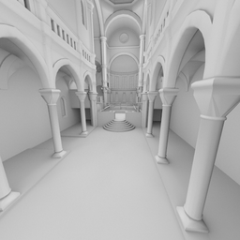
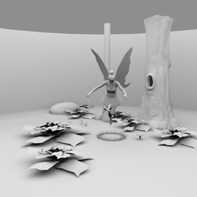
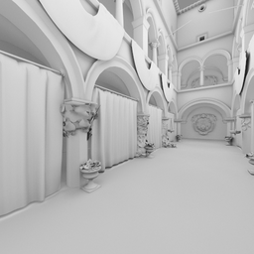
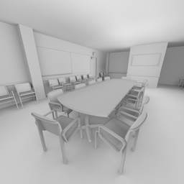


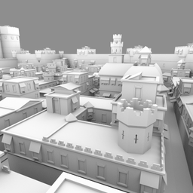
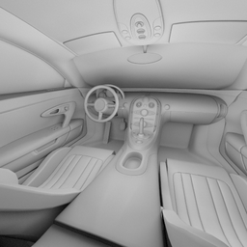
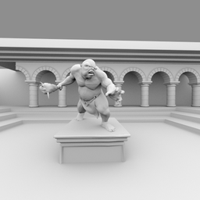
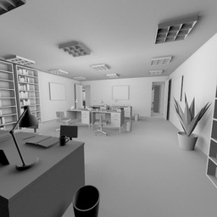
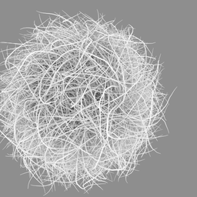
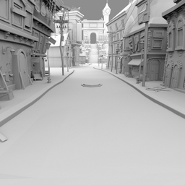
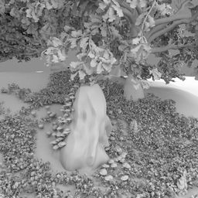
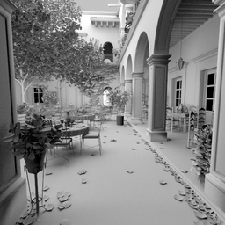
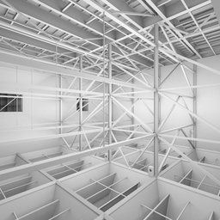
Benchmark setup
80k
174k
262k
283k
Diffuse path tracing, measure ray cast time for each bounce separately
2048x2048 resolution
15 scenes with 1-5 viewpoints each.
Hardware: NVIDIA Titan X (Pascal)
407k
606k
762k
1.3M
1.9M
2.2M
2.9M
4.1M
7.5M
10.5M
12.8M
Notes:
No ray sorting, paths only terminated when the ray misses the scene.

Slide 27
Notes:
Our method is about 2x faster than previous methods for incoherent rays. With coherent primary rays, Irregular grids demonstrates excellent performance, though the performance varies a lot depending on scene (See paper).

Slide 28
Notes:
Per-scene variation. Absolute performance varies a lot between scenes, but the speedup of our method compared to state of the art is pretty consistent. Scenes sorted by triangle count. Note that y-axis scale is different.

Slide 29
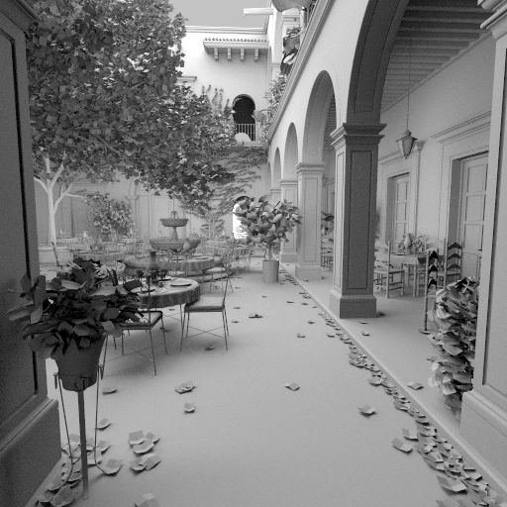
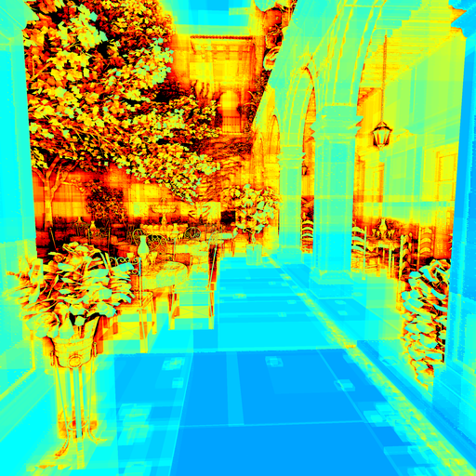
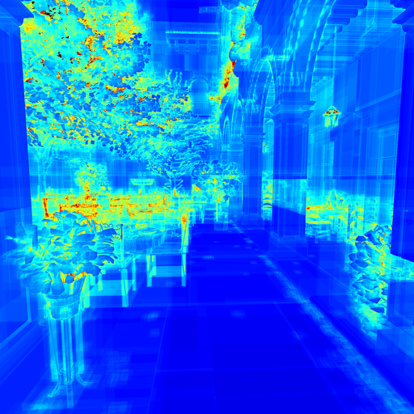

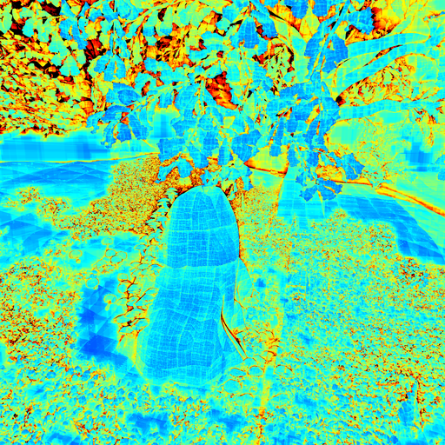
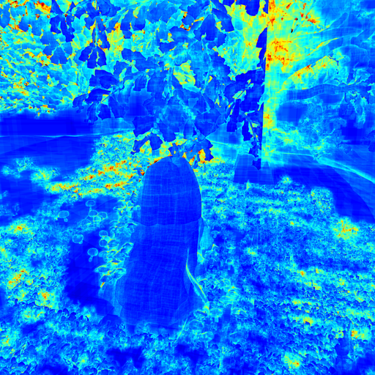
Memory bandwidth – node and triangle fetches
≈ 0.5x on average
Scene image
[Aila et al. 2012]
Ours
Notes:
A major advantage of our method is reduced memory bandwidth usage from traversal. On average, our method generates 0.5x the memory traffic. Suboptimal traversal order decision of our method visible in top-right corner of Enhanced forest image.

Slide 30
Memory usage
0.27 - 0.47x compared to fastest previous method [Binder and Keller 2016]
Notes:
Triangles and triangle index remaps excluded.

Slide 31
Questions?

Slide 32
Thank you!

Slide 33
Improving SIMD utilization
Replacing terminated rays
Rays in a warp finish traversal at different times
Low SIMD utilization with incoherent rays
Fetch new rays to replace terminated ones:
  Persistent threads: Fetch when entire warp is out of work [Aila and Laine 2009]
  Original: Fetch when more than 8 lanes inactive [Aila and Laine 2009]
Notes:
Two methods introduced by Aila and Laine. Found the Original threshold that is optimal for our traversal. Want best of both.

Slide 34
Improving SIMD utilization
Replacing terminated rays
Fetch new rays to replace terminated ones:
  Persistent threads: Fetch when entire warp is out of work [Aila and Laine 2009]
  Original: Fetch when more than 8 lanes inactive [Aila and Laine 2009]
  Improved: Keep track of lost work in the warp since last ray fetch, fetch when a threshold is exceeded
Notes:
Our improved heuristic reduces excess ray fetches with coherent ray workloads. Dynamic ray fetch not beneficial in baseline binary BVH traversal of Aila et al. [2012] on current hardware.

Slide 35
Constructing wide BVHs
For each node in the binary BVH, starting from bottom:
  Compute optimal SAH cost for subtree, 3 options

Slide 36
Constructing wide BVHs
For each node in the binary BVH, starting from bottom:
  Compute optimal SAH cost for subtree, 3 options
    Create leaf

Slide 37
Constructing wide BVHs
For each node in the binary BVH, starting from bottom:
  Compute optimal SAH cost for subtree, 3 options
    Create leaf
    Create internal node

Slide 38
Constructing wide BVHs
For each node in the binary BVH, starting from bottom:
  Compute optimal SAH cost for subtree, 3 options
    Create leaf
    Create internal node
    Create forest with 2 - 7 roots

Slide 39
Constructing wide BVHs
For each node in the binary BVH, starting from bottom:
  Compute optimal SAH cost for subtree, 3 options
    Create leaf
    Create internal node
    Create forest with 2 - 7 roots

Slide 40
Constructing wide BVHs
For each node in the binary BVH, starting from bottom:
  Compute optimal SAH cost for subtree, 3 options
    Create leaf
    Create internal node
    Create forest with 2 - 7 roots
Backtrack decisions starting from root and create wide nodes so that optimal cost is realized.

