Slide 1
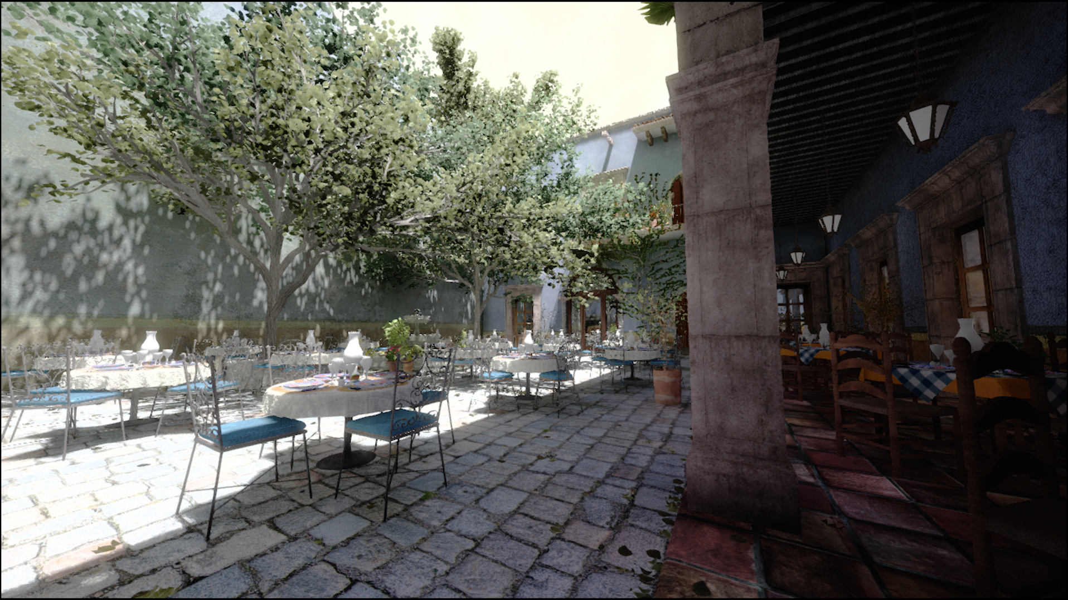
Deep G-Buffers for Stable Global Illumination Approximation
HPG 2016
Michael Mara, Morgan McGuire,
Derek Nowrouzezahrai, David Luebke
NVIDIA, University of Montreal, Stanford University, and Williams College

Slide 2
Review of Screen-Space Effects
The Good News
Notes:
A lot of the lighting techniques used to give modern games their realistic quality rely on replacing recursive world-space rays with screen-space texture sampling. Let’s take a look at some of them.

Slide 3
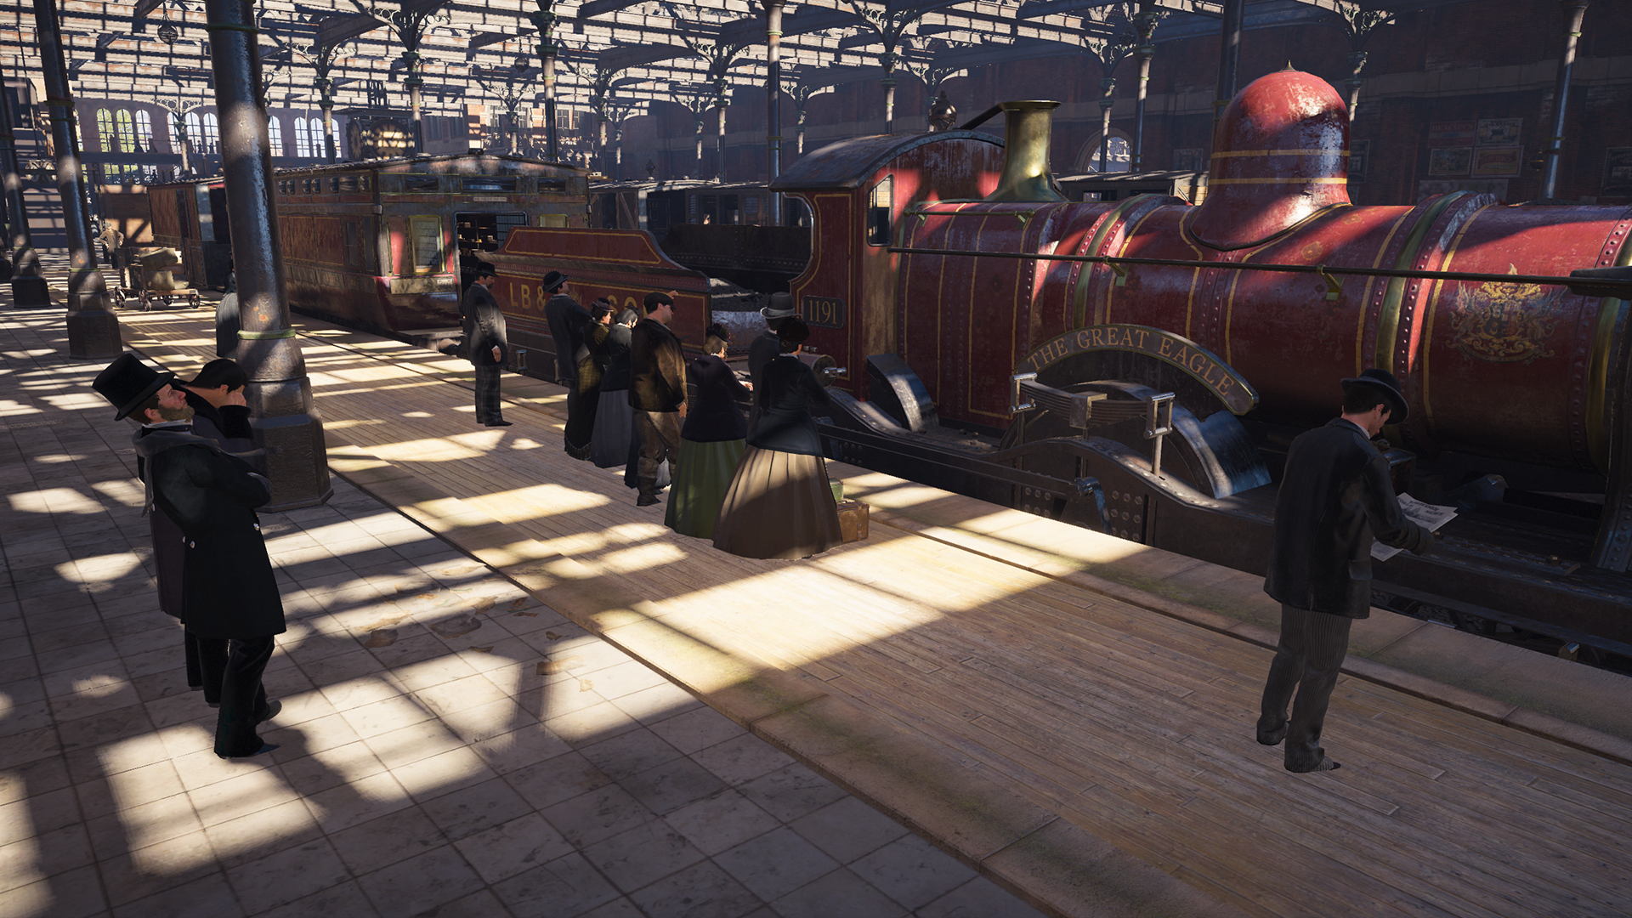
AAA AO
No Ambient Obscurance
Assassin’s Creed Syndicate
Notes:
Screen Space Ambient Obscurance is a popular visual effect that has been used in most top video games in the last half-decade. Here is a screen shot without ambient obscurance from Assassin’s Creed Syndicate

Slide 4
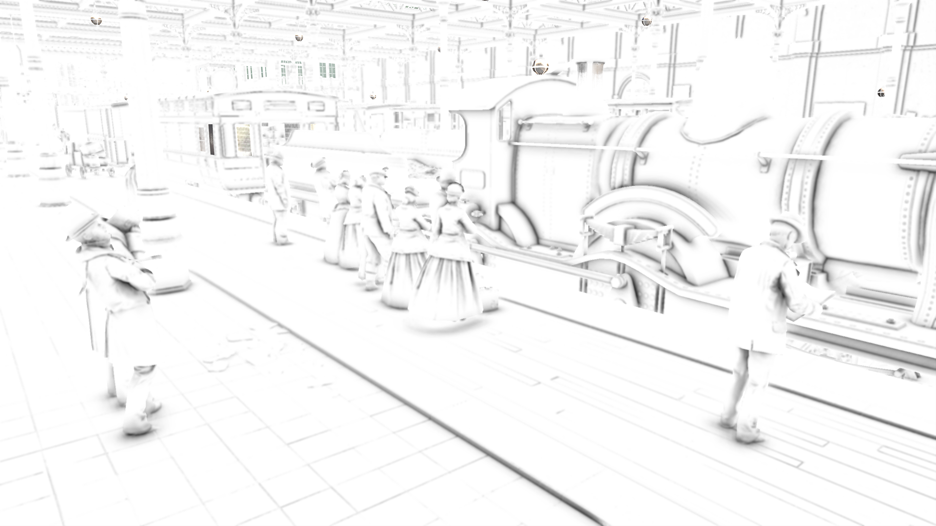
Ambient Obscurance Buffer
Assassin’s Creed Syndicate
Notes:
Here is the ambient obscurance buffer, directly visualizing the values you multiply ambient lighting by to add contact shadows, corner darkening and other details

Slide 5
AAA AO
With Ambient Obscurance
Assassin’s Creed Syndicate
Notes:
And the final composited image

Slide 6
AAA AO
With Ambient Obscurance
Assassin’s Creed Syndicate
Notes:
It might be hard to see on this washed out projector screen, so lets zoom in a bit

Slide 7
AO
Notes:
With AO, we have some interesting detail and corner darkening

Slide 8
No AO
Notes:
Without, everything is a bit more flat
*flip back and forth*

Slide 9
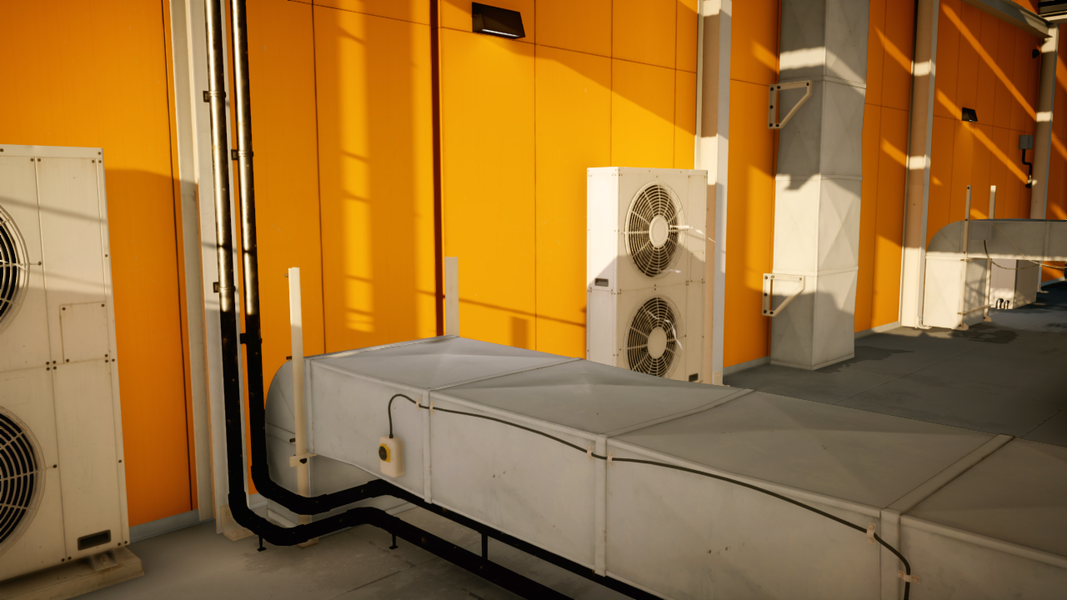
No Screen-Space Reflection
Mirror’s Edge Catalyst
[Stachowiak15]
Notes:
You can also compute reflections in screen space. Here’s the image without

Slide 10
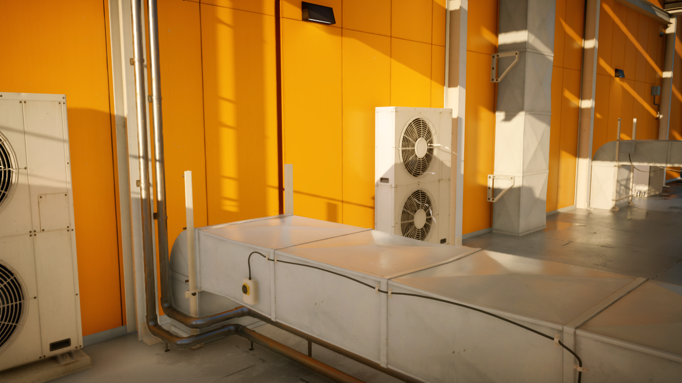
Screen-Space Reflection
Mirror’s Edge Catalyst
[Stachowiak15]
Notes:
and with. It definitely improves the final image quality,

Slide 11
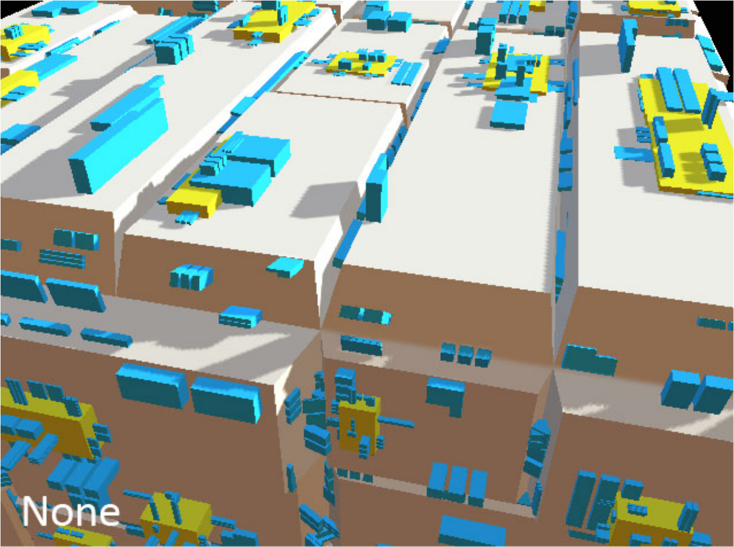
No Screen-Space Indirect Lighting
[Ritschel09]
Notes:
You can even compute diffuse interreflection in screen-space, back in 2009 in their Screen-Space Directional Occlusion paper Ritschel and others presented a technique for this…

Slide 12
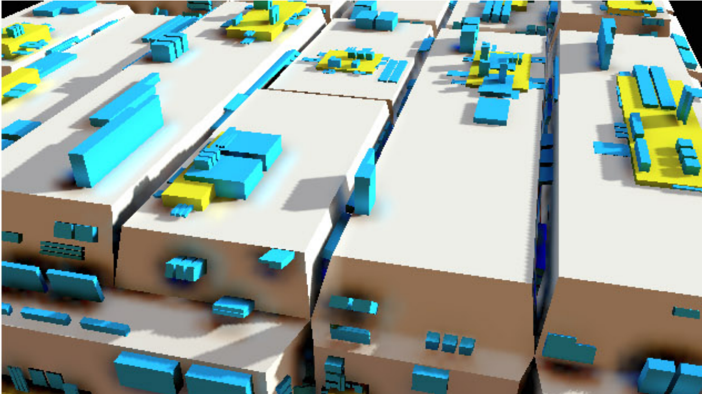
Screen-Space Indirect Lighting
[Ritschel09]
Notes:
that works really well, based on extending ambient obscurance techniques.

Slide 13
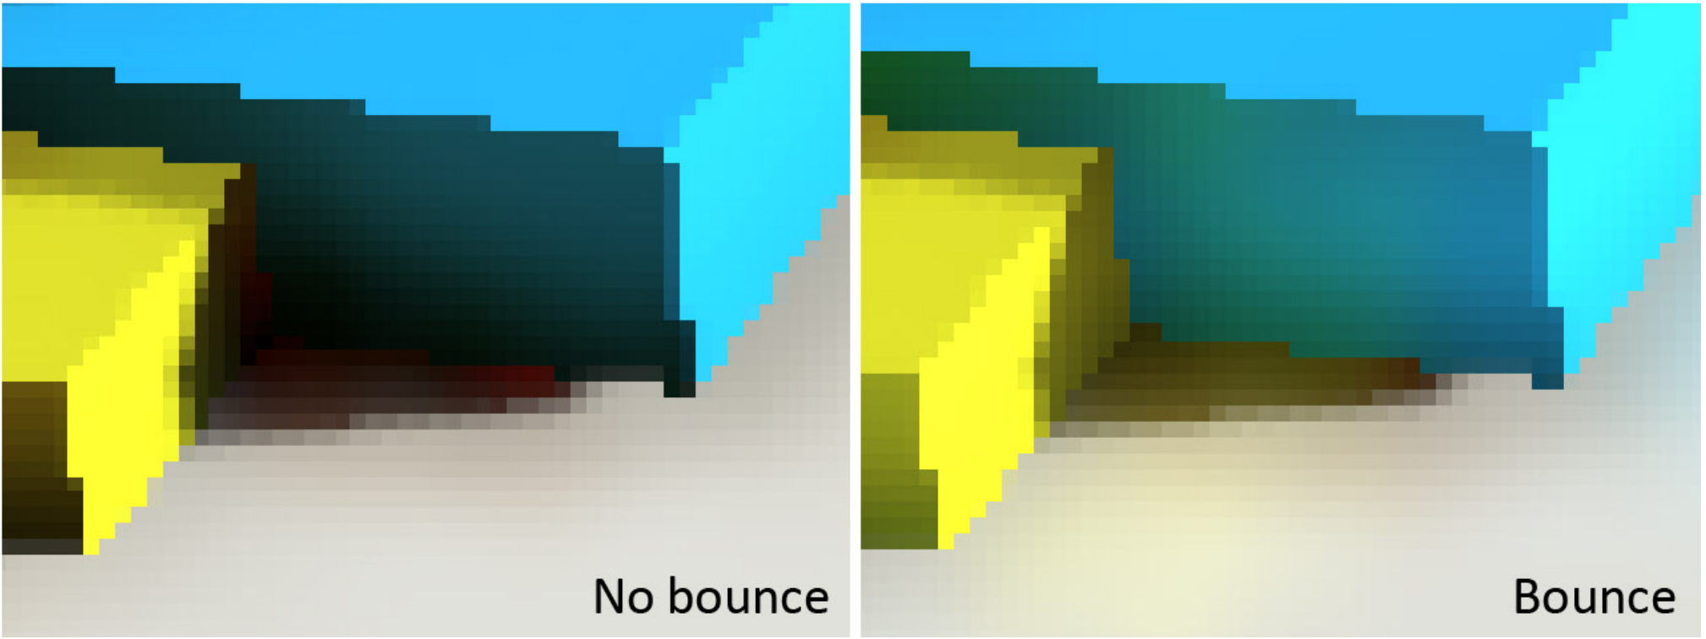
Screen Space Indirect Lighting
[Ritschel09]
Notes:
The reason you probably haven’t seen this one in many games is because is much slower than the other two effects. But don’t worry, the same technique we’ll present to improve the other effects will help make this one quick enough to use.

Slide 14
Review of Screen-Space Effects
The Bad News
Notes:
Screen-space lighting techniques, while widely used to great effect, only looks good in the best case. They fail in really obvious and embarrassing ways in the worst cases. We should know---at various jobs, my co-author and I have written the implementations used in some top games and game engines. We're accustomed to seeing the limitations of these effects, and trying to hide them from players.
The key idea of the next few slides is to show you that these techniques are not stable in the worst case, and motivate our technique to increase robustness of screen-space effects.

Slide 15
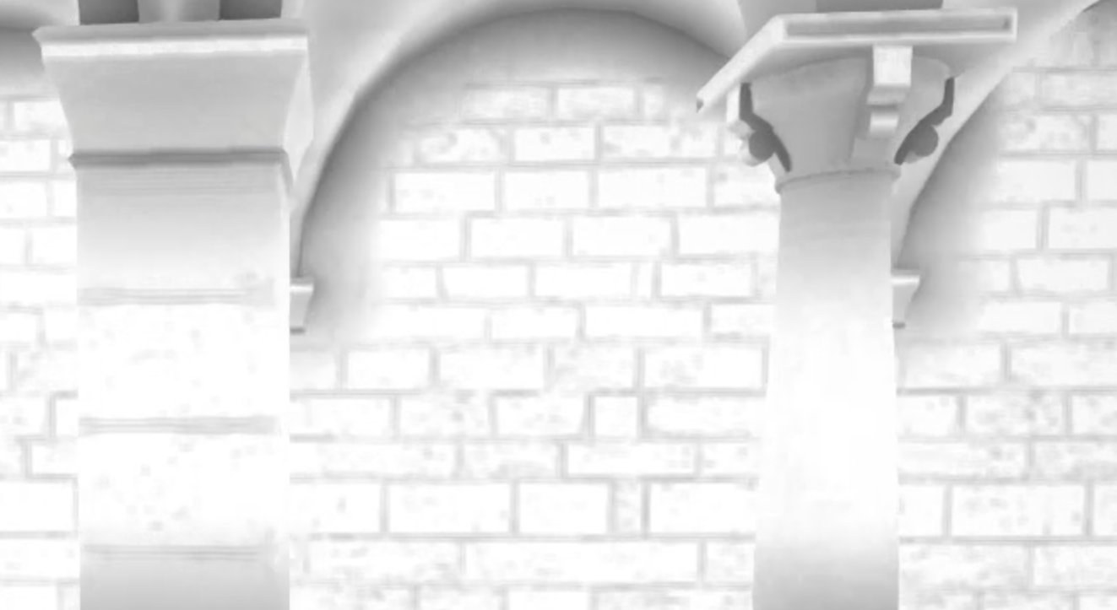
Notes:
With screen-space Ambient Occlusion,
As you walk past a pillar,

Slide 16
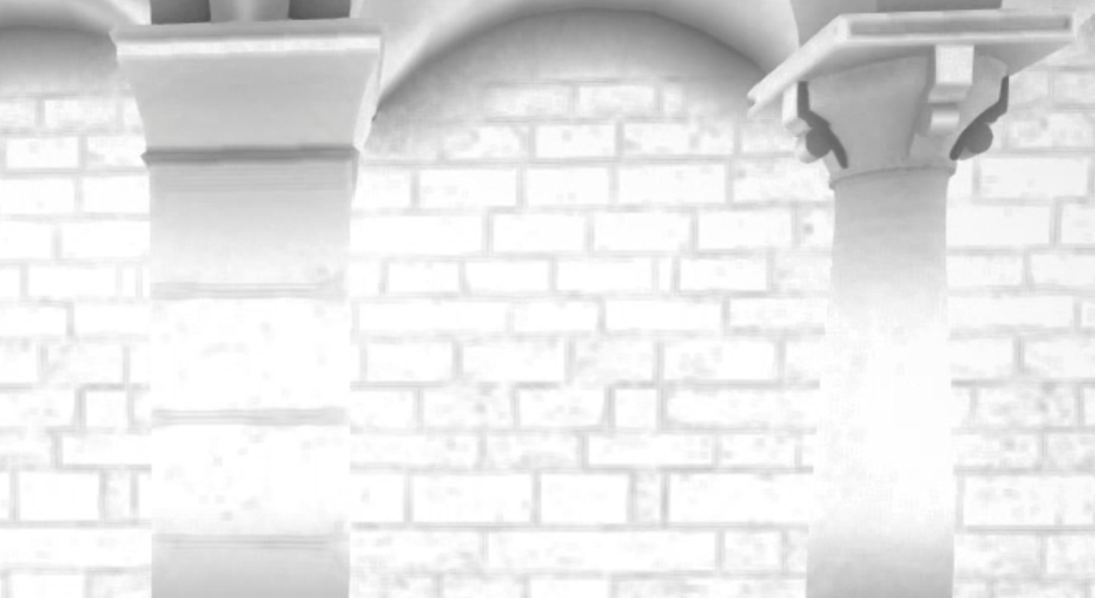
Notes:
the cracks in the wall behind it light up.

Slide 17
Video of AO halos
Notes:
Here it is in motion

Slide 18
Notes:
I’m going to play a clip of the unreal kite demo, first demoed at GDC 2015. It looks fantastic, a lot like a Pixar movie. But take a look at the reflections in the water, and see if you can see anything wrong

Slide 19
Notes:
When the character steps over a river, the reflection of the rocks and trees in the river disappears.

Slide 20
Z
Notes:
The primary reason that screen-space lighting effects fail is that those algorithms can only consider objects visible on the screen.
This diagram shows a top view of a scene with a camera in it denoted with a black camera symbol on the left. A screen-space effect can only “see” the green bush and blue pentagon,
*
in fact just the parts highlighted in orange.
The orange box is occluded and everything else is outside the view frustum.
Guard bands allow us to expand our definition of "the screen" slightly beyond what the player can see in the horizontal x and vertical y dimensions to smooth out the edges of the frame (though you wouldn’t expand the field of view to something like 270 degrees on modern hardware to capture the purple triangle or anything like that)
*
(in this case, it allows us to see a part of the red circle).
But there's still no robustness along the z-axis. That is why one object passing in front of another causes so much trouble for these effects. If this orange box is temporarily unseen behind the green bush, it still needs to appear in reflections, bounce light out onto the floor and ceiling, and cast ambient occlusion shadows on nearby walls.
Our solution to this problem is to extend the regular computer graphics geometry buffer with a k additional depth layers. The result is a deep G-buffer that provides enough information to dramatically increase the robustness of screen-space lighting effects.
*
Here, k=2 is enough to capture everything that can be captured through this technique (in this case it captures the blue highlighted section of the orange box), though its pretty easy to construct a case that needs k layers for maximal information for any k, by just lining up k-1 objects behind the bush

Slide 21
Notes:
These effects still aren't perfect, but for only a small amount of overhead to generate an additional layer as I will will demonstrate later in the talk, there is a dramatic increase in quality.
Ok so, there are a lot of these screen space effects, but they are not particularly stable. And one way to increase stability is render extra layers, so lets take a deeper look.

Slide 22
Deep G-Buffer Generation
Notes:
The algorithms require a bit more information than just color at each pixel, they might require depth and normals, and material information. A framebuffer that has all of these pieces of information is called a geometry buffer, or g-buffer for short. Ours needs multiple layers in depth, so we call it a deep gbuffer following standard graphics terminology conventions. This is a similar concept to deep shadow maps or layered depth images.
The key challenge is to produce the deep G-buffer without a significant overhead compared to generating a regular G-buffer. The screen-space effects are not too hard to extend to use the information once the data structure has been produced. So, how do we generate the deep gbuffer?

Slide 23
Depth Peeling
Step 1: Submit geo, render front-most layer
Step 2: Bind depth buffer from last layer rendered
Step 3: Resubmit all geo, render next layer
Pixel shader: if on or in front of the last layer, discard
Step 4: If more layers needed, go to Step 2
Expensive
[Everitt01]
Notes:
Well, here’s the first thing you would try
Cass Everitt came up with the depth peeling algorithm for rendering transparent surfaces back in 2001, and you can directly use it for deep g-buffer generation. The idea is simple and elegant.
First render the front-most layer like usual.
Then, take that depth buffer we just rendered, and bind it to a sampler so that we can read from it in the next shader pass.
Then, submit the geometry again, let it go through the whole rendering pipeline like before, but in the fragment shader, read the depth of the previous layer.
If the current fragment you are processing is on that previous layer or in front of it, discard the fragment. This will cause the closest surface behind the previous layer to be rendered.
You can then repeat this process to get as many layers as you want. Repeat this entire process k times to generate k layers.
The drawback to this approach is that it is expensive.
Generating K layers costs K times as much as generating 1. Demanding real-time applications simply cannot afford to waste 2-5 milliseconds per frame just to generate even one extra layer to make a few effects more robust

Slide 24
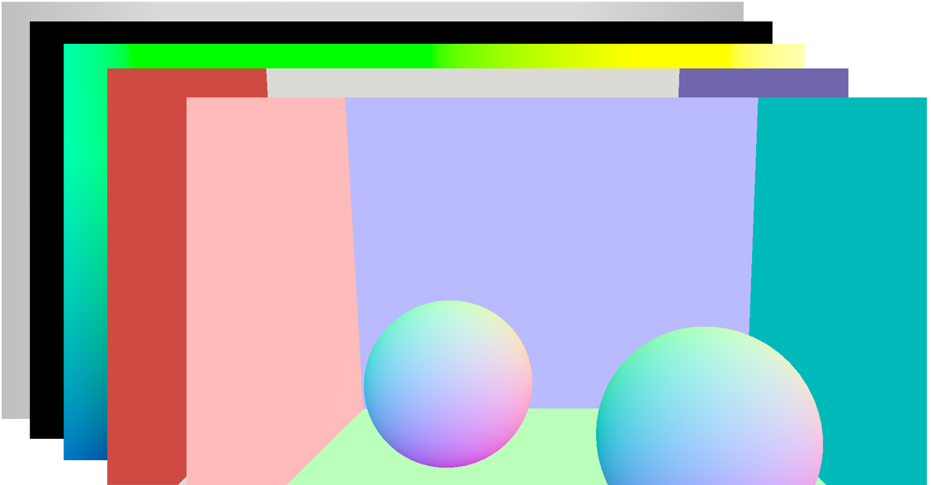
Depth Peeling
Depth Test/
Fragment Shader
Draw call setup
Primitive
Assembly
Rasterization
Setup
Rasterization
Skinning
Tesselation
Layer 0
Layer 1
Notes:
If we want to make K layers of a framebuffer, we have to do K passes over the geometry. Here we show the standard graphics pipeline each pass executes.
*
So for k=2, we do all this work for layer 0,
*
and then
*
all this work for layer 1. But most of the work is redundant.
*
In fact, everything is the same between these k passes over the geometry except for the extra software depth test in the fragment shader. This front part of the pipeline can take a significant amount of time in a modern game engine.

Slide 25
Fragment Shader Interlock / Pixelsync
Slower than regular framebuffer write
Mutex-like synchronization
High bandwidth
Can’t support heterogenous layer resolution
Requires unbounded memory for minimum separation between layers
Z
Notes:
New GPUs support fragment shader interlock or pixelsync which my colleague Chris Wyman was using yesterday for implementing Order Independent Transparency, this is used to store k-layers at a pixel, through a spinlock approach, and is very useful for transparency rendering. Although this seems like a perfect fit for our needs, there are several reasons why it is not
The first reason is that it is much slower than simply writing to a framebuffer: there is the cost of synchronization, and there a lot of bandwidth burned to update a list of the k closest layers and all of their gbuffer values.
The next two reasons are a bit more subtle and I will go into them in a bit of detail:
Since you do not directly see the second or deeper layers, it may be acceptable to decrease your memory bandwidth and increase efficiency by dropping the resolution of all but the first layer. This approach does not let us do this.
Finally, if you noticed in my top-view figure from before, where we went behind the bush, which likely has a ton of internal geometry: we don’t always want the very next layer, we may want to enforce a minimum separation between the layers. However, we show in our paper that you need an unbounded amount of storage per-pixel to enforce such a minimum separation when using this method. Let’s dig in a bit deeper to the idea of a minimum separation

Slide 26
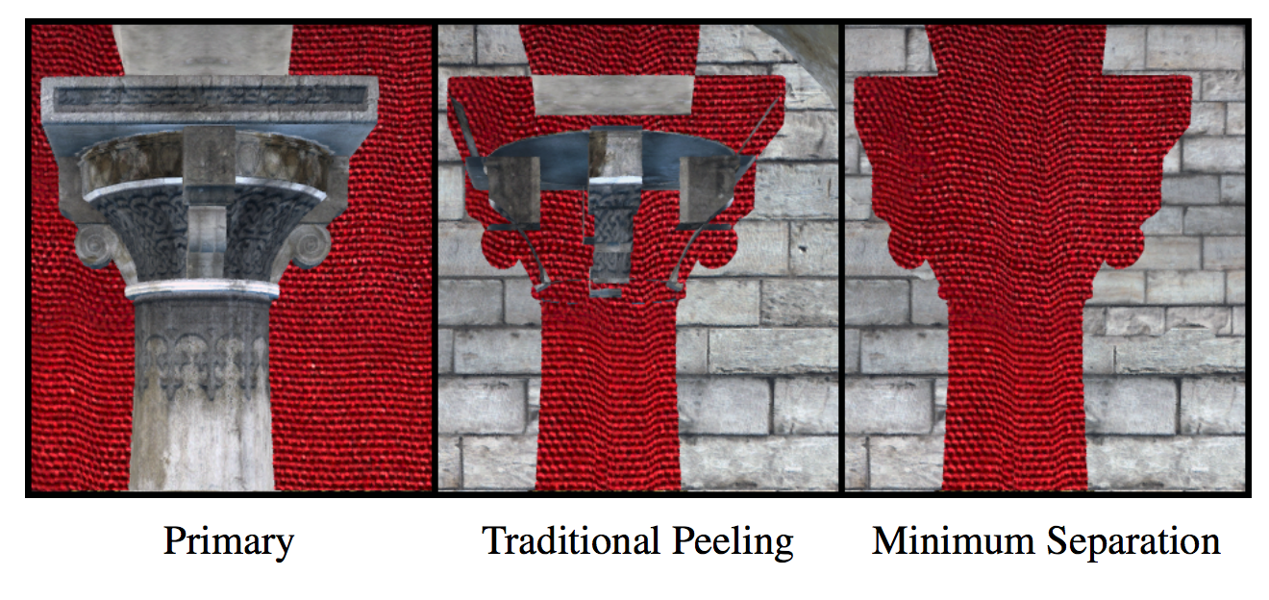
Minimum Separation
Notes:
Most interesting scenes have a lot of layered objects in close proximity. A castle's stone pillar might have a tapestry or lighting sconce mounted on it, a fine cornice where it meets the ceiling, or rendering decals such as dripping water.
*
The true next surface in these cases provides us little useful information, but the next one that is separated by some minimum distance from the primary surface can be much more useful. Here, by enforcing a minimum separation, we see what is behind the pillar and not the next detail on the pillar.
What should you set the minimum separation distance to be? Well, it’s the characteristic length of your scene, so perhaps the width of a wall. But for all the standard benchmark scenes and video games scenes we tried, we got good results choosing any value between half a meter and 2 meters.

Slide 27
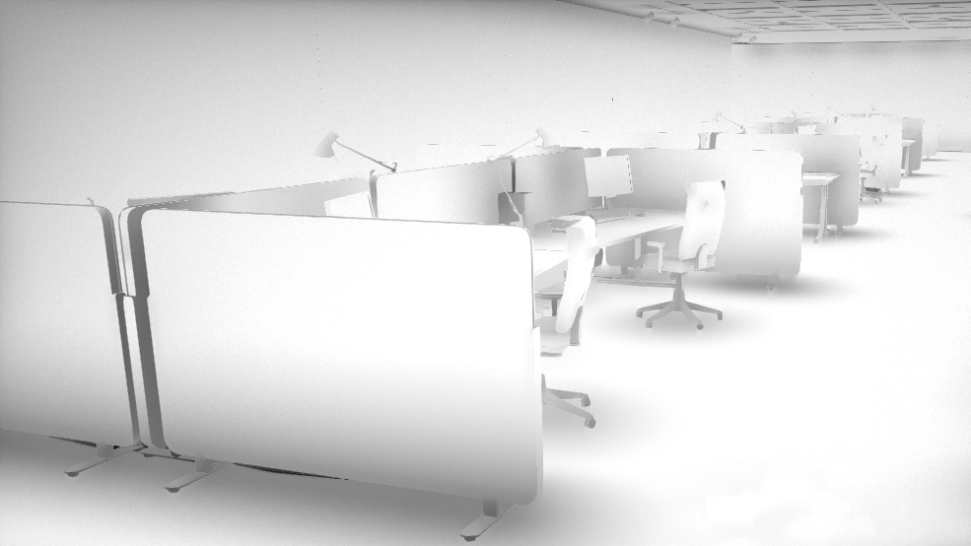
2-layer AO
Notes:
Here is an concrete example. This is that Ambient Obscurance term visualized for some office cubicles using 2 layers without minimum separation

Slide 28
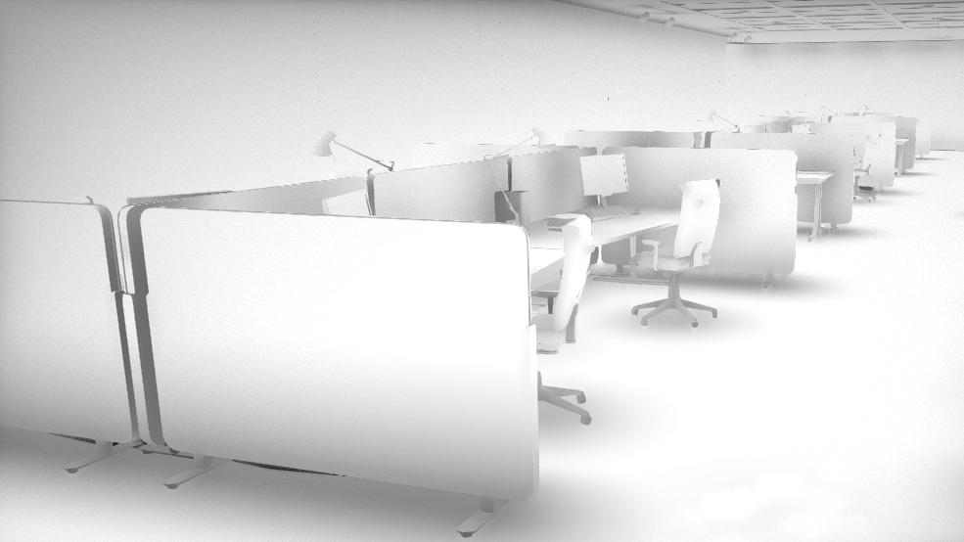
2-layer w/ min separation
Notes:
And with minimum separation

Slide 29
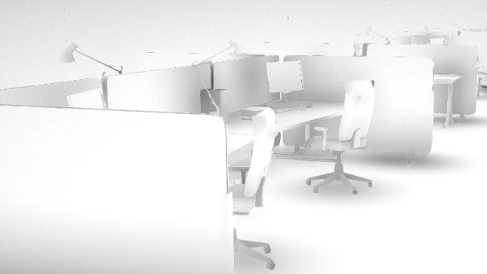
2-layer AO
Notes:
without

Slide 30
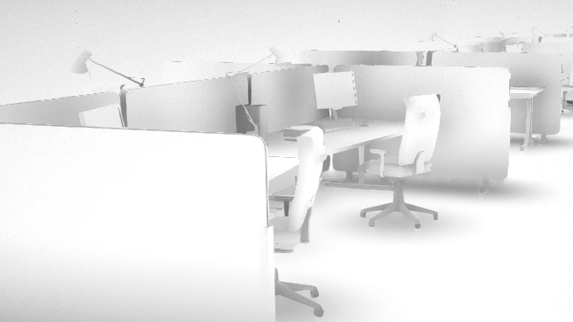
2-layer w/ min separation
Notes:
With
*flip back and forth*
You can see we capture far more of the ambient occlusion signal, avoiding a lot of the haloing from 1 layer or without min separation.

Slide 31
Notes:
So depth peeling is not going to work, and fragment shader interlock is not going to work, and I’ve motivated developing a new algorithm that is compatible with enforcing a minimum separation distance and operates in a single pass over the geometry

Slide 32
Layer 0
Layer 1
Notes:
I am going to sketch how to generate a 2 layer deep gbuffer (with minimum separation) in a single pass, but it works just as well for up to 8 layers in modern graphics APIs. Remember this diagram from depth peeling?

Slide 33
Single Pass Generation
Depth Test/
Fragment Shader
Draw call setup
Primitive
Assembly
Rasterization
Setup
Rasterization
Skinning
Tesselation
Layer 0
Layer 1
Notes:
We’re going to cut off the front part of the pipeline for all but the first layer. Zooming in to when we have complete triangles

Slide 34
Single Pass Generation
Layer 0
Layer 1
What do we peel against?
Notes:
The general outline is that we take every triangle after primitive assembly and duplicate it, running separate fragment shader invocations on both copies. This duplication can be easily accomplished by a geometry shader, and is relatively fast on modern hardware, since both trangles are the same and the geometry shader is otherwise passthrough. On NVIDIA Maxwell GPUs, this duplication can be further sped up through the use of of the viewport multicast extension, which makes broadcasting identical triangles to multiple viewports or layers very cheap.
Now there is a problem with this method that you may be wondering about: in the fragment shader of layer 1 we need know what layer 0 is to perform depth peeling. But we can’t access the depth buffer for layer 0 while its being rendered to on modern graphics APIs, and even if we could, what we need is the final layer 0 depth, not whatever is in there when we are running the fragment shaders for an arbitrary triangle on layer 1.
So how do we know what the 2nd layer is without the first?

Slide 35
Depth Oracle
Perfect oracle -> perfect results
Imperfect oracle -> good results
Always renders real geometry
Correctness matters
Temporal stability matters
Notes:
The algorithm as sketched out works, if only we have an oracle for the depth of the 1st layer that we can peel against in the fragment shader of the 2nd layer.
A perfect oracle gives perfect results, of course,
but an imperfect depth oracle can still capture most of what we want.
Every entry in the 2nd layer will at least be real geometry in the scene.
Of course a good oracle will be mostly correct, but most importantly should be temporally stable, if large swaths of the 2nd layer of the deep gbuffer jump between storing the correct 2nd layer and storing a copy of the first, for example, this could easily manifest as unsightly flickering in the final ambient obscurance or reflections.
We tried and discarded several different methods for generating a depth oracle, see the paper for more details, but the best approach was

Slide 36
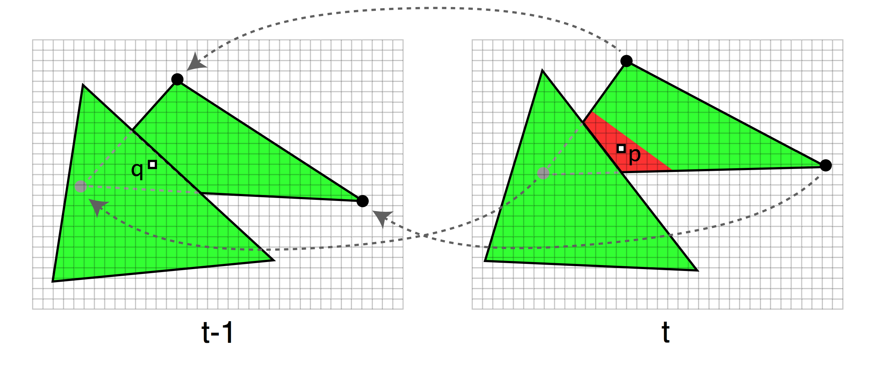
Reverse Reprojection
Reproject the current fragment into previous frame
“Accelerating Real-Time Shading with Reverse Reprojection Caching,” Nehab et al. SIGGRAPH SGH 2007
Notes:
Using Reverse Reprojection, introduced in the literature by Nehab et. al in 2007, to re-use shading on the first layer.
The idea behind reverse reprojection is that you can take your fragment and advect it backwards along its velocity vector to find out the pixel location and depth that fragment had in in the last frame.
To perform depth peeling we, check if the reverse reprojected point is behind the previous g-buffers depth at layer n-1. Essentially we depth peel one frame in the past. The basic idea is that if we take the fragment back in time one frame, and it should have been in the second layer then, it probably should still be in the second layer now.
We've found in experiments that this reverse reprojection approach is almost as good as perfect knowledge for this application in common scenarios

Slide 37
Implementation
geometryShader(tri)
for i=0 to k
emit tri to layer k
Notes:
The final implementation is very clean. You keep your vertex shader as is, and just modify the geometry shader to passthrough all vertex attributes and emit k triangles, one on each layer

Slide 38
NVIDIA Maxwell Version
#version 440
#extension NV_viewport_array2 : enable
#extension NV_geometry_shader_passthrough : enable
layout(triangles) in;
layout(triangle_strip, max_vertices = 3) out;
layout(viewport_relative) out int gl_Layer;
layout(passthrough) in gl_PerVertex { vec4 gl_Position; };
in layout(location = 0, passthrough) vec3 csPosition[];
…
void main() {
gl_ViewportMask[0] = (1 << k) - 1;
}
Notes:
In fact, as the Maxwell Architecture, NVIDIA’s GPUs have a way to do this even more efficiently. In OpenGL, you enable the viewport_array2 and geometry_shader_passthrough, set gl_Layer to be viewport relative. And then mark all of your vertex attributes as passthrough,
Then the body of the geometry shader is literally just one line, setting the bitmask for gl_ViewportMask to broadcast the triangle to the k layers.

Slide 39
Implementation
pixelShader(x,y,z)
if layer > 0
C = transformToPrevFrame(x,y,z)
if C.z > Z_{t-1}[layer-1][C.x,C.y] - minSeparation
discard
// Write to GBuffer
Notes:
The pixel shader also undergoes only minor changes, whether you use the Maxwell optimizations or not.
*
If your fragment is on layer n for n greater than 0,
*
reverse reproject the fragment into the previous frame,
*
and compare its z value against the z-buffer of the n-1’th layer from the previous frame. This is also where we can handle minimum separation with a single subtraction.
*
If the fragment is in front of the n-1th layer or not behind by more than the min separation distance, we discard it.
*
The rest of the pixel shader is the same as any other gbuffer generation shader.

Slide 40
Other Contributions
Multilayer Scalable Ambient Obscurance
Improved Sampling Pattern
Robust Estimator
Dual Layer Fetching
Deep G-Buffer Radiosity
Multibounce Convergence
Bandwidth Reduction
Spatial Temporal Reconstruction
Notes:
In the talk up to this point I have motivated making screen-space effects more robust through the use of a deep gbuffer, and gone over our fast approximate algorithm for generating such a deep gbuffer.
But that isn’t useful unless the screen space techniques can take advantage of it efficiently. So our paper also goes into detail about how we improved the Scalable Ambient Obscurance algorithm and made it work efficiently with multiple layers, and our own variant of Ritschel’s technique for indirect lighting specialized for larger scale diffuse interreflection effects and optimized to be feasible for current games.
For details, see the paper

Slide 41
Results
Notes:
So let’s go into results.

Slide 42
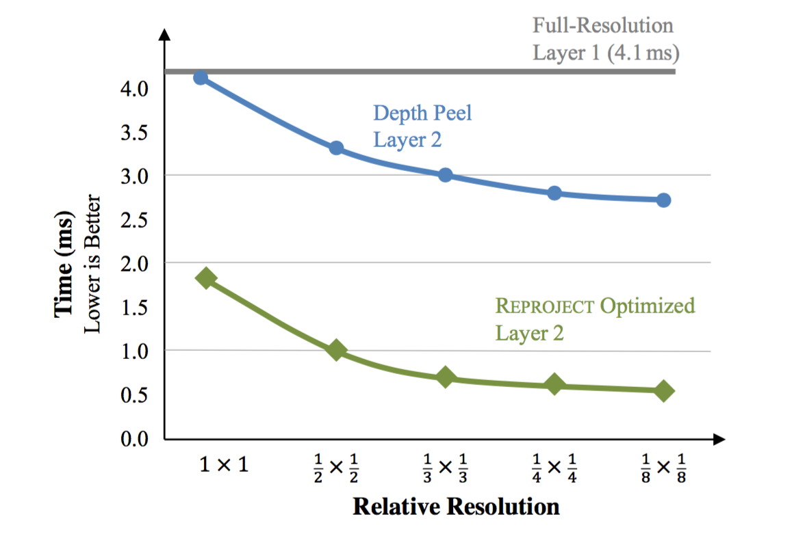
Deep G-Buffer Generation and Lowering Resolution
Notes:
As I mentioned before when discussing why the fragment shader interlock or pixelsync approach was not ideal: the second layer can be at lower resolution than the first.
Here we show the additional cost of rendering the second layer of a 2-layer deep Gbuffer at 1080p on a GeForce 980.
The vertical axis is time in milliseconds.
The horizontal axis is the downsample factor.
Lower is better.
Cass Everitt style depth peeling is the blue line in the middle and Our reprojection approach is the green line on the bottom,
The grey line at the top shows the time for rendering just the first layer.
Starting at full resolution, we see our technique has more than double the performance of depth peeling (which takes as long to render the second layer as the first), and asymptotically approaches 8 times the performance of full-res depth peeling as we drop resolution.
These results are from our most complex scene, San Miguel, clocking in at just under 6 million triangles.

Slide 43
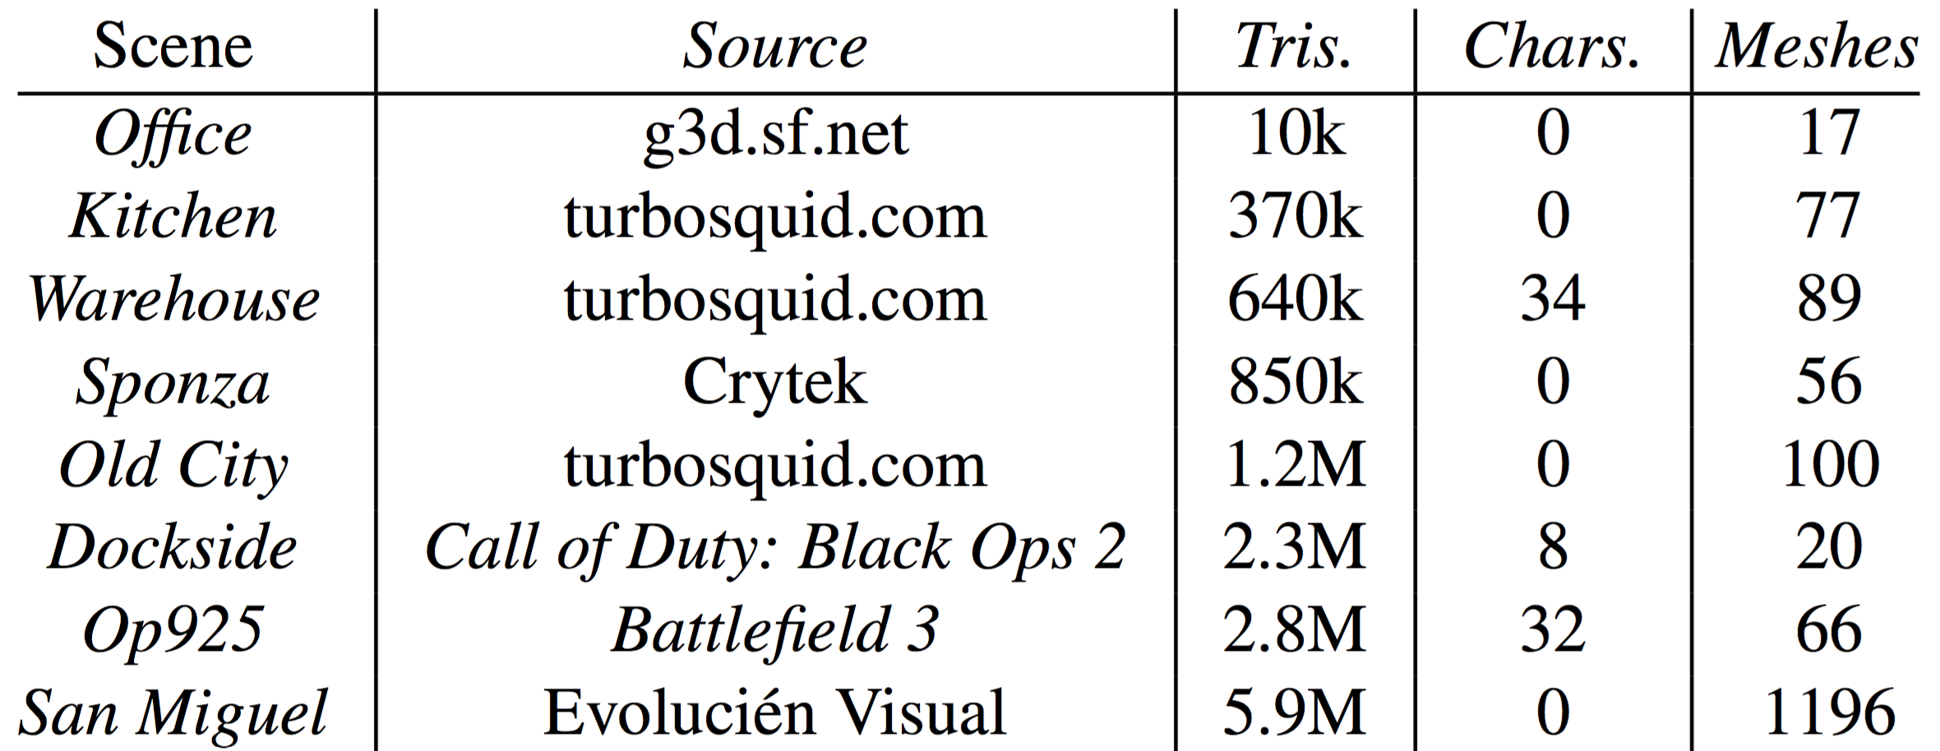
Scenes Tested
Notes:
We also evaluated our algorithm on a wide variety of scenes with drastically varying geometric complexity.
Our scenes vary from 10 thousand to 6 million triangles, with half our scenes over the million triangle mark.
Now wait, you might say, aren’t you talking about screen-space effects, which have runtime mostly independent of the number of triangles? There are two issues, to run the actual effects fast and the Deep G-Buffer generation which creates the data structure those screen-space effects use, which is highly dependent on geometric complexity.

Slide 44
Our Generation Method is Fast
 |  | Layer 2 [ms]
Scene | Layer 1 [ms] | Depth Peel | Reprojection
Office | 0.2 | 0.2 | 0.1
Kitchen | 2.2 | 2.2 | 0.3
Warehouse | 2.4 | 2.4 | 0.9
Sponza | 1.5 | 1.5 | 0.9
Old City | 1.2 | 1.1 | 0.7
Dockside | 2.1 | 2.0 | 1.1
Op925 | 2.7 | 2.8 | 0.8
San Miguel | 4.1 | 4.0 | 1.7
Notes:
The main performance result is that our generation method is fast. You already know that our approach takes slightly over 1 and a half milliseconds more than single layer gbuffer generation to a 2 layer deep gbuffer on San Miguel.
The rest of our scenes take about an addition 1 millisecond or less to generate the 2-layer Deep G-Buffer (take a look at the rightmost column), and it outperforms depth peeling in every case.
On this test suit, our improvement over depth peeling range from about 60% to over 7x improvement on the Kitchen scene
So the overhead of extending a regular G-Buffer to a 2-layer Deep G-Buffer is inexpensive, just like we need. Now what about computing with 2x the bandwidth

Slide 45
Computing with 2 layers is Efficient
Scene | AO [ms] | Radiosity [ms]
Kitchen | 1.4 + 0.1 | 3.2 + 0.4
Sponza | 1.4 + 0.0 | 3.4 + 0.5
Old City | 1.8 + 0.1 | 3.5 + 0.4
Dockside | 1.7 + 0.1 | 3.2 + 0.3
Op925 | 1.7 + 0.0 | 3.6 + 0.3
San Miguel | 1.7 + 0.0 | 3.5 + 0.5
(1 layer time) + (additional time to use 2nd layer)
Notes:
Computing the screen-space effects using the optimizations in our paper for multiple layers is inexpensive, adding little overhead for computing with 2 layers instead by amortizing the address lookups and hiding the extra compute behind the existing memory latency. Within each column there are two numbers added together. The left number is the cost of running the algorithm on just one layer in milliseconds, the number on the right is additional time required to compute with both layers instead.
The second layer for AO costs less than 10% of the single layer cost on all scenes.
Our screen space radiosity algorithm, inspired by Ritschel’s approach, but extending scalable ambient obscurance takes about three and a half milliseconds on a single layer, and only half a millisecond more on a 2 layer deep gbuffer on all scenes.

Slide 46
Qualitative results
Notes:
So let’s take a look at some qualitative results.

Slide 47
Notes:
Here we have some rippling mirror-reflective water in a call of duty level reflecting some red crates. A bird flies by and its reflection quickly flies off screen. With one layer, we get a duck-shaped hole in our reflection of the rest of the scene where the duck hides information. With two layers the hole is filled.

Slide 48
Notes:
This is actually a screenshot from our demo with full source that you can download from our webpage. This is showing that scene before with the columns which I used to demonstrate the unsightly halos from 1 layer AO.
*Play Twice*

Slide 49
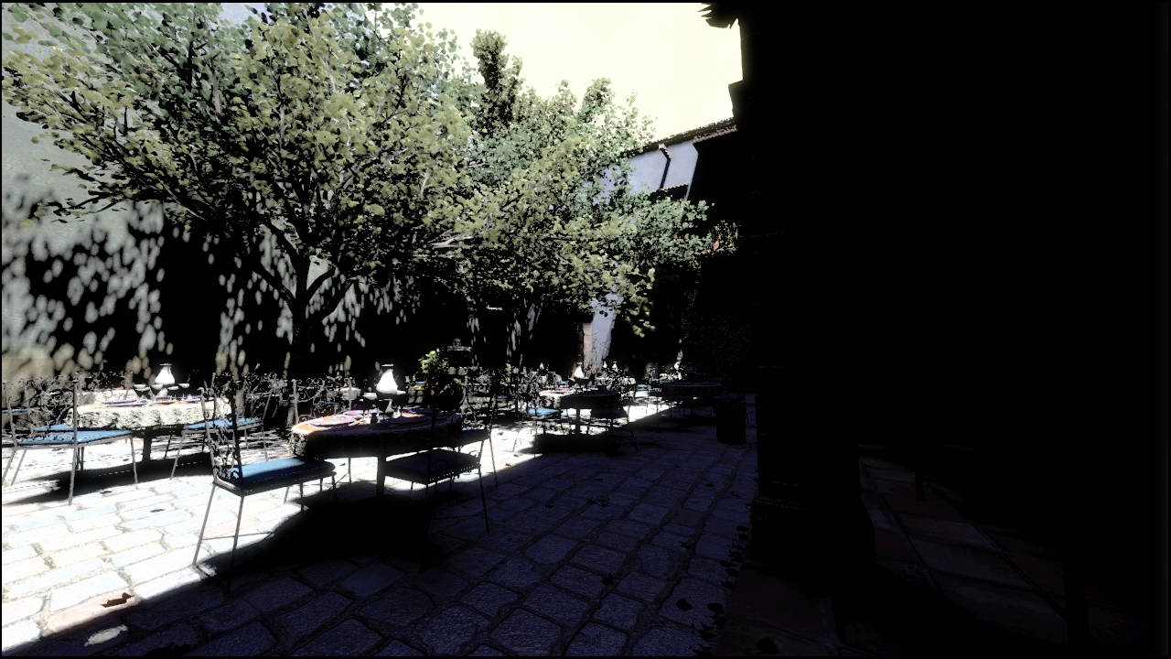
Direct Illumination Only
Notes:
Here’s the image from my title slide with direct illumination only

Slide 50
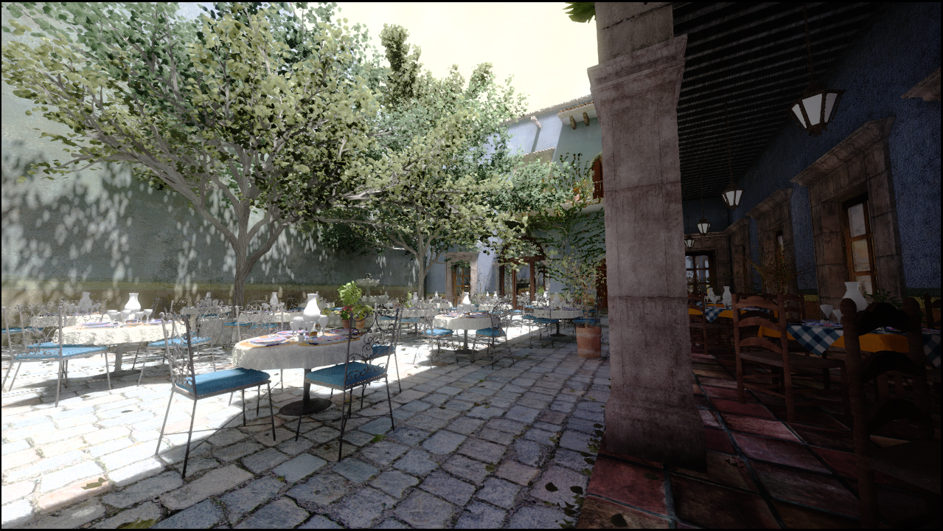
Deep G-Buffer Radiosity
Notes:
Deep Gbuffer radiosity provides plausible spatially varying diffuse illumination

Slide 51
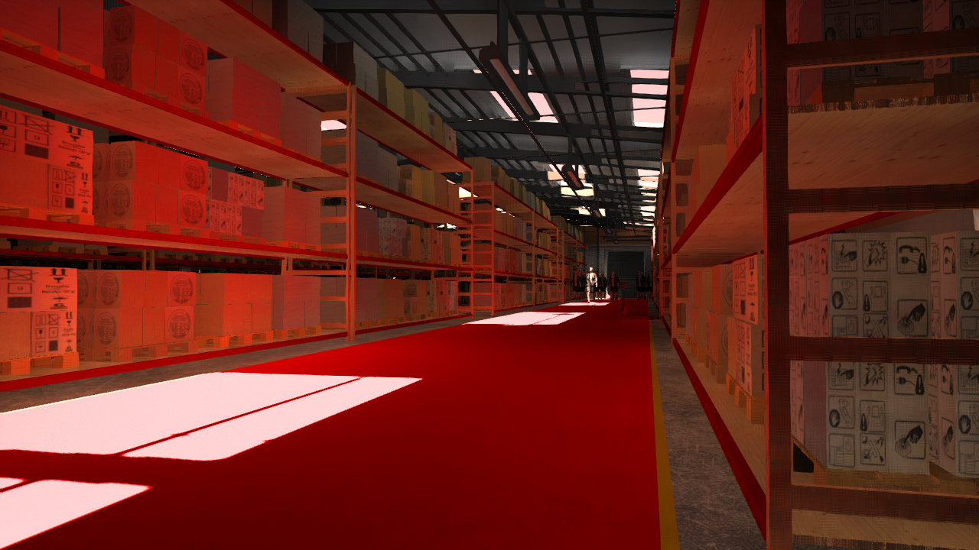
Screen-space Radiosity
Notes:
Here is a view of a warehouse with a skylight with a very bright red floor. We can see the bounce lighting tinting the boxes on the left red. Now lets take a look at what happens if we move into the adjacent isle and look back into this isle between the boxes

Slide 52
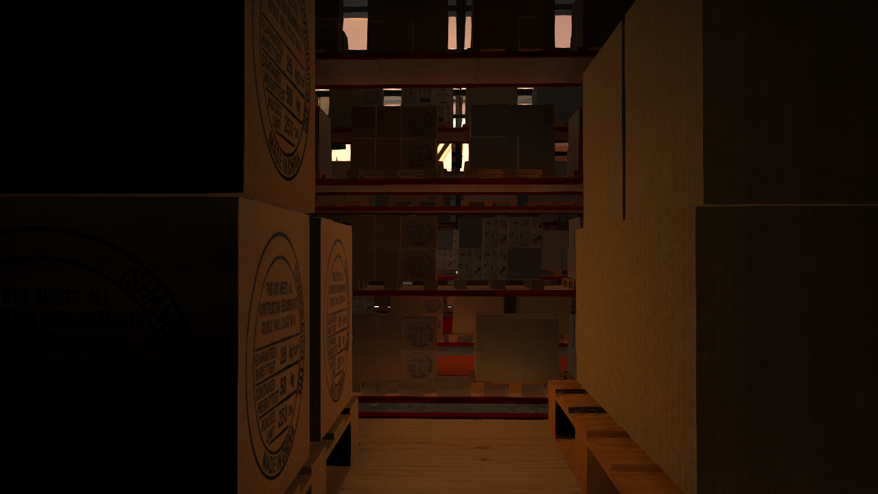
Screen-space Radiosity
Notes:
There is no red indirect light if you only have one layer, despite the bright red floor being in the view frustum.

Slide 53
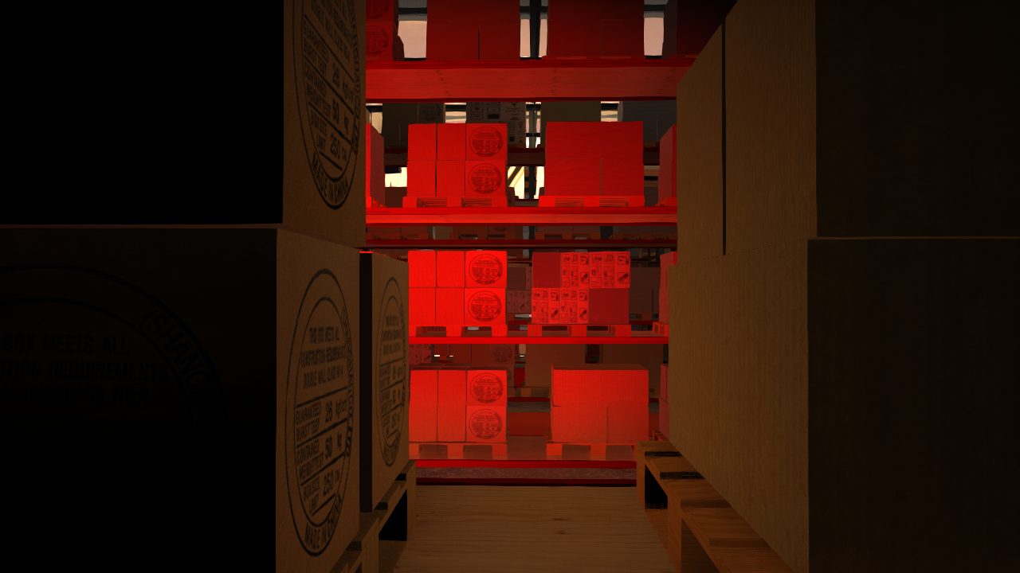
Deep G-Buffer Radiosity
Notes:
A second layer fixes this error in this case, though of course it too fails if you move the direct light outside the guard-band expanded view frustum.

Slide 54
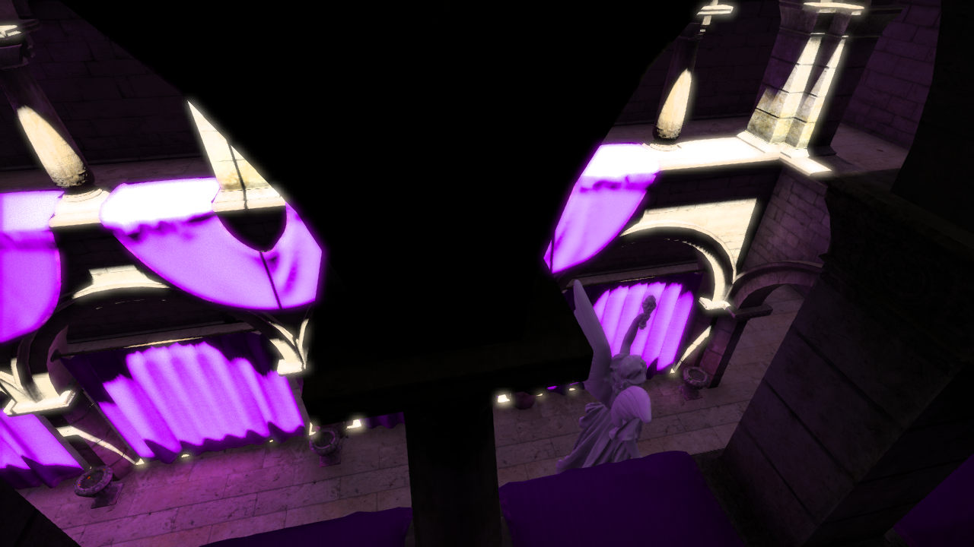
1 Layer Radiosity
Notes:
Here is screen space radiosity, which acts on one layer. We are on Sponza, looking down on the open center area from the balcony. A column blocks our view of one of the purple banners

Slide 55
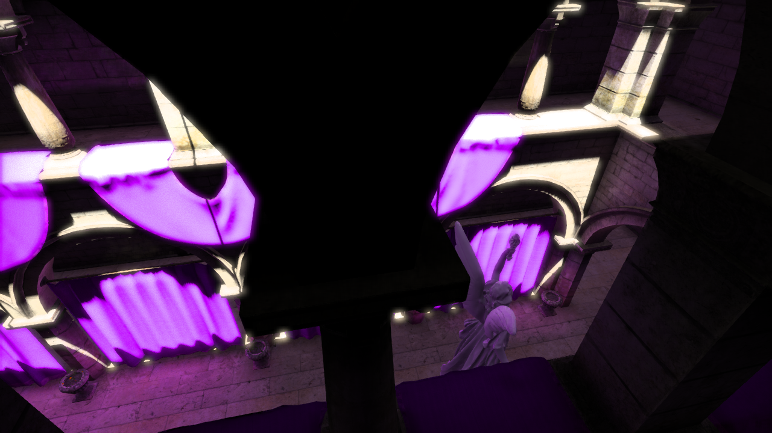
2 Layer Radiosity
Notes:
With two layers without minimum separation, we get some more bounce lighting, but we run into the issue where the decorative geometry on the pillar causes the 2nd layer to be non-informative

Slide 56
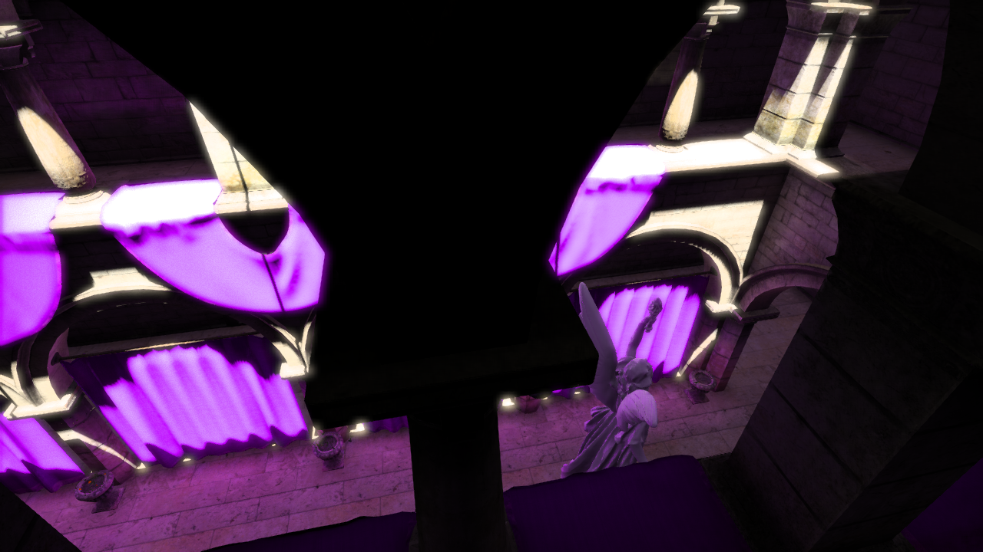
With min. separation
Notes:
With a minimum separation

Slide 57
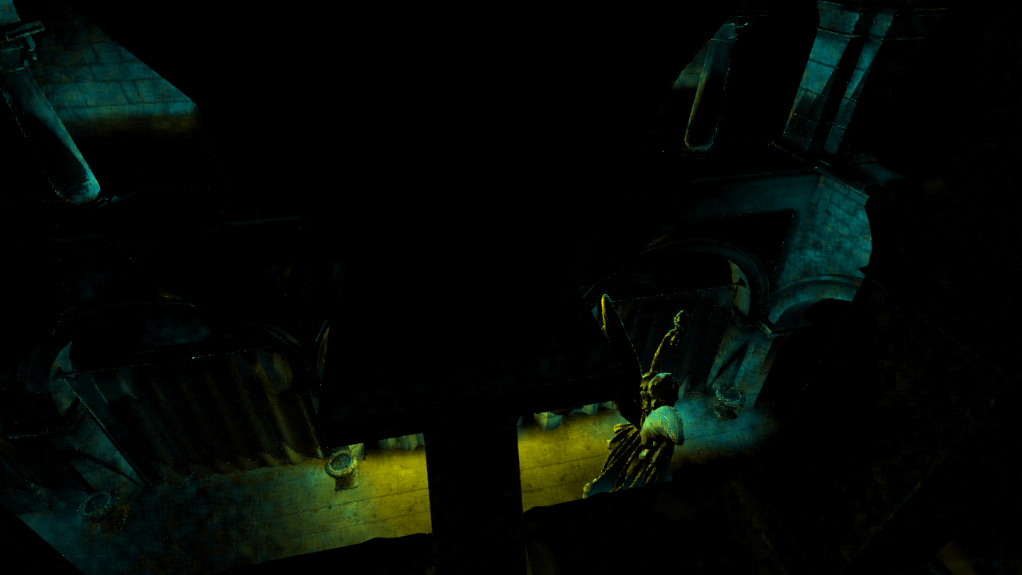
Cyan = 2 Layer
Yellow = Min. Separation
Notes:
This is a 2 times difference image color coded to try and give you an idea what benefit is due to a second layer, and what is due to the minimum separation.
Cyan shows the extra contribution to the final image due to having a second layer with no minimum separation, and yellow is the further extra contribution due to having a minimum separation between the two layers. IN this case, most of the benefit is realized with a minimum separation. We have several other examples in the paper.

Slide 58
Notes:
I know I want to see all graphics techniques in motion, so here is some video from our demo app, which again, is available on our website in both source and pre-built windows binary form, here setup to compare prerendered light probes on the left to two layer deep gbuffer radiosity on the right.

Slide 59
Future Work
Cube-map
Low resolution
Use as fallback
Other Screen-Space Effects
Ambient Obscurance
Radiosity
Reflection
Refraction
Motion Blur
Depth of Field
Shadow Filtering
Temporal AA
Notes:
The natural next step for screen-space lighting is to eliminate the guard bands and static cube map fallback. These can be replaced by renderering a low-resolution cube around the camera every frame or every few frames. Any sample location that is out of bounds on the main screen can be replaced with one from this low resolution cube map, and results near the edges blended in to hide the transition.
This is a step closer to a full blown ray tracing solution such as DIRT,
We covered three screen space effects in this talk, but there are a wide variety of techniques that might benefit from a deep gbuffer structure.

Slide 60
Final Slide
Acknowledgments: Aaron Lefohn, Bengt-Olaf Schneider and the NVIDIA Architecture team
Project Website: http://graphics.cs.williams.edu/papers/DeepGBuffer16/
Up-to-date-demo: svn://g3d.cs.williams.edu/g3d/G3D10/samples/deepGBufferRadiosity

Slide 61
References
[Everitt01] - Everitt, C., 2001. “Interactive Order-Independent Transparency”, Tech. Report,. NVIDIA Corporation.
[Ritschel09] - Tobias Ritschel, Thorsten Grosch, and Hans-Peter Seidel. 2009. Approximating dynamic global illumination in image space. In Proceedings of the 2009 symposium on Interactive 3D graphics and games (I3D '09). ACM, New York, NY, USA, 75-82.
[Stachowiak15] - Stachowiak, Tomasz and Uludag, Yasin “Stochastic Screen Space Reflections.” SIGGRAPH 2015 Advances in Realtime Rendering
Notes:
Screenshots of AC:S from: http://www.geforce.com/whats-new/guides/assassins-creed-syndicate-graphics-and-performance-guide#assassins-creed-syndicate-nvidia-hbao-plus-ambient-occlusion

Slide 62
Extra Slides

Slide 63
1st Layer Depth Oracle Options
Dead-reckon geometry for next frame and render predicted first layer depth buffer
Can be *very* wrong
Slow
Generate depth buffer for next frame on current one
Perfect oracle
Slow
Increases display latency by a frame
Use last frame’s depth buffer
Fast!
Correct when not moving
Very wrong when moving
Notes:
We evaluated 4 options for an Oracle for the 1st layer depth.
The first is to use the geometry shader to generate *another* triangle, this one transformed by the predicted camera and object transforms for the next frame. There are two major problems with this: one, when the prediction is wrong, as it will be whenever the player say, turns their head for example, the oracle can be wrong everywhere. This causes very unsightly flickering. On current hardware, geometry shaders that expand the amount of geometry are quite slow, which is the other major problem.
The 2nd approach is to actually do the transforms a frame ahead of time, so that you have accurate transforms to generate next frames depth buffer, which allows you to generate a perfect oracle This method isn’t any faster than the previous method, since its essentially the same from the shader side and increases latency by a frame.
The 3rd approach is to simply use the previous frame’s 1st layer depth buffer as the depth oracle. This is extremely fast, as it requires no extra rendering and is trivially the correct solution when not under motion. However it is completely wrong under motion, and in non-coherent ways. For example, the results will be almost correct when slowly moving forwards, but if you move backwards by the min separation distance each frame, you end up with the 2nd layer just being a copy of the first layer. We can salvage this approach, however

Slide 64
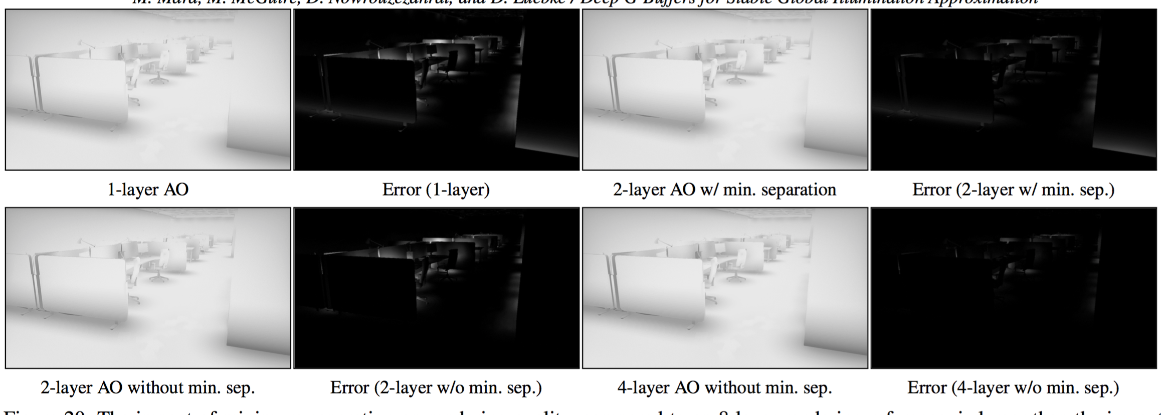

Slide 66
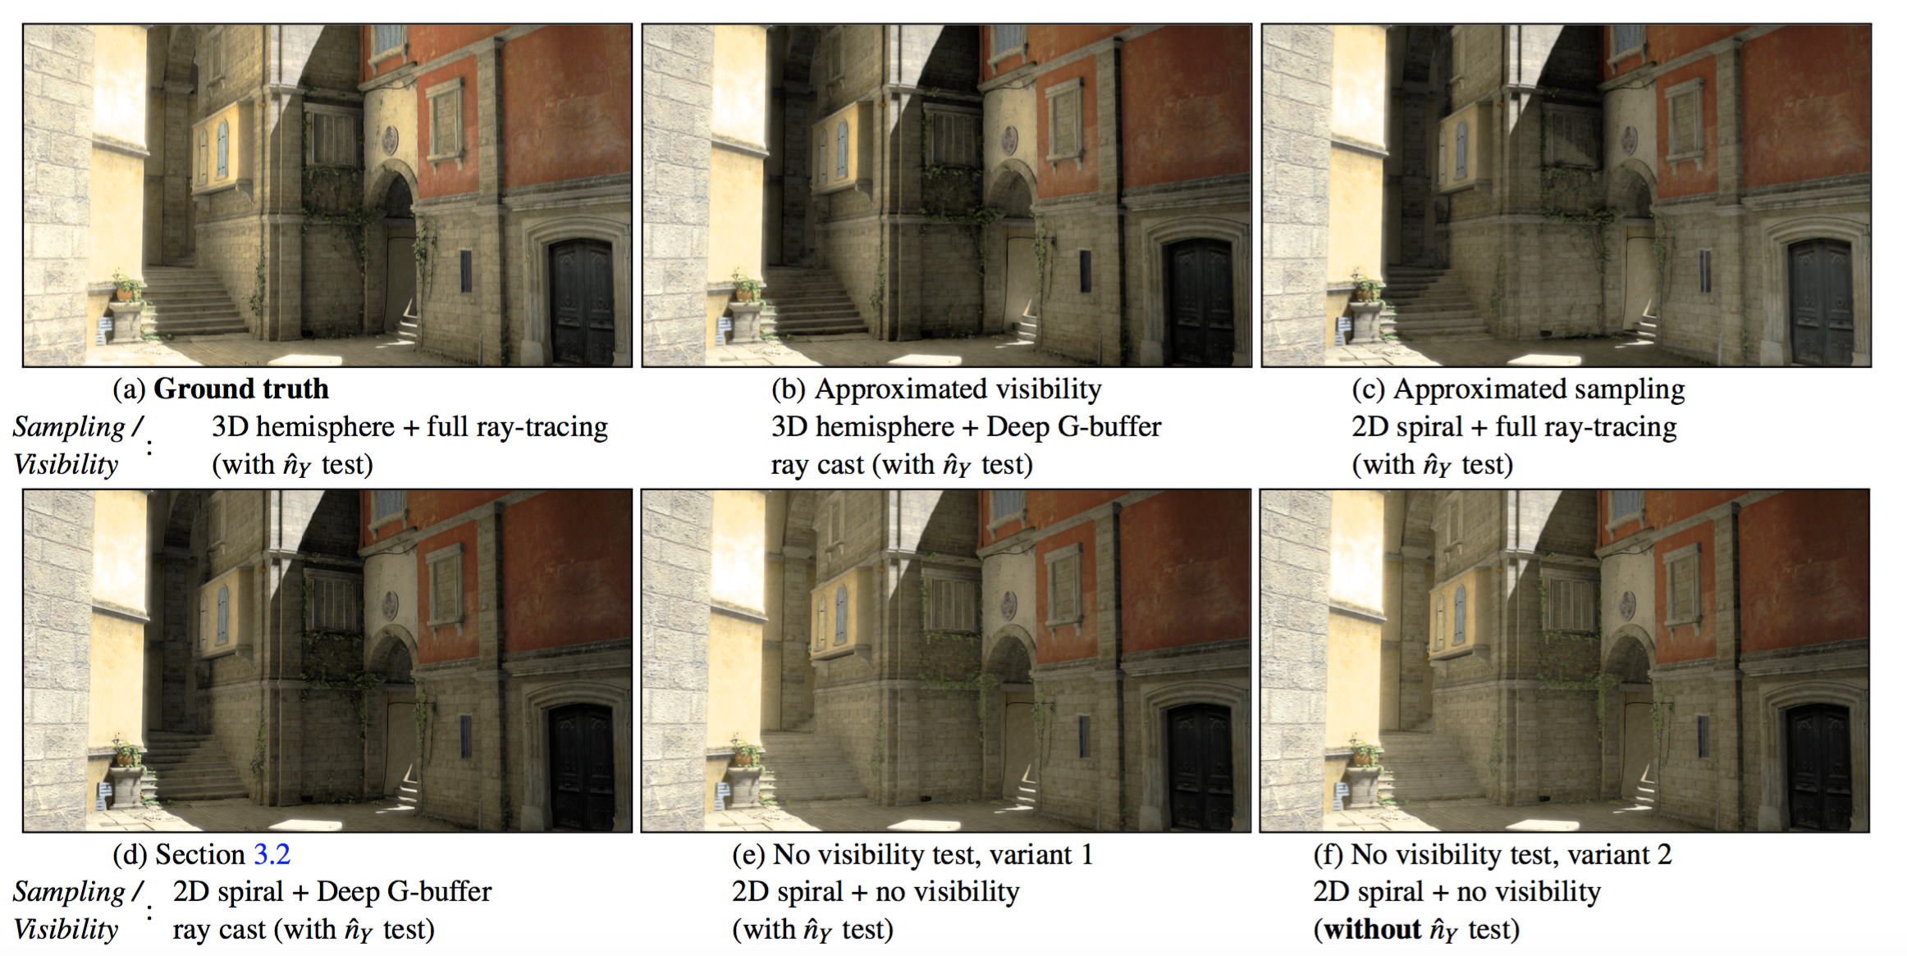

Slide 67
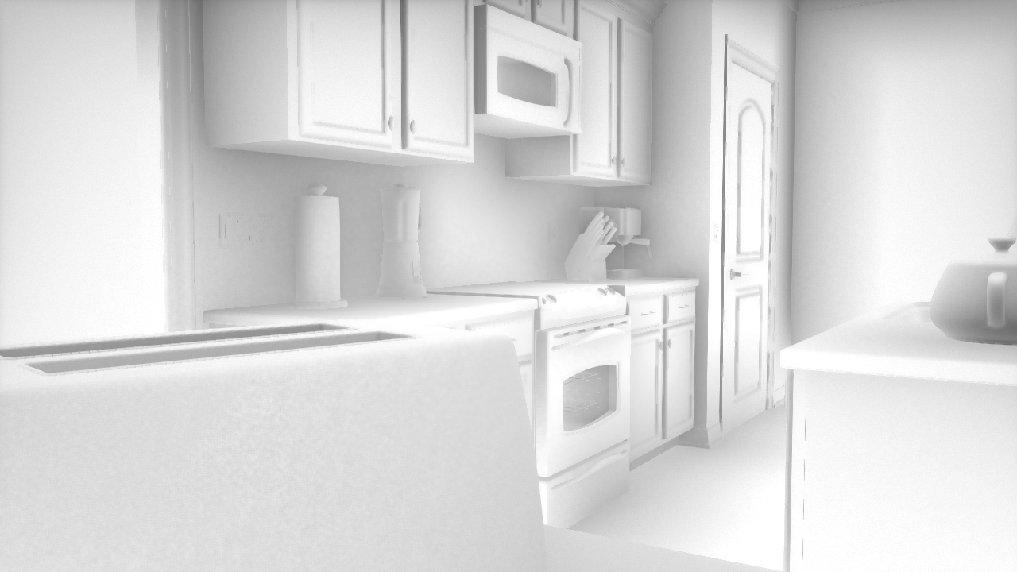
1 Layer AO
Notes:
Lets take a look again at the benefit of multiple layers: here’s 1 layer ambient obscurance on the kitchen scene

Slide 68
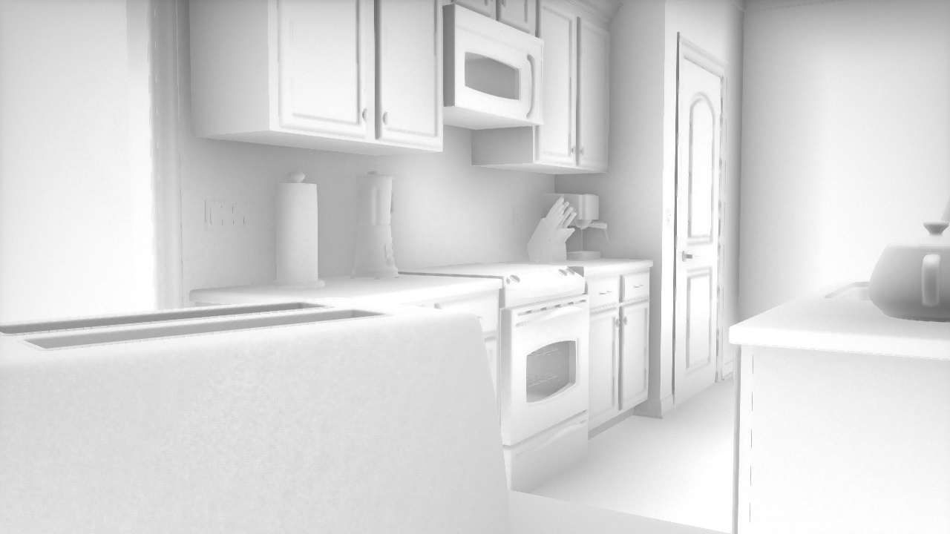
2 Layer AO
Notes:
Versus 2 layers without a minimum separation

Slide 69
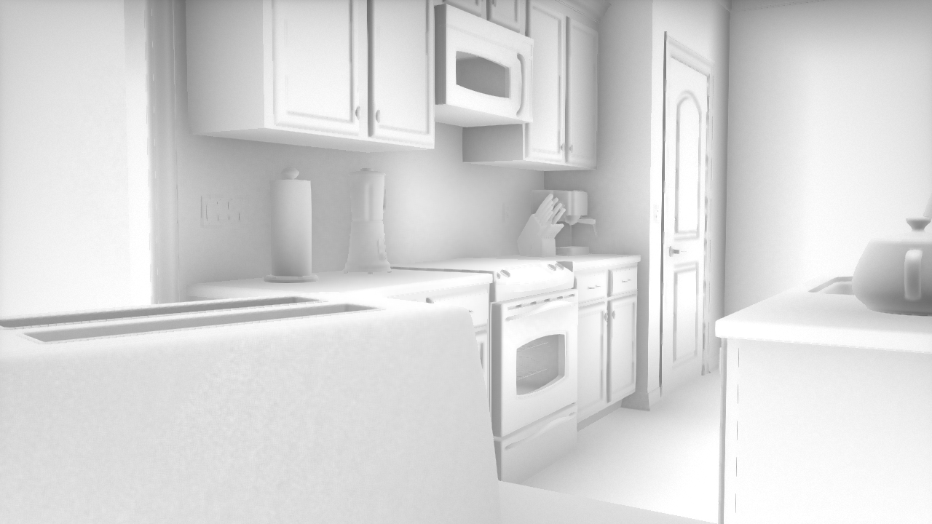
With min. separation
Notes:
And finally 2 layers with minimum separation

Slide 70
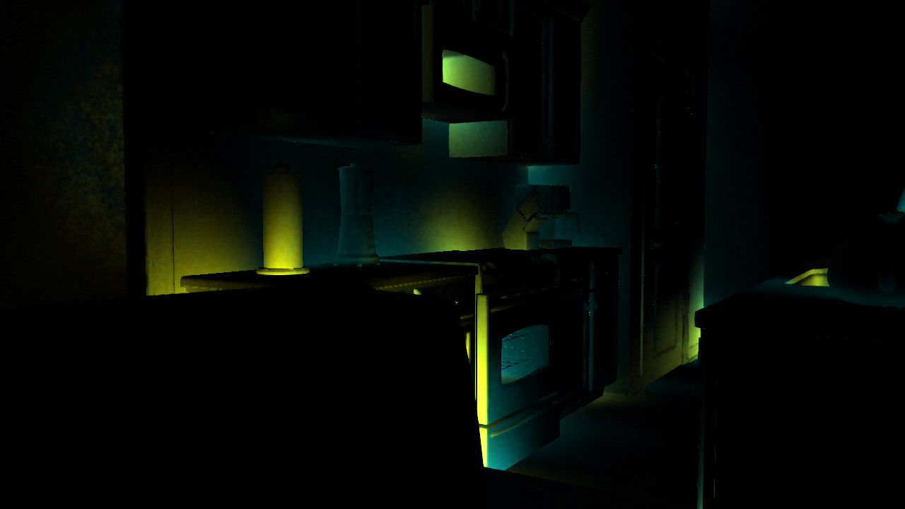
Cyan = 2 Layer
Yellow = Min. Separation
Notes:
This is a 2 times difference image color coded to try and give you an idea what benefit is due to a second layer, and what is due to the minimum separaiton.
Cyan shows the extra contribution to the final image due to having a second layer with no minimum separation, and yellow is the further extra contribution due to having a minimum separation between the two layers. IN this case, most of the benefit is realized with a minimum separation

Slide 71
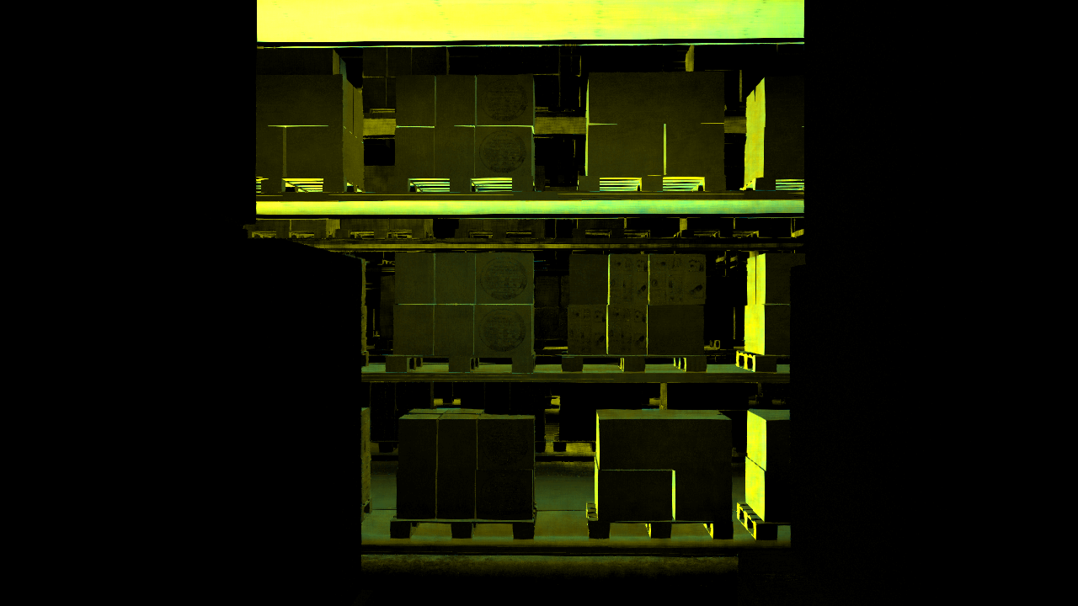
Cyan = 2 Layer
Yellow = Min. Separation

Slide 72
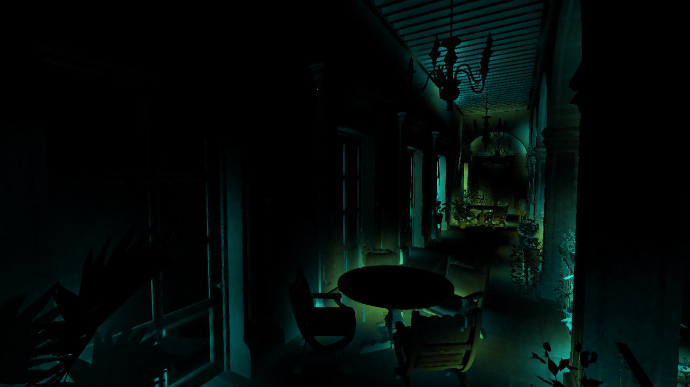
Cyan = 2 Layer
Yellow = Min. Separation

Slide 73
Limitations
Outside Frustum
Glancing angles
Back facing geometry
Geometry not captured in k layers

Slide 74
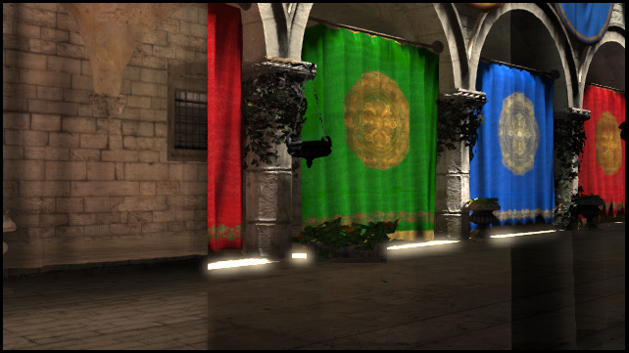
Ground Truth
Notes:
Here is the second layer, shaded for visualization purposes, behind a pillar in sponza. When performing this test we were performing rapid, unpredictable head movement which is worst-case for many of our approaches

Slide 75
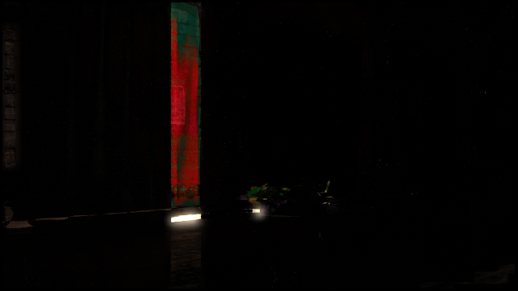
“Last Frame” Error
Notes:
The “Last Frame” approach has large error in this case, which would manifest as flicker in AO for example when our velocity changes.

Slide 76
“Prediction” Error
Notes:
In this particular case, prediction is even worse, since dead reckoning is just incredibly wrong under acceleation

Slide 77
“Reverse Reprojection” Error
Notes:
Meanwhile for reverse reprojection: The region of error is very small, and localized to silhouette edges.
If we hadn’t used a guard band, you would also see a small column of error on the left side of the screen

Slide 78
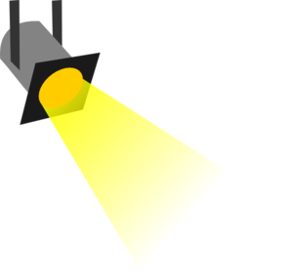
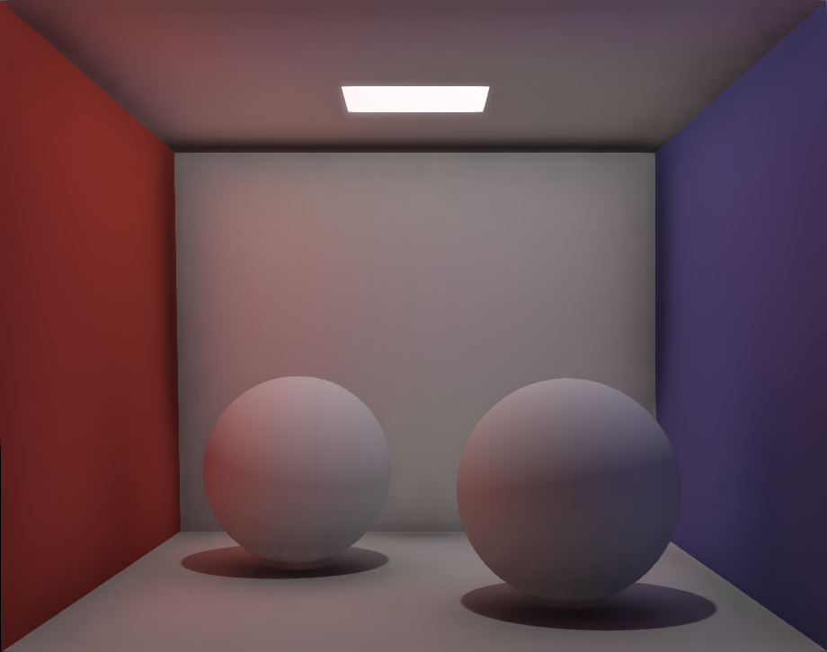
Deferred Shading
Geometry and Materials
Geometry Buffer (G-Buffer)
Lighting
Final Image

Slide 80
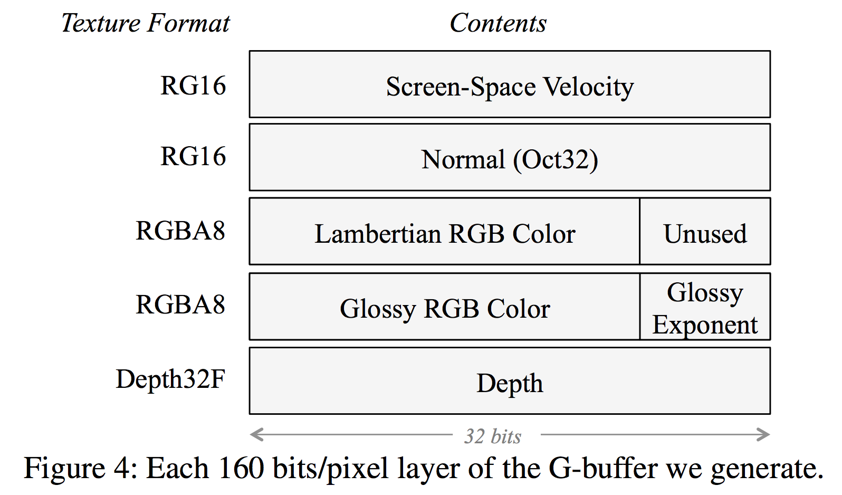

Slide 81
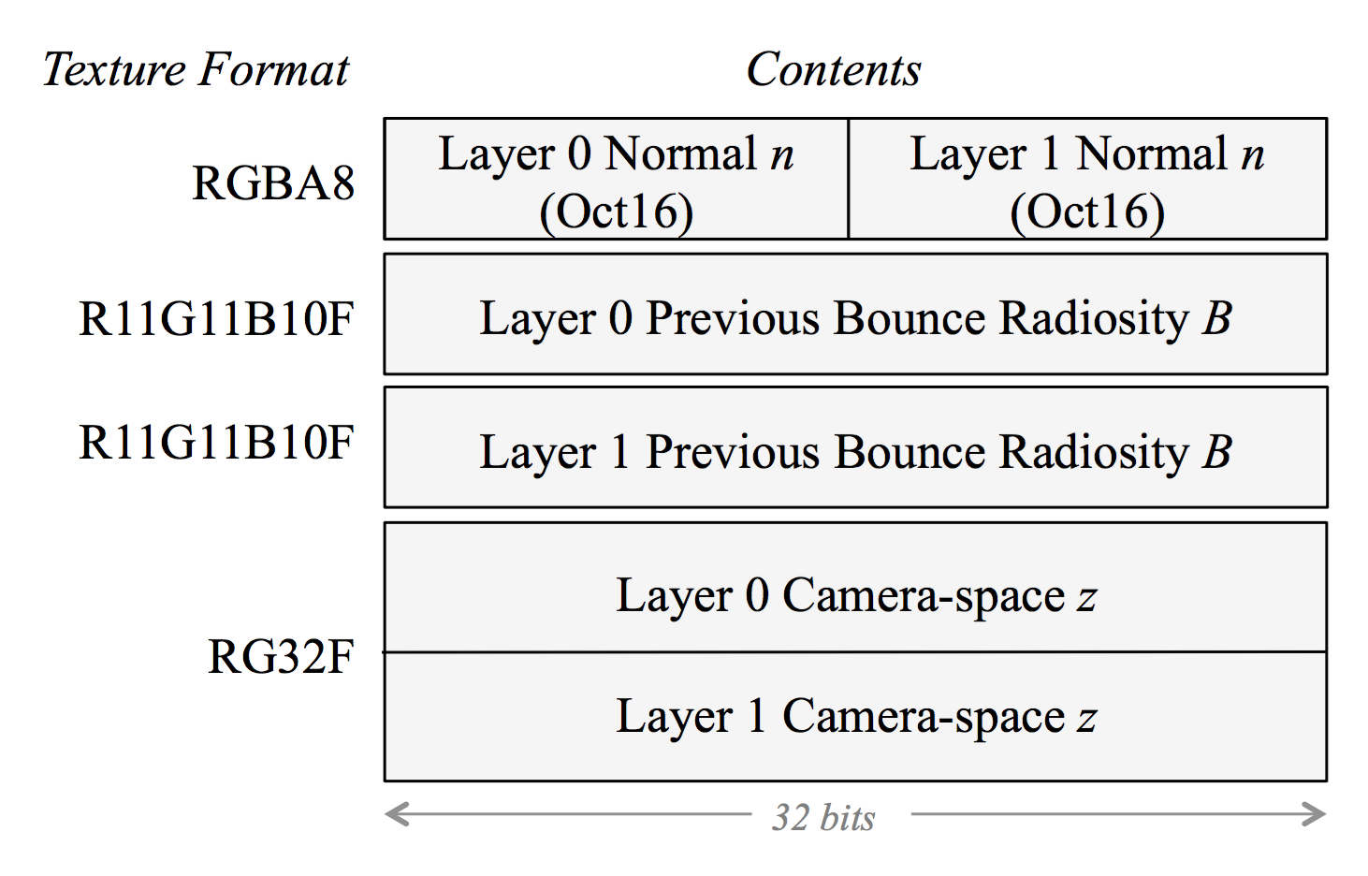

Slide 82
Timing Results (Deep G-Buffer Generation)
 |  | Layer 2 [ms]
Scene | Layer 1 [ms] | Depth Peel | Reprojection
San Miguel | 4.1 | 4.0 | 1.7
Kitchen | 2.2 | 2.2 | 0.3
Sponza | 1.5 | 1.5 | 0.9
Dockside | 2.1 | 2.0 | 1.1
Op925 | 2.7 | 2.8 | 0.8
Old City | 1.2 | 1.1 | 0.7
Office | 0.2 | 0.2 | 0.1
Warehouse | 2.4 | 2.4 | 0.9

Slide 83
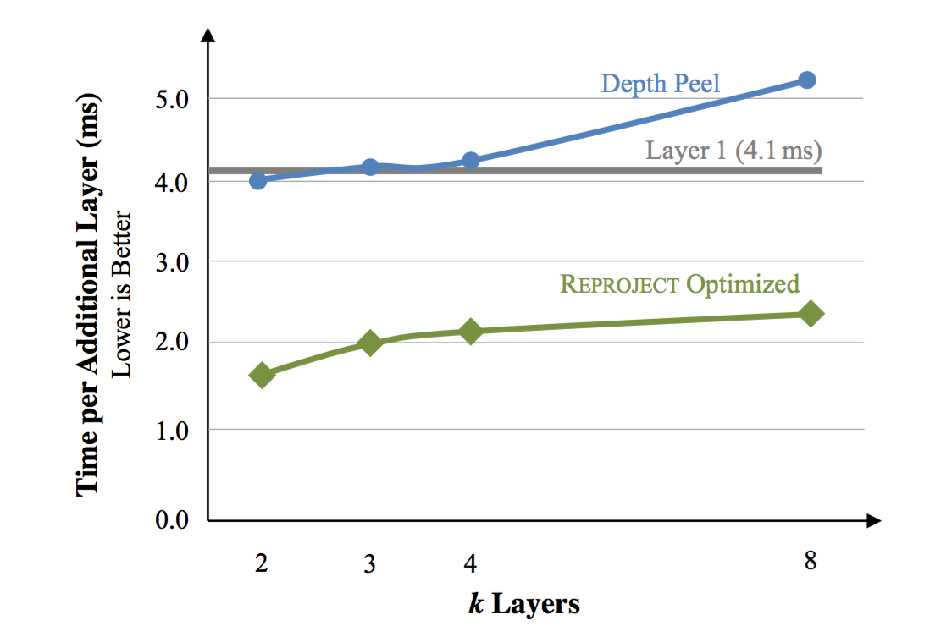
Timing Results (k Layers)

Slide 85
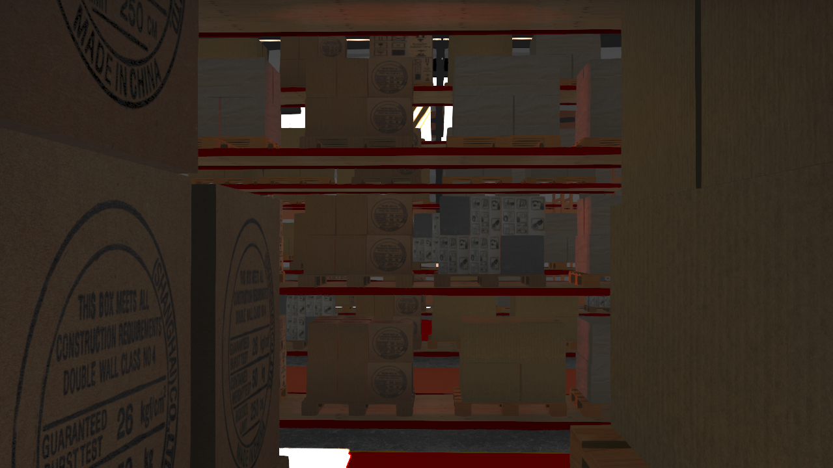

Slide 86
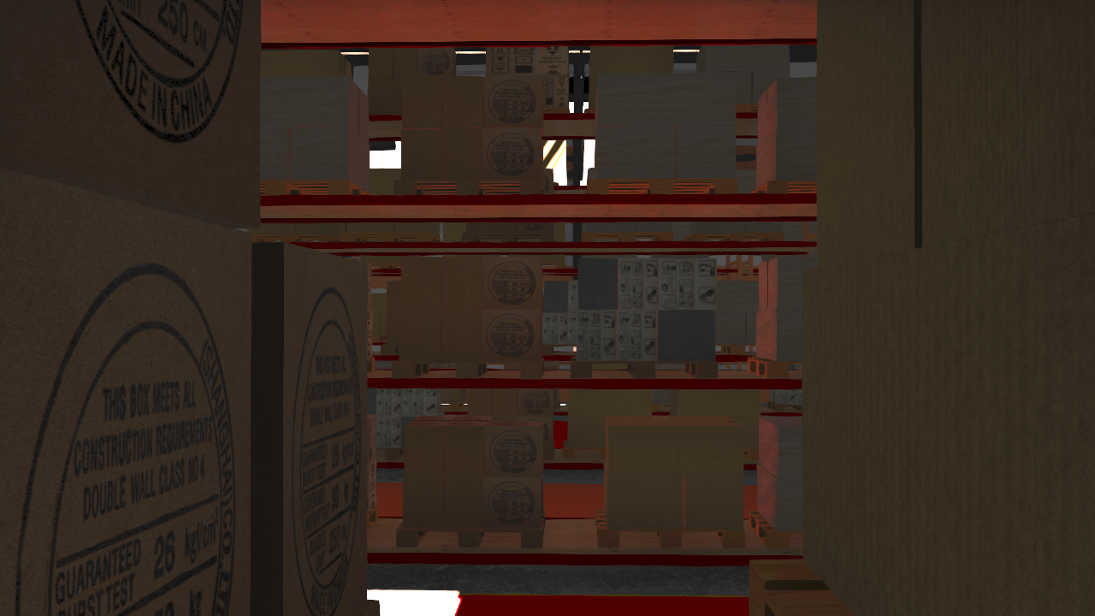

Slide 87
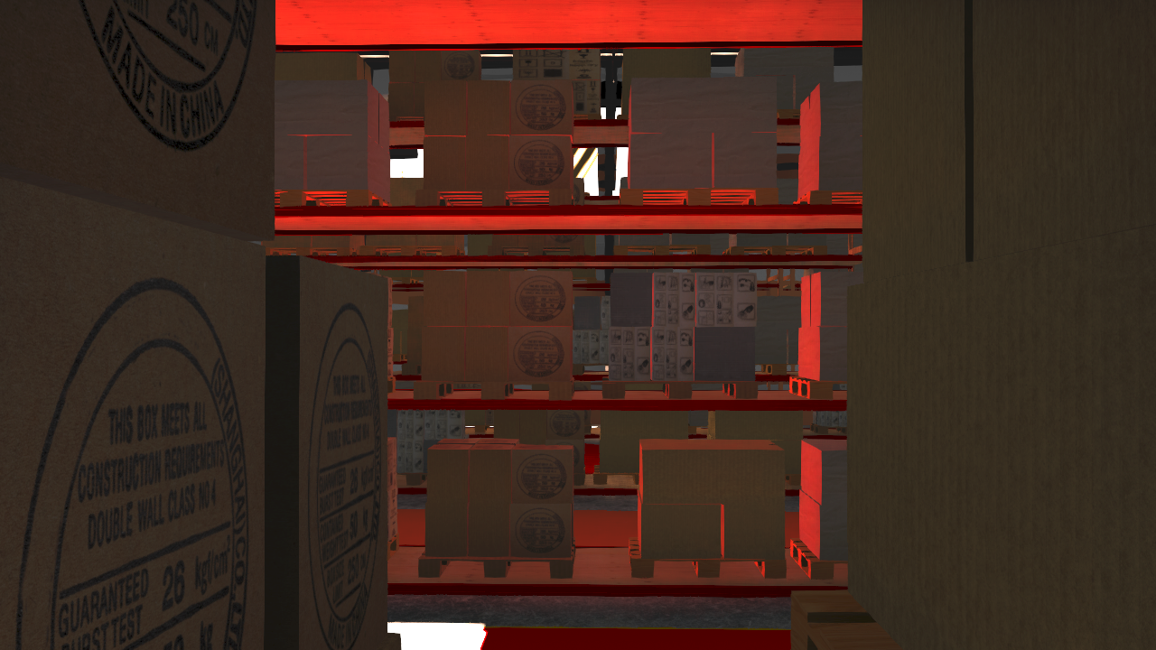

Slide 88
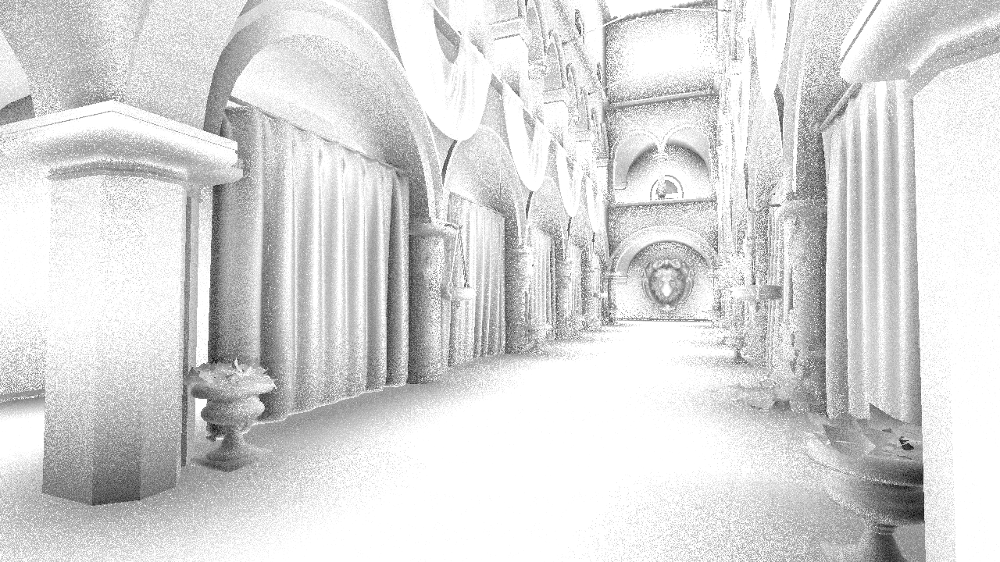
Too Slow to Take Many Samples

Slide 89
Temporal Filtering

Slide 90
Spatial Filtering

Slide 91
Temporal and Spatial Filtering

