Slide 1
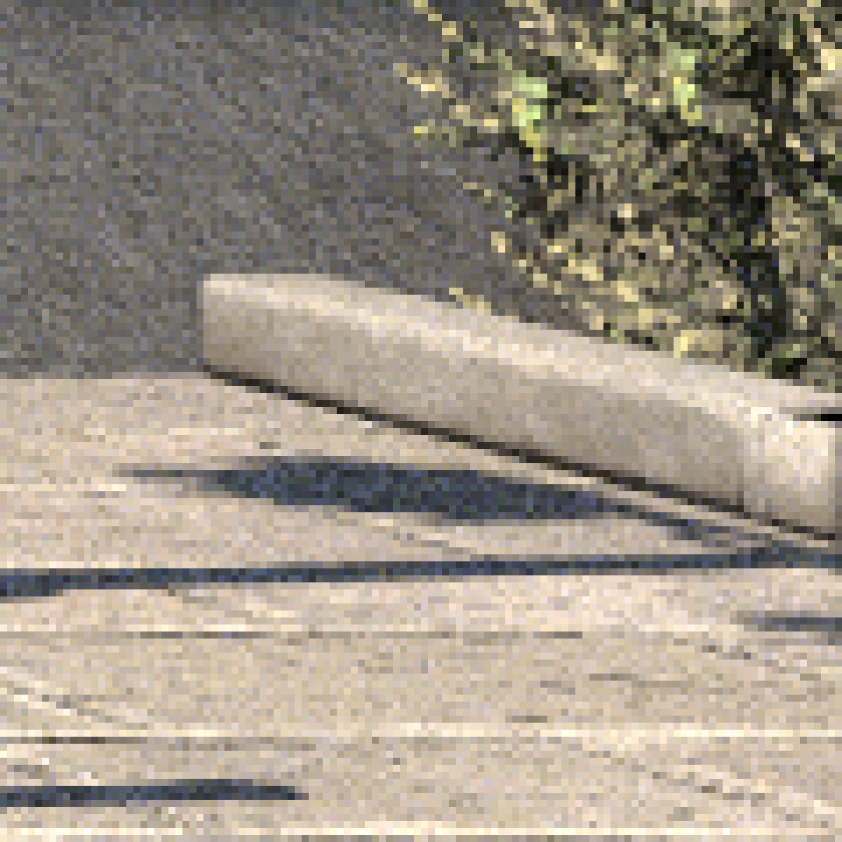
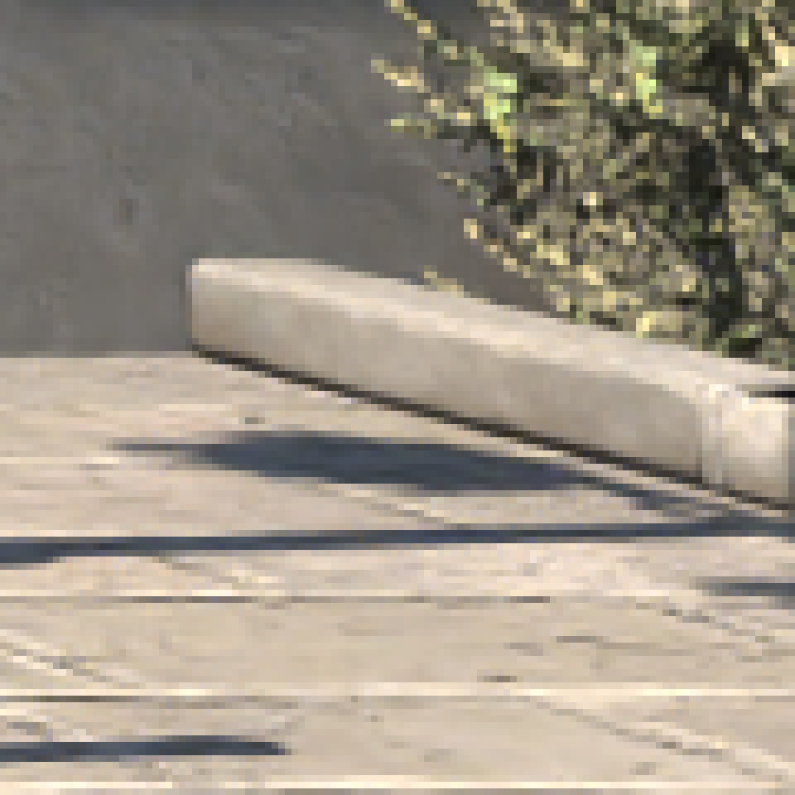


Converging Algorithm-Agnostic Denoising for Monte Carlo Rendering
(a) Input crop 256 spp
(b) Denoised
(c) Ours
(d) Reference 65K spp
α · a + β · b = c
Elena Denisova, Leonardo Bocchi

Slide 2
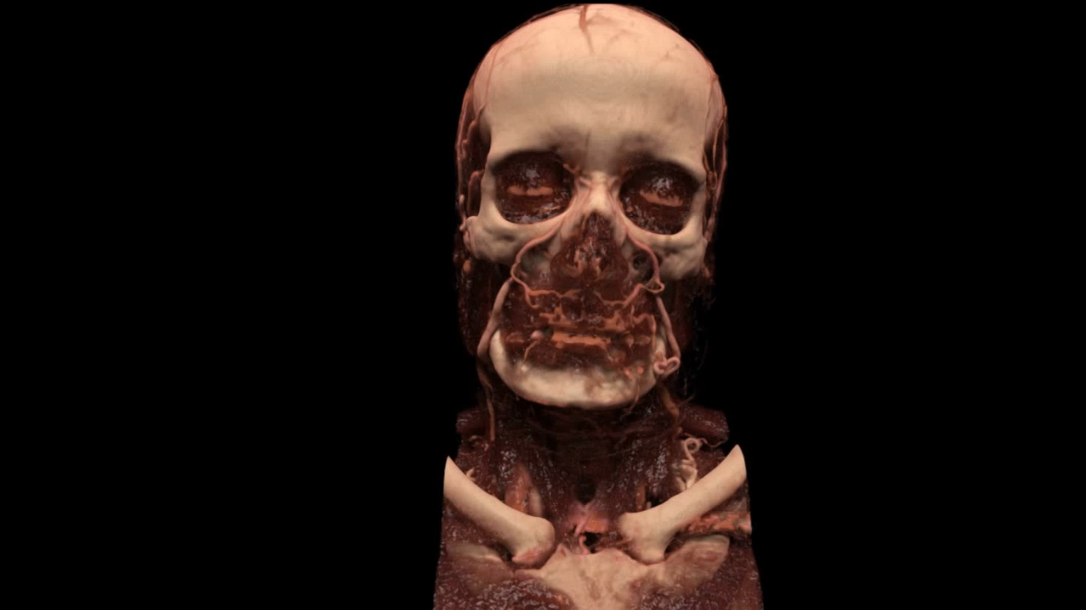
AR²T
Notes:
Monte Carlo path tracing is a rendering technique primarily used for offline image and video generation in the movie industry and medicine.

Slide 3
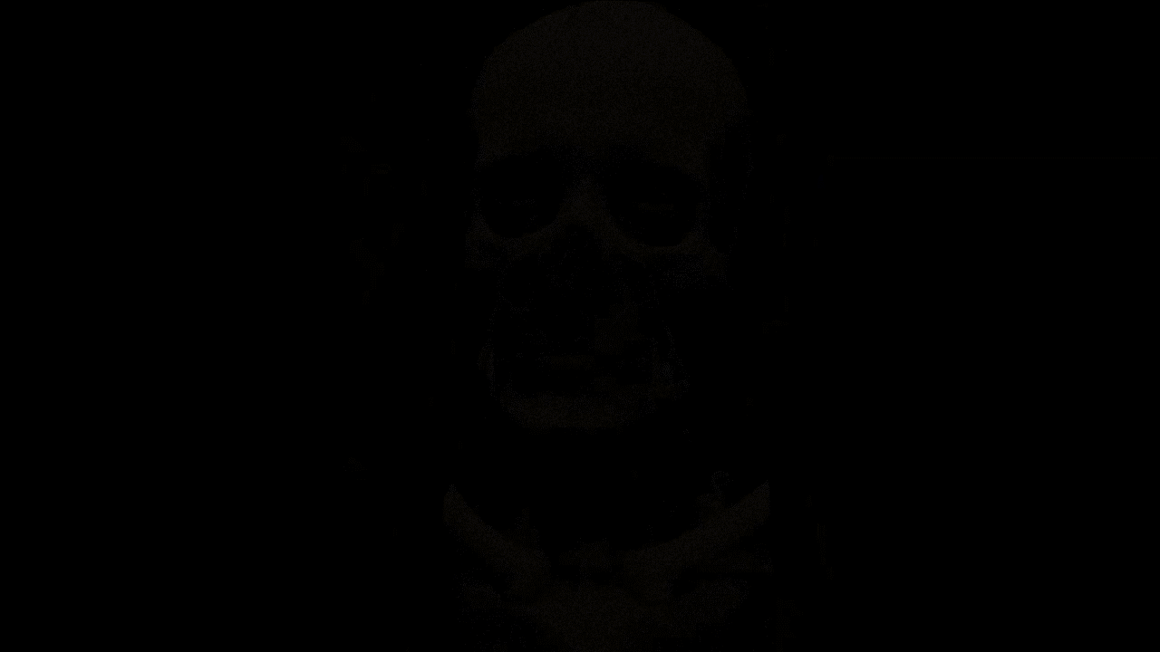
AR²T
Notes:
The algorithm is iterative, meaning the quality improves progressively with the growth of sample counts. The average of the samples forms the Monte Carlo (MC) estimate for each pixel. To address the problem of excessive noise, denoising can be applied to MC estimates to improve the overall quality.

Slide 4
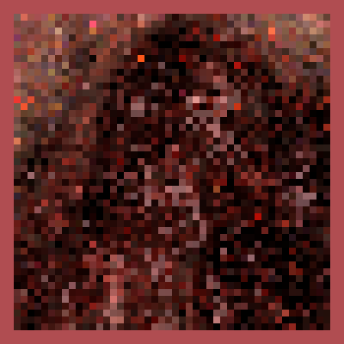
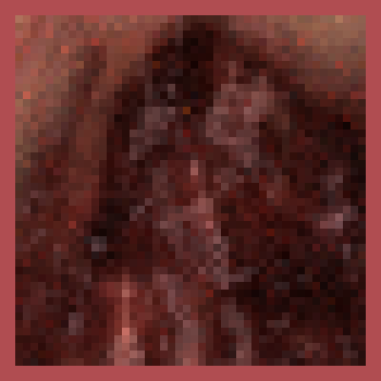
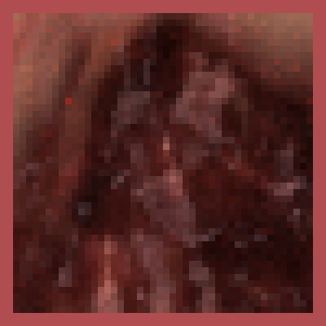


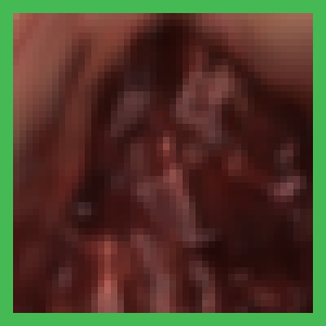
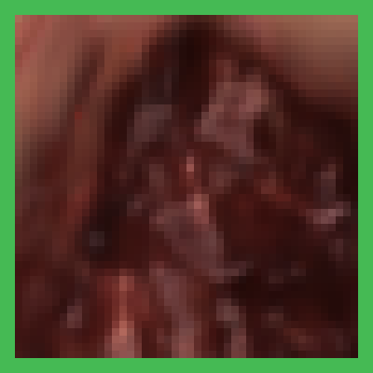
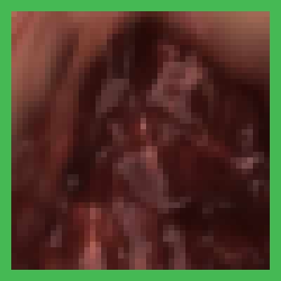
Motivation
32 spp
512 spp
2048 spp
32K spp
MC Estimate
Denoised
Notes:
However, even high-quality deep-learning-based denoisers such as OIDN or OptiX sometimes struggle to distinguish fine details from noise, resulting in excessive smoothing.

Slide 5
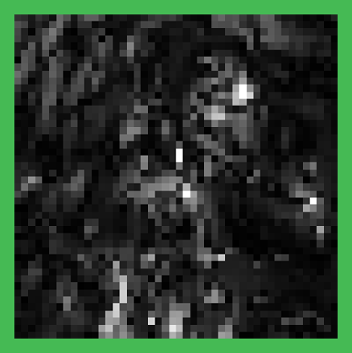
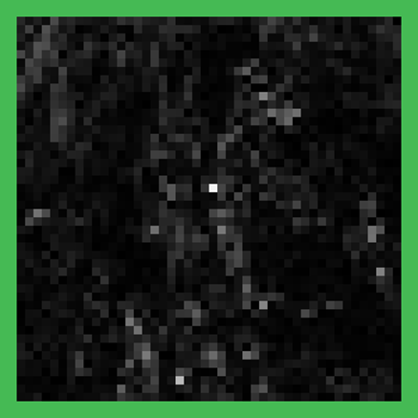
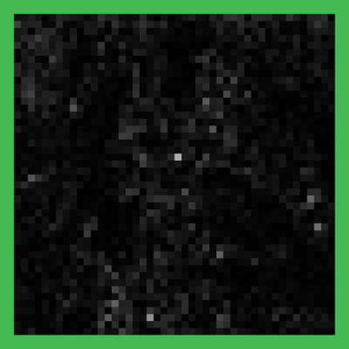
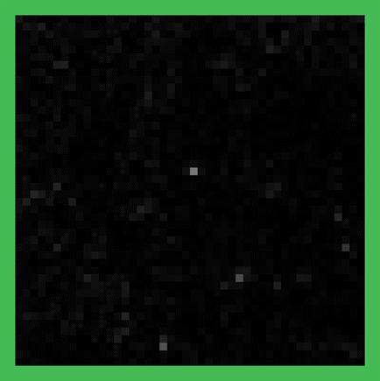
Motivation
32 spp
512 spp
2048 spp
32K spp
MC Estimate
|Den. – Ref.|
Notes:
This issue is better illustrated in the visualization of the differences between the denoised images and the reference. Darker pixels indicate better results.

Slide 6
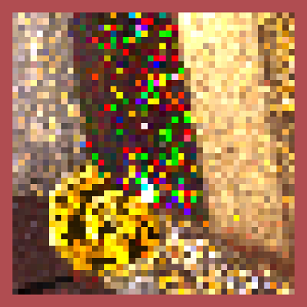
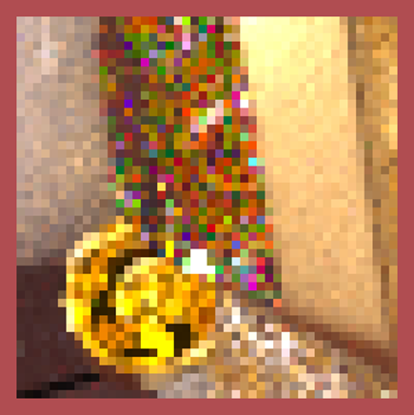
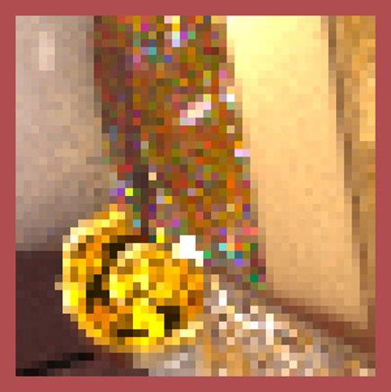

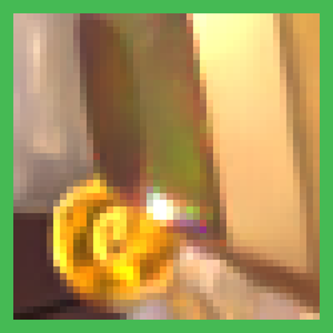
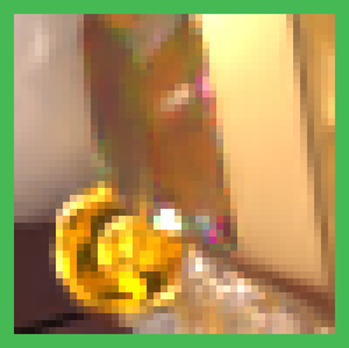
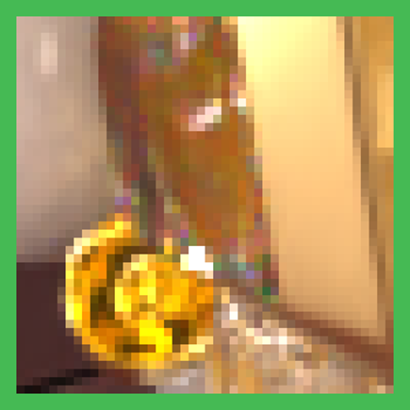

Motivation
32 spp
512 spp
2048 spp
32K spp
MC Estimate
Denoised
Notes:
Sometimes, especially in scenes with a lot of fine details, denoising may stop improving the image after a certain number of iterations.

Slide 7
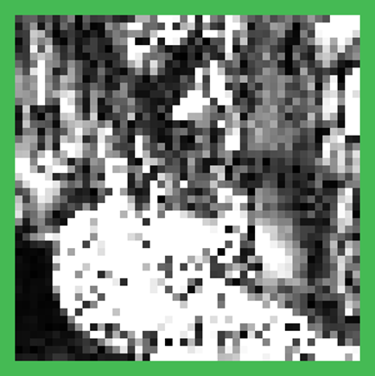
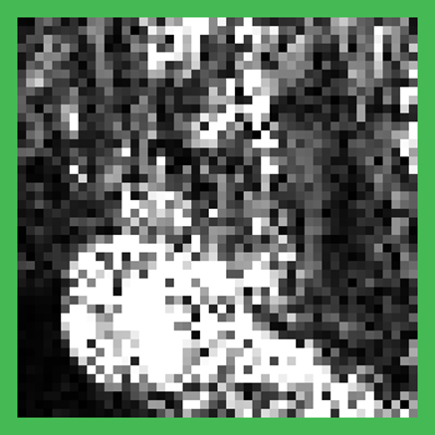
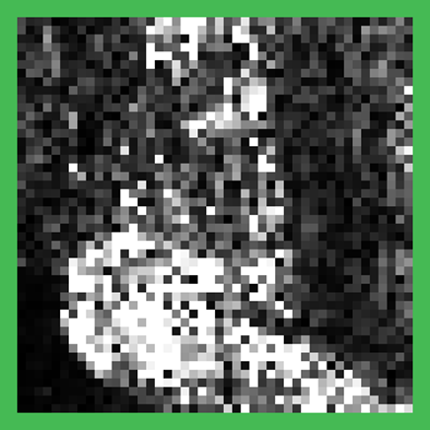
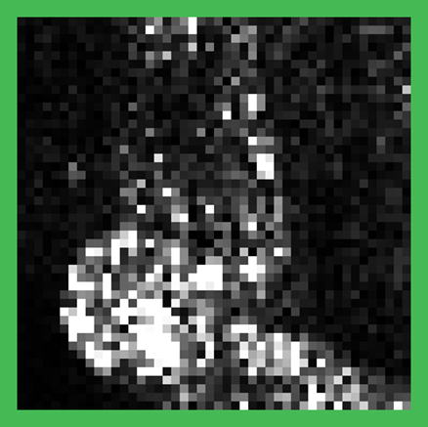
Motivation
32 spp
512 spp
2048 spp
32K spp
MC Estimate
|Den. – Ref.|

Slide 8
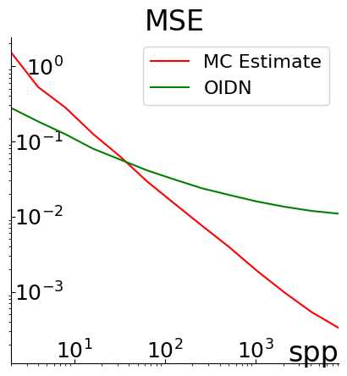
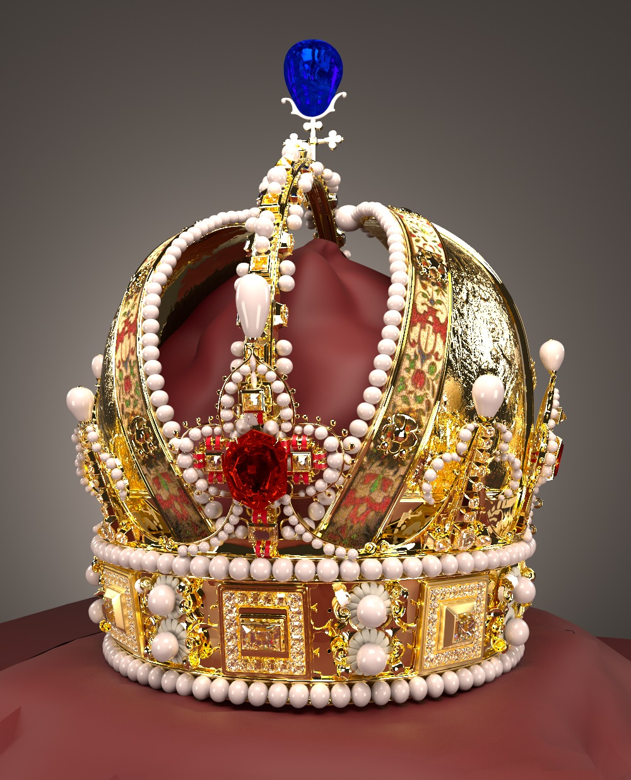
Motivation
Notes:
In such cases, the denoised images do not converge to the reference image.

Slide 9

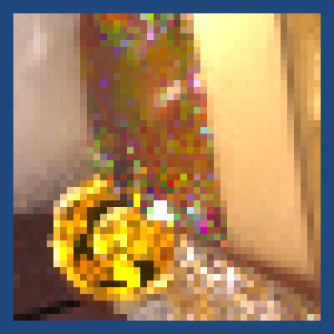

Idea
Notes:
Thus, it can be beneficial to blend the noisy MC estimate with its denoised counterpart. This approach aims to recover fine details while preserving the denoising where needed.

Slide 10
State of the Art

Slide 11

State of the Art
Deep-Learning Based Solutions
Denoising & Blending at the same iteration
Notes:
The idea is not new, but unfortunately, all practical solutions proposed so far are deep-learning-based. This means that every time the denoising algorithm changes, the model must be retrained.
Moreover, these solutions require the MC estimate and denoised image to be obtained at the same iteration for blending, which may not be efficient.
We propose a solution free from these two limitations.

Slide 12
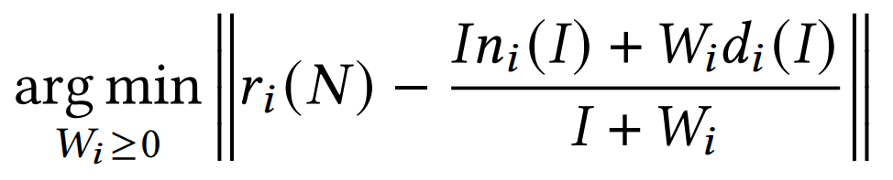
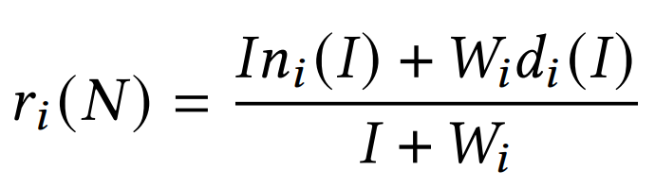
Method
Notes:
Let's consider the following optimization problem. We want to blend two pixels: noisy n_i and denoised d_i, so that the result is as close as possible to the reference r_i. Let the weight I for the noisy pixel be the iteration number at which this pixel was obtained. We need to find a non-negative weight W_i for the denoised pixel. As the norm is non-negative, the solution to this problem satisfies the following equation.

Slide 13
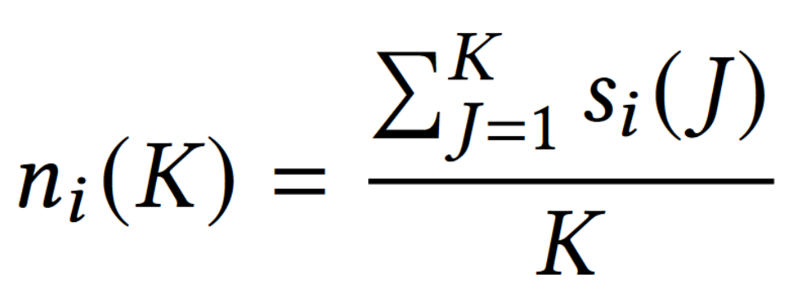
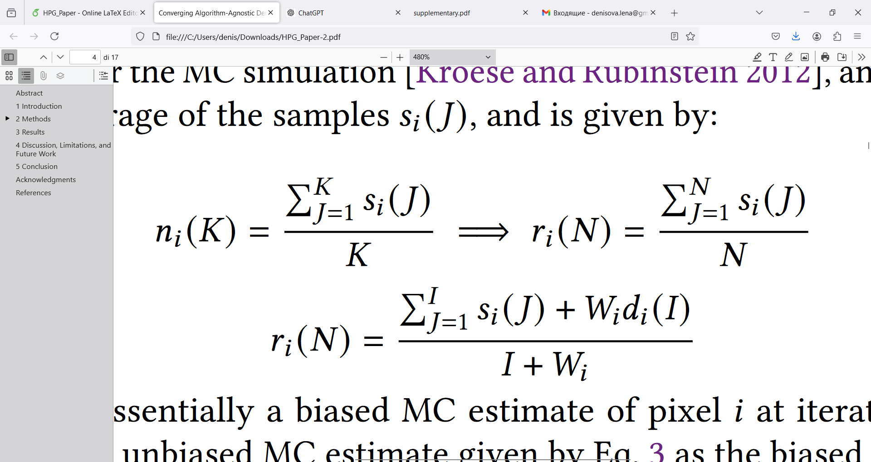
Method
Notes:
On the other hand, the MC estimate at iteration K is the average of all samples obtained until iteration K. As the reference pixel is also MC estimate, but obtained at a very high sample count N, the following is also true for the reference.

Slide 14
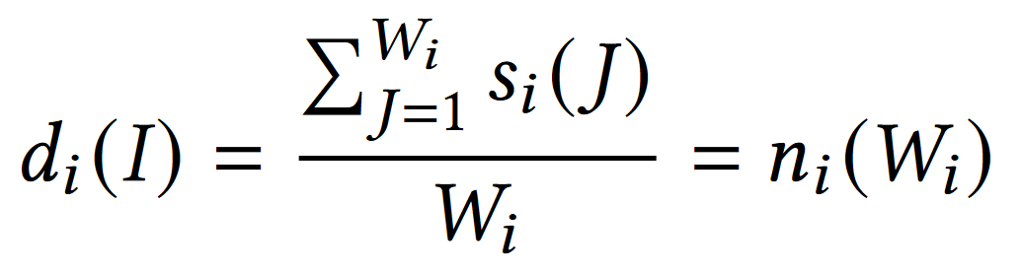
Method
Notes:
Let’s substitute the first member of the sum with the MC estimate definition. Then, let’s present the value of the denoised pixel d_i as the average of the samples obtained until some iteration W_i. In this case, the value of d_i at iteration I will equal to the value of unbiased MC estimate at iteration W_i.

Slide 15
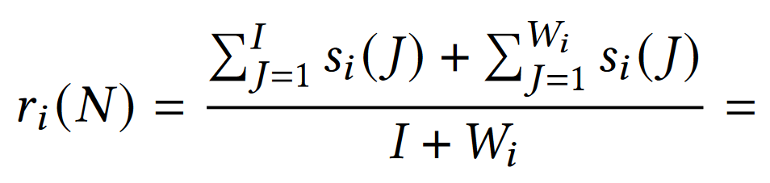
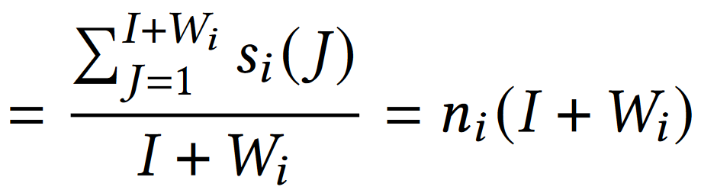
Method
Notes:
By substituting the second member of the sum with the representation of the d_i, we can see that the reference value r_i equals to the unbiased MC estimate at iteration I + W_i.

Slide 16
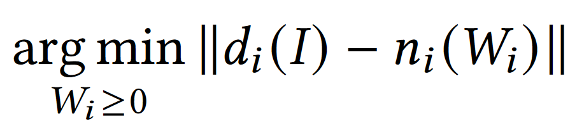
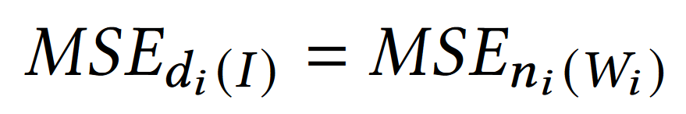
Method
Notes:
This means that instead of solving the initial problem, we can solve the following problem. It can be shown that for the solution of this problem, the following is true. It means that the MSE of d_i obtained at iteration I should be equal to the MSE of the MC estimate n_i at iteration W_i.

Slide 17
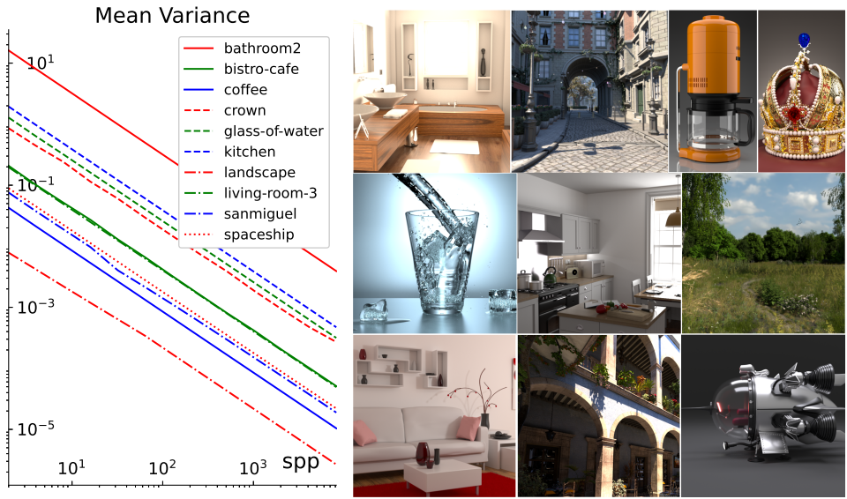
Convergence Curves
Notes:
With this in mind, let's consider the convergence curves obtained for different scenes generated with the Mitsuba framework. You can see that these curves can be approximated by lines in a logarithmic scale. So, if we know the convergence curve and the mean variance of the MC estimate, we can determine the iteration at which this estimate was obtained.

Slide 18
Convergence Curves
Calculate Curves
Estimate Denoised
Least Square Regression
Stein Unbiased Risk Estimator
Notes:
To solve our problem, we need to know two things: the convergence curves and the MSE of the denoised image. We can calculate the convergence curves by applying the least squares regression to the variances of each channel of each pixel of the MC estimates. The denoising MSE can be estimated by Stein's unbiased risk estimator (SURE).

Slide 19
Convergence Curves
Calculate Curves
Estimate Denoised
Least Square Regression
Stein Unbiased Risk Estimator (SURE)
* Samples should follow normal distribution
** Denoising function should be weakly differentiable
Notes:
To make this work, two conditions should be satisfied: the samples should follow a normal distribution, and the denoising function should be at least weakly differentiable.

Slide 20
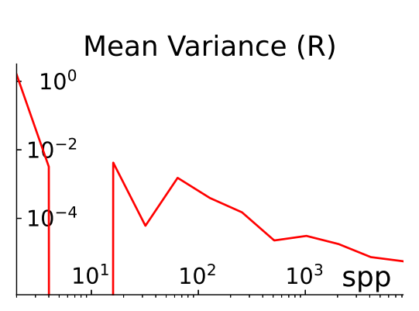
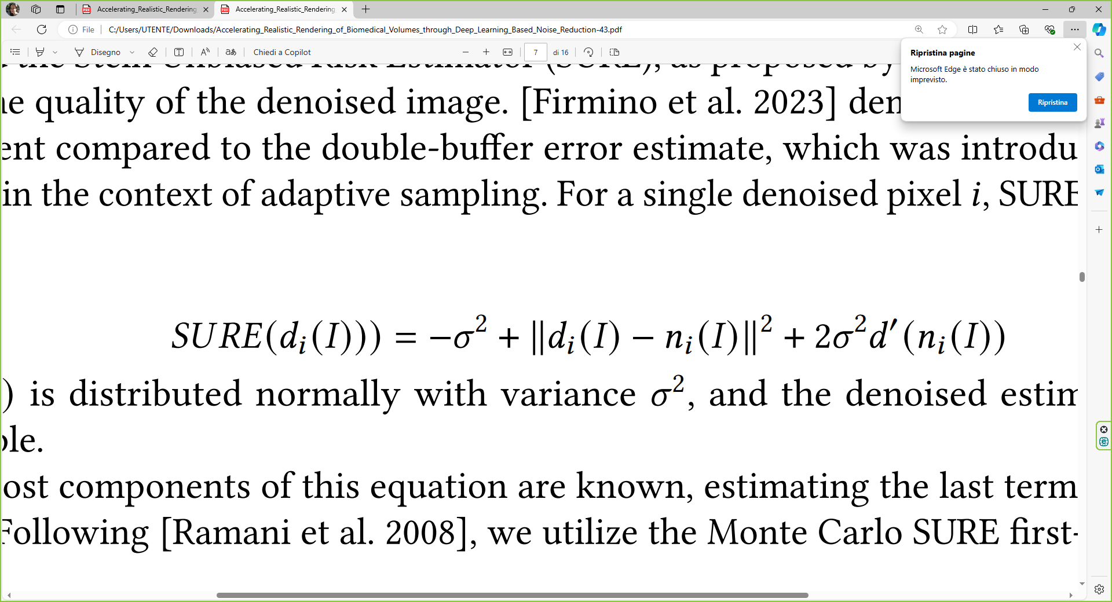
Convergence Curves
Calculate Curves
Estimate Denoised
Details in Paper!
Notes:
However, the convergence curve of a single channel of a pixel is slightly different from the convergence curve calculated for the entire image. This difference can be explained by the presence of outliers. Moreover, as follows from the formula for SURE, the estimate can be negative, which has no physical sense. So, some filtering should be done before applying the method to the pixels. We suggest using a Gaussian blur for estimations filtering and zeroing or taking the magnitude of the negative SURE values. All the details can be found in the paper.

Slide 21
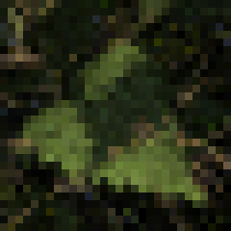
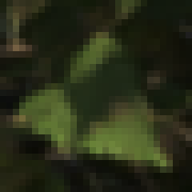
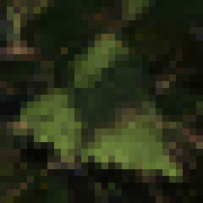
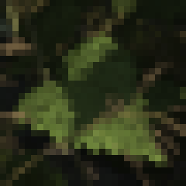




Results
Input (32 spp)
Denoised (OIDN)
Blended (Ours)
Reference (32K spp)
RMSE = 0.0109
RMSE = 0.0118
RMSE = 0.0090
Input (128 spp)
Denoised (OptiX)
Blended (Ours)
Reference (32K spp)
RMSE = 0.0267
RMSE = 0.0381
RMSE = 0.0244
Notes:
We first applied our method to standard scenes generated with Mitsuba using OIDN and OptiX. As you can see from the RMSE values of the crops, our method produces images that are closer to the reference.

Slide 22
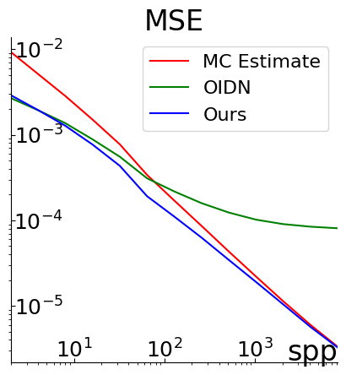
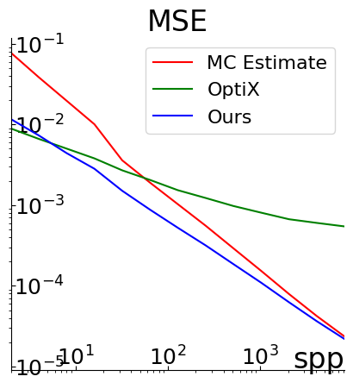
Results
Input (32 spp)
Denoised (OIDN)
Blended (Ours)
RMSE = 0.0109
RMSE = 0.0118
RMSE = 0.0090
Input (128 spp)
Denoised (OptiX)
Blended (Ours)
RMSE = 0.0267
RMSE = 0.0381
RMSE = 0.0244
Notes:
This is also true for the MSE of the entire scenes. Here, we used landscape and San Miguel scenes.

Slide 23
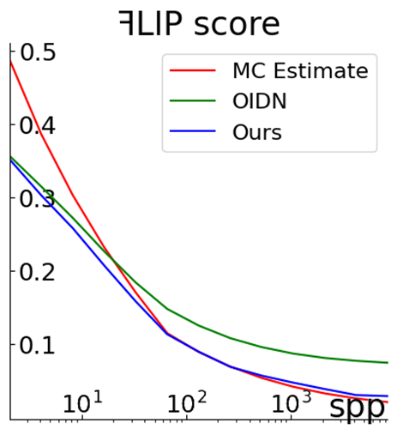
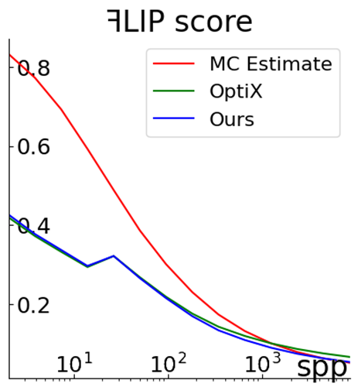
Results
Input (32 spp)
Denoised (OIDN)
Blended (Ours)
RMSE = 0.0109
RMSE = 0.0118
RMSE = 0.0090
Input (128 spp)
Denoised (OptiX)
Blended (Ours)
RMSE = 0.0267
RMSE = 0.0381
RMSE = 0.0244
Notes:
We also measured the FLIP scores for the scenes. FLIP is a metric designed to measure the perceptual similarity between the produced images and the reference. It provides a robust evaluation aligned with human visual perception. As you can see, our method also performs better in terms of FLIP.

Slide 24
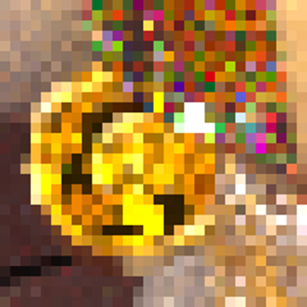
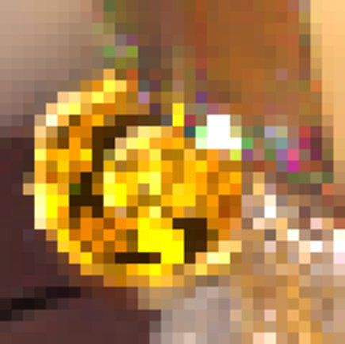
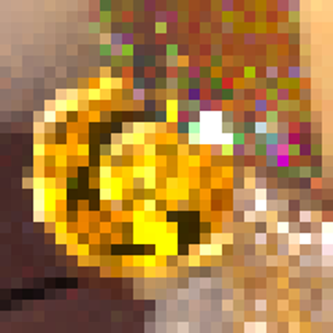





Results
Input (512 spp)
Denoised (OIDN)
Blended (Ours)
Reference (32K spp)
RMSE = 0.1292
RMSE = 0.1266
RMSE = 0.1140
Input (512 spp)
Denoised (OptiX)
Blended (Ours)
Reference (65K spp)
RMSE = 0.0141
RMSE = 0.0122
RMSE = 0.0113
Notes:
We also compared our results with the recently proposed deep-learning-based method, PD, which stands for progressive denoising, using OIDN and RT denoisers. RT is a denoiser based on OIDN but also considers the variances of the images.

Slide 25


Results
Input (512 spp)
Denoised (OIDN)
Blended (Ours)
RMSE = 0.1292
RMSE = 0.1266
RMSE = 0.1140
Input (512 spp)
Denoised (OptiX)
Blended (Ours)
RMSE = 0.0141
RMSE = 0.0122
RMSE = 0.0113
Notes:
Our results are comparable or even better, especially at higher sample counts.

Slide 26


Results
Input (512 spp)
Denoised (OIDN)
Blended (Ours)
RMSE = 0.1292
RMSE = 0.1266
RMSE = 0.1140
Input (512 spp)
Denoised (OptiX)
Blended (Ours)
RMSE = 0.0141
RMSE = 0.0122
RMSE = 0.0113
Notes:
The same applies to the FLIP scores.

Slide 27


Results
Notes:
These are two plots representing the mean MSE among ten Mitsuba scenes for our method in comparison with the MC estimates, OIDN, and RT denoisers. Here, the curves with the dots represent the situation when the denoising stops at iteration 128, but the blending continues. So, the MC estimates obtained at higher sample counts are blended with the image denoised at iteration 128. You can see that even in this case, our curves smoothly align in the direction of the reference.

Slide 28


Results
Notes:
These two plots represent the mean FLIP among the ten scenes for MC estimates, OIDN, our method, and the PD method. On the left, we can see that our method is slightly worse than OIDN and PD at lower sample counts, more precisely until sample count 16, but then becomes better as you can see on the right plot.

Slide 29

Results: AR²T
Notes:
We also applied our method to the recently proposed advanced realistic rendering technique for biomedical volumes – a technique based on Monte Carlo path tracing. As expected, our algorithm works well for this technique too.

Slide 30

Results: AR²T

Slide 31
Results
Nvidia RTX A4000
1920 x 1080
OIDN 15 ms
SURE 16 ms
Curves < 1ms
Total ~32 ms
Notes:
On Nvidia RTX A4000 the blending of the images of dimension 1920x1080 takes about 32 ms using OIDN.

Slide 32

Limitations
Notes:
Similar to deep-learning-based techniques, our method is not free from artifacts. These random patches were extracted from the exact center of the Mitsuba scenes and blended at a random iteration number. You can see that our method works particularly well at higher sample counts and for scenes with a lot of fine details. At lower sample counts and especially in homogeneous areas, some artifacts are present.

Slide 33
Conclusion
Fully Analythical Method
Any Denoising Algorithm
Progressive Denoising or Final Step
Notes:
So, we proposed a fully analytical method for blending MC estimates with their denoised counterparts. This method is independent of the denoising algorithm used and allows blending images obtained at different sample counts. The method can be applied both during progressive denoising and as a final step in denoising not fully-converged MC estimates.

Slide 34
Future Work
Better Denoised Estimate
Real-time Progressive Rendering
Adaptive Sampling
Notes:
We saw that the main issue lies in denoising estimations, so some recent techniques could be applied to improve SURE calculation. We applied our method to pre-generated scenes, but it would be interesting to apply it to real-time generation. It could suggest a better strategy for calculating convergence curves and deciding when to stop denoising. Also, our method could be applied to adaptive sampling, as the weights we assign to each pixel could guide the adaptive sampling in a straightforward manner.

Slide 35



Source Code
Paper
THANK YOU!

