Slide 1
PLOC++
Parallel Locally-Ordered Clustering for Bounding Volume Hierarchy Construction Revisited
Carsten Benthin *
Radoslaw Drabinski *
Lorenzo Tessari *
Addis Dittebrandt *
* Intel Corporation

Slide 2
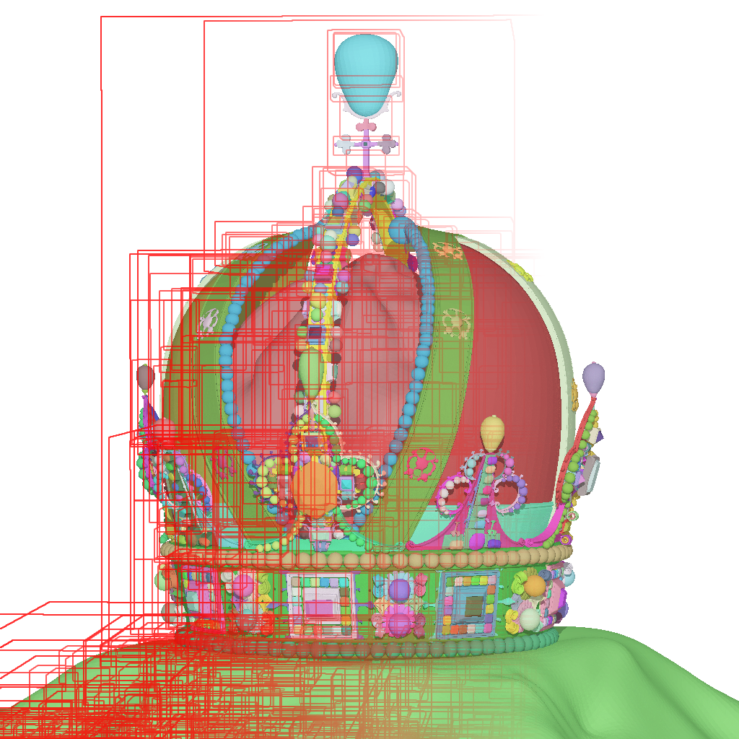
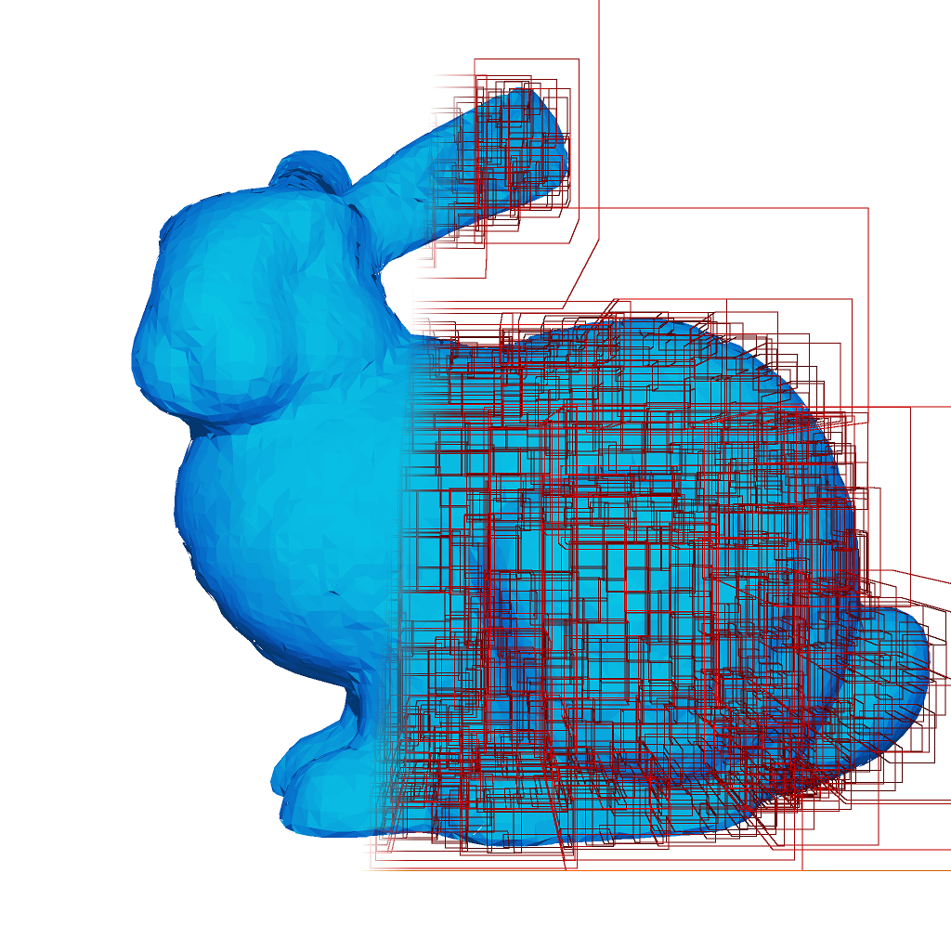
Motivation
Ray-tracing has become mainstream for interactive/real-time apps
Bounding Volume Hierarchy (BVH) dominant acceleration structure
Dynamic content requires fast BVH (re-)construction

Slide 3
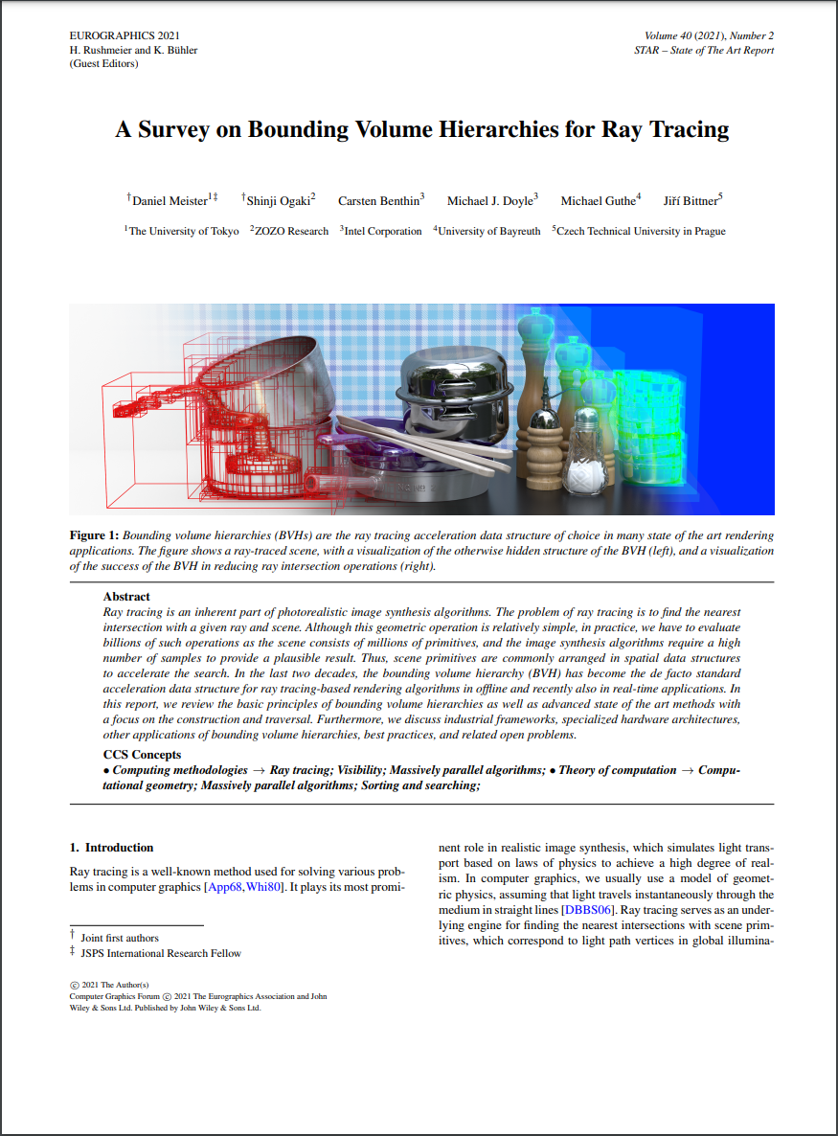
Previous Work
Top-down, bottom-up, insertion-based
Binary or wide BVHs
CPU, GPU or custom HW-focused
…

Slide 4
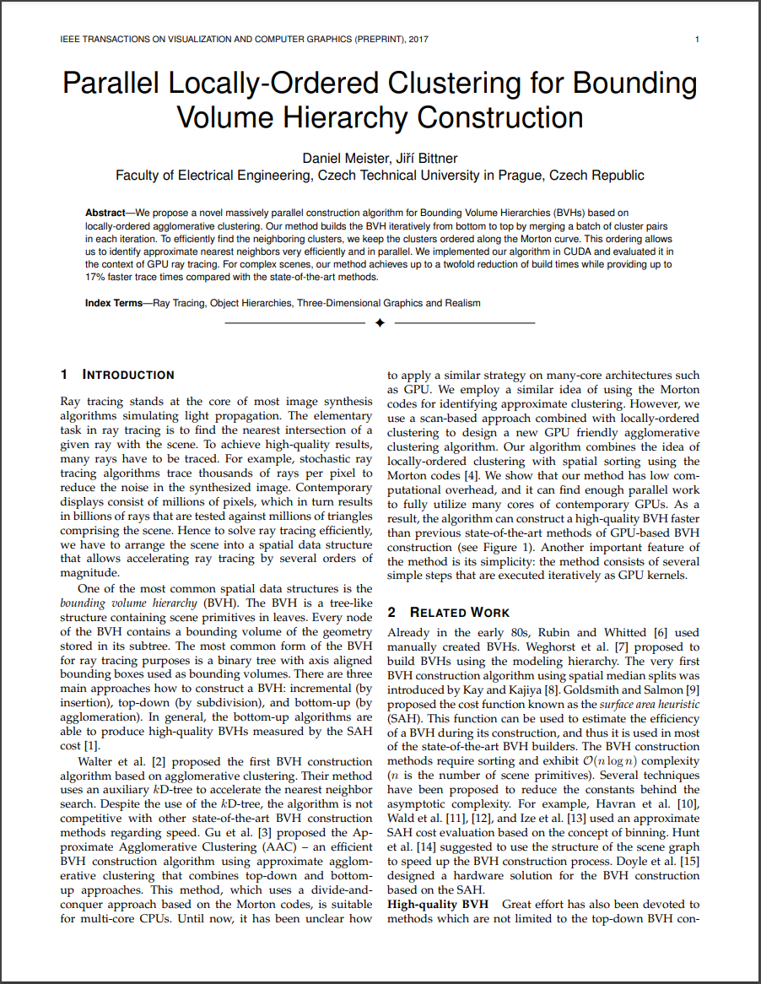
Previous Work
Parallel Locally-Ordered Clustering (PLOC) for Bounding Volume Hierarchy Construction by Daniel Meister and Jiri Bittner
GPU-focused, bottom-up
Simple and elegant approach (iterative)
Moderate implementation effort
Quite decent performance

Slide 5
Previous Work
Parallel Locally-Ordered Clustering (PLOC) for Bounding Volume Hierarchy Construction by Daniel Meister and Jiri Bittner
GPU-focused, bottom-up
Simple and elegant approach (iterative)
Moderate implementation effort
Quite decent performance
Will show how to make it really fast ☺

Slide 6
Outline
Recap PLOC
Introduce PLOC++
PLOC++ Extension
PLOC vs. PLOC++ vs. LBVH comparison
Conclusion & Future Work

Slide 7
Original PLOC : Pre-Build Phase
Create cluster representatives for primitives
Sort cluster representatives based on their Morton-codes (centroids)
A
C
A
C
E
E
B
D
B
D
A
B
C
D
E

Slide 8
Original PLOC : Iterative Build Phase
Approximate NN Search
  Distance function
    Area of merged bounds
  Search radius R
R
A
B
C
D
E

Slide 9
Original PLOC : Iterative Build Phase
Approximate NN Search
  Distance function
    Area of merged bounds
  Search radius R
R
A
B
C
D
E
A
B
C
D
E

Slide 10
Original PLOC : Iterative Build Phase
Locally Ordered Clustering (LOC)
  Merge two cluster reps into new cluster rep, if NN[ NN[ i ] ] = i
  Creates binary BVH
R
A
B
C
D
E
A
B
C
D
E
A+C
D+E
A
C
D
E

Slide 11
Original PLOC : Iterative Build Phase
Locally Ordered Clustering (LOC)
  Override cluster rep with smaller index with new “merged” cluster rep
  Invalidate other
R
A
B
C
D
E
A
B
C
D
E
A+C
D+E
A
C
D
E
G
C
G
B
C
A+C
D+E
E

Slide 12
Original PLOC : Iterative Build Phase
Cluster Compaction
  Removes invalid entries
R
A
B
C
D
E
A
B
C
D
E
A+C
D+E
A
C
D
E
G
C
G
B
C
A+C
D+E
E
A+C
B
D+E

Slide 13
Original PLOC : Iterative Build Phase
Repeat iterative process
  Approximative NN Search
  Locally ordered clustering (LOC)
  Cluster compaction
Until single cluster rep
  Creates full binary BVH
A
B
C
D
E
A+C+B
+D+E
A+C
+B
A+C
B
D+E
A+C
D+E
A+C
+B
A
C
B
D
E
D+E
A+C+B+D+E

Slide 14
Original PLOC : Implementation
5 GPU kernel launches per iteration
  1 x Approximate NN search (most expensive phase)
  1 x Locally ordered clustering
  3 x Compaction with prefix-sum
Auxiliary arrays for NN indices, valid flag, and prefix-sum

Slide 15
Original PLOC : Implementation
5 GPU kernel launches per iteration
  1 x Approximate NN search (most expensive phase)
  1 x Locally ordered clustering
  3 x Compaction with prefix-sum
Auxiliary arrays for NN indices, valid flag, and prefix-sum
Most scenes need 50-150 iterations ➔ kernel launch overhead

Slide 16
PLOC++ : Contributions
Merges phases to reduce kernel launches per iteration
Gets rid of auxiliary data buffers
Reduces cost of approximate nearest neighbor search
Handles small number of cluster reps more efficiently

Slide 17
PLOC++ : Merging Phases
How can we merge the approx. NN search and LOC phase?

Slide 18
PLOC++ : Merging Phases
How can we merge the approx. NN search and LOC phase?
Operate on independent chunks of cluster representatives
  Include 4 x R (search radius) neighboring cluster reps with each chunk
  Merge if NN[ NN[ x ] ] = x, x < NN[ x ], and x ∈ chunk_{i}
chunk_{i-1}
chunk_{i}
chunk_{i+1}
C
B
A
D
E
F
R
R
R
R

Slide 19
PLOC++ : Merging Phases
Merging of approx. NN search and LOC phase has more advantages
  Can do parts of the compaction phase
  No auxiliary arrays for NN indices, valid flags and prefix sum required
  Assign GPU work-group per chunk
  Can keep chunk and neighborhood data in shared local memory
Instead of 5 only 2 kernel launches per iteration

Slide 20
PLOC++ : NN Search Cost Reduction
Reduce cost of approximate nearest neighbor search: O(N * 2 * R)
R
A
B
C
D
E

Slide 21
PLOC++ : NN Search Cost Reduction
Reduce cost of approximate nearest neighbor search: O(N * 2 * R)
Operate on single chunk of cluster reps
Exploit symmetry distance(A,C) = distance(C,A)
R
A
B
C
D
E

Slide 22
PLOC++ : NN Search Cost Reduction
Reduce cost of approximate nearest neighbor search: O(N * 2 * R)
Operate on single chunk of cluster reps
Exploit symmetry distance(A,C) = distance(C,A)
Array of smallest distance + NN index (shared local memory)
  When computing distance(A,C), (atomically) update array at position A and C
➔ O(N*R)
R
A
B
C
D
E

Slide 23
PLOC++ : Handling Small #Cluster Reps
Explicit kernel launches inefficient when #cluster reps is small
  Happens when constructing top of the binary BVH tree

Slide 24
PLOC++ : Handling Small #Cluster Reps
Explicit kernel launches inefficient when #cluster reps is small
  Happens when constructing top of the binary BVH tree
Simple solution
  Launch single work-group kernel to perform iterations for small #cluster reps
  Use fast per work-group barriers for synchronization
  Keeps #kernel launch iterations < 50

Slide 25
PLOC++ : Extension
How can we reduce the kernel launch overhead further?

Slide 26
PLOC++ : Extension
How can we reduce the kernel launch overhead further?
Extract M “independent” partitions from Morton-code tree
Launch kernel to process all M partitions independently
Assign one work-group per partition
0011…
0111…
1011…
1111…
Work-Group 0
Work-Group 1
Work-Group 2
Work-Group 3

Slide 27
PLOC++ : Extension
Work-group finishes if #cluster reps per partition is smaller than threshold
Launch kernel (single work-group) to process remaining cluster reps across partitions
Fixed number of kernel launches but restricts NN search (BVH differs)
➔ PLOC++ Two-Level

Slide 28
Results
oneAPI DPC++ on Ubuntu 20.04
Pre-production Intel Alchemist-G10 GPU
  32 Xe cores, 16 GB DDR6, RT HW support
Work-group size of 1024 work items
64bit key + 32bit index Morton-codes (LSB radix sort)
Search radius of 16

Slide 29
PLOC++ vs. PLOC : Build Perf Comparison

Slide 30
PLOC++ vs. PLOC : Build Perf Comparison

Slide 31
PLOC++ vs. PLOC : RT Perf Comparison

Slide 32
Conclusion & Future Work
BVH2 construction performance
  PLOC++ outperforms PLOC by up to 2.3x
  PLOC++ Two-Level increases speed-up to 3x (comes quite close to LBVH)
BVH quality/ray tracing performance
  PLOC++ RT performance within 10% of offline binned SAH builder
PLOC++ easy to implement, will publish source code along Embree 4
Future
  Even faster NN, compress cluster reps, re-braiding to reduce overlap, …

Slide 33
Questions?

