Slide 1
Supporting Unified Shader Specialization by Co-opting C++ Features
Kerry A. Seitz, Jr.,*‡ Theresa Foley,†
Serban D. Porumbescu,* and John D. Owens*
*University of California, Davis
†NVIDIA
‡Now at Wētā Digital x Unity Technologies
Notes:
Hi, my name is Kerry Seitz, and I’ll be presenting our work, Supporting Unified Shader Specialization by Co-opting C++ Features, on behalf of my coauthors Theresa Foley, Serban Porumbescu, and John Owens.
The overarching motivation of this work is to think about the problem of the strict divide between host (CPU) code and GPU code that we have in real-time graphics programming.

Slide 2
Strict divide between host (CPU) and GPU code
CPU
GPU
Threads
SIMD
VS
HS
DS
GS
PS
Compute
Sets up and invokes rendering work
(written in C++)
Highly parallel rendering calculations
(written in HLSL or GLSL)
Notes:
In real-time rendering, we generally have some code running on GPUs performs highly parallel rendering calculations written in a special-purpose shading language like HLSL or GLSL.
And there’s corresponding host code sets up and invokes the rendering work, including choosing which bits of GPU code to invoke and passing parameters to the GPU, and other communication and coordination between host and GPU code. This is written in a general-purpose systems language like C++.
And in the real-time graphics APIs, there’s a really strict divide between these two portions of code, which results in a lot of pain points, like subtle bugs if the two halves of code are not kept in sync with each other.
Instead, what I think we really want is a “unified” programming model for real-time graphics.

Slide 3
Unified Programming Environments
Host code and GPU code are in the:
Same programming language
Same file
Same lexical scope
Benefits of Unified Programming
Host/GPU can share types and functions
Guaranteed compatibility between host/GPU
No magic number “bindings points,” just proper variables
Type layouts are the same
Unified Systems for GPU Compute
CUDA and SYCL
Notes:
In these so call “unified” environments, host and GPU code can be in the same programming language, same file, and same lexical scope.
Unified systems have inherent benefits, such as sharing types and functions between host and GPU code and compatibility guarantees. Host and GPU code can communicate using proper variables, not magic number binding points, and type layouts are guaranteed to be the same.
Unfortunately, none of the real-time graphics APIs provide unified environments, but in the GPU compute space, unified system are the standard, like CUDA and SYCL.
So you may be wondering … Can’t real-time graphics just use CUDA or SYCL?

Slide 4
Can’t graphics just use CUDA or SYLC?
Yes.
Notes:
Yes.

Slide 5
Thank you!
Kerry A. Seitz, Jr., Theresa Foley, Serban D. Porumbescu, and John D. Owens
kaseitz@ucdavis.edu
Source Code:
https://github.com/owensgroup/UnifiedShaderSpecialization
Notes:
Thank you for coming to my talk, you’ve been a great audience.

Slide 6
Can’t graphics just use CUDA or SYLC?
No.
Existing popular unified systems lack adequate support for GPU shader code specialization
Notes:
Ok, not really.
There are multiple reasons why graphics can’t just use one of these existing systems.
In this work, we focused one in particular: the lack of adequate support for GPU shader code specialization.
So what is shader specialization. Let’s look at an example.

Slide 7
Shader Specialization
Three materials
Standard Material
Skin Material
Cloth Material
Lots of other complex code to run along with material-specific code
Need to slot in the material-specific code
Notes:
Let’s say that we have a scene with three different materials that need to use different pieces of code to calculate their final rendered color. We have a standard material, that we use for most object. Special materials for skin and cloth.
Along with the material-specific shader code, we also have a bunch of other complex code that we need to run in the shader in order to calculate the pixel’s color. (Lots of handwaving here about what that is.) So we need to be able to slot in the material-specific code, at the appropriate place in the shader.

Slide 8
Shader Specialization
Specialized Material Shader
float4 surfaceShader(…) {
…
#if defined(STANDARD)
color = evalStandardMaterial(…);
#elif defined(SKIN)
color = evalSkinMaterial(…);
#elif defined(CLOTH)
color = evalClothMaterial(…);
#endif
…
}
Statically specialized variants generated at shader compile time
Notes:
To get the best performance, what shader programmers typically do is express these specialization options as static, compile-time branches. These will be evaluated when we compile the shader, depending on which material type we’ve defined during compilation.

Slide 9
float4 surfaceShader(…) {
…
color = evalStandardMaterial(…);
…
}
float4 surfaceShader(…) {
…
#if defined(STANDARD)
color = evalStandardMaterial(…);
#elif defined(SKIN)
color = evalSkinMaterial(…);
#elif defined(CLOTH)
color = evalClothMaterial(…);
#endif
…
}
Shader
Compiler
STANDARD
float4 surfaceShader(…) {
…
color = evalSkinMaterial(…);
…
}
SKIN
Shader
Compiler
CLOTH
float4 surfaceShader(…) {
…
color = evalClothMaterial(…);
…
}
Shader
Compiler
Notes:
We can generate a specialized shader variant just for the Standard material resulting in a compiled shader that just contains the Standard material code, stripping out the code for the other two.
We can do the same for the Skin and Cloth material, resulting in three total compiled shader variants, each specialized for exactly one material.
So when we’re rendering an object that uses the standard material, we don’t pay any of the costs associated other materials, such as shared local memory usage and higher register pressures.

Slide 10
Shader Specialization: Host vs. GPU
Compile GPU Shader Variants
Host code to invoke GPU code
float4 surfaceShader(…) {
…
color = evalStandardMaterial(…);
…
}
void (auto shape : allShapes) {
if(shape.materialType == mat::STANDARD)
invokeStandardVariant();
else if(shape.materialType == mat::SKIN)
invokeSkinVariant();
else if(shape.materialType == mat::CLOTH)
invokeClothVariant();
}
Standard Variant
float4 surfaceShader(…) {
…
color = evalSkinMaterial(…);
…
}
Skin
Variant
float4 surfaceShader(…) {
…
color = evalClothMaterial(…);
…
}
Cloth
Variant
Notes:
Then, when shading an object, we can use the shader variant specific to the material of that object.
On the left the corresponding host code that chooses which variant to invoke based on the runtime information in the scene being rendered.

Slide 11
Shader Specialization: Host vs. GPU
Host code to invoke GPU code
Specialized Material Shader
void (auto shape : allShapes) {
if(shape.materialType == mat::STANDARD)
invokeStandardVariant();
else if(shape.materialType == mat::SKIN)
invokeSkinVariant();
else if(shape.materialType == mat::CLOTH)
invokeClothVariant();
}
float4 surfaceShader(…) {
…
#if defined(STANDARD)
color = evalStandardMaterial(…);
#elif defined(SKIN)
color = evalSkinMaterial(…);
#elif defined(CLOTH)
color = evalClothMaterial(…);
#endif
…
}
Runtime Parameters
(based on shapes in the scene)
Compile-time Parameters
(based on #define when compiled)
Notes:
And if we compare the host code to the GPU shader code from a few slides ago, notice that the GPU code is using compile-time parameters to generate different variants.
But the host really needs to use runtime versions of those same parameters, since it doesn’t know what material types are used in the scene until runtime.

Slide 12
Key Challenge of Unified Shader Specialization
Specialization parameters are
Compile-time parameters for GPU code
Runtime parameters for host code
Workarounds in non-unified systems
#define in GPU code
Runtime parameter in host code
Fundamental problem in unified systems
Same parameter must serve both a compile-time and runtime role
Notes:
And that’s a key challenge with supporting unified shader specialization.
Specialization parameters are compile-time parameters in GPU code, but runtime parameters in host code.
In a non-unified world, we can work around this as show in the previous example.
But in a unified system, where we want a singular definition for these parameters, that same parameter now need to serve both a compile-time and a runtime purpose.

Slide 13
Related Work
Unified Shader Programming
BraidGL [Sampson et al. 2017]
Uses BraidGL’s static staging feature to express shader code and specializations
Selos [Seitz et al. 2019]
Relies on staged metaprogramming, a key set of language features available in Lua-Terra [DeVito et al. 2013]
Neither BraidGL nor Lua-Terra are widely used in real-time graphics
Static staging and staged metaprogramming aren’t available in the widely used languages (e.g., C++)
Notes:
Some prior works have explored unified shader programming, including shader specialization.
BraidGL utilizes a programming language feature called “static staging” to express shader code and specializations.
Also, our prior work, Selos, uses a key set of language features called “staged metaprogramming” that are available in the Lua-Terra language to enable a unified shader system.
However, neither BraidGL nor Lua-Terra are widely used languages in real-time graphics.
And more importantly, these key features that they rely on aren’t available in the widely used language either.
So what we wanted to ask is: Can we bring the benefits of unified programming to today’s shader programming systems in the near term? Can we meet these existing systems where they are instead of relying on features they don’t have access to?

Slide 14
Goals and Constraints
Use a language widely used in real-time graphics
And allow programmers to write code that looks and feels familiar in that language
Minimize changes to the language as much as possible
Equivalent performance compared to current implementations
Ease of adoption / integration into real-time graphics applications
First-class support for composition and specialization of (GPU) shader code
Notes:
So to that end, we have some goals and constraints that guide our efforts.
We of course want to use a language that’s widely used in real-time graphics. But more than that, we want to allow programmers to write code that really looks and feels familiar in that language. And so, we need to minimize any changes as much as possible.
Performance is obviously important in real-time graphics.
In contrast to many prior works, we want to make sure that our approach and implementation strategies are ones that modern applications could adopt in the near.
And finally, as mentioned earlier, we think these systems need to have first-class support for shader composition and specialization in order to handle the compile-time vs. runtime dichotomy of specialization.

Slide 15
Key Insight
Unified shader programming can be integrated into an existing, widely used programming language in real-time graphics by co-opting existing language features and implementing them with alternate semantics that are better suited to the domain of real-time graphics and its corresponding hardware.
Notes:
Which bring me to the key insight of our work, which is that we can create such a unified system in an existing, widely used language by co-opting existing features of the language and implementing them with alternate semantics that are better suited to the domain of real-time graphics.
Co-opting existing features allows us to repurpose language features that are unsuitable for GPU code to instead express GPU- and graphics-specific semantics and optimizations. Also, by reusing existing features, we don’t have to add new language features and then worry about how those features interact with the rest of the language.
To demonstrate this, we created a unified shader system integrated into an existing game engine, specifically Unreal Engine 4.

Slide 16
Shader Programming in Unreal Engine 4

Slide 17
Unreal Engine 4 (UE4)
[Epic Games, Inc. 2015]
Popular, widely used game engine
GPU shader code in HLSL
Corresponding C++ host class for each shader entry point
Notes:
UE4 is a popular, widely used game engine.
In UE4, users can write GPU shader code in HLSL. And for each HLSL entry point, users must also write a corresponding C++ host class to manage the host-side aspects of shader set up and invocation.
Let’s look at an example.

Slide 18
Example Shader in Unreal Engine 4
HLSL shader code (GPU)
C++ shader code (host)
int MyStruct_TileSizeX;
int MyStruct_TileSizeY;
int MyStruct_NumTilesX;
int MyStruct_NumTilesY;
Texture2D ColorTexture;
SamplerState ColorSampler;
uint GetIterationCount() {
#if QUALITY == LOW
return 2;
#elif QUALITY == MEDIUM
return 4;
#elif QUALITY == HIGH
return 8;
#else
return 16;
}
[numthreads(THREADGROUP_SIZEX, THREADGROUP_SIZEY, 1)]
void MainCS(uint2 DispatchThreadID : SV_DispatchThreadID) {
const uint IterationCount = GetIterationCount();
...
}
class MyShaderCS : public FGlobalShader {
public:
DECLARE_SHADER_TYPE(MyShaderCS, Global);
BEGIN_SHADER_PARAMETER_STRUCT(FParameters, )
SHADER_PARAMETER_STRUCT(MyStructType, MyStruct)
SHADER_PARAMETER_RDG_TEXTURE(Texture2D, ColorTexture)
SHADER_PARAMETER_SAMPLER(SamplerState, ColorSampler)
END_SHADER_PARAMETER_STRUCT()
class QualityDimension :
SHADER_PERMUTATION_ENUM_CLASS("QUALITY", QualityEnumType);
class ThreadgroupSizeXDimension :
SHADER_PERMUTATION_SPARSE_INT("THREADGROUP_SIZEX", 8, 16);
class ThreadgroupSizeYDimension :
SHADER_PERMUTATION_SPARSE_INT("THREADGROUP_SIZEY", 8, 16);
using FPermutationDomain = TShaderPermutationDomain<
QualityDimension,
ThreadgroupSizeXDimension,
ThreadgroupSizeYDimension>;
};
IMPLEMENT_GLOBAL_SHADER(MyShaderCS, "/path/to/HLSL/file.usf",
"MainCS", SF_Compute);
Notes:
On the left, we have GPU shader code, written HLSL.
And on the right, we have the corresponding host shader code, written in C++.
I’m not going to talk about the code in detail, but I’ll just highlight a few key points.

Slide 19
Repeated declarations for uniform/varying parameters
HLSL shader code (GPU)
C++ shader code (host)
int MyStruct_TileSizeX;
int MyStruct_TileSizeY;
int MyStruct_NumTilesX;
int MyStruct_NumTilesY;
Texture2D ColorTexture;
SamplerState ColorSampler;
uint GetIterationCount() {
#if QUALITY == LOW
return 2;
#elif QUALITY == MEDIUM
return 4;
#elif QUALITY == HIGH
return 8;
#else
return 16;
}
[numthreads(THREADGROUP_SIZEX, THREADGROUP_SIZEY, 1)]
void MainCS(uint2 DispatchThreadID : SV_DispatchThreadID) {
const uint IterationCount = GetIterationCount();
...
}
class MyShaderCS : public FGlobalShader {
public:
DECLARE_SHADER_TYPE(MyShaderCS, Global);
BEGIN_SHADER_PARAMETER_STRUCT(FParameters, )
SHADER_PARAMETER_STRUCT(MyStructType, MyStruct)
SHADER_PARAMETER_RDG_TEXTURE(Texture2D, ColorTexture)
SHADER_PARAMETER_SAMPLER(SamplerState, ColorSampler)
END_SHADER_PARAMETER_STRUCT()
class QualityDimension :
SHADER_PERMUTATION_ENUM_CLASS("QUALITY", QualityEnumType);
class ThreadgroupSizeXDimension :
SHADER_PERMUTATION_SPARSE_INT("THREADGROUP_SIZEX", 8, 16);
class ThreadgroupSizeYDimension :
SHADER_PERMUTATION_SPARSE_INT("THREADGROUP_SIZEY", 8, 16);
using FPermutationDomain = TShaderPermutationDomain<
QualityDimension,
ThreadgroupSizeXDimension,
ThreadgroupSizeYDimension>;
};
IMPLEMENT_GLOBAL_SHADER(MyShaderCS, "/path/to/HLSL/file.usf",
"MainCS", SF_Compute);
Uniform Parameters
Varying Parameters
Notes:
We can see uniform parameters declared in both the GPU and host code. Users are responsible for keeping these declarations in sync.
I’ll also briefly mention varying parameters. In this compute shader case, only the GPU code needs to declare them, but other shader types require both host and GPU declarations for varying parameters.
Looking at a specific uniform parameter for a second…

Slide 20
Host and GPU do not share types
HLSL shader code (GPU)
C++ shader code (host)
int MyStruct_TileSizeX;
int MyStruct_TileSizeY;
int MyStruct_NumTilesX;
int MyStruct_NumTilesY;
struct MyStructType {
int TileSizeX;
int TileSizeY;
int NumTilesX;
int NumTilesY;
};
Struct in host code
Redeclared (and flattened) in GPU code
Notes:
I want to point out that host and GPU code don’t share types. We’ve declared a struct in host code that must be redeclared in GPU code.
SKIP:
(You could use a shared header between host and GPU code, but still programmers are responsible for handling memory layouts manually, since the GPU compiler will insert padding for certain types. Ideally, programmers should be able to use the same types in host and GPU code so that they don’t need to worry about this issue.)
(Also, a quirk of UE4 is that these struct uniform parameters are flattened in GPU code. This again is something that users have to deal with manually, but even without this quirk, using different types for host and GPU code still causes issues.)

Slide 21
Specialization parameters are implicit in GPU code
HLSL shader code (GPU)
C++ shader code (host)
int MyStruct_TileSizeX;
int MyStruct_TileSizeY;
int MyStruct_NumTilesX;
int MyStruct_NumTilesY;
Texture2D ColorTexture;
SamplerState ColorSampler;
uint GetIterationCount() {
#if QUALITY == LOW
return 2;
#elif QUALITY == MEDIUM
return 4;
#elif QUALITY == HIGH
return 8;
#else
return 16;
}
[numthreads(THREADGROUP_SIZEX, THREADGROUP_SIZEY, 1)]
void MainCS(uint2 DispatchThreadID : SV_DispatchThreadID) {
const uint IterationCount = GetIterationCount();
...
}
class MyShaderCS : public FGlobalShader {
public:
DECLARE_SHADER_TYPE(MyShaderCS, Global);
BEGIN_SHADER_PARAMETER_STRUCT(FParameters, )
SHADER_PARAMETER_STRUCT(MyStructType, MyStruct)
SHADER_PARAMETER_RDG_TEXTURE(Texture2D, ColorTexture)
SHADER_PARAMETER_SAMPLER(SamplerState, ColorSampler)
END_SHADER_PARAMETER_STRUCT()
class QualityDimension :
SHADER_PERMUTATION_ENUM_CLASS("QUALITY", QualityEnumType);
class ThreadgroupSizeXDimension :
SHADER_PERMUTATION_SPARSE_INT("THREADGROUP_SIZEX", 8, 16);
class ThreadgroupSizeYDimension :
SHADER_PERMUTATION_SPARSE_INT("THREADGROUP_SIZEY", 8, 16);
using FPermutationDomain = TShaderPermutationDomain<
QualityDimension,
ThreadgroupSizeXDimension,
ThreadgroupSizeYDimension>;
};
IMPLEMENT_GLOBAL_SHADER(MyShaderCS, "/path/to/HLSL/file.usf",
"MainCS", SF_Compute);
Specialization Parameters
(Declaration)
Specialization Parameters
(Usage)
Specialization Parameters
(Usage)
Notes:
Going back to the example shader, we have these specialization parameters. But they are only declared in the host code.
However, they are then used in GPU code. I’m going to omit a discussion of how this all works in UE4, but the point I want to make is that it’s really easy to mess this up.
If I have a typo in the GPU code that uses a specialization parameter, I won’t get any sort of warning or error, and similarly so if there’s a typo in the string name on the host side.
Also, forgetting to declare a parameter in host code doesn’t result in any diagnostic messages either. So future readers might wonder whether it was intentionally omitted or a bug, which actually happened to me.

Slide 22
Specialization: Compile time for GPU; Runtime for host
HLSL shader code (GPU)
C++ shader code (host)
#define LOW 0
#define MEDIUM 1
#define HIGH 2
#define VERYHIGH 3
...
uint GetIterationCount() {
#if QUALITY == LOW
return 2;
#elif QUALITY == MEDIUM
return 4;
#elif QUALITY == HIGH
return 8;
#else
return 16;
}
enum class QualityEnumType : uint32 {
Low,
Medium,
High,
VeryHigh,
MAX,
};
...
MyShaderCS::PermutationDomain PermutationVector;
PermutationVector.Set<MyShaderCS::Quality>(quality);
PermutationVector.Set<MyShaderCS::ThreadgroupSizeX>(sizeX);
PermutationVector.Set<MyShaderCS::ThreadgroupSizeY>(sizeY);
← Compile-time constant
set by
Runtime value →
Notes:
An very critical---but very subtle---property of specialization parameters is that parameters that must be compile-time constant in GPU code are set by runtime values in host code. As mentioned before, this is ok in a system where host and GPU code are separated, and the UE4 toolchain handles compilation and dispatch appropriately. But this is a real issue in unified systems that we must deal with.

Slide 23
The Host-GPU Interface
Need to express:
Uniform Parameters
Varying Parameters
Specialization Parameters
Entry Point Functions
And other GPU-compatible functions
Notes:
We’ve identified the required elements of interface between host code and GPU code.
The interface needs to express Uniform, Varying, and Specialization Parameters, as well an entry point function. I’m also going to claim that it’s useful to be able to denote which other functions are GPU-compatible. This allows host-only functions to use host-only language features, and vice versa.
Now, let’s look at our unified shader design, both to see how we express these various element and to see some of the benefits a unified system provides.

Slide 24
Unified Shaders in C++

Slide 25
Unified Shader Design
C++ shader code (host and GPU)
class [[ShaderClass]] MyShader {
public:
[[uniform]] MyStructType MyStruct;
[[uniform]] Texture2D ColorTexture;
[[uniform]] SamplerState ColorSampler;
[[specialization]]
QualityEnumType Quality;
[[specialization-sparseInt(8,16)]]
int ThreadgroupSizeX;
[[specialization-sparseInt(8,16)]]
int ThreadgroupSizeY;
// Continued on the right
// Continued from the left
[[gpu]]
uint GetIterationCount() const {
if (Quality == QualityEnumType::Low)
return 2;
else if (Quality == QualityEnumType::Medium)
return 4;
else if (Qualiiy == QualityEnumType::High)
return 8;
else
return 16;
}
[[entry-computeShader(ThreadgroupSizeX, ThreadgroupSizeY, 1)]]
void MainCS([[SV_DispatchID]] uint2 DispatchThreadID) const {
const uint IterationCount = GetIterationCount();
...
}
};
Notes:
Here’s the example shader in our unified system. Note that the left and right parts of the slide are both part of the same C++ class, all contained within one file.
Like UE4, shaders are written as C++ classes. But in contrast, this class contains both host and GPU code.
The various elements of the host-GPU interface are…

Slide 26
Use C++ attributes for elements of the host-GPU interface
C++ shader code (host and GPU)
class [[ShaderClass]] MyShader {
public:
[[uniform]] MyStructType MyStruct;
[[uniform]] Texture2D ColorTexture;
[[uniform]] SamplerState ColorSampler;
[[specialization]]
QualityEnumType Quality;
[[specialization-sparseInt(8,16)]]
int ThreadgroupSizeX;
[[specialization-sparseInt(8,16)]]
int ThreadgroupSizeY;
// Continued on the right
// Continued from the left
[[gpu]]
uint GetIterationCount() const {
if (Quality == QualityEnumType::Low)
return 2;
else if (Quality == QualityEnumType::Medium)
return 4;
else if (Qualiiy == QualityEnumType::High)
return 8;
else
return 16;
}
[[entry-computeShader(ThreadgroupSizeX, ThreadgroupSizeY, 1)]]
void MainCS([[SV_DispatchID]] uint2 DispatchThreadID) const {
const uint IterationCount = GetIterationCount();
...
}
};
Notes:
(The various elements of the host-GPU interface are…)
expressed using C++ attributes, including uniform and specialization parameters, as well as marking GPU-compatible code and the GPU code entry point.
Because both the host and GPU code are unified into the same C++ class…

Slide 27
Use C++ attributes for elements of the host-GPU interface
C++ shader code (host and GPU)
class [[ShaderClass]] MyShader {
public:
[[uniform]] MyStructType MyStruct;
[[uniform]] Texture2D ColorTexture;
[[uniform]] SamplerState ColorSampler;
[[specialization]]
QualityEnumType Quality;
[[specialization-sparseInt(8,16)]]
int ThreadgroupSizeX;
[[specialization-sparseInt(8,16)]]
int ThreadgroupSizeY;
// Continued on the right
// Continued from the left
[[gpu]]
uint GetIterationCount() const {
if (Quality == QualityEnumType::Low)
return 2;
else if (Quality == QualityEnumType::Medium)
return 4;
else if (Qualiiy == QualityEnumType::High)
return 8;
else
return 16;
}
[[entry-computeShader(ThreadgroupSizeX, ThreadgroupSizeY, 1)]]
void MainCS([[SV_DispatchID]] uint2 DispatchThreadID) const {
const uint IterationCount = GetIterationCount();
...
}
};
Single declaration of parameters
Notes:
(Because both the host and GPU code are unified into the same C++ class…)
The programmer only needs to declare parameters once, rather than needing separate declarations for host and GPU code.
Related to this…

Slide 28
Explicit declaration of specialization parameters (for GPU)
C++ shader code (host and GPU)
class [[ShaderClass]] MyShader {
public:
[[uniform]] MyStructType MyStruct;
[[uniform]] Texture2D ColorTexture;
[[uniform]] SamplerState ColorSampler;
[[specialization]]
QualityEnumType Quality;
[[specialization-sparseInt(8,16)]]
int ThreadgroupSizeX;
[[specialization-sparseInt(8,16)]]
int ThreadgroupSizeY;
// Continued on the right
// Continued from the left
[[gpu]]
uint GetIterationCount() const {
if (Quality == QualityEnumType::Low)
return 2;
else if (Quality == QualityEnumType::Medium)
return 4;
else if (Qualiiy == QualityEnumType::High)
return 8;
else
return 16;
}
[[entry-computeShader(ThreadgroupSizeX, ThreadgroupSizeY, 1)]]
void MainCS([[SV_DispatchID]] uint2 DispatchThreadID) const {
const uint IterationCount = GetIterationCount();
...
}
};
Compile-time error
(instead of a bug)
Notes:
Specialization parameters are now explicitly declared not only for host code, but also for GPU code.
This enables the compiler to provide extra validation, such as catching this typo as a compile-time error, rather than it causing a bug if it were only implicitly declared.
Also thanks to the unified design…

Slide 29
Types shared between host and GPU
C++ shader code (host and GPU)
class [[ShaderClass]] MyShader {
public:
[[uniform]] MyStructType MyStruct;
[[uniform]] Texture2D ColorTexture;
[[uniform]] SamplerState ColorSampler;
[[specialization]]
QualityEnumType Quality;
[[specialization-sparseInt(8,16)]]
int ThreadgroupSizeX;
[[specialization-sparseInt(8,16)]]
int ThreadgroupSizeY;
// Continued on the right
// Continued from the left
[[gpu]]
uint GetIterationCount() const {
if (Quality == QualityEnumType::Low)
return 2;
else if (Quality == QualityEnumType::Medium)
return 4;
else if (Qualiiy == QualityEnumType::High)
return 8;
else
return 16;
}
[[entry-computeShader(ThreadgroupSizeX, ThreadgroupSizeY, 1)]]
void MainCS([[SV_DispatchID]] uint2 DispatchThreadID) const {
const uint IterationCount = GetIterationCount();
...
}
};
Notes:
Types are shared between host and GPU code. So the GPU code that uses the Quality enum parameter can reference the enum type options directly.

Slide 30
Specialization:
Handling Compile-time vs. Rutnime
C++ shader code (host and GPU)
class [[ShaderClass]] MyShader {
public:
[[uniform]] MyStructType MyStruct;
[[uniform]] Texture2D ColorTexture;
[[uniform]] SamplerState ColorSampler;
[[specialization]]
QualityEnumType Quality;
[[specialization-sparseInt(8,16)]]
int ThreadgroupSizeX;
[[specialization-sparseInt(8,16)]]
int ThreadgroupSizeY;
// Elsewhere in the code
MyShader shader;
shader.Quality = quality;
shader.ThreadgroupSizeX = sizeX;
shader.ThreadgroupSizeY = sizeY;
Values set at runtime
Options listed at compile time
Notes:
And lastly, remember that specialization parameters must be compile-time constant in GPU code but must then be set by runtime values in host code.
We handle this difference by requiring that specialization parameter declarations include a list of all possible options for those parameters as compile-time constants. Then, in host code, the programmer is free to set those parameters using runtime values.
SKIP:
(As a side note, our system generates asserts to validate that the runtime values match one of the compile-time options (and, to be fair, UE4 already provides similar validation for host code.))

Slide 31
Design Decisions
Use C++
One of (if not the) most-used languages in real-time graphics
(And because it’s what UE4 uses)
Express a “shader” as a C++ class
C++’s mechanism for encapsulating code and data
Both host and GPU code in the same class
Notes:
Now that we know what a shader looks like in this unified system, let’s dive in to some of the specific design decisions for our system. We’ve already covered some of them.
For starters, we use C++ as our programming language of choice. It is one of (if not the) most-used languages in real-time graphics. And it’s a natural choice for us since it’s what UE4 uses.
Similarly, UE4 already expresses host shader code using C++ classes, so we do the same in our system.
However, unlike UE4, our unified shader classes contain both host code and GPU code.

Slide 32
Design Decisions (cont.)
Co-opt C++ attributes to express elements of the host-GPU interface
[[uniform]] float3 myColor;
Co-opt the C++ inheritance and virtual functions model to implement composition and specialization
Notes:
The last two design decisions I have are very much related to the “minimize changes” idea.
The first we’ve already seen: co-opt C++ attributes to express the elements of the host-GPU interface. This attribute syntax is standard since C++11, but C++ doesn’t provide support for user-controlled attributes. Also, C++ compilers are free to ignore attributes they don’t understand. Therefore, attributes should not change the semantics of a program. However, in our case, ignoring these attributes will result in an incorrect program, so we’re very much violating the standard semantics of C++ attributes and instead repurposing them for the needs of graphics programming.
But even more so than C++ attributes, where our design really departs from standard C++ is our use of inheritance and virtual functions to implement shader composition and specialization.
Why do we need to co-opt anything for compositing and specialization? Well…

Slide 33
C++ is insufficient for composition + specialization
Inheritance and virtual functions
Dynamic dispatch of functions
Appropriate for host shader code
Templates
Static dispatch of functions
Appropriate for GPU shader code
Dynamic dispatch is bad on GPUs
Templates lead to unwieldy host code
Notes:
C++ really doesn’t have what we need for shader specialization. It has two main ways to compose together different classes.
We could use standard inheritance and virtual functions. This leads to dynamic dispatch of function implementations through the virtual function table.
In contrast, could use C++ template. All template parameters must be fully specified at compile time, so this leads to static dispatch of functions.
And what I’ll claim is that dynamic dispatch is better for host shader code, since we want to invoke GPU rendering work based on runtime parameter values.
But in GPU shader code, specialization is really important to achieve the best performance. So we really want static dispatch of all functions on the GPU. But this leads to problems for the host code.
So we have this problem where neither of these options are suitable for unified shader code, because the host code and the GPU code have these differing requirements.
I hope it’s clear why virtual functions aren’t a good solution, but in case you don’t believe me about templates, I have an extra slide we can talk about.

Slide 34
Solution: Co-opt virtual functions for specialization
Author shader code using inheritance and virtual functions
Codegen different GPU specializations based on subtypes
Host sets parameters using regular C++ syntax
System invokes different (specialized) GPU code based on runtime types
Notes:
The solution we came up with is to co-opt virtual functions to implement specialization.
Programmers author shader code using inheritance and virtual functions, but then the system will codegen different GPU specializations based on the relevant subtypes.
Host code can then set parameter just as it normally would in C++, but under the hood, the system will invoke different specialized GPU code based on the runtime types. So in effect, we get the best of both worlds, all while allowing programmers to express composition in a very C++ style.
To look at this visually…

Slide 35
Write code using virtual functions
class [[ShaderClass]] StandardMaterial : public Material {
public:
[[gpu]] virtual float4 eval(...) {
/* GPU code to evaluate the standard material */
}
};
class [[ShaderClass]] ClothMaterial : public Material {
public:
[[gpu]] virtual float4 eval(...) {
/* GPU code to evaluate the cloth material */
}
};
class [[ShaderClass]] MyShader {
public:
Material* material;
[[gpu]] void entryPoint(...) {
float4 color = material->eval(...);
}
};
Notes:
The code programmers write looks similar to regular virtual function usage.

Slide 36
Generate de-virtualized functions for
GPU code
class [[ShaderClass]] StandardMaterial : public Material {
public:
[[gpu]] virtual float4 eval(...) {
/* GPU code to evaluate the standard material */
}
};
class [[ShaderClass]] ClothMaterial : public Material {
public:
[[gpu]] virtual float4 eval(...) {
/* GPU code to evaluate the cloth material */
}
};
class [[ShaderClass]] MyShader {
public:
Material* material;
[[gpu]] void entryPoint(...) {
float4 color = material->eval(...);
}
};
[[gpu]] float4 evalStandardMaterial(...) {
/* GPU code to evaluate the standard material */
}
[[gpu]] float4 evalClothMaterial(...) {
/* GPU code to evaluate the cloth material */
}
Notes:
But then the system will generate de-virtualized versions of the virtual functions for GPU code.

Slide 37
Generate specialized GPU shader variants for subtypes
class [[ShaderClass]] StandardMaterial : public Material {
public:
[[gpu]] virtual float4 eval(...) {
/* GPU code to evaluate the standard material */
}
};
class [[ShaderClass]] ClothMaterial : public Material {
public:
[[gpu]] virtual float4 eval(...) {
/* GPU code to evaluate the cloth material */
}
};
class [[ShaderClass]] MyShader {
public:
Material* material;
[[gpu]] void entryPoint(...) {
float4 color = material->eval(...);
}
};
[[gpu]] float4 evalStandardMaterial(...) {
/* GPU code to evaluate the standard material */
}
[[gpu]] float4 evalClothMaterial(...) {
/* GPU code to evaluate the cloth material */
}
[[gpu]] void entryPoint_Standard(...) {
evalStandardMaterial(...);
}
[[gpu]] void entryPoint_Cloth(...) {
evalClothMaterial(...);
}
Notes:
And it will also generate specialized GPU shader variants for shaders that use these virtual functions.
This allows programmers to write regular looking C++ code for their shaders, but then that code gets transformed into an implementation that is better suited to GPU hardware.

Slide 38
Implementation
Source-to-source translator using Clang’s LibTooling
Code live external to Clang
Use Clang AST to retrieve info from user-written shader source code
Generate HLSL for GPU code
Generate C++ for host code
Use UE4’s existing shader system under-the-hood
Could support other engines via additional backends
Notes:
I’ll briefly mention the implementation.
We use a source-to-source translator built on top of Clang, but in a way that doesn’t require modifying the Clang codebase (which helps constrain implementation and maintenance costs).
The translator walks the Clang AST to retrieve relevant info from user-written shader source code.
It then generates HLSL for GPU code, including multiple shader variants to turn dynamic dispatch via virtual functions into static dispatch.
For the host code, it generates C++ and uses UE4’s existing shader system under-the-hood. This helps to facilitate ease of integration and adoption, by making these unified shaders compatible with existing UE4 code.
We could add support for other shading language and engines by writing additional backends.

Slide 39
[Epic Games, Inc. 2015]
Evaluation – Infiltrator Demo
Screenshots used with permission of Epic Games Unreal Engine Marketplace
Notes:
To evaluate our system, we rewrote some of UE4’s shaders to use the unified system, and we ran the Infiltrator Demo using both the original shaders and our unified shaders.

Slide 40
Evaluation – GPU Performance
Similar Performance
Shader | Motion Blur Filter (time in ms) Min Avg Max |  |  | Temporal AA (time in ms) Min Avg Max
Original UE4 Code | 0.06 | 0.18 | 0.70 | 0.23 | 0.28 | 0.74
Unified Code | 0.06 | 0.18 | 0.70 | 0.24 | 0.28 | 0.75
Notes:
As shown, the performance of our unified shaders is similar to the original UE4 versions.
We also wanted to make sure our abstraction didn’t lead to excessive code bloat.

Slide 41
Evaluation – Lines of Code
Similar Code Sizes
Shader | Motion Blur Filter | Temporal AA
Original UE4 Code | 902 | 2,138
Unified Code | 920 | 2,251
Notes:
And similarly, the Lines of Code counts are comparable as well. Some of the additional lines are due to stylistic differences, some due to some minor code duplication from HLSL header files, and yes, some are due to our abstractions, but we think the trade-offs of more robust code is worth it.

Slide 42
Limitations
Only support compute shaders
An increasingly large portion of a modern game’s shader code
Pixel shaders can be supported similarly
Only support equivalent of UE4’s Global Shaders
Do not interface with the material or mesh systems
Future work to explore Material and MeshMaterial shaders
Notes:
As for limitations, our current implementation only supports compute shaders. These are an increasingly large portion of a modern game’s shader code, and they are sufficient to demonstrate the challenges in unified shader programming.
Similarly, our translator only supports UE4’s “Global Shaders,” which don’t interface with the material or mesh systems.

Slide 43
Wrapping up

Slide 44
Summary
Support unified shader specialization in C++ by co-opting its existing features and implementing them with alternate semantics
Co-opt C++ attributes for the host-GPU interface
Co-opt inheritance and virtual functions for shader specialization
Maintain compatibility as C++ evolves, since we aren’t adding new features
Similar performance and code size to original UE4 shaders
Notes:
We added unified shader programming to C++ by co-opting its existing features and implementing them with alternate semantics.
We co-opt C++’s attributes to express elements of the host-GPU interface, and we co-opt inheritance and virtual functions for shader specialization.
Since we aren’t adding new features to C++, just re-using existing ones, our system can maintain compatibility with future versions of C++.
Our unified shaders achieve similar performance and code sizes compared to the original UE4 shaders

Slide 45
Future Work
Co-opting features of another language for graphics
E.g., Rust’s generics
Optimizations across the host-GPU boundary
Unified view of the code → more opportunities to optimize
E.g., Memory allocations & transfers, synchronization between host/GPU & render passes
Programming models beyond separate shaders per rendering pass
Notes:
As future work, we think it’d be interesting to try co-opting features of another language for graphics programming.
Also, what kinds of optimizations can we perform by giving the compiler a unified view of the code.
And what will make those optimizations even more powerful is developing programming models beyond just separate shaders per rendering pass.

Slide 46
Future Work (cont.)
Programming models beyond separate shaders per rendering pass
Write rendering code as one integrated unit → (JIT) compiler splits it up into different shader kernels
Some benefits from compile-time analysis
Greater benefits from runtime optimizations too?
Utilizing render graphs to generate optimized kernels per frame
Unified shader programming and specialization support is a prerequisite for these types of future systems!
Notes:
For example, maybe we could write rendering code as one integrated unit and let the compiler split it up into different shader kernels.
I think there could be some benefit from compile-time analysis, but there’s a greater potential for incorporating runtime optimizations too, perhaps leveraging information available in a render graph system.
And I want to note that unified shader programming and specialization support is a prerequisite for these types of future systems!
And with that…

Slide 47
Acknowledgments
Guidance, feedback, and technical advice
Anjul Patney, Chuck Rozhon, Yong He, Brian Karis, Ola Olsson, Andrew Lauritzen, Yuriy O’Donnell, Angelo Pesce, Charlie Birtwistle, Michael Vance, Dave Shreiner, and the anonymous reviewers
Hardware donations and financial support
Intel Corporation
NVIDIA Corporation
Notes:
I’d like to thank the many people who helped us with this work.
And also thank you to Intel Corporation and NVIDIA Corporation for financial support.

Slide 48
Thank you!
Kerry A. Seitz, Jr., Theresa Foley, Serban D. Porumbescu, and John D. Owens
kaseitz@ucdavis.edu
Source Code:
https://github.com/owensgroup/UnifiedShaderSpecialization
Notes:
And thank you! The source code of our translator is available on GitHub.
And I’d be happy to answer any questions.

Slide 49
References
Zachary DeVito, James Hegarty, Alex Aiken, Pat Hanrahan, and Jan Vitek. 2013. Terra: A Multi-Stage Language for High-Performance Computing. In Proceedings of the 34th ACM SIGPLAN Conference on Programming Language Design and Implementation (PLDI ’13). 105–116. https://doi.org/10.1145/2491956.2462166
Epic Games, Inc. 2015. Infiltrator Demo. https://www.unrealengine.com/marketplace/en-US/product/infiltrator-demo
Epic Games, Inc. 2019. Unreal Engine 4 Documentation. https://docs.unrealengine.com/en-us/
Adrian Sampson, Kathryn S. McKinley, and Todd Mytkowicz. 2017. Static Stages for Heterogeneous Programming. Proceedings of the ACM on Programming Languages 1, OOPSLA, Article 71 (Oct. 2017), 27 pages. https://doi.org/10.1145/3133895
Kerry A. Seitz, Jr., T. Foley, Serban D. Porumbescu, and John D. Owens. 2019. Staged Metaprogramming for Shader System Development. ACM Transactions on Graphics 38, 6 (Nov. 2019), 202:1–202:15. https://doi.org/10.1145/3355089.3356554

Slide 50
Extra Slides

Slide 51
References for Extra Slides
NVIDIA Corporation. 2022. cuda-samples: reduction_kernel.cu. https://github.com/NVIDIA/cuda-samples/blob/b312abaa07ffdc1ba6e3d44a9bc1a8e89149c20b/Samples/2_Concepts_and_Techniques/reduction/reduction_kernel.cu#L633-L1025
Kekoa Proudfoot, William R. Mark, Svetoslav Tzvetkov, and Pat Hanrahan. 2001. A Real-Time Procedural Shading System for Programmable Graphics Hardware. In Proceedings of the 28th Annual Conference on Computer Graphics and Interactive Techniques (SIGGRAPH 2001). 159–170. https://doi.org/10.1145/383259.383275

Slide 52
Overcoming the Limitations
Global Shader Pixel Shaders
Trivial extension of the Compute Shader case
Mesh and MeshMaterial Shaders
Challenge: Coordinating varying parameters between shader types
E.g., Vertex Shader outputs → Pixel Shader inputs
Possible Solution: Pipeline Shader design [Proudfoot et al. 2001]
Challenge: Different amounts and type of data that need to be stored / accessed
E.g., Eye Material might have more data than Standard Material
Possible Solution: Compiler could specialize datatypes if only one material is used
Compiler could union the types if multiple are used
(e.g., auto-generated Gbuffer)

Slide 53
Why Templates are Insufficient
reduction_kernel.cu (CUDA Sample)
Our version
...
template <typename T, unsigned int blockSize, bool nIsPow2>
__global__ void reduce6(T *g_idata, T *g_odata, unsigned int n) { ... }
template <typename T, unsigned int blockSize, bool nIsPow2>
__global__ void reduce7(T *g_idata, T *g_odata, unsigned int n) { ... }
...
// Boilerplate
template <typename T>
class [[ShaderClass]] ReduceBase {
[[specialization_SparseInt(1024, 512, ...)]] int numThreads;
[[specialization_Bool]] bool nIsPow2;
[[gpu]] virtual void reduceKernel(...) = 0;
};
// Boilerplate
template <typename T>
class [[ShaderClass]] ReduceRunner {
[[specialization_ShaderClass]] ReduceBase* reducer;
[[entry_ComputeShader(reducer->numThreads, 1, 1)]]
void runReducer(...) { reducer->reduceKernel(); }
};
// Our version of reduce6 and reduce7
template <typename T>
class [[ShaderClass]] ShaderReduce6 : public ReduceBase {
[[gpu]] virtual void reduceKernel(...) override { ... }
};
template <typename T>
class [[ShaderClass]] ShaderReduce7 : public ReduceBase {
[[gpu]] virtual void reduceKernel(...) override { ... }
};
[NVIDIA Corporation 2022]
Notes:
On the left is an example from the NVIDIA CUDA samples. There are multiple reduction kernel implementations that are optimized for different situations. These kernels use template parameters to generate specialized implementations for better performance. The code on the left shows the GPU kernel declarations from the CUDA sample.
On the right is a version written using our abstractions. Ours has a little bit of extra boilerplate to declare the base ShaderClass, and also to declare the Runner ShaderClass (the latter is necessary with our current translator implementation, but we could eliminate the need for it with minor modifications in the future).
Then, we can declare the reduction implementation similarly, with just a little extra boilerplate. So at first, yes ours looks longer. But…

Slide 54
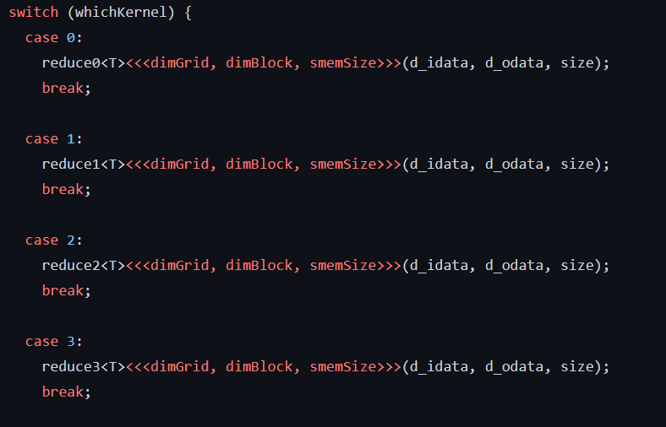
Why Templates are Insufficient
reduction_kernel.cu (CUDA Sample)
Our version
// Running one of the reduce kernels
void reduce(...) {
...
...
// Running one of the reduce shaders
template <typename T>
void reduce(...) {
...
ReduceBase* reduceShader;
switch (whichKernel) {
case 0: reduceShader = new ReduceShader0<T>(); break;
case 1: reduceShader = new ReduceShader1<T>(); break;
case 2: reduceShader = new ReduceShader2<T>(); break;
case 3: reduceShader = new ReduceShader3<T>(); break;
case 4: reduceShader = new ReduceShader4<T>(); break;
case 5: reduceShader = new ReduceShader5<T>(); break;
case 6: reduceShader = new ReduceShader6<T>(); break;
case 7: reduceShader = new ReduceShader7<T>(); break;
case 8: reduceShader = new ReduceShader8<T>(); break;
case 9: reduceShader = new ReduceShader9<T>(); break;
}
reduceShader->numThreads = threads;
reduceShader->nIsPow2 = isPowTwo(size);
reduceRunner runner;
runner.reducer = reduceShader;
runner.addComputePass(...);
}
[NVIDIA Corporation 2022]
Notes:
Where we get huge wins is when we look at the code that sets up and invokes these reduce kernels. On the right is our version, where we simply choose which class to use, set the numThreads and nIsPow2 parameters, and run the Runner ShaderClass. And we’re done.
The CUDA version look similar at first, where it’s selecting between different kernel implementations.

Slide 55
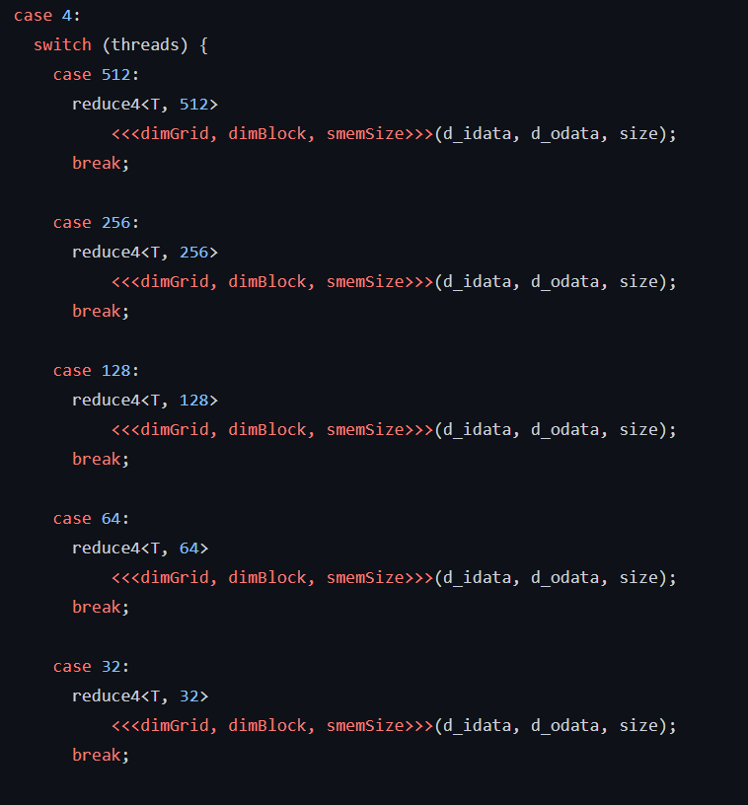
Why Templates are Insufficient
reduction_kernel.cu (CUDA Sample)
Our version
// Nothing :)
[NVIDIA Corporation 2022]
Notes:
But then, we see the real problem. There’s a bunch of extra code to map the runtime threads variable to template parameter, since these template parameters must be all specified at compile time. So there are cases for 512 to 32…

Slide 56
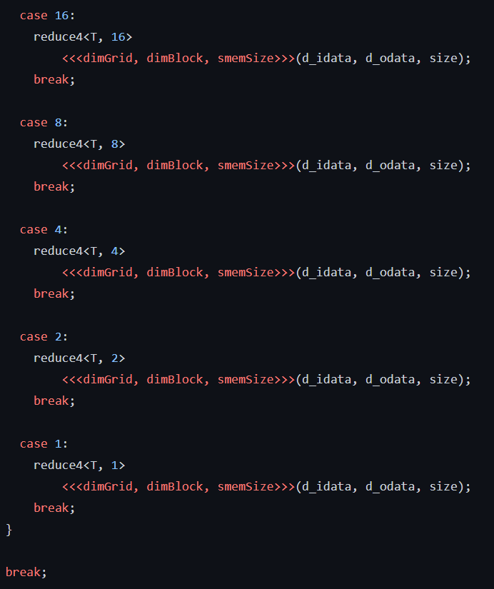
Why Templates are Insufficient
reduction_kernel.cu (CUDA Sample)
Our version
// Nothing :)
[NVIDIA Corporation 2022]
Notes:
And then for 16 to 1.

Slide 57
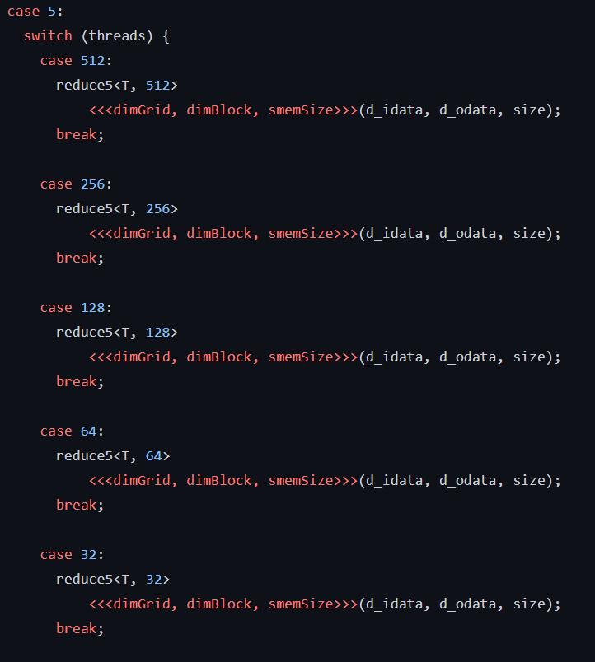
Why Templates are Insufficient
reduction_kernel.cu (CUDA Sample)
Our version
// Nothing :)
[NVIDIA Corporation 2022]
Notes:
And then we move on to the next kernel implementation, where we have to have a switch over the runtime variable again.

Slide 58
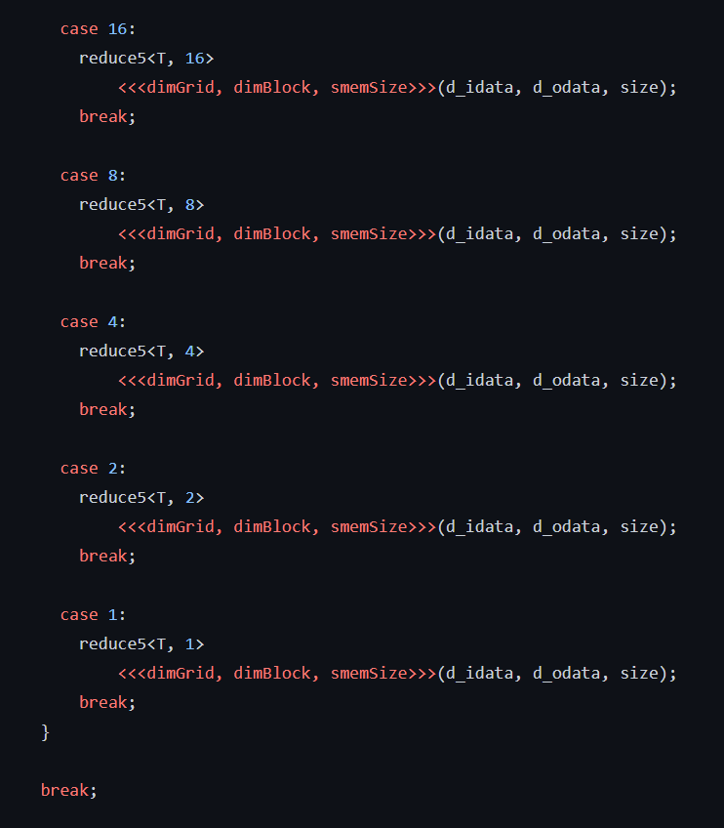
Why Templates are Insufficient
reduction_kernel.cu (CUDA Sample)
Our version
// Nothing :)
[NVIDIA Corporation 2022]
Notes:
And again.

Slide 59
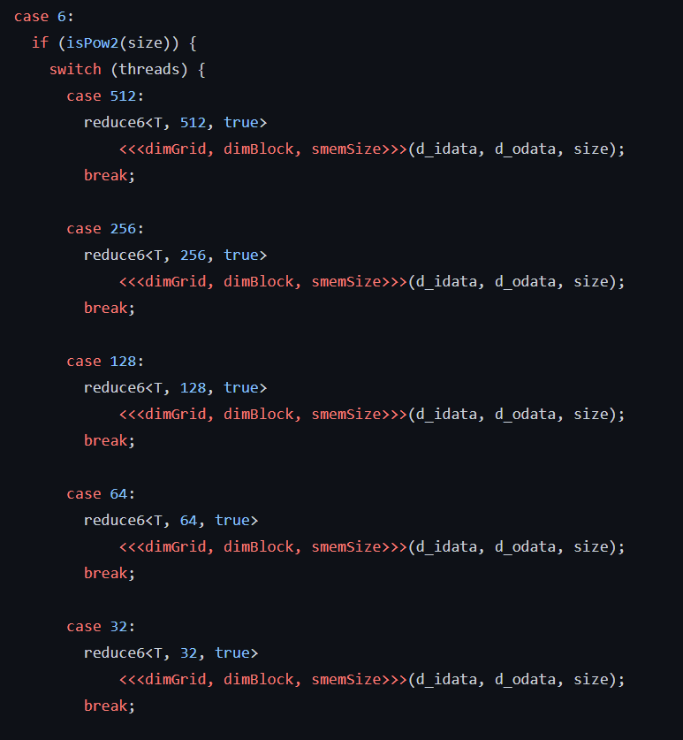
Why Templates are Insufficient
reduction_kernel.cu (CUDA Sample)
Our version
// Nothing :)
[NVIDIA Corporation 2022]
Notes:
And again, except now there is a nested switch, because we also need to handle the nIsPow2 parameter in the same way.

Slide 60
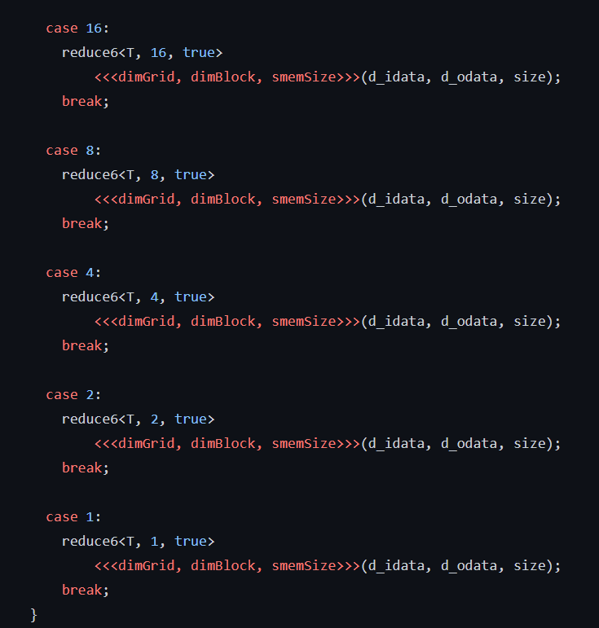
Why Templates are Insufficient
reduction_kernel.cu (CUDA Sample)
Our version
// Nothing :)
[NVIDIA Corporation 2022]
Notes:
And so on.

Slide 61
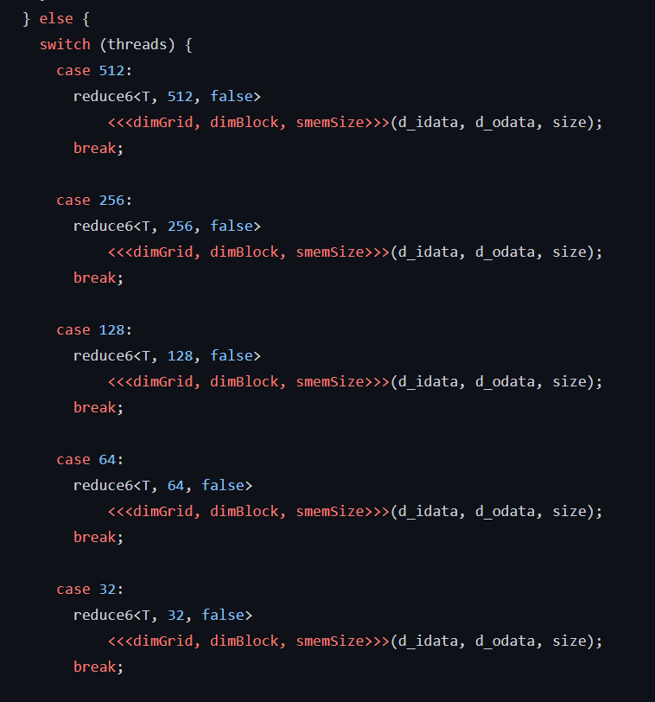
Why Templates are Insufficient
reduction_kernel.cu (CUDA Sample)
Our version
// Nothing :)
[NVIDIA Corporation 2022]
Notes:
And so on.

Slide 62
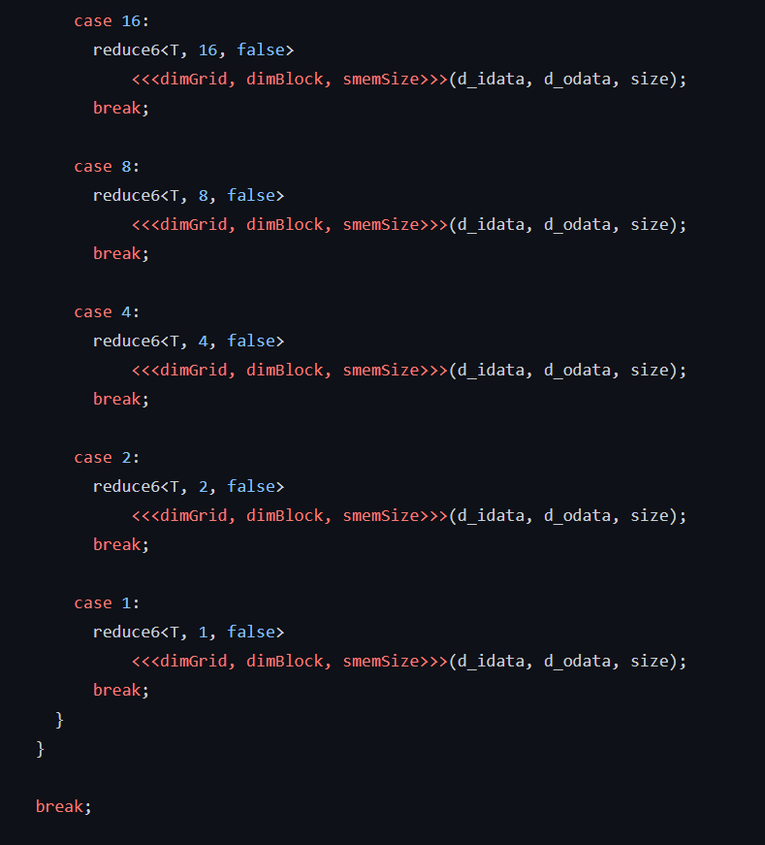
Why Templates are Insufficient
reduction_kernel.cu (CUDA Sample)
Our version
// Nothing :)
[NVIDIA Corporation 2022]
Notes:
And so on.

Slide 63
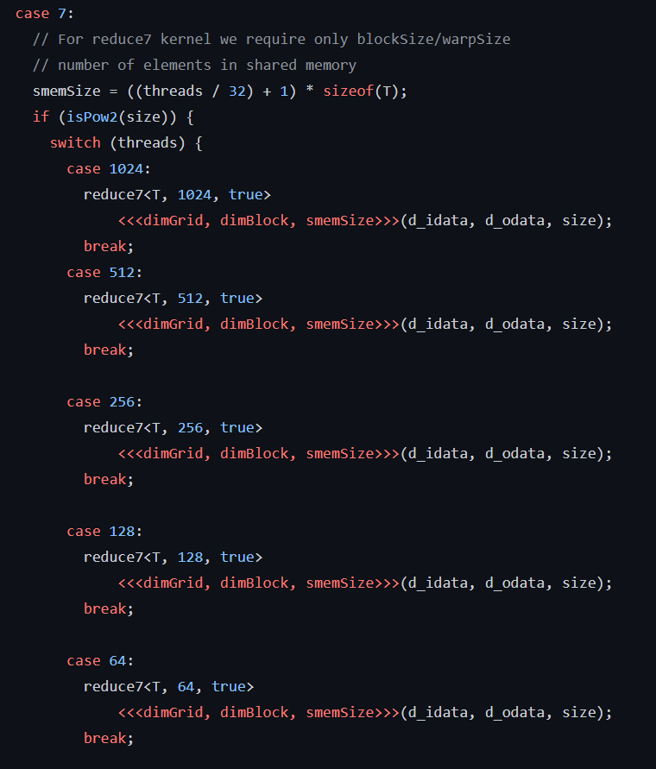
Why Templates are Insufficient
reduction_kernel.cu (CUDA Sample)
Our version
// Nothing :)
[NVIDIA Corporation 2022]
Notes:
And so on.

Slide 64
Why Templates are Insufficient
reduction_kernel.cu (CUDA Sample)
Our version
// etc. etc. etc.
// Nothing :)
[NVIDIA Corporation 2022]
Notes:
And… I think you see the point.

Slide 65
Why Templates are Insufficient
reduction_kernel.cu (CUDA Sample)
Our version
// Running one of the reduce kernels
void reduce(...) {
...
// Running one of the reduce shaders
template <typename T>
void reduce(...) {
...
ReduceBase* reduceShader;
switch (whichKernel) {
case 0: reduceShader = new ReduceShader0<T>(); break;
case 1: reduceShader = new ReduceShader1<T>(); break;
case 2: reduceShader = new ReduceShader2<T>(); break;
case 3: reduceShader = new ReduceShader3<T>(); break;
case 4: reduceShader = new ReduceShader4<T>(); break;
case 5: reduceShader = new ReduceShader5<T>(); break;
case 6: reduceShader = new ReduceShader6<T>(); break;
case 7: reduceShader = new ReduceShader7<T>(); break;
case 8: reduceShader = new ReduceShader8<T>(); break;
case 9: reduceShader = new ReduceShader9<T>(); break;
}
reduceShader->numThreads = threads;
reduceShader->nIsPow2 = isPowTwo(size);
reduceRunner runner;
runner.reducer = reduceShader;
runner.addComputePass(...);
}
~400 Lines
of Code
~30 Lines
of Code
[NVIDIA Corporation 2022]
Notes:
The original CUDA sample version uses about 400 lines of code to set up and invoke the reduce kernels.
In contrast, our version does the same in about 30 lines of code.
So I hope this helps to demonstrate why C++ templates are not a good solution for implementing shader specialization. Templates result in a bunch of extra boilerplate code needed to map runtime parameters to their compile-time counterparts. Imagine having to add another case to all of these switch statements!
In our system, we support shader specialization as a first-class operation, and we designed our system to elegantly handle the compile-time vs. runtime dichotomy of specialization parameters, resulting in a much more maintainable implementation. So adding another case is much simpler!

